Slide 1
UML
Use cases

Slide 2
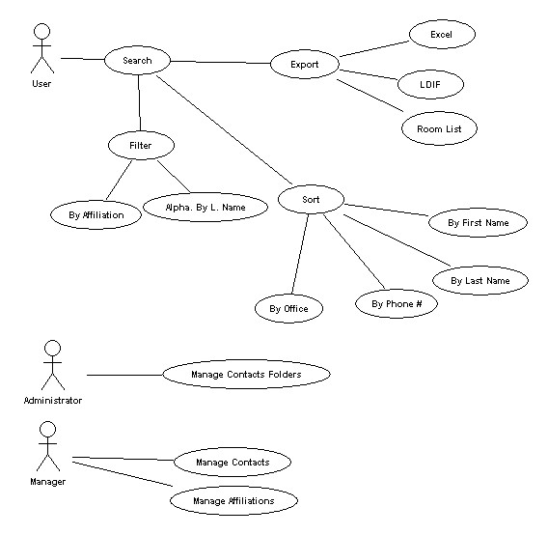
Use case Diagrams
Actors
Use Cases
Relationships

Slide 3
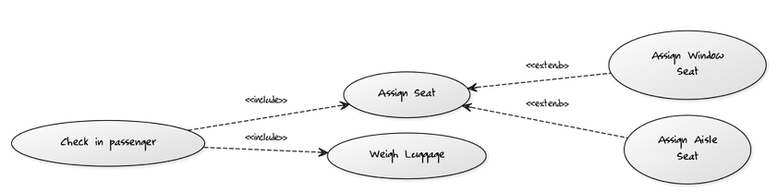
Include vs extend
Include: When one action requires another.
Extend: When one action can be replaced by another (inheritance)

Slide 4

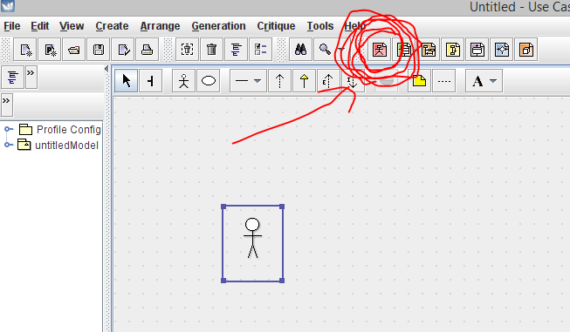
ArgoUML
Make Use case diagrams by pressing the red button on top

Slide 5
Exercise
You have been asked to design the backend system of a library. The library has books, videos, and CDs that it loans to its users. Reference-only material is loaned for 2hrs and can’t be removed from the library.
Users can borrow, renew or return any of these items. However, children are allowed only to borrow books.
Librarians can create new users and charge late fees.
Draw a use case diagram using ArgoUML. You may choose to be as detailed as you like

Slide 6
References
http://www.objectmentor.com/resources/articles/umlClassDiagrams.pdf
http://www.ibm.com/developerworks/rational/library/content/RationalEdge/sep04/bell/
http://en.wikipedia.org/wiki/Class_diagram
http://slides.com/dominiccharleyroy/

