Slide 1
Intro to Java Game programming
Using Java Swing and MVC Design Pattern

Slide 2
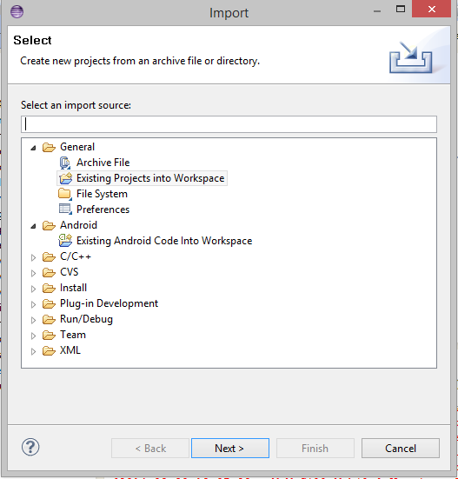
Importing a project
File -> Import -> Existing project into Workspace -> Browse for project
Go ahead and import today’s example code

Slide 3

Model View Controller Design Pattern
High Coupling
Low Cohesion
Modular
Model: Representation of Data
View: Graphical Interface
Controller: Binds Model to View
Notes:
Source: http://en.wikipedia.org/wiki/Model%E2%80%93view%E2%80%93controller#mediaviewer/File:MVC-Process.svg

Slide 4


Model View Controller Design Pattern

Slide 5
Why do we need this?
Your assignment is all about the model!

Slide 6
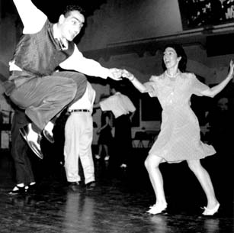
Java Swing
The very basics

Slide 7
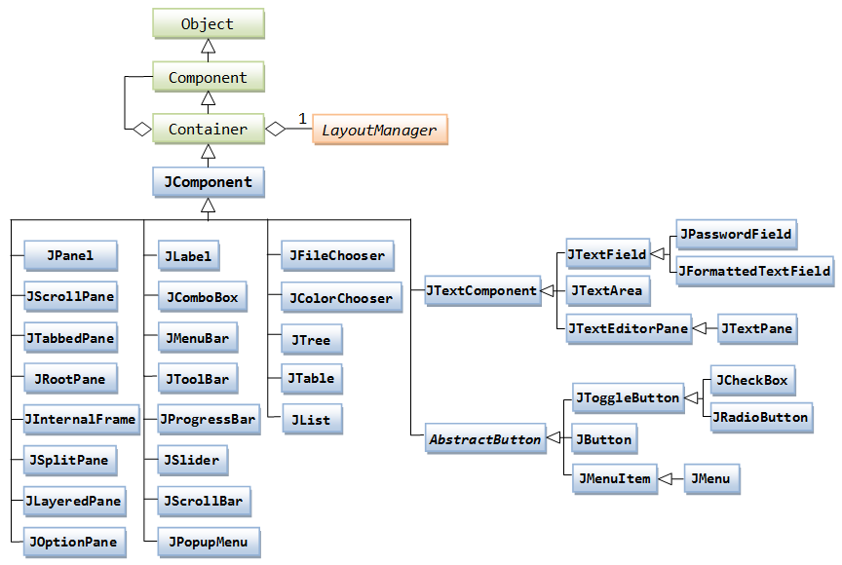
Java Swing
Java Swing is the library used to make Graphical user interfaces in Java
Notes:
Source: http://www.ntu.edu.sg/home/ehchua/programming/java/images/Swing_JComponentClassDiagram.png

Slide 8
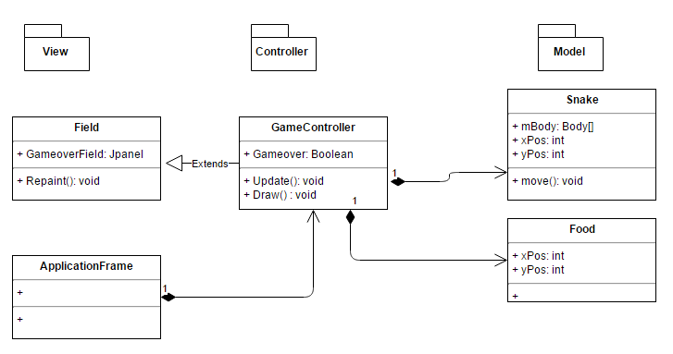
MVC in Java Swing

Slide 9
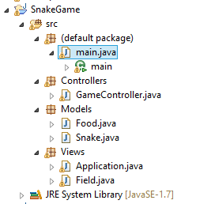
MVC in Java Swing
Divide the project into Packages

Slide 10
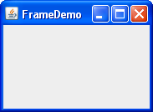
Swing Basics - JFrame
A JFame object is your window

Slide 11
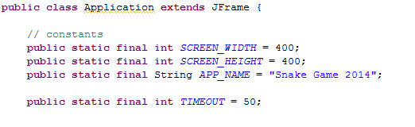
Swing Basics - JFrame

Slide 12
Swing Basics - JPanel
A JPanel is the Square area inside your window. Think of this as your Canvas.

Slide 13
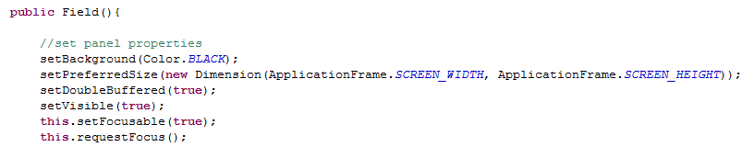
Swing Basics - JPanel
Need to add JPanel to JFrame:

Slide 14
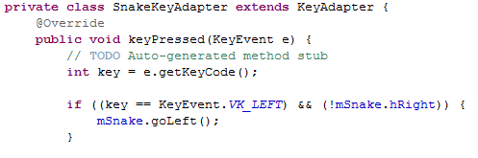
Swing Basics - KeyListeners
A KeyAdapter Implements keyListener

Slide 15
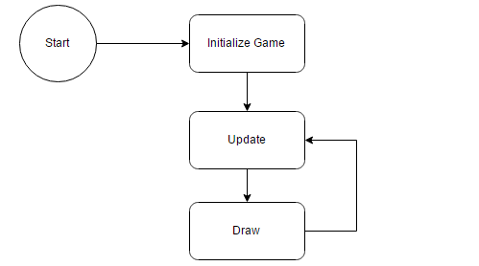
MVC Basics - Controllers
All Games have the basic update and redraw method called every frame.

Slide 16
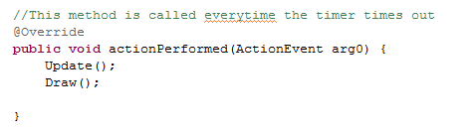
MVC Basics - Controllers
All Games have the basic update and redraw method called every frame.

Slide 17
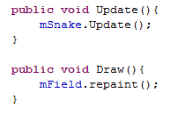
MVC Basics - Controllers
Update: updates the business Logic (Model)
Draw: Refreshes the sprites on screen (View)

Slide 18
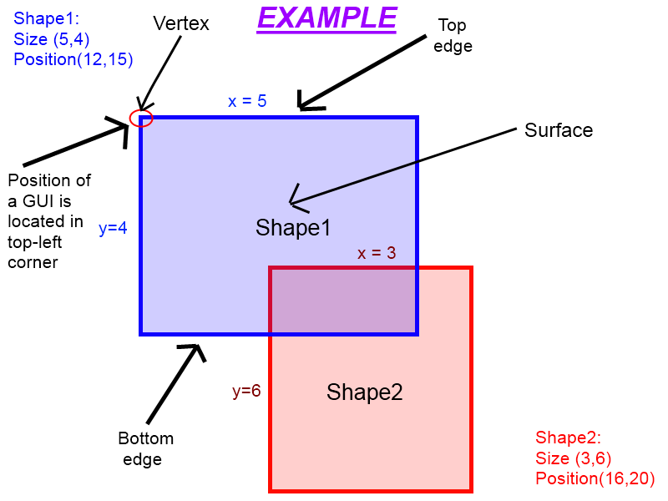
Collision Detection
Detect Two shapes touching by checking if they overlap
Notes:
Source: http://wiki.roblox.com/images/0/0e/Gui_example_1_dot_1.png

Slide 19
Exercise Choose 2
Add Collision detection vs Snake and food
Make snake’s body length longer
Make snake move along a grid

Slide 20
Extra Credit
Finish the Snake game

Slide 21
References
Java Game Tutorial: http://zetcode.com/tutorials/javagamestutorial/
Collision detection: http://wiki.starling-framework.org/tutorials/basic_collision_detection

