Slide 1
Functional programming and integrating models in the world of the web
Nick Benton
Microsoft Research

Slide 2
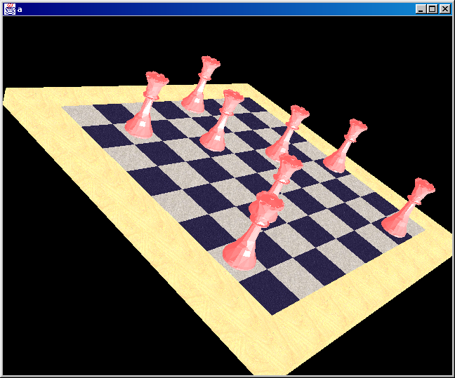
MLj (96-98)
SML to Java bytecode compiler (Benton, Kennedy, Russell)
With extensions for interoperability
Desktop applications
Applets
Ian Stark: Thimble library
With Dave Halls: Client-side stylesheets, functional forms
Notes:
SGML – this was when XML hype was just beginnning
Dave Halls also invented stateless servers with CPS in 97
Also mention Artifact architecture

Slide 3
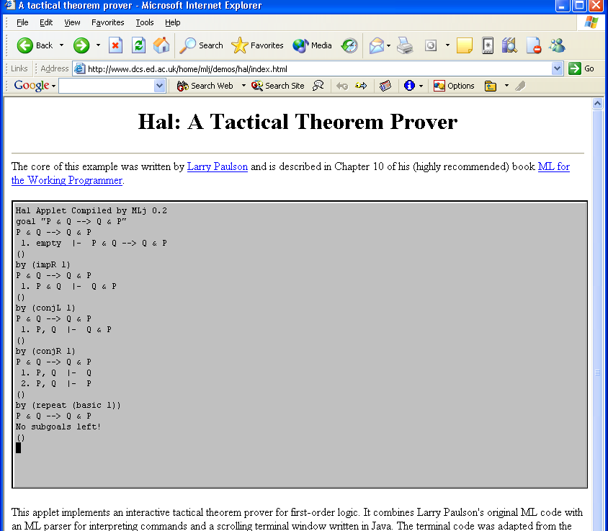

Slide 4
Client-side XML stylesheets
SGML document
SML stylesheet
Third-party tool
MLj compiler
XML document
JVM applet
XML document
JVM applet
HTML document
Web browser
User
Browser view

Slide 5
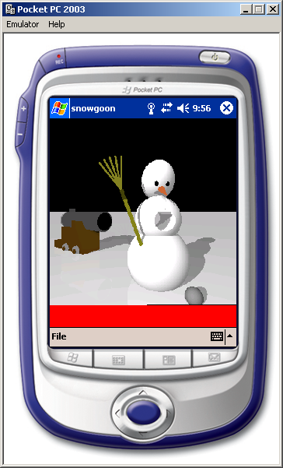
SML.NET (99- )
The same idea for .NET (Benton, Kennedy, Russo)
Integrated in Visual Studio
Desktop apps
Server-side w/ ASP.NET
Inherit rich libraries, web services, concurrency, database access, legacy interop,… from .NET

Slide 6
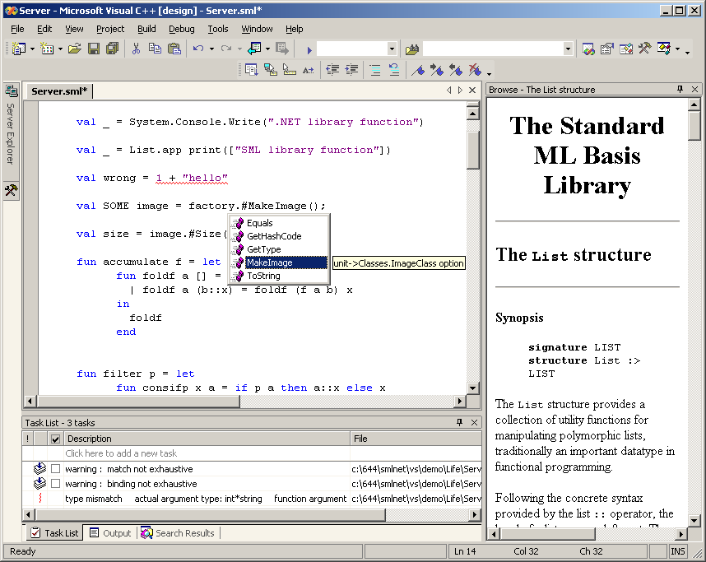

Slide 7
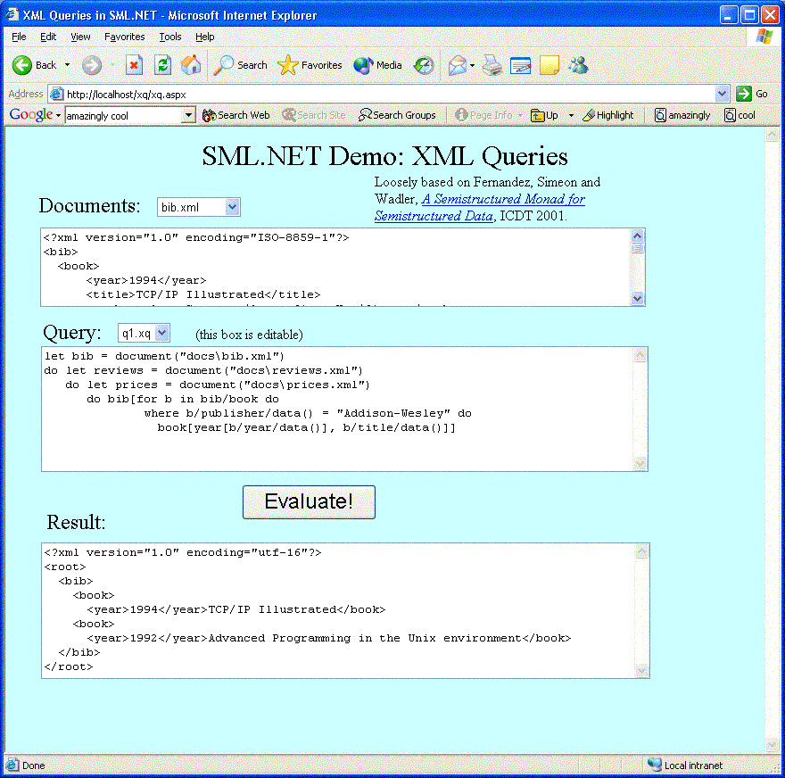

Slide 8

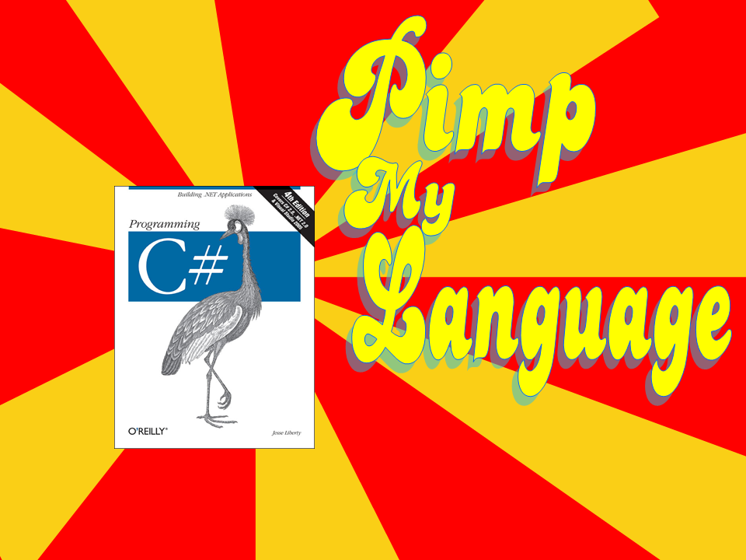
Extension of C# control and data aimed at 3-tier web programming
  Asynchronous concurrency based on join calculus (Polyphonic C#: Benton, Cardelli, Fournet)
    Async methods, chords
  Data type extensions for semistructured and relational data manipulation (Xen, X#: Bierman, Meijer, Schulte)
    streams, tuples, unions, …
    generalized member access (Xpath-y)
    XML literals and SQL syntax

Slide 9
Data 1
Cool type declarations!
public class card {
struct{
string name;
string title;
string email;
string? phone;
logo? logo;
};
}
<card>
<name>John Doe</name>
<title>CEO, Widget Inc.</title>
<email>john.doe@widget.com</email>
<logo>widget.gif</logo>
</card>

Slide 10
Data 2
XML in your code!!
card c = <card>
<name>John Doe</name>
<title>CEO, Widget Inc.</title>
<email>john.doe@widget.com</email>
<logo>widget.gif</logo>
</card>;
c.*.{ Console.WriteLine(it); };
Path expressions (like XPath) in your code!!

Slide 11
Data 3
SQL in your code!!
alts1 = select Title,Artist
from CDs
where Style == CDStyle.Alt;
alts1.{ConsoleWriteLine(“Title={0},Artist={1}”,
it.Title,it.Artist);};
Notes:
Embedded SQL fragment; queries over streams of tuples etc, not just DB RecordSets.

Slide 12
Concurrency 1
public class ReaderWriter {
async Idle();
async S(int n);
public void Exclusive() & Idle() {}
public void ReleaseExclusive() { Idle(); }
public void Shared() & Idle() { S(1); }
& S(int n) { S(n+1); }
public void ReleaseShared() & S(int n) {
if (n == 1) Idle(); else S(n-1);
}
public ReaderWriter() { Idle(); }
}
A single private message represents the state:
none ←→ Idle() ←→ S(1) ←→ S(2) ←→ S(3) …

Slide 13
Concurrency 2
class Join2 {
async first(int r);
async second(int r);
struct{int;int;} waitAll()
& first(int r1) & second(int r2) {
return new{r1,r2};
}
}
// client code:
struct{int;int;} results;
Join2 x = new Join2();
service1.request(arg1, new IntCB(x.first));
service2.request(arg2, new IntCB(x.second));
// do something useful in the meantime
// now wait until both results have come back
results = x.waitAll();
// do something with results

Slide 14

Web-based applications today
Presentation: HTML, CSS, Javascript, Flash, Java applets, ActiveX controls
Application server
Web server
Content management system
Business logic: C#, Java, VB, PHP, Perl, Python,Ruby …
Beans, servlets, CGI, ASP.NET,…
Operating System
Database: SQL
File system
Sockets, HTTP, email, SMS, XML, SOAP, REST, Rails, reliable messaging, AJAX, …
Replication, distribution, load-balancing, security, concurrency

Slide 15
We Lost
The database part is pretty sensible, but decades of research on programming languages seem to have had little impact on the way the rest is done
A mess of little bits of script, configuration files, templates, frameworks, middleware, held together with chewing gum, string and a lot of pointy-clicky stuff
Cut-and-paste programming (no model to comprehend)
Dynamic typing (“loosely coupled”=doesn’t work)
Ad hoc metaprogramming, lots of reflection and introspection and more coming all the time (aspects,…)
Universal datatype is the string

Slide 16
We Won
Garbage collection
Static typing in Java, C#
  Parametric polymorphism
  Anonymous functions
  Even some inference
Continuations are cool
  Web applications and statelessness
  Python, Perl 6
  Async RPCs
XQUERY
Pi calculus and BPEL, Indigo, etc.
There’s a lot of snake oil about, but that’s partly because people in this space know they need something better than what they’ve got

Slide 17
Pain points
Multiple languages
Multiple data formats and protocols
Multiple presentation formats
Multiple times (staging)
Multiple places (distribution)
Multiple namespaces (scoping)
Multiple versions (evolution)
+ concurrency, failure, security,…
The traditional “program” has
lost control over its environment

Slide 18
What might a next-generation web language do?
Enable unified treatment of
  (interactive) documents
  presentations
  web “sites”
  web “applications”
  web services
  desktop applications

Slide 19
What would that take?
All the good stuff we’ve already seen, done from the ground up:
  Commitment to interop: rich enough type system to deal with functions, semistructured data, relations and Java/.NET objects
  Continuations
  Asynchronous concurrency
But don’t overdo it – taking control of more of the architecture means doing more oneself…
Compilation to multiple targets
  MLj, SML.NET, Cw SQL expressions
  ASP.NET winforms/webforms “big pieces for little hands”
Control over staging
  MetaML with communication
  ASP.NET [runat=server], [runat=client]
  Automatic binding-time and binding place optimization
Service-orientation
  heap-allocated objects / machine allocated services somehow reconciled in the language – system description level

Slide 20
That’s all
questions?

