Slide 1
Monads in Compilation
Nick Benton
Microsoft Research
Cambridge

Slide 2
Outline
Intermediate languages in compilation
Traditional type and effect systems
Monadic effect systems

Slide 3
Compilation by Transformation
parse, typecheck,
translate
generate code
Source
Language
Intermediate
Language
Target
Language
Backend
IL
analyse, rewrite

Slide 4
Compilation by Transformation
MLj
SML
MIL
JVM
bytecode
BBC

Slide 5
Compilation by Transformation
SML/NJ
SML
CPS
Native
code
MLRISC

Slide 6
Compilation by Transformation
GHC
Haskell
Core
Native
code
C

Slide 7
Compilation by Transformation
Source
Language
Intermediate
Language
Target
Language
Backend
IL

Slide 8
Transformations ⊆ Semantics
Rewrites should preserve the semantics of the user's program.
  So they should be observational equivalences.
Rewrites are applied locally.
  So they should be instances of an observational congruence relation.
Source
Language
Intermediate
Language

Slide 9
Why Intermediate Languages?
Couldn't we just rewrite on the original parse tree?
  Complexity
  Level
  Uniformity, Expressivity, Explicitness

Slide 10
Complexity
Pattern-matching
Multiple binding forms (val,fun,local,…)
Equality types, overloading
Datatype and record labels
Scoped type definitions
…

Slide 11
Level
Multiple arguments
Holes:
fun map f l =
if null l then nil
else cons (f (hd l), map f (tl l))
fun map f l =
let fun mp r xs = if null xs then *r = []
else let val c = cons(f (hd xs), -)
in *r = c;
mp &(c.tl) (tl xs)
end
val h = newhole()
in mp &h l;
*h
end

Slide 12
Uniformity, Expressivity, Explicitness
Replace multiple source language concepts with unifying ones in the IL
  E.g. polymorphism+modules => Fω
For rewriting want “good” equational theory
  Need to be able to express rewrites in the first place and want them to be local
Make explicit in the IL information which is implicit in (derived from) the source

Slide 13
Trivial example: naming intermediate values
let val x=((3,4),5)
in (#1 x, #1 x)
end
(#1 ((3,4),5), #1 ((3,4),5))
((3,4),(3,4))
Urk!

Slide 14
Trivial example: naming intermediate values
let val y = (3,4)
val x = (y,5)
val w = #1 x
val z = #1 x
in (w,z)
end
let val x=((3,4),5)
in (#1 x, #1 x)
end
let val y = (3,4)
in (y,y)
end
let val y = (3,4)
val x = (y,5)
val w = y
val z = y
in (w,z)
end

Slide 15
MIL’s try-catch-in construct
Rewrites on ML handle tricky. E.g:
(M handle E => N) P
≠
(M P) handle E => (N P)
Introduce new construct:
try x=M catch E=>N in Q
Then:
(try x=M catch E=>N in Q) P
=
try x=M catch E=>(N P) in (Q P)

Slide 16
Continuation Passing Style
Some compilers (SML/NJ,Orbit) use CPS as an intermediate language
  CBV and CBN translations into CPS
  Unrestricted βη valid on CPS (rather than just β_{v} and η_{v}) and prove more equations (Plotkin)
  Evaluation order explicit, tail-call elimination just β, useful with call/cc

Slide 17
CPS
But “administrative redexes”, undoing of CPS in backend
Flanagan et al. showed the same results could be achieved for CBV by adding let and performing A-reductions:
ε[if V then M else N]
⇒
if V then ε[M] else ε[N]

Slide 18
Typed Intermediate Languages
Pros
  Type-based analysis and representation choices
  Backend: GC, registers
  Find compiler bugs
  Reflection
  Typed target languages

Slide 19
Typed Intermediate Languages
Cons
  Type information can easily be bigger than the actual program. Hence clever tricks required for efficiency of compiler.
  Insisting on typeability can inhibit transformations. Type systems for low-level representations (closures, holes) can be complex.

Slide 20
λML_{T} as a Typed Intermediate Language
Benton 92 (strictness-based optimisations)
Danvy and Hatcliff 94 (relation with CPS and A-normal form)
Peyton Jones et al. 98 (common intermediate language for ML and Haskell)
Barthe et al 98 (computational types in PTS)

Slide 21
Combining Polymorphism and Imperative Programming
The following program clearly “goes wrong”:
let val r = ref (fn x=>x)
in (r := (fn n=>n+1);
!r true
)
end

Slide 22
Combining Polymorphism and Imperative Programming
But it seems to be well-typed:
α→α
let val r = ref (fn x=>x)
in (r := (fn n=>n+1);
!r true
)
end

Slide 23
Combining Polymorphism and Imperative Programming
α→α ref
let val r = ref (fn x=>x)
in (r := (fn n=>n+1);
!r true
)
end

Slide 24
Combining Polymorphism and Imperative Programming
∀α.α→α ref
let val r = ref (fn x=>x)
in (r := (fn n=>n+1);
!r true
)
end

Slide 25
Combining Polymorphism and Imperative Programming
∀α.α→α ref
let val r = ref (fn x=>x)
in (r := (fn n=>n+1);
!r true
)
end
(int→int) ref
int→int

Slide 26
Combining Polymorphism and Imperative Programming
∀α.α→α ref
let val r = ref (fn x=>x)
in (r := (fn n=>n+1);
!r true
)
end
(bool→bool) ref

Slide 27
Combining Polymorphism and Imperative Programming
∀α.α→α ref
let val r = ref (fn x=>x)
in (r := (fn n=>n+1);
!r true
)
end
bool
(bool→bool)

Slide 28
Solution: Restrict Generalization
Type and Effect Systems
  Gifford, Lucassen, Jouvelot, Talpin,…
Imperative Type Discipline
  Tofte (SML’90)
Dangerous Type Variables
  Leroy and Weis

Slide 29
Type and Effect Systems
Type = α→α ref
Effect = “creates an α→α ref”
let val r = ref (fn x=>x)
in (r := (fn n=>n+1);
!r true
)
end

Slide 30
Type and Effect Systems
No Generalization
Type = α→α ref
Effect = “creates an α→α ref”
α→α ref
let val r = ref (fn x=>x)
in (r := (fn n=>n+1);
!r true
)
end

Slide 31
Type and Effect Systems
Type = α→α ref
Effect = “creates an α→α ref”
α→α ref
Unify
let val r = ref (fn x=>x)
in (r := (fn n=>n+1);
!r true
)
end
int→int ref
int→int

Slide 32
Type and Effect Systems
Type = int→int ref
Effect = “creates an int→int ref”
int→int ref
let val r = ref (fn x=>x)
in (r := (fn n=>n+1);
!r true
)
end
int→int ref
int→int

Slide 33
Type and Effect Systems
Type = int→int ref
Effect = “creates an int→int ref”
int→int ref
let val r = ref (fn x=>x)
in (r := (fn n=>n+1);
!r true
)
end
int→int ref

Slide 34
Type and Effect Systems
Type = int→int ref
Effect = “creates an int→int ref”
int→int ref
let val r = ref (fn x=>x)
in (r := (fn n=>n+1);
!r true
)
end
bool
Error!
int→int

Slide 35
All very clever, but…
Wright (1995) looked at lots of SML code and concluded that nearly all of it would still typecheck and run correctly if generalization were restricted to syntactic values.
This value restriction was adopted for SML97.
Imperative type variables were “an example of premature optimization in language design”.

Slide 36
Despite that…
Compilers for impure languages still have good reason for inferring static approximations to the set of side effects which an expression may have
let val x = M in N end where x not in FV(N)
is observationally equivalent to N if
M doesn’t diverge
or perform IO
or update the state
or throw an exception

Slide 37
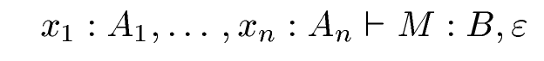
“Classic” Type and Effect Systems: Judgements
term
variable
type
type
effect
Variables don’t have effect annotations because we’re only considering CBV, which means they’ll always be bound to values.

Slide 38
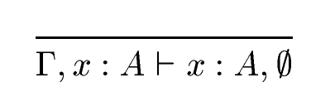
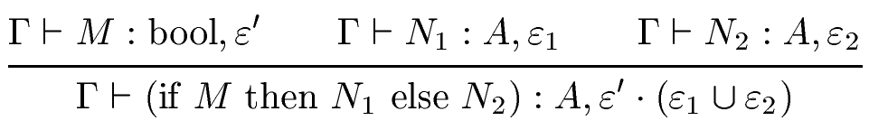
“Classic” Type and Effect Systems: Basic bits
No effect
Effect sequence, typically ∪ again
Effect join (union)

Slide 39

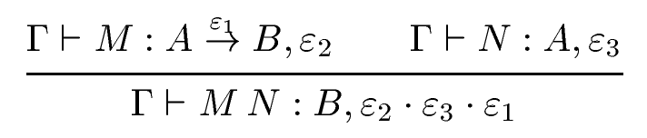
“Classic” Type and Effect Systems: Functions
Abstraction is value, so no effect
Effect of body becomes “latent effect” of function
“latent effect” is unleashed in application

Slide 40
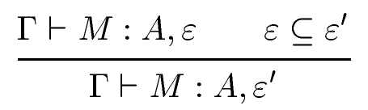
“Classic” Type and Effect Systems: Subeffecting
Typically just inclusion on sets of effects
Can further improve precision by adding more general subtyping or effect polymorphism.

Slide 41
“Classic” Type and Effect Systems: Regions 1
(let x=!r; y=!r in M) = (let x=!r in M[x/y])
fn (r:int ref, s:int ref) =>
let x = !r;
_ = s := 1;
y = !r
in M
end
read
write
read
Can’t commute the middle command with either of the other two to enable the rewrite.
Quite right too! r and s might be aliased.

Slide 42
“Classic” Type and Effect Systems: Regions 2
What if we had different colours of reference?
fn (r:int ref, s:int ref) =>
let x = !r;
_ = s := 1;
y = !r
in M
end
read
write
read
Can commute a reading computation with a writing one.
Type system ensures can only assign r and s different colours if they cannot alias.

Slide 43
“Classic” Type and Effect Systems: Regions 3
Colours are called regions, used to index types and effects
A ::= int | ref(A,ρ) | A→B | α | …
ε ::= rd(A, ρ) | wr(A, ρ) | al(A, ρ) | ∅ | ε∪ε′ | e | …
ε

Slide 44
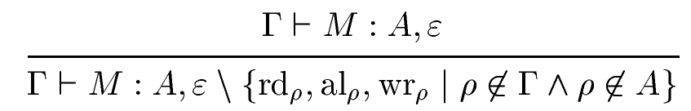
“Classic” Type and Effect Systems: Regions 4
Neat thing about regions is effect masking:
Improves accuracy, also used for region-based memory management in the ML Kit compiler (Tofte,Talpin)

Slide 45
Monads and Effect Systems
Γ⎟⁻ M:A,ε
A ::= … | A→B
ε
Effect inference
Γ⎟⁻ M:A
A ::= … | A→B
CBV translate
Γ⎟⁻ M^{v}:TA^{v}
A^{v} ::= … | A^{v}→TB^{v}

Slide 46
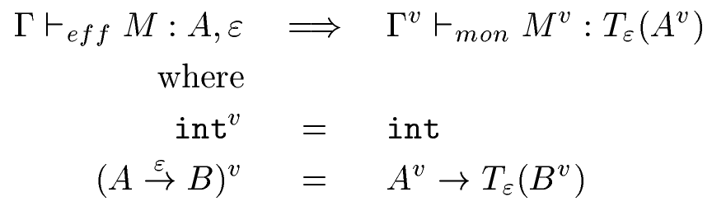
Monads and Effect Systems
Wadler ICFP 1998
Soundness by instrumented semantics and subject reduction

Slide 47
Monads and Effect Systems
Tolmach TIC 1998
  Four monads in linear order
stream output, exceptions and nontermination
ST
≤
EXN
exceptions and nontermination
≤
LIFT
≤
ID
nontermination
identity

Slide 48
Monads and Effect Systems
Tolmach TIC 1998
  Language has explicit coercions between monadic types
  Denotational semantics with coercions interpreted by monad morphisms
  Emphasis on equations for compilation by transformation

Slide 49
Monads and Effect Systems
Benton, Kennedy ICFP 1998, HOOTS 1999
  MLj compiler uses MIL (Monadic Intermediate Language) for effect analysis and transformation
  MIL-lite is a simplified fragment of MIL about which we can prove some theorems
  Still not entirely trivial…

Slide 50
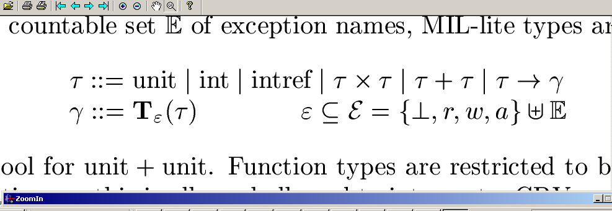
MIL-lite types
Value types:
Computation types:
values to computations
Effect annotations:
raising particular exceptions
nontermination
allocating refs
reading refs
writing refs

Slide 51
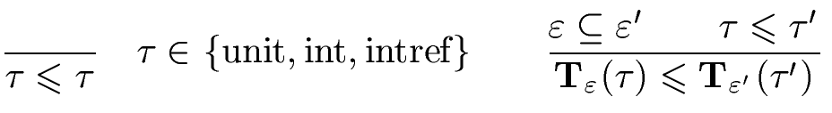
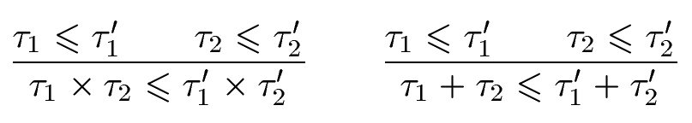
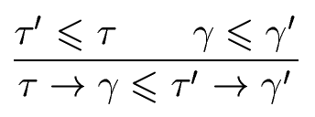
MIL-lite subtyping

Slide 52
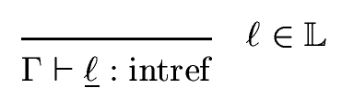
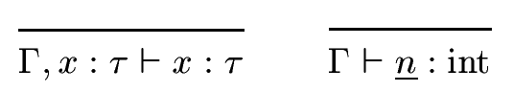
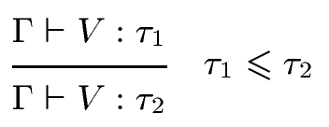
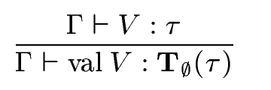
MIL-lite terms 1
Like types, terms stratified into values and computations.
Terms of value types are actually in normal form. (Could allow non-canonical values but this is simpler, if less elegant.)

Slide 53
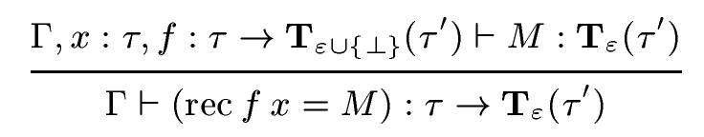
MIL-lite terms 2
Recursion only at function type because CBV
Very crude termination analysis
Allows lambda abstraction to be defined as syntactic sugar and does the right thing for curried recursive functions

Slide 54
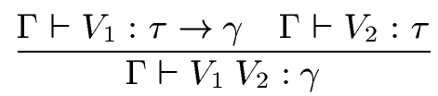
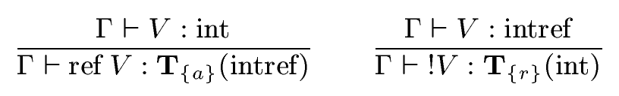
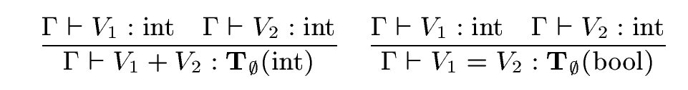
MIL-lite terms 3

Slide 55
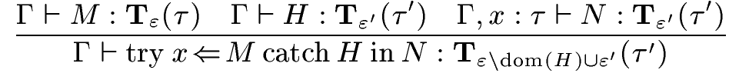
MIL-lite terms 4
H is shorthand for a set of handlers {E_{i}⇒P_{i}}
try-catch-in generalises handle and monadic let
There’s a more accurate version of this rule
Effect union localised here

Slide 56
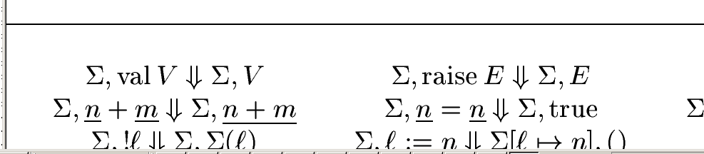
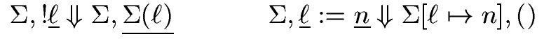
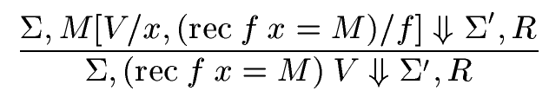
MIL-lite semantics 1
Computations evaluate to values.

Slide 57
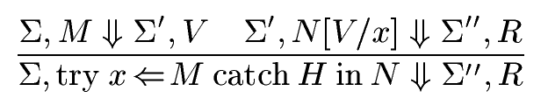
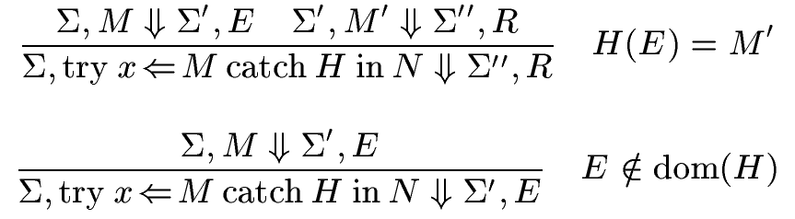
MIL-lite semantics 2

Slide 58
Transforming MIL-lite
Now want to prove that the transformations performed by MLj are contextual equivalences
Giving a sufficiently abstract denotational semantics is jolly difficult (it’s the fresh names, not the monads per se that make it complex)
So we used operational techniques in the style of Pitts

Slide 59
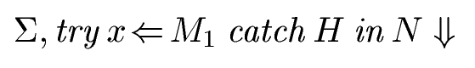
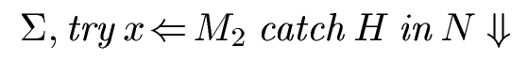
ciu equivalence
Reformulate operational semantics using structurally inductive termination relation
Use that to prove various things, including that contextual equivalence coincides with ≈ where M₁ ≈ M₂ iff for all Σ, H, N
⇔

Slide 60
Semantics of effects
Could use instrumented operational semantics to prove soundness of the analysis
But that feels too intensional - it ties the meaning of effects and the justification of transformations to the formal system used to infer effect information
For example, having a trace free of writes versus leaving the store observationally unchanged

Slide 61
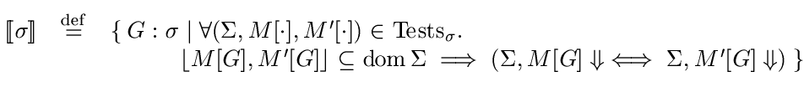
Semantics of effects
Instead, define the meaning of each type by a set of termination tests defined in the language

Slide 62
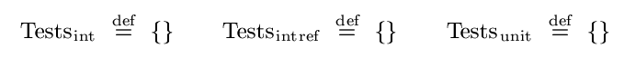
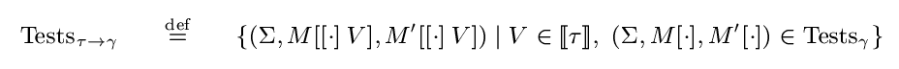
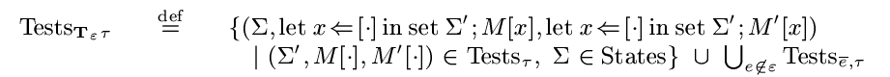
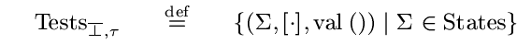
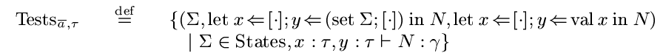
Definition of Tests_{σ}

Slide 63
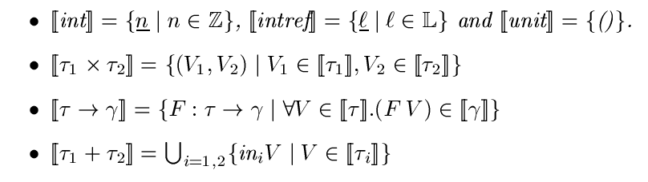
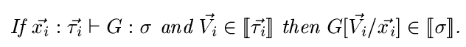
Tests_{σ} and fundamental theorem
At value types it’s just a logical predicate:
Fundamental theorem:

Slide 64
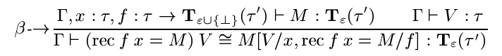
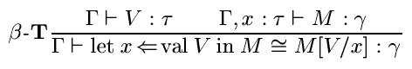
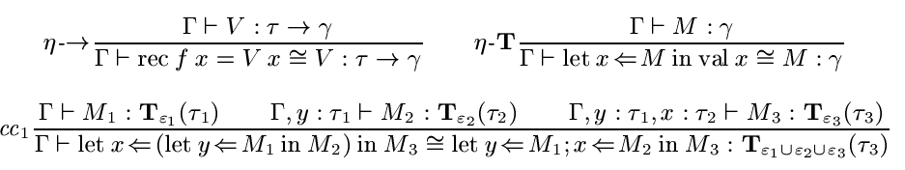
Effect-independent Equivalences

Slide 65
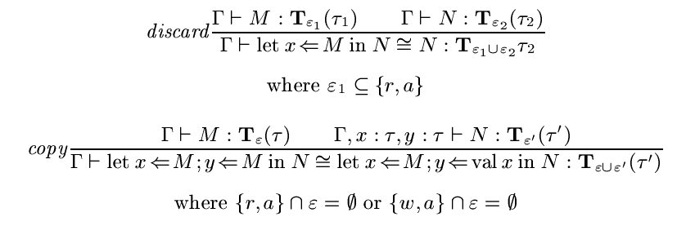
Effect-dependent equivalences 1
τ₁→Τ∅(τ₂→γ) ≈ τ₁×τ₂→γ

Slide 66
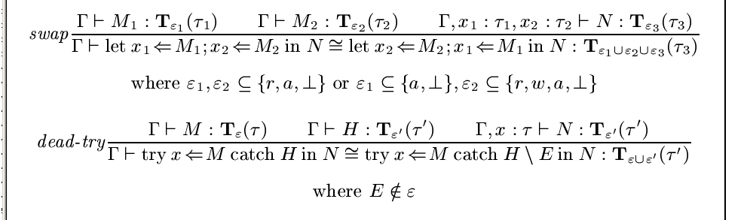
Effect-dependent equivalences 2

