Slide 1
Multilanguage Infrastructure and Interoperability
Nick Benton
Microsoft Research
Cambridge UK
nick@microsoft.com
Acknowledgements: Andrew Kennedy, George Russell and Claudio Russo

Slide 2
Plan
Ancient Times and the Middle Ages
  Common intermediate languages for compilation
  Cross-language interoperability
The Rennaissance
  The JVM and the CLR
  MLj and SML.NET
The Future

Slide 3
"We dissect nature along lines laid down by our native language .… Language is not simply a reporting device for experience but a defining framework for it."
-- Benjamin Whorf, Thinking in Primitive Communities in Hoyer (ed.) New Directions in the Study of Language, 1964

Slide 4
CLR Execution Model (2000)
VB
C++
C#
...
JScript
J#
Eiffel
Native
Code
Install time
Code Gen
MSIL
Common Language Runtime
JIT
Compiler
JIT
Compiler
x86 Native
Code
IA64 Native
Code
...
Notes:
PreJIT not available to users in Beta 1

Slide 5
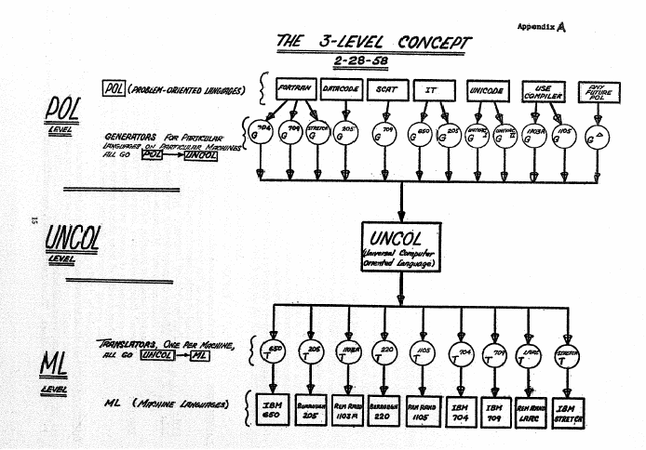
Strong et al. “The Problem of Programming Communication with Changing Machines: A Proposed Solution” C.ACM. 1958

Slide 6
Quote
This concept is not particularly new or original. It has been discussed by many independent persons as long ago as 1954. It might not be difficult to prove that “this was well-known to Babbage,” so no effort has been made to give credit to the originator, if indeed there was a unique originator.

Slide 7
“Everybody knows that UNCOL was a failure”
Subsequent attempts:
  Janus (1978)
    Pascal, Algol68
  Amsterdam Compiler Kit (1983)
    Modula-2, C, Fortran, Pascal, Basic, Occam
  Pcode -> Ucode -> HPcode (1977-?)
    FORTRAN, Ada, Pascal, COBOL, C++
  Ten15 -> TenDRA -> ANDF (1987-1996)
    Ada, C, C++, Fortran
  ....

Slide 8
Sharing parts of compiler pipelines is common
Compiling to textual assembly language
Retargetable code-generation libraries
  VPO, MLRISC
Compiling via C
  Cedar, Fortran, Modula 2, Ada, Scheme, Standard ML, Haskell, Prolog, Mercury,...
x86 is a pretty convincing UNCOL
  pure software translation (VirtualPC)
  mixed hardware/software (Transmeta “code morphing”)
  pure hardware (x86 -> Pentium RISC “micro-ops”)

Slide 9
Compiling high-level languages via C as a “portable assembler”
Everybody does it, but it’s painful
  Interfacing to garbage collection
  Tail-calls
  Exceptions
  Concurrency
  Control operators (call/cc & friends)
Hard to achieve genuine portability (gcc only plus lots of ifdefs is common)
Performance often unimpressive
  C is difficult to optimise well, and it’s hard or impossible for the front-end to communicate invariants (e.g. alias information) to the backend
Often can’t use what little it seems to give you (e.g. GHC doesn’t use the C stack at all)

Slide 10
Ramsey, Peyton Jones, Reig: C--
C-like, but explicitly designed as a portable assembler for high-level languages
Hooks for communication with runtime system (e.g. stack walking for GC)
Careful thought given to exceptions, control operators, concurrency
Support this project!

Slide 11
Interlanguage Working
Smooth interoperability between components written in different programming languages is another dream with a long history
Distinct from, more ambitious and more interesting than, UNCOL
  The benefits accrue to users not to compiler-writers!
Interoperability is more important than performance, especially for niche languages
  For years we thought nobody used functional languages because they were too slow
  But a bigger problem was that you couldn’t really write programs that did useful things (graphics, guis, databases, sound, networking, crypto,...)
  We didn’t notice, because we never tried to write programs which did useful things...

Slide 12
Interlanguage Working
Bilateral or Multilateral?
Unidirectional or bidirectional?
How much can be mapped?
Explicit or implicit or no marshalling?
What happens to the languages?
  All within the existing framework?
  Extended?
  Pragmas or comments or conventions?
External tools required?
Work required on both sides of an interface?

Slide 13
Calling C bilaterally
All compilers for high-level languages have some way of calling C
  Often just hard-wired primitives for implementing libraries
    Extensibility by recompiling the runtime system ☹
  Sometimes a more structured FFI
  Typically implementation-specific
Issues:
  Data representation (31/32 bit ints, strings, record layout,...)
  Calling conventions (registers, stack,..)
  Storage management (especially copying collectors)
It’s a dirty job, but somebody’s got to do it

Slide 14
Example: JNI
Declare external functions in Java code
Compile, then run tool to generate .h file
Write C code to implement the generated interface, including explicit marshalling and conversion, utility functions which take Java types as strings,...
Compile to shared library and run
JNIEXPORT jstring JNICALL Java_Prompt_getLine(JNIEnv *env, jobject obj, jstring prompt)
{
char buf[128];
const char *str = (*env)->GetStringUTFChars(env,prompt,0);
printf("%s", str);
(*env)->ReleaseStringUTFChars(env, prompt, str);
…
scanf("%s", buf);
return (*env)->NewStringUTF(env, buf);
}

Slide 15
Example: Blume’s FFI for SML/NJ
“Data-level interoperability” – no implicit marshalling
Complete (very nearly) model of C’s “type system” entirely within ML. No stubs on C side or calling ML from C
Phantom types for array dimensions, pointer type size+mutability, etc:
Supported by tool which generates ML signatures and structures from standard C header files (plus modifications to runtime system and compilation manager)
Efficient, useful and very cunning!
type (t,d) arr
val create : d dim -> t -> (t,d) arr
type dec and a dg0 and ... and a dg9 and a dim
val dec : dec dim
val dg0 : a dim -> a dg0 dim
...
val dg9 : a dim -> a dg9 dim
dg2 (dg1 (dg5 dec)) : dec dg5 dg1 dg2 dim
= the type representation of size 512

Slide 16
Example: PInvoke (C#/VB)
Declare external functions in C# with C# types, including delegates for function pointers
Marshalling/unmarshalling/calling handled automatically with optional control over mapping, including layout for C# structures
Explicit GCHandles prevent CLR GC collecting objects passed to native code
[StructLayout(LayoutKind.Sequential)]
public struct Point {
public int x; public int y;
}
[StructLayout(LayoutKind.Explicit)]
public struct Rect {
[FieldOffset(0)] public int left;
[FieldOffset(4)] public int top;
[FieldOffset(8)] public int right;
[FieldOffset(12)] public int bottom;
}
class Win32API {
[DllImport("User32.dll")]
public static extern bool PtInRect(ref Rect r, Point p);
}

Slide 17
Comparison
JNI: Exposes Java to C
  You can’t do anything without writing Java-specific C code
Blume’s FFI: Brings C into SML
  You can’t do anything without writing C-specific ML code
PInvoke: Maps between C and C#
  All done from within C#
  Automatic marshalling and unmarshalling
  Fine control where necessary

Slide 18
Multilateral Interoperability: The NO-OP Approach
Strings are a universal datatype
Given minimal OS support (files, sockets, pipes) can communicate strings between programs written in different languages
Inefficient, unsafe, messy
Very flexible: SQL, Tcl/tk
This is the way the web works
Web services are the cleaned-up version of this

Slide 19
Multilateral Interoperability: The IDL approach
COM and CORBA
Language specific tools (usually) generate stubs and proxies for local/remote calling and (un)marshalling from IDL
Both define abstractions above traditional language level: components or services with their own models of naming, distribution, discovery, security, etc.
COM: C, C++, VB, J++, OCaml, SML, Scheme, Dylan, Erlang, Component Pascal, Haskell,...
CORBA: C, C++, Java, Python, Mercury, Erlang, Smalltalk, Modula3, LISP, Eiffel, Ada,...
IDL rather inexpressive (C-like lowest common denominator)
Middleware rather heavyweight
  No sane person would use CORBA to put a Java GUI on an ML program
  By the time you’ve ploughed through all the Enterprise Client-Server Object-Adapter Pattern nonsense, you’ve forgotten what your program was supposed to do in the first place...
Memory management still often tricky (reference counting)

Slide 20
Example: H/Direct
IO monad used when importing
Stable pointers and Haskell finalizers (automagically call Release, may do other cleanup actions)
Dynamic code generation allows export of closures
Polymorphic types used to model inheritance of interfaces etc.
Plumbing for registration etc. neatly handled with higher-order functions (instead of “wizards”)

Slide 21
The JVM and the CLR
High-level, typed, OO, multithreaded, garbage-collected, JIT compiled execution environments
Part of larger frameworks: security, deployment, versioning, distribution
Serious industrial backing, rich libraries, good middleware support (web, database), many users so lots of useful stuff out there
Very attractive compilation targets, especially for “research” languages:
  High-level, portable services (JIT compilation, GC, exceptions, deployment, common primitives) mean you can produce a decent implementation of your language more easily
  Other tools (debuggers, class browsers, verifiers, profilers) can be reused
  High-level interoperability means you and others can actually write useful programs in your language!
  Component-based approach means mixed-language approach is more viable, so you might actually get some serious users

Slide 22
Many agree
JVM
  Designed just for Java
  But hundreds of other-language projects
  Of which about 20 seem serious:
    Scheme, Ada, Cobol, Component Pascal, Python, NESL, Standard ML, Haskell,
CLR
  Intended for multiple languages
  Probably about 15 serious languages
    C#, Visual Basic, JScript, Java, C++, C, Standard ML, Eiffel, Fortan, Mercury, Cobol, Component Pascal, Smalltalk, Oberon, Caml (F#), Mondrian (Haskellish for web), Pan# (Haskellish for graphics)
Related trend: Language researchers produce modified versions of Java/C# instead of brand new languages
  Is this a good thing? Discuss.

Slide 23
Options
Compilation options
  C#/Java source
  IL (assembler or binary)
  Reflection.Emit
Verifiable or unverifiable?
  Only really an option on CLR though we got 20% on JVM by omitting downcasts
How much work do you want to do?
  Modify existing compiler vs. write from scratch
  Think hard and optimize or do the naive thing

Slide 24
The simple option
For languages which are close to the platform model, this can work very well
  Component Pascal, Oberon for .NET
  Not just syntactic variants of C#/Java
For more interesting languages, usually there’s some straightforward mapping but it’s likely to be unlike that for native code and may not perform terribly well. You may choose to miss out some features.
  Naive Scheme outperforms interpreters but misses out call/cc
  You do still need application and a brain (cf. two languages beginning with P)
Challenges
  Polymorphism
  First-class functions
  Structural datatypes
  Separate compilation
  Tail calls (supported on CLR but not always honoured)
  Fancy control (call/cc, lightweight threads, backtracking)

Slide 25
fn x=>fn y=>x+y
abstract class III { // represents int->(int->int)
public abstract II apply(int x);
}
abstract class II { // represents int->int
public abstract int apply(int y);
}
class Clos1 : III { // represents instances of fn x=>...
public override II apply(int x) {
return new Clos2(x);
}
public Clos1() {
}
}
class Clos2 : II { // represents instances of fn y=>...
int x; // environment
public override int apply(int y) {
return x+y;
}
public Clos2(int x) {
this.x = x;
}
}
One class per function type
Plus one class per abstraction
No fast entry points for multiple application
Breaks separate compilation

Slide 26
fn x=>fn y=>x+y
abstract class Fun { // represents functions
public abstract object apply(object x);
}
class Clos1 : Fun { // represents instances of fn x=>...
public override object apply(object x) {
return new Clos2(x);
}
public Clos1() {
}
}
class Clos2 : Fun { // represents instances of fn y=>...
object x; // environment
public override object apply(object y) {
return ((int)x) + ((int)y);
}
public Clos2(object x) {
this.x = x;
}
}
Still one class per abstraction
Still no fast entry points for multiple application
Boxing and unboxing are slow (no tag bits)
Supports separate compilation
You were probably going to do this for polymorphism anyway

Slide 27
The complex option
Work harder to get an accurate and efficient mapping
SML, Eiffel, Cobol
There are solutions for tail calls
Could even do call/cc by CPS translation in the compiler
All these things make interop harder though

Slide 28
Interoperability in .NET
Languages share a common higher-level infrastructure:
  shared heap means no tricky cross-heap pointers
  (cf reference counting in COM)
  shared type system means no marshalling
  (cf string<->char* marshalling for Java<->C)
  can even do cross-language inheritance
  self-describing assemblies with rich metadata make this practical
  shared exception model supports cross-language exception handling

Slide 29
But what about wacky feature X?
Restrict to CLS on boundaries
  Either don’t export feature X
  Or compile it to a predictable representation (this is the F# approach)
    End up writing impedance matching code in C#
    Morally a bit like JNI but higher level so less painful
Using predictable representations restricts choices for optimization
  Either work hard to use multiple implementations (needs clear import/export boundaries)
  or just do something simple throughout

Slide 30
Non OO to non OO interop?
For example SML ←→ Mercury
Never really been tried, as far as I know
Syme’s ILX is a step in the right direction, but so far only used by F#
Nice project for someone...

Slide 31
Multiple runtimes
Shared runtime isn’t actually a prerequisite for interoperability
Sigbjorn Finne’s Hugs98 for .NET has interoperability extensions roughly along the lines of H/Direct, but is implemented by cross-calling between the CLR and the Hugs runtime
Reuse, performance good
Requires low-level hacking and it’s hard to achieve close-coupling
Don’t get verifiability, deployment

Slide 32
MLj and SML.NET
MLj 1997-1999 SML.NET 2000-
SML.NET compiles the full SML’97 language including the module system
Compact code with good performance
Tasteful and powerful extensions for easy interlanguage working
Visual Studio integration
~80,000 lines of SML and bootstraps
Freely available under BSD-style licence

Slide 33
Compiling SML
When we started, JVM was purely interpretive and a naive compilation scheme ran nfib about 40 times slower than an ML interpreter!
We were also very concerned about code size, since we thought applets might be important ☺
So we decided some optimisation was necessary
Main radical decision: whole-program optimization
  Compile polymorphism by specialization
  Sensible data representations
  Inlining etc. through heavy rewriting-based optimization
  Effect analysis
Minuses
  Slow compiler

Slide 34
Compiling ML tuples
ML tuple and record types map to CLR classes with immutable fields for the components of the tuple. Examples:
type intpair = int*string
type pairpair = intpair*intpair
Tuples are allocated on the heap. Therefore try to flatten where possible e.g.
fun f (x,y) = …
datatype T = C1 of int*int | C2 of int
Each tuple type generates a new class. Therefore try to share classes e.g. int*string string*int {x:string,y:int}
class IP
{ int v1; string v2 }
class PP
{ IP v1; IP v2; }

Slide 35
Compiling ML datatypes, cont.
Enumeration types e.g.
datatype colour = Red | Blue | Yellow
map to CLR int
We use CLR null value for a “free” nullary constructor where possible. Example:
datatype intlist =
empty
| cell of int * intlist
class intlist
{
int v1;
intlist v2;
}

Slide 36
Compiling ML datatypes, cont.
For all other datatypes, we could use the “inheritance idiom” e.g.
datatype Expr =
Const of int
| BinOp of string*Expr*Expr
abstract class Expr
class Const
{ int v1; }
class BinOp
{
string v1;
Expr v2;
Expr v3;
}

Slide 37
Compiling ML datatypes, cont.
Downside: no IL typecase instruction (only one-at-a-time class test), and lots of classes. So instead:
class U
{ tag: int; }
universal datatype class
class C1
{ int v1; }
class C2
{
string v1;
U v2;
U v3;
}
one class per constructor type

Slide 38
Compiling ML functions
When function isn’t “first-class” just generate a static method or sometimes just a basic block
This is very common
Otherwise, we have to create a proper closure
Could use naive approach, but better
One superclass for all functions with a separate apply method for each type
Subclasses for individual closures shared between functions with the same free variable types but different argument types

Slide 39
Compiling ML polymorphism,.
Specialisation instead of uniform representations
Only possible because (a) we have the whole program and (b) no polymorphic recursion in SML (unlike Haskell)
In theory: exponential code blowup.
In practice: it doesn’t happen. Why?
  We specialise with respect to CLR representation e.g.
  (length [2], length [Red])
  generates only one version of length.
  Specialisation leads to further optimisations.
  Polymorphic functions tend to be small

Slide 40
Effect Analysis
This deserves a long talk to itself
And is mostly turned off in the first release of SML.NET in the interests of stability, but:
SML.NET has a novel intermediate language in which types track the possible side-effects of expressions
  We track possible non-termination, exception raising, I/O and allocating, reading and writing of references
This information is used to enable more optimizing transformations to be performed
Minamide has extended this system to selectively introduce trampolines in MLj with good results

Slide 41
Anecdotal stuff
A great way to find bugs in JVMs
Stupid restrictions hurt (64K methods)
Performance hard to predict – lots of experimentation
  Exceptions
  JIT limits (method size, locals)
The Italian bug
We get compact code
We get good performance: always better than Moscow ML, sometimes better than SML/NJ

Slide 42
Interop in MLj and SML.NET
We’re not using predictable representations
We want to be able to do all the OO stuff
First version of MLj
  We thought interop was really for library writers, who would put functional wrappers around useful things
  We added separate types and ugly syntax for almost all of Java with explicit conversions in a library
  Then we discovered how useful interop really is, so we thought again
SML.NET (Embrace and extend)
  embrace existing features where appropriate (non-object-oriented subset)
  extend language for convenient interop when “fit” is bad (object-oriented features)
  live with the CLS at boundaries: don’t try to export complex ML types to other languages (what would they do with them?)

Slide 43
Re-use SML features
multiple args
tuple
void
unit
null
NONE
static field
val binding
static method
fun binding
SML
CLS
namespace
structure
delegate
first-class function
mutability
ref
using
open
private fields
local decls

Slide 44
Generalize SML features
Various pointer types in .NET become different kinds of SML ref by phantom types
SML datatypes extended to model .NET enumerations

Slide 45
Extend language
type test
cast patterns
class definitions
classtype
instance method invocation
obj.#meth
instance field access
obj.#fld
custom attributes
attributes in classtype
casts
exp :> ty
CLS
SML

Slide 46
Extract from Windows.Forms interop
open System.Windows.Forms System.Drawing System.ComponentModel
fun selectXML () =
let
val fileDialog = OpenFileDialog()
in
fileDialog.#set_DefaultExt("XML");
fileDialog.#set_Filter("XML files (*.xml) |*.xml");
if fileDialog.#ShowDialog() = DialogResult.OK
then
case fileDialog.#get_FileName() of
NONE => ()
| SOME name =>
replaceTree (ReadXML.make name, "XML file '" ^ name ^ "'")
else ()
end
no args = ML unit value
CLS Namespace = ML structure
constructor = ML function
static constant field = ML value
NEW!
instance method invocation
CLS string = ML string
null value = NONE

Slide 47
Creating classes
structure PointStr =
struct
_classtype Point(xinit, yinit)
with local
val x = ref xinit
val y = ref yinit
in
getX () = !x
and getY () = !y
and move (xinc,yinc) = (x := !x+xinc; y := !y+yinc)
and moveHoriz xinc = this.#move (xinc, 0)
and moveVert yinc = this.#move (0, yinc)
end
_classtype ColouredPoint(x, y, c) : Point(x, y)
with
getColour () = c : System.Drawing.Color
and move (xinc, yinc) = this.##move (xinc*2, yinc*2)
end
end

Slide 48
Ray tracing in ML
ICFP programming competition: build a ray tracer in under 3 days
39 entries in all kinds of languages:
  C, C++, Clean, Dylan, Eiffel, Haskell, Java, Mercury, ML, Perl, Python, Scheme, Smalltalk
ML (Caml) was in 1st and 2nd place
Translate winning entry to SML (John Reppy)
Add Windows.Forms interop using extensions
Run on .NET CLR
Performance on this example twice as good as popular optimizing native compiler for SML
  (though on others we’re twice as bad)

Slide 49
Interop experience
It’s really nice to use
Still find ourselves unmarshalling to get more idiomatic data representations sometimes
Language-level reasoning not always sufficient – frameworks make extra assumptions
  ASP.NET autogenerates subclasses of your behaviour classes which assume the existence of fields with particular names – ad hoc metaprogramming
Type inference for objects with overloading is a really revolting problem

Slide 50
Demo: XML queries
Interpreter for XQuery-like language written in SML, using ML-Lex and ML-Yacc to generate parser
Uses .NET libraries to parse XML files
Embedded in an ASP.NET web page
Run

Slide 51
Recent work: VS integration
SML.NET inside VS
  syntax colouring & brace matching
  automatic completion
  debugger support (breakpoints, call stack, local vars)
  continuous parsing & type inference
  project support
Implementation
  Bootstrap the compiler to produce a .NET component for parsing, typechecking, etc. of SML
  Use interlanguage working extensions to expose that as a COM component which can be glued into Visual Studio
  Write new ML code to handle syntax highlighting, tooltips, error reporting, etc.

Slide 52
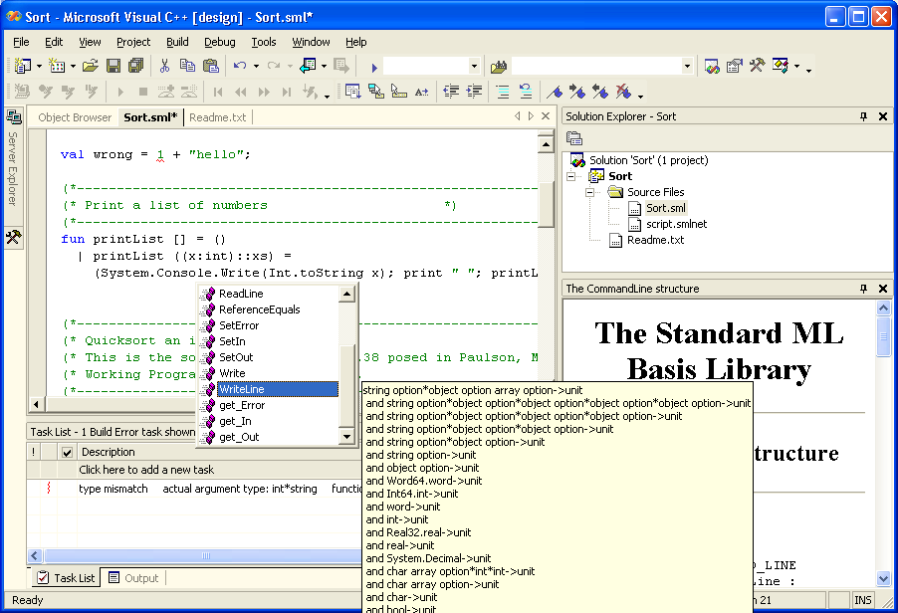

Slide 53
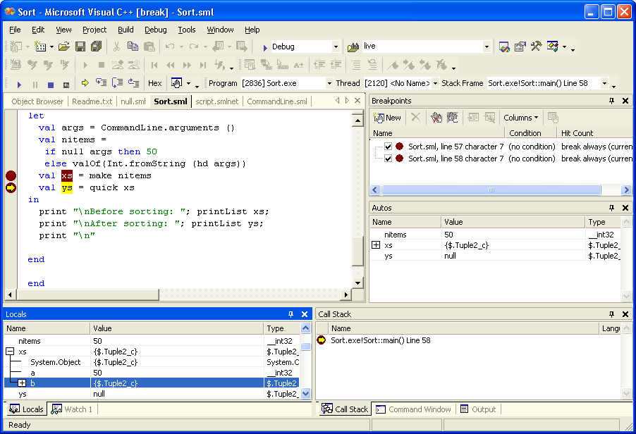

Slide 54
State of the art
Really can use CLR (or, if you must, JVM) as target for your language
But expect to do some work if you want good performance and/or accurate semantics
Have to work harder to get smooth interop
But it’s worth it

Slide 55
The near future: Generics for .NET
Next version of CLR and C# will have full support for parametric polymorphism, thanks to Andrew Kennedy and Don Syme
Not just a source-level translation – this is really built all the way through the runtime, tools and libraries
Parameterize everywhere (classes, structs, interfaces, methods)
Parameterize by any type (not just reference types), with F-bounded constraints
Exact run-time type information
High performance – runtime shares and specializes depending on representation to give performance as good as hand-specialized code in most cases

Slide 56
So what does this mean?
Compilation of languages with polymorphism gets much easier and much more efficient
Still hard to satisfy everybody
  Eiffel wants unsound covariant subtyping
  Haskell and ML modules would like higher-kinded polymorphism (quantification over type constructors)
  C++ would like parameterization by values as well as types
Separate compilation gets a bit easier
  class Fun<A,B> {B apply(A x);}
Interop just got easier
  Polymorphic languages can export polymorphic things directly
  can export other things using polymorphism
Interop just got harder
  What to do about non-polymorphic languages? Generic VB…

Slide 57
Further ahead: The next Common Language Runtime?
CISC approach: keep extending what we have
  Generic CLR + variance + tweaks for mixins + control operators = nice platform
  But I wouldn’t like to try to push it much further than that
RISC approach: really try to isolate a small computational core and equip it with a powerful, regular type system
  Restrict serious attention to safe languages (including e.g. Cyclone)

Slide 58
Which common core?
Options include
  An abstract typed assembly language
  Powerful typed lambda calculus
    Shao, League: Type-preserving compilation of Java into Fω+row polymorphism
  Typed pi-calculus
    Honda, Yoshida: Type systems for pi which give full abstraction for lambda calculi and capture sequentiality
Linearity, effects, continuations, regions
We can’t do all this stuff in one place right now – but the pieces are coming together and there’s lots of cool stuff to be done
The UNCOL part is doable
No magic bullet for universal high-level interoperability
  semantics-based tool/environment support deserves more work

Slide 59
But why?
Next generation CLR will be “good enough” for many scenarios and be where all the stuff you want to use lives
It’s good because it’s popular, the other way around doesn’t matter so much
Something new has to be really compelling, not just a bit better
Performance?
  2x better isn’t enough, 10x might be
  Cross-language optimisation?
Security?
Programming model?
  Concurrency, distribution, failure?
  Metaprogramming? Configuration+deployment?
  Data integration?
  Needs an amazing new language to drag the others along
Application
  Core of OS built on language-based security??

Slide 60
Advertisement
val test13 = let val c = ltest "c"
"(new v v!0 | v?*n = c?[x r]=r!n | inc![n v]) |
(new v v!0 | v?*n = c?[x r]=r!n | inc![n v])"
in project (unit --> int) c
end
- test13();
val it = 0 : int
- test13();
val it = 0 : int
- test13();
val it = 1 : int
- test13();
val it = 1 : int
- test13();
val it = 2 : int

Slide 61
Questions?
http://www.cl.cam.ac.uk/Research/TSG/SMLNET
http://research.microsoft.com/~nick

Slide 62
Backup

Slide 63
Generalise SML features: references
ML has a single kind of heap allocated, mutable storage:
type 'ty ref
val ref : 'ty -> 'ty ref
val ! : 'ty ref -> 'ty
val := : 'ty ref * 'ty -> unit
SML.NET provides a more general, kind-indexed storage type:
type ('ty,'kind) reference
val ! : ('ty, 'kind) reference -> 'ty
val := : ('ty, 'kind) reference * 'ty -> unit
SML ref’s are just one kind of reference ('kind = heap)
type 'ty ref = ('ty,heap) reference
val ref : 'ty -> ('ty, heap) reference
Other kinds describe static and instance fields:
val x : (int,(Point,x) field) reference = p.#x
val global : (int,(Counters,global) static) reference = Counters.global
A new function lets us take the address of any kind of storage,
eg to pass it as a C# call-by-reference argument.
val & : ('ty,'kind) reference -> ('ty, address) reference
… val counter = ref 1
Library.method(& counter) …

Slide 64
Generalise SML features: enums
.NET supports light-weight C++ style enumeration types:
public enum MyEnum { A = 0 , B , C = A }
Often similar to flat SML datatypes but, in general,
- each enum has an underlying integral type (here int)
- constants are not unique (C = A)
- constants are not exhaustive ( 5 is a legal value of type MyEnum)
.NET enumerations are imported as a dataype with 1 “real” constructor, and multiple derived constructors, in pseudo SML:
datatype MyEnum = MyEnum of int
structure MyEnum = struct
constructor A = MyEnum 0
constructor B = MyEnum 1
constructor C = MyEnum 0
end
Derived constructors may be used in patterns and as values:
fun toString MyEnum.C = "A"
| toString MyEnum.B = "B"
| toString (MyEnum i) = Int.toString i

