Slide 1
Traced Premonoidal Categories
Nick Benton
Microsoft Research
Martin Hyland
University of Cambridge

Slide 2
This talk is about
Denotational semantics of languages with
  Side-Effects and
  Recursion
Functional programming
Notes:
The new stuff is quite modest and rather technical, so I’ll spend a bit longer than usual placing it in context

Slide 3
Effects
“Pure” functional programs satisfy lots of nice equational laws. Expressions behave like familiar mathematical values, e.g. with respect to substitution.
Can be given semantics in well-behaved mathematical places, e.g. in CCCs. Pairs modelled by products, functions by exponentials, etc.
But real languages (even Haskell) don’t quite behave like that because expressions can have effects as well as (or instead of) producing a result.

Slide 4
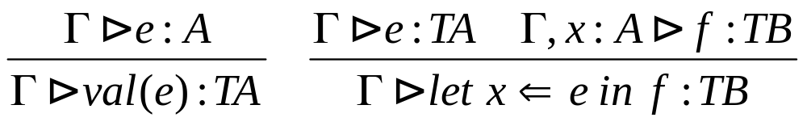
Monads
Moggi proposed structuring the semantics of languages with effects by distinguishing computations from values
Values modelled in a cartesian (closed) category C
Computations by a strong monad T on C
Semantics via translation into computational metalanguage λML_{T}
Semantics decomposes source language types. E.g. for CBV, (A->B)* = A* -> T(B*)
T
Partiality: TA = A⊥
Exceptions: TA = A + E
Nondeterminism: TA = ℘A
State: TA = S→S×A
Continuations: TA = (A→R)→R
Etc…
1 × →
C

Slide 5
Monads
A big success, not just in semantics
Monads have become the “design pattern” for doing I/O etc in Haskell and are a useful structuring device in impure languages too (e.g. parser combinators)
CBV translation modelled in Kleisli category, T=GF
What structure does that have?
?
C_{T}
Computations
F
─┤
G
1 ×
C
Values

Slide 6
Monads
A big success, not just in semantics
Monads have become the “design pattern” for doing I/O etc in Haskell and are a useful structuring device in impure languages too (e.g. parser combinators)
CBV translation modelled in Kleisli category, T=GF
What structure does that have?
If T is a commutative monad (e.g. lifting, powerset)
I ⊗
C_{T}
let x⇐M in let y⇐N in P
= let y⇐N in let x ⇐M in P
Computations
F
─┤
G
then C_{T} is symmetric monoidal
1 ×
C
Values

Slide 7
Symmetric Monoidal Categories
Symmetric monoidal categories well understood (cartesian a special case)
Boxes-and-wires diagrams
Multiplicative linear logic
“direct” models start with two categories and a (strict, identity on objects, symmetric monoidal) functor between them
I ⊗
M
f
h
Computations
g
F
1 ×
C
(f;h)⊗g
Values

Slide 8
Premonoidal Categories
But what about non-commutative monads?
We get a premonoidal category K (Power/Robinson)
⊗ is a functor in each variable separately, which gives two ways of composing f:A→B and g:A’→B’ to get A⊗A’→B⊗B’
A
f
B
A
f
B
A’
g
B’
A’
g
B’
fg = (f⊗A’);(B⊗g)
f g = (A⊗g);(f⊗B’)


Slide 9
Premonoidal Categories
But what about non-commutative monads?
We get a premonoidal category K (Power/Robinson)
⊗ is a functor in each variable separately, which gives two ways of composing f:A→B and g:A’→B’ to get A⊗A’→B⊗B’
A
f
B
A
f
B
A’
g
B’
A’
g
B’
fg = (f⊗A’);(B⊗g)
f g = (A⊗g);(f⊗B’)


Slide 10
Centres
Say f is central if for all g,
Central morphisms form a symmetric monoidal subcategory Z(K)
We prefer to work in a more algebraic setting in which we specify an SM subcategory M of central morphisms
fg =
f g

I 
K

I ⊗
Z(K)
J
I ⊗
M

Slide 11
Centres
f g

Say f is central if for all g, fg =
Central morphisms form a symmetric monoidal subcategory Z(K)
We prefer to work in a more algebraic setting in which we specify an SM subcategory M of central morphisms
If M is cartesian
then have a
Freyd category
Hughes: “arrows”
I 
K

I ⊗
Z(K)
J
1 ×
C

Slide 12
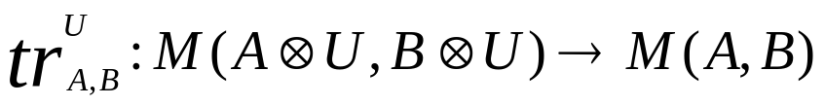
Traces
Traces on symmetric monoidal categories (Joyal, Street, Verity)
Family of operations
Satisfying some axioms…
U
f
U
A
B

Slide 13
Trace axioms 1
=
left tightening
=
right tightening

Slide 14
Trace axioms 2
=
sliding
=
superposing

Slide 15
Trace axioms 3
=
=
vanishing
=
yanking

Slide 16
Natural Question
Can we have a traced (symmetric) premonoidal category?
The axioms make sense, but
Theorem:
  A traced symmetric premonoidal category is actually symmetric monoidal.
Proof:
  “Take fg, introduce a loop at the end using yanking, expand the loop using naturality and superposition until it goes around both f and g, slide g around the loop, putting it before f ,and finally tighten the loop again until it disappears, leaving ”
The culprit seems to be sliding
f g


Slide 17

New definition
A trace on a symmetric premonoidal category J:M→K is a family
satisfying the usual trace axioms except
  We restrict sliding to central morphisms
  We require the trace to preserve the centre M (it’s actually automatic that it preserves Z(K) )
This generalizes the usual definition

Slide 18

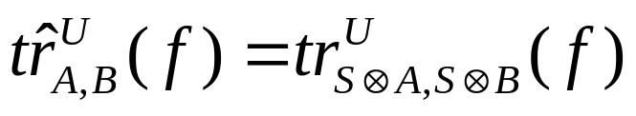
Example: State
Let M be a traced symmetric monoidal category in the usual sense and define K to have the same objects but
with the obvious composition
Then define a premonoidal trace on K by

Slide 19
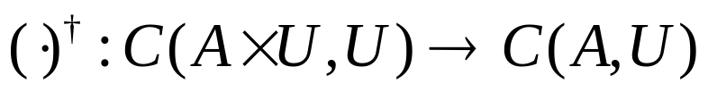
Fixpoints
Parameterized fixpoint operators on cartesian categories
Family of operations
Satisfying some axioms…
U
f
U
A

Slide 20
Parameterized Fixpoint Axioms
=
naturality
=
fixpoint property

Slide 21
Additional Axioms for Conway Operators 1
f
g
f
=
g
f
parameterized dinaturality

Slide 22
Additional Axioms for Conway Operators 2
f
f
=
diagonal property

Slide 23
Traces and Fixpoints
Theorem (Hasegawa/Hyland)
  In a cartesian category, there is a bijective correspondence between traces and Conway operators.
Another Natural Question
  Can we generalise this result to the premonoidal case?
This is interesting in view of recent work on “recursive monads” in functional programming.

Slide 24
fixT operations
Haskell library includes some monadic fixpoint operations in which the recursion takes place “over the values not the computations” eg fixIO : (a→ IO a)→IO a
data Tree a = Leaf a | Branch (Tree a) (Tree a)
f (Leaf n) m = do print n
return (n, Leaf m)
f (Branch t1 t2) m = do (m1,r1) <- f t1 m
(m2,r2) <- f t2 m
return (min m1 m2, Branch r1 r2)
replacemin t = fixIO (\ ~(m,r) -> f t m)

Slide 25
Launchbury and Erkök
Proposed an extension to Haskell’s do notation and an axiomatisation of such mfix operations (fixTs)
Their axiomatisation is partly equational and partly inequational and they discuss a number of laws which hold only in some cases
So, can we generalise the relation between fixpoints and traces and in the process better understand Launchbury and Erkök’s axioms?

Slide 26
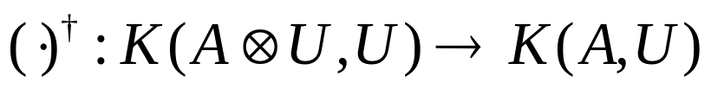
New Definition
A Conway operator on a Freyd category J:C→K is a family
satisfying some axioms…

Slide 27
Premonoidal Conway Axioms 1
=
centre preservation
=
naturality

Slide 28
Premonoidal Conway Axioms 2
central fixed point property
=
parallel property
=

Slide 29
Premonoidal Conway Axioms 3
=
withering property

Slide 30
Theorem
In a Freyd category, there is a bijective correspondence between traces and Conway operators.

Slide 31
So does this explain mfix?
In one sense we’re more general, since premonoidal traces don’t require cartesian structure
And our Conway operators are the same as their mfixes when we can define them (state, monoids)
But the mfix axioms are more liberal – many of their examples are not Conway operators according to our definition

Slide 32
Other Related Work
Hasegawa
Jeffrey
Paterson
Friedman and Sabry

Slide 33
Future work
Try to get a better account of mfix axioms in a categorical setting. Perhaps by being more explicit about presence of abstract lifting monad
Look at premonoidal variant of “Geometry of Interaction” construction

