Slide 1

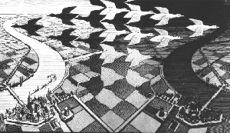
A small part of what you should know about continuations, but were too afraid to ask
Nick Benton

Slide 2
Continuations…
One of the best ideas in CS
Rediscovered in different forms/domains many times since 1964
Simple
Mind-bogglingly complicated
Very useful
A good example of the interaction between theory and practice
Profound: e.g. connections with classical logic
Something which should be part of every computer scientist’s mental toolkit

Slide 3
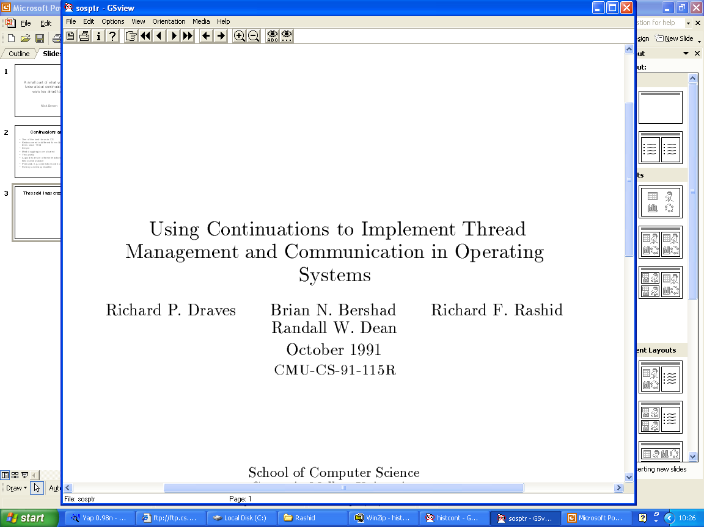

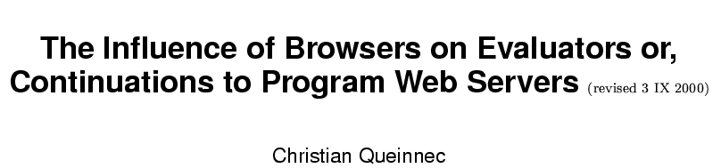
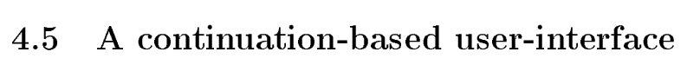
They said I was crazy, but…
Interest not entirely from programming language theoreticians:

Slide 4

Overstretched metaphors ahead…

Slide 5

Warm up
. Get total sales figure
. Insert it into report
…

Slide 6

Warm up
. Get total sales figure
. Insert it into report
…
To compute total sales:
Get sales for europe
Get sales for america
Add them together
Return the result

Slide 7

Warm up
europe
. Get total sales figure
. Insert it into report
…
To compute total sales:
Get sales for europe
Get sales for america
Add them together
Return the result
To get sales for europe:
Get report for europe
Look up the sales figure
Return it

Slide 8

Warm up
. Get total sales figure
. Insert it into report
…
To compute total sales:
Get sales for europe
Get sales for america
Add them together
Return the result
To get sales for europe:
Get report for europe
Look up the sales figure
Return it
europe
To get report for europe:
Search for europe file
Take it out
Copy it
Replace original
Return copy

Slide 9
Warm up
. Get total sales figure
. Insert it into report
…
To compute total sales:
Get sales for europe
Get sales for america
Add them together
Return the result
To get sales for europe:
Get report for europe
Look up the sales figure
Return it
To get report for europe:
Search for europe file
Take it out
Copy it
Replace original
Return copy

Slide 10
Warm up
. Get total sales figure
. Insert it into report
…
To compute total sales:
Get sales for europe
Get sales for america
Add them together
Return the result
To get sales for europe:
Get report for europe
Look up the sales figure
Return it
To get report for europe:
Search for europe file
Take it out
Copy it
Replace original
Return copy

Slide 11
Warm up
. Get total sales figure
. Insert it into report
…
To compute total sales:
Get sales for europe
Get sales for america
Add them together
Return the result
To get sales for europe:
Get report for europe
Look up the sales figure
Return it
To get report for europe:
Search for europe file
Take it out
Copy it
Replace original
Return copy

Slide 12
Warm up
. Get total sales figure
. Insert it into report
…
To compute total sales:
Get sales for europe
Get sales for america
Add them together
Return the result
To get sales for europe:
Get report for europe
Look up the sales figure
Return it
To get report for europe:
Search for europe file
Take it out
Copy it
Replace original
Return copy

Slide 13
Warm up
. Get total sales figure
. Insert it into report
…
To compute total sales:
Get sales for europe
Get sales for america
Add them together
Return the result
To get sales for europe:
Get report for europe
Look up the sales figure
Return it
E

Slide 14
Warm up
. Get total sales figure
. Insert it into report
…
To compute total sales:
Get sales for europe
Get sales for america
Add them together
Return the result
To get sales for europe:
Get report for europe
Look up the sales figure
Return it
E

Slide 15
Warm up
. Get total sales figure
. Insert it into report
…
To compute total sales:
Get sales for europe
Get sales for america
Add them together
Return the result
To get sales for europe:
Get report for europe
Look up the sales figure
Return it
E
2

Slide 16
Warm up
. Get total sales figure
. Insert it into report
…
To compute total sales:
Get sales for europe
Get sales for america
Add them together
Return the result
To get sales for europe:
Get report for europe
Look up the sales figure
Return it
E
2

Slide 17
Warm up
2
. Get total sales figure
. Insert it into report
…
To compute total sales:
Get sales for europe
Get sales for america
Add them together
Return the result

Slide 18
Warm up
. Get total sales figure
. Insert it into report
…
To compute total sales:
Get sales for europe
Get sales for america
Add them together
Return the result
2

Slide 19
Warm up
america
. Get total sales figure
. Insert it into report
…
To compute total sales:
Get sales for europe
Get sales for america
Add them together
Return the result
To get sales for america:
Get report for america
Look up the sales figure
Return it
2

Slide 20
Warm up
. Get total sales figure
. Insert it into report
…
To compute total sales:
Get sales for europe
Get sales for america
Add them together
Return the result
To get sales for america:
Get report for america
Look up the sales figure
Return it
2
america
To get report for america:
Search for america file
Take it out
Copy it
Replace original
Return copy

Slide 21
Warm up
. Get total sales figure
. Insert it into report
…
To compute total sales:
Get sales for europe
Get sales for america
Add them together
Return the result
To get sales for america:
Get report for america
Look up the sales figure
Return it
2
To get report for america:
Search for america file
Take it out
Copy it
Replace original
Return copy

Slide 22
Warm up
. Get total sales figure
. Insert it into report
…
To compute total sales:
Get sales for europe
Get sales for america
Add them together
Return the result
To get sales for america:
Get report for america
Look up the sales figure
Return it
2
To get report for america:
Search for america file
Take it out
Copy it
Replace original
Return copy

Slide 23
Warm up
. Get total sales figure
. Insert it into report
…
To compute total sales:
Get sales for europe
Get sales for america
Add them together
Return the result
To get sales for america:
Get report for america
Look up the sales figure
Return it
2
To get report for america:
Search for america file
Take it out
Copy it
Replace original
Return copy

Slide 24
Warm up
. Get total sales figure
. Insert it into report
…
To compute total sales:
Get sales for europe
Get sales for america
Add them together
Return the result
To get sales for america:
Get report for america
Look up the sales figure
Return it
2
To get report for america:
Search for america file
Take it out
Copy it
Replace original
Return copy

Slide 25
Warm up
. Get total sales figure
. Insert it into report
…
To compute total sales:
Get sales for europe
Get sales for america
Add them together
Return the result
To get sales for america:
Get report for america
Look up the sales figure
Return it
2
A

Slide 26
Warm up
. Get total sales figure
. Insert it into report
…
To compute total sales:
Get sales for europe
Get sales for america
Add them together
Return the result
To get sales for america:
Get report for america
Look up the sales figure
Return it
2
A

Slide 27
Warm up
. Get total sales figure
. Insert it into report
…
To compute total sales:
Get sales for europe
Get sales for america
Add them together
Return the result
To get sales for america:
Get report for america
Look up the sales figure
Return it
2
A
7

Slide 28
Warm up
. Get total sales figure
. Insert it into report
…
To compute total sales:
Get sales for europe
Get sales for america
Add them together
Return the result
To get sales for america:
Get report for america
Look up the sales figure
Return it
2
A
7

Slide 29
Warm up
7
. Get total sales figure
. Insert it into report
…
To compute total sales:
Get sales for europe
Get sales for america
Add them together
Return the result
2

Slide 30
Warm up
. Get total sales figure
. Insert it into report
…
To compute total sales:
Get sales for europe
Get sales for america
Add them together
Return the result
2
7

Slide 31
Warm up
. Get total sales figure
. Insert it into report
…
To compute total sales:
Get sales for europe
Get sales for america
Add them together
Return the result
2
7
9

Slide 32
Warm up
9
. Get total sales figure
. Insert it into report
…

Slide 33
Warm up
. Get total sales figure
. Insert it into report
…
9

Slide 34
Warm up
And so on…
At any stage there is a list of workers
All but the last are blocked waiting for a response
When the active one completes her task, she returns a result to her immediate predecessor
So she has to know who that is
Various ways of arranging this:
  Everybody sits in a line, passes to the right
  Shared pile of names in the middle of the room
  Make it part of the request
. Get total sales figure
. Insert it into report
…
9

Slide 35
Pile of names
. Get total sales figure
. Insert it into report
…
To compute total sales:
Get sales for europe
Get sales for america
Add them together
Return the result
2
To get sales for america:
Get report for america
Look up the sales figure
Return it
Before delegating, put your name on top
To return, take the top name off and send to that person
A
To get report for america:
Search for america file
Take it out
Copy it
Replace original
Return copy

Slide 36
Part of request 1
. Get total sales figure
. Insert it into report
…
To compute total sales for
Get sales for europe
Get sales for america
Add them together
Return the result to
Whenever you delegate, send your name as part of the request
Tasks end with “send the result to the person named in the request”

Slide 37
Part of request 2
europe
. Get total sales figure
. Insert it into report
…
To compute total sales for
Get sales for europe
Get sales for america
Add them together
Return the result to
To get europe sales for
Get report for europe
Look up the sales figure
Return it to

Slide 38
An optimization 1
If there were only one region, things would look like this…
. Get total sales figure
. Insert it into report
…
To compute total sales for
Get sales for europe
Return the result to
To get europe sales for
Get report for europe
Look up the sales figure
Return it to
2

Slide 39
An optimization 2
2
. Get total sales figure
. Insert it into report
…
To compute total sales for
Get sales for europe
Return the result to

Slide 40
An optimization 3
. Get total sales figure
. Insert it into report
…
To compute total sales for
Get sales for europe
Return the result to
2

Slide 41
An optimization 4
2
. Get total sales figure
. Insert it into report
…

Slide 42
An optimization 5
2
. Get total sales figure
. Insert it into report
…

Slide 43
An optimization 6
But that’s rather inefficient: Betty (in the middle) is just a postperson
. Get total sales figure
. Insert it into report
…
To compute total sales for
Get sales for europe
Return the result to

Slide 44
An optimization 7
Betty tells Clare to give her an answer, which she passes directly to Angela
europe
. Get total sales figure
. Insert it into report
…
To compute total sales for
Get sales for europe
Return the result to

Slide 45
An optimization 8
Much better: Betty tells Clare to return her answer directly to Angela:
europe
. Get total sales figure
. Insert it into report
…
To compute total sales for
Get sales for europe
Err... that’s it!

Slide 46
An optimization 9
When Clare’s finished…
2
. Get total sales figure
. Insert it into report
…
Tail Call

Slide 47
Betty got to go home early
But Angela’s hanging around for ages…
. Get total sales figure
and then
Err.. That’s it!
. Insert it into report

Slide 48
Now Betty’s instructions will have to take account of the fact that she’ll get another sheet of instructions
To compute total sales and then do x
Get sales for europe
Get sales for america
Add them together
Do x with the result
That’s it
Insert it into report
Insert it into report

Slide 49
But Betty delegates too
To compute total sales and then do x
Get sales for europe
and then do
1a. Get sales for america
2a. Add 1. and 1a. together
3a. Do x with the sum
(and that’s it)

Slide 50
But…
To compute total sales and then do x
Get sales for europe
and then do
1a. Get sales for america and then do
1b. Add 1. and 1a. together
2b. Do x with the sum

Slide 51
Clare and Daphne do…
To get sales for c and then do y
1. get report for c and then do
1a. look up sales figure from 1
2a. do y with 1a.
To get report for c and then do z :
Search for c file
Take it out
Copy it
Replace original
do z with 3.

Slide 52
So what happens?
Get total sales and then insert it into report

Slide 53
Betty does
and then do
Get sales for europe
1a. Get sales for america and then do
1b. Add 1. and 1a. together
2b. Do insert 1b into the report

Slide 54
Clare does
1. get report for europe and then do
1a. look up sales figure from 1
2a. do
1b. Get sales for america and then do
1c. Add 1a. and 1b. together
2c. Do insert 1c into the report

Slide 55
Daphne
Search for europe file
Take it out
Copy it
Replace original
do
1a. look up sales figure from 3
2a. do
1b. Get sales for america and then do
1c. Add 1a. and 1b. together
2c. Do insert 1c into the report

Slide 56
Daphne
Search for europe file
Take it out
Copy it
Replace original
do
E
1a. look up sales figure from 3
2a. do
1b. Get sales for america and then do
1c. Add 1a. and 1b. together
2c. Do insert 1c into the report

Slide 57
Daphne
Search for europe file
Take it out
Copy it
Replace original
do
E
2
1a. look up sales figure from 3
2a. do
E
1b. Get sales for america and then do
1c. Add 1a. and 1b. together
2c. Do insert 1c into the report
2

Slide 58
Clare-2 (??)
1. get report for america and then do
1a. look up sales figure from 1
2a. do
1b. Add 1a. and 1a. together
2b. Do insert 1b into the report
2

Slide 59
And so on…
This is continuation-passing style (CPS)
  Every function gets an extra argument saying what do do with the result
  i.e. “the rest of the computation”
  Every call becomes a tail-call!
  So call-and-return replaced by “jump with arguments”
  We’ve replaced a long line of workers with a single worker manipulating a large pile of bits of paper
    (frames on the heap rather than the stack)

Slide 60
How does that help?
once you make continuations explicit you can manipulate them in interesting ways
this gives complete control of control flow
  you can ignore the continuation you were given and use a different one
  you can pass it as an argument to someone else
  you can duplicate it
As a programmer, you can do all these things just with functions
and semantically, you can explain all this just using proper mathematical functions

Slide 61
What sort of thing can you do with continuations?
Early exit (abort)
Exceptions
Backtracking (Prolog-type stuff)
Generators, iterators, whatever
Implement tail calls on VMs that don’t have them
Lightweight threads
Security stuff
Cool stuff in distributed setting
  stateless servers
  migratory applications
…
Reason

Slide 62
History
Invented to give semantics to jumps (Algol 60)
Studied and generalised
Becomes a programming pattern
Which is added as a language feature (Scheme, SML/NJ, Python)
And used in compiler intermediate languages
Still an active topic of research

Slide 63
But it looks horrid
You don’t have to do it all explicitly
Translation into CPS can be done by compiler
Or leave most compilation alone and then add special implementations for continuation-manipulating primitives (copy stack to heap and vice-versa)

Slide 64
e.g. stateless servers

Slide 65
Questions?

Slide 66
Monadic reflection using call/cc
Add nondeterminism (for example) to already-compiled code
val pick : 'a list -> 'a
val fail : unit -> 'a
val results : (unit->'a)->'a list
- results (fn () =>
let val x = pick [1,2]
val y = pick [2,5]
in if x = y then fail() else x+y
end)
> [3,6,7] : int list

Slide 67
Types

