Slide 1
Embedded Interpreters
Nick Benton
Microsoft Research
Cambridge UK

Slide 2
Writing interpreters in functional languages is easy
Every introductory text includes a metacircular interpreter for lambda calculus (and some parser combinators).
What more is there to say?
But in practice there are two kinds of interpreter
  Those for self-contained new languages
  Domain-specific command or scripting languages added to applications

Slide 3
Application scripting languages
Start with an application written in the host language (metalanguage, and in this talk it will be SML)
Application comprises many interesting higher-type values and new type definitions
Purpose of scripting language (object language) is to give the user a flexible way to glue those bits together at runtime
Requires more sophisticated interoperability between the two levels than in the self-contained case
SML tradition is to avoid the problem by not defining an object language at all – just use interactive top-level loop instead. Not really viable for stand-alone applications, libraries, interesting object-level syntaxes, situations in which commands come from files, network, etc.
Scheme is a bit more flexible (dynamic typing, eval, macros) than SML for this sort of thing. But I like SML.

Slide 4
Starting point: A Tactical Theorem Prover Applet
Sample for MLj (Benton, Kennedy, Russell)
HAL is a theorem prover for first order logic written in SML by Paulson
No interface – intended to be used from the interactive SML environment
We wanted to compile it as an applet so one could do interactive theorem proving in a web browser (don’t ask why…)
Problem 1: Applets don’t get any simple scrolling text UI by default.
  Solution: Download 3rd party terminal emulator in Java, strip out network bits and link into SML code with MLj’s interlanguage working extensions. Easy.
Problem 2: Have to parse and evaluate user commands
  Non-Solution: Package a complete ML environment as an applet to provide interface to an application of a few hundred lines

Slide 5
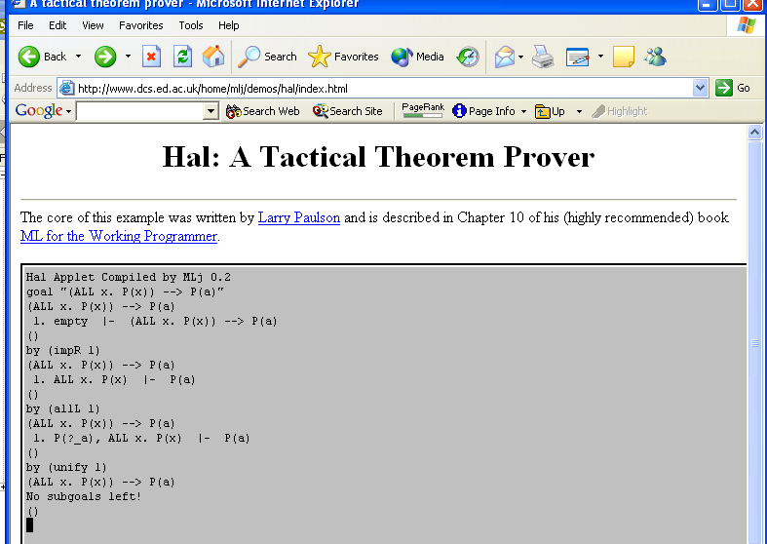

Slide 6
HAL’s command language
Simple combinatory functional language
Integers, strings and tactics as base values, functions and tuples as constructors
Easy to write parser and interpreter for such a language
But HAL itself comprises about 30 ML values, some of which have higher-order types
How to make those available within the interpreted language?
We’d like to avoid special-casing them all in the interpreter itself (effectively making them new language constructs)

Slide 7
Let’s look at an interpreter
Expressions:
datatype Exp = EId of string (* identifiers *)
| EI of int (* integer consts *)
| ES of string (* string consts *)
| EApp of Exp*Exp (* application *)
| EP of Exp*Exp (* pairs *)
Note:
Object language functions interpreted using ML functions
Build the interpreter using a universal datatype U
datatype U = UF of U->U | UP of U*U | UUnit |
UI of int | US of string | UT of tactic

Slide 8


Mapping into U
To make an ML values of type A available in the object language, we need a map
For base types this is easy, e_{int} = UI for example
But to embed a function of type A→B we need to map it to one of type U →U so we can wrap it with UF
We can only do that if we also have a projection
Then e_{A→B} f = UF (e_{B} o f o p_{A})
These projections will be partial

Slide 9
Embedding-Projection Pairs in ML
How do we program these type-indexed functions?
We represent each type explicitly by its associated embedding-projection pair and define combinators for each constructor
type 'a EP
val embed : 'a EP -> ('a->U)
val project : 'a EP -> (U->'a)
val unit : unit EP
val int : int EP
val string : string EP
val ** : ('a EP)*('b EP) -> ('a*'b) EP
val --> : ('a EP)*('b EP) -> ('a->'b) EP

Slide 10
Matching structure
type 'a EP = ('a->U)*(U->'a)
fun embed (e,p) = e
fun project (e,p) = p
fun PF (UF(f))=f (* : U -> (U->U) *)
fun PP (UP(p))=p (* : U -> (U*U) other similar elided *)
val int = (UI,PI)
val string = (US,PS) (* etc for other base types *)
infix **
fun cross (f,g) (x,y) = (f x,g y)
fun (e,p)**(e',p') = (UP o cross(e,e'), cross(p,p') o PP)
infixr -->
fun arrow (f,g) h = g o h o f
fun (e,p)-->(e',p') = (UF o arrow (p,e'), arrow (e,p') o PF)

Slide 11
Using embeddings to define an environment
val rules = map (cross (I, (embed (int-->tactic))))
[("basic", Rule.basic),
("conjL", Rule.conjL),...]
val comms =
[("goal", embed (string-->unit) Command.goal),
("by", embed (tactic-->unit) Command.by)]
val tacs =
[("||", embed (tactic**tactic-->tactic) Tacs.||),
("repeat", embed (tactic-->tactic) Tacs.repeat),
...]
val builtins = rules @ comms @ tacs

Slide 12
Defining and using the interpreter
fun interpret e = case e of
EI n => UI n
| ES s => US s
| EId s => lookup s builtins
| EP (e1,e2) => UP(interpret e1,interpret e2)
| EApp (e1,e2) => let val UF(f) = interpret e1
val a = interpret e2
in f a
end
Top level loop just repeatedly reads expressions from the terminal window, parses them and calls interpret.
E.g. interpret (parse “by (repeat (conjR 1))”)
We’re done! But let’s see how far the idea goes…

Slide 13
Embedding Polymorphic Functions
Just instantiate at U. Given
fun I x = x
fun K x y = x
fun S x y z = x z (y z)
val any : (U EP) = (I,I)
val combinators =
[("I", embed (any-->any) I),
("K", embed (any-->any-->any) K),
("S", embed ((any-->any-->any)-->(any-->any)-->
any-->any) S)]
Evaluating
interpret (read "(S K K 2, S K K \"two\")")
yields
UP (UI 2, US "two") : U

Slide 14
Multilevel Programming
We can project as well as embed
So we can construct object-level programs and reflect them back as ML values
For example
let val eSucc =
interpret(read "fn x=>x+1",[]) []
val succ = project (int-->int) eSucc
in (succ 3) end;
val it = 4 : int
But that’s a bit boring…

Slide 15
The traditional power function
- local fun p 0 = %`1`
| p n = %`y * ^(p (n-1))`
in fun pow x = project (int-->int)
(interpret (%`fn y => ^(p x)`,[]) [])
end;
val pow = fn : int -> int -> int
- val p5 = pow 5;
val p5 = fn : int -> int
- p5 2;
val it = 32 : int
- p5 3;
val it = 243 : int
Note: %`…^(…)…` is “antiquote” – like parse but allows parser results to be spliced in

Slide 16
Projecting Polymorphic Functions
Represent type abstraction and application by ML’s value abstraction and application:
let val eK = embed (any-->any-->any) K
val pK = fn a => fn b =>
project (a-->b-->a) eK
in (pK int string 3 "three",
pK string unit "four" ())
end

Slide 17
Untypeable object expressions
- let val embY = interpret (read
"fn f=>(fn g=> f (fn a=> (g g) a))
(fn g=> f (fn a=> (g g) a))",[]) []
val polyY = fn a => fn b=> project
(((a-->b)-->a-->b)-->a-->b) embY
val sillyfact = polyY int int
(fn f=>fn n=>if n=0 then 1 else n*(f (n-1)))
in (sillyfact 5) end;
val it = 120 : int

Slide 18
Multistage computation?
fun run s = interpret (read s,["run"])
[embed (string-->any) run];
val run = fn : string -> U
- run "let val x= run \"3+4\" in x+2";
val it = UI 9 : U

Slide 19
Recursive datatypes
datatype U = ... | UT of int*U
val wrap : ('a -> 'b) * ('b -> 'a) -> 'b EP -> 'a EP
val sum : 'a EP list -> 'a EP
val mu : ('a EP -> 'a EP) -> 'a EP
fun wrap (decon,con) ep = ((embed ep) o decon,
con o (project ep))
fun sum ss =
let fun cases brs n x =
UT(n, embed (hd brs) x)
handle Match => cases (tl brs) (n+1) x
in (fn x=> cases ss 0 x,
fn (UT(n,u)) => project (List.nth(ss,n)) u)
end
fun mu f = (fn x => embed (f (mu f)) x,
fn u => project (f (mu f)) u)

Slide 20
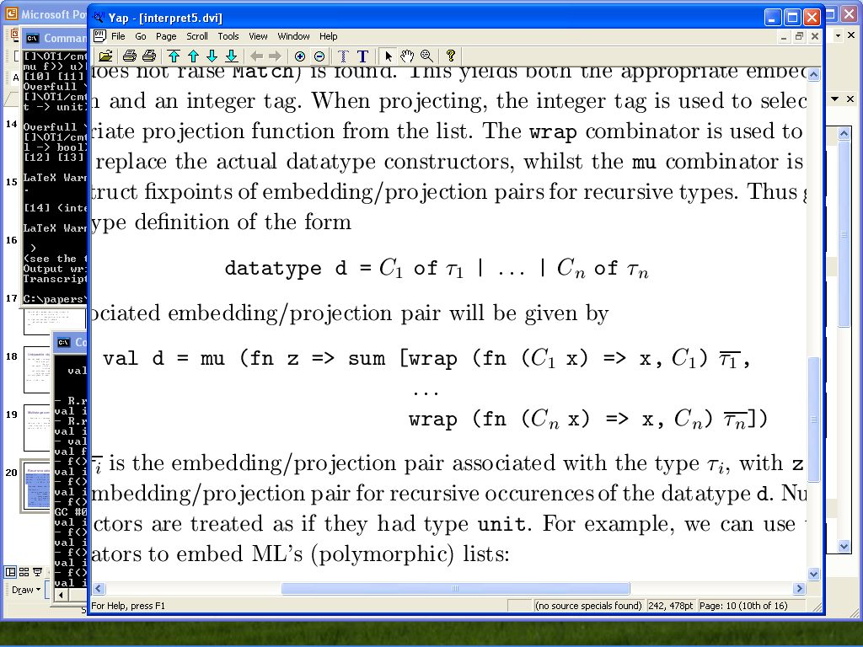
Usage pattern
Given
The associated EP is

Slide 21
Example: lists
- fun list elem = mu ( fn l => (sum
[wrap (fn []=>(),fn()=>[]) unit,
wrap (fn (x::xs)=>(x,xs),
fn (x,xs)=>(x::xs)) (elem ** l)]));
val list : 'a EP -> 'a list EP
(* now extend the environment *)
[...
("cons", embed (any**(list any)-->(list any)) (op ::)),
("nil", embed (list any) []),
("null", embed ((list any)-->bool) null), ... ]

Slide 22
Lists continued
- interpret (read
"let fun map f l = if null l then nil
else cons(f (hd l),map f (tl l))
in map", []) [];
val it = UF fn : U
- project ((int-->int)-->(list int)-->(list int)) it;
val it = fn : (int -> int) -> int list -> int list
- it (fn x=>x*x) [1,2,3];
val it = [1,4,9] : int list

Slide 23
That’s semantically elegant, but…
It’s also absurdly inefficient
Every time a value crosses the boundary between the two languages (twice for each embedded primitive) its entire representation is changed
Laziness doesn’t really help – even in Haskell, that version of map is quadratic
There is a more efficient approach based on using the extensibility of exceptions to implement a Dynamic type, but
  It doesn’t allow datatypes to be treated polymorphically.
  If you embed the same type twice, the results are incompatible

Slide 24
More Advanced: Monadic Interpreters
What about parameterizing our interpreter by an arbitrary monad T (e.g. for non-determinism, probabilities, continuations,…)?
Assume CBV translation, so an expression in the object language which appears to have type A will be given a semantics of type TA* where
  int* = int
  (A→B)* = A*→TB*

Slide 25
Embedding seems impossible
An ML function value of type
(int→ int) → int
needs to be given a semantics in the interpreter of type
(int →T int) →T int
and that’s not possible extensionally. (How can the ML function “know what to do” with the extra monadic information returned by calls to its argument?)
More generally, need an extensional version of the CBV monadic translation, which cannot be defined in core ML (or Haskell)

Slide 26
But…
Semantically, an ML function of type
(int→ int) → int
is already really of type
(int →M int) →M int
where M is the implicit monad for ML.
Always includes references, exceptions, non-termination and IO, but for SML/NJ and MLton it also includes first-class continuations
Amazing fact (Filinski): M_{NJ} is universal, in the sense that any ML-expressible monad T is a retract of M_{NJ}.

Slide 27
How does that help?
For any monad T in ML can define polymorphic functions
val reflect : 'a T -> 'a
val reify : (unit -> 'a) -> 'a T
This cunning idea of Filinski combines with representing types by embedding-projection pairs to allow the definition of an extensional monadic translation just as we wanted
A* is not parametric in A (like A EP was) but can still represent the type by a pair of a translation function t : A→A* and an “untranslation” function n : A*→A with combinators for type constructors being well-typed

Slide 28
Like this
val int = (I,I)
val string = (I,I)
…
fun (t,n)**(t',n') = (cross(t,t'), cross(n,n'))
fun (t,n)-->(t',n') =
(fn f=> fn x=> reify (fn ()=> t' (f (n x))),
fn g=> fn x=> n'( reflect (g (t x)))

Slide 29
Like this
val int = (I,I)
val string = (I,I)
…
fun (t,n)**(t',n') = (cross(t,t'), cross(n,n'))
fun (t,n)-->(t',n') =
(fn f=> fn x=> reify (fn ()=> t' (f (n x))),
fn g=> fn x=> n'( reflect (g (t x)))
B
A→B
B→B*
(unit→B*) →T B*
A*→A
A*

Slide 30
The translation at work
structure IntStateMonad :> sig
type ’a T = int->int*’a
val return : ’a->’a T
val bind : ’a T -> (’a -> ’b T) -> ’b T
val add : int -> unit T (* = fn m => fn n => (n+m,()) *)
… end
fun translate (t,n) x = t x
- fun apptwice f = (f 1; f 2; “done”)
val apptwice : (int->unit)->string
- val tapptwice = translate ((int-->unit)-->string) apptwice;
val tapptwice : (int->unit T)->string T
- tapptwice add 0;
val it = (3,”done”) : int * string

Slide 31
The embedded monadic interpreter
Now combine the embedding-projection pairs with the monadic translation-untranslation functions
There is a choice: the monad can be either implicit or explicit in the universal datatype and the code for the interpreter
We’ll choose implicit
Each type A is represented by a 4-tuple
  e_{A} : A→U
  p_{A} : U→A
  t_{A} : A→A*
  n_{A} : A*→A
With the implicit monad, the definition of the universal datatype and the code for the interpreter itself remains exactly as it was in the case of the non-monadic interpreter!

Slide 32
Embedding and projecting in the monadic case
Ordinary ML values of type A are still embedded with e_{A}.
The ML values which represent the operations of the monad will have ML types which are already in the image of the (.)* translation
We embed them by first untranslating them, to get an ML value of the type which they will appear to have in the object language and then embedding the result, i.e. e_{A} o n_{A}
When projecting an object expression of type A we want to see it as a computation of type A* which requires another use of reification:
fun project (e,p,t,n) f x =
R.reify (fn ()=> t (p (f x)))

Slide 33
Example: Non-determinism
Use list monad with monad operations for choice and failure
fun choose (x,y) = [x,y] (* choose : 'a*'a->'a T *)
fun fail () = [] (* fail : unit->'a T *)
val builtins =
[("choose", membed (any**any-->any) choose),
("fail", membed (unit-->any) fail),
("+", embed (int**int-->int) Int.+), ... ]
- project int (interpret (read
"let val n = (choose(3,4))+(choose(7,9))
in if n>12 then fail() else 2*n",[])) [];
val it = [20,24,22] : int ListMonad.t

Slide 34
Even more advanced: π-calculus
(Asynchronous) π-calculus is a first-order process calculus based on name passing
There is a well-known translation of (CBV) λ-calculus into π.
Goal: write an interpreter for π with embeddings which turn ML functions into processes ,and projections which turn (suitably well-behaved) processes into ML functions

Slide 35
An interpreter for asynchronous π
type 'a chan = ('a Q.queue) * ('a C.cont Q.queue)
datatype BaseValue = VI of int | VS of string | VB of bool
| VU | VN of Name
and Name = Name of (BaseValue list) chan
type Value = BaseValue list
val readyQ = Q.mkQueue() : unit C.cont Q.queue
fun new() = Name (Q.mkQueue(),Q.mkQueue())
fun scheduler () = C.throw (Q.dequeue readyQ) ()
fun send (Name (sent,blocked),value) =
if Q.isEmpty blocked then Q.enqueue (sent,value)
else C.callcc (fn k => (Q.enqueue(readyQ,k);
C.throw (Q.dequeue blocked) value))
fun receive (Name (sent,blocked)) =
if Q.isEmpty sent then
C.callcc (fn k => (Q.enqueue (blocked,k); scheduler ()))
else Q.dequeue sent
Etc…

Slide 36
Pict-style syntax on top
- val pp = read "new ping new pong
(ping?*[] = echo!\"ping\" | pong![]) |
(pong?*[] = echo!\"pong\" | ping![]) |
ping![]";
val pp = - : Exp
- schedule (interpret (pp, Builtins.static) Builtins.dynamic);
val it = () : unit
- sync ();
pingpongpingpongpingpongpingpongpingpongpingpong...

Slide 37
Embeddings and projections
signature EMBEDDINGS =
sig
type 'a EP
val embed : ('a EP) -> 'a -> Process.BaseValue
val project : ('a EP) -> Process.BaseValue -> 'a
val int : int EP
val string : string EP
val bool : bool EP
val unit : unit EP
val ** : ('a EP)*('b EP) -> ('a*'b) EP
val --> : ('a EP)*('b EP) -> ('a->'b) EP
end
Looks just as before, but now side-effecting

Slide 38
Function case
fun (ea,pa)-->(eb,pb) =
( fn f => let val c = P.new()
fun action () = let val [ac,VN rc] = P.receive c
val _ = P.fork action
val resc = eb (f (pa ac))
in P.send(rc,[resc])
end
in (P.fork action; VN c)
end,
fn (VN fc) => fn arg => let val ac = ea arg
val rc = P.new ()
val _ = P.send(fc,[ac,VN rc])
val [resloc] = P.receive(rc)
in pb resloc
end
)

Slide 39
And it works
- fun test s = let val p = Interpreter.interpret (Exp.read s,
Builtins.static) Builtins.dynamic
in (schedule p; sync())
end;
val test = fn : string -> unit
- test "new r1 new r2 twice![inc r1] | r1?f = f![3 r2]
| r2?n = itos![n echo]";
5
This is the translation of
print (Int.toString (twice inc 3))
and does do the right thing (note TCO)

Slide 40
Can interact in non-functional ways
fun appupto f n = if n < 0 then ()
else (appupto f (n-1); f n)
has type (int->unit)->int->unit, can then do
- test "new r1 new r2 new c appupto![printn r1] |
(r1?f = c?*[n r] = r![] | f![n devnull]) |
appupto![c r2] | r2?g = g![10 devnull]";
0010011022013012012310234201343012454123552346634574565676787889910
For each n from 0 to 10, print each integer from 0 to n, all run in parallel

Slide 41
Projection
- fun ltest name s = let val n = newname()
val p = Interpreter.interpret (Exp.read s,
name :: Builtins.static) (n :: Builtins.dynamic)
in (schedule p; n)
end;
val ltest = fn : string -> string -> BaseValue
- val ctr = project (unit-->int) (ltest
"c" "new v v!0 | v?*n = c?[r]=r!n | inc![n v]");
val ctr = fn : unit -> int
- ctr();
val it = 0 : int
- ctr();
val it = 1 : int
- ctr();
val it = 2 : int

Slide 42
Two counters on same channel
- val dctr = project (unit --> int) (ltest "c"
"(new v v!0 | v?*n = c?[x r]=r!n | inc![n v]) |
(new v v!0 | v?*n = c?[x r]=r!n | inc![n v])");
val dctr = fn : unit -> int
- dctr();
val it = 0 : int
- dctr();
val it = 0 : int
- dctr();
val it = 1 : int
- dctr();
val it = 1 : int

Slide 43
Fixpoints…
- val y = project (((int-->int)-->int-->int)-->int-->int)
(ltest "y" "y?*[f r] = new c new l r!c | f![c l] |
l?h = c?*[x r2]= h![x r2]");
val y = fn : ((int -> int) -> int -> int) -> int -> int
- y (fn f=>fn n=>if n=0 then 1 else n*(f (n-1))) 5;
val it = 120 : int

Slide 44
Summary
Embedding higher typed values into lambda calculus interpreter using embedding-projection pairs
Projecting object-level values back to typed metalanguage
Polymorphism
Metaprogramming
Recursive datatypes
Embedded monadic interpreter via extensional monadic transform (using monadic reflection and reification)
Embedded pi-calculus interpreter. (Extensional lambda→pi translation has not previously been studied.)

Slide 45
Related work
Modelling types as retracts of a universal domain in denotational semantics
Normalization by Evaluation (Berger, Schwichtenberg, Danvy, Filinski, Dybjer, Yang)
printf-like string formatting (Danvy)
pickling (Kennedy)
Lua
Pict (Turner, Pierce)
Concurrency and continuations (Wand,Reppy,Claessen,…)

Slide 46
That’s it.
Questions?

Slide 47
Now add variable-binding constructs
type staticenv = string list
type dynamicenv = U list
fun indexof (name::names, x) = if x=name then 0 else 1+(indexof(names, x))
(* val interpret : Exp*staticenv -> dynamicenv -> U *)
fun interpret (e,static) = case e of
EI n => K (UI n)
| EId s => (let val n = indexof (static,s)
in fn dynamic => List.nth (dynamic,n)
end handle Match => let val lib = lookup s builtins
in K lib
end)
| EApp (e1,e2) => let val s1 = interpret (e1,static)
val s2 = interpret (e2,static)
in fn dynamic => let val UF(f) = s1 dynamic
val a = s2 dynamic
in f a
end
end
| ELetfun (f,x,e1,e2) =>
let val s1 = interpret (e1, x::f::static)
val s2 = interpret (e2,f::static)
fun g dynamic v = s1 (v::UF(g dynamic)::dynamic)
in fn dynamic => s2 (UF(g dynamic)::dynamic)
end

