Slide 1
Machine Obstructed Proof
Nick Benton
Microsoft Research

Slide 2
I have a dream…

Slide 3
One logic to rule them all?
A low-level logic / model / set of reasoning principles for machine code programs that is
  Rich enough to capture different type systems, analyses, logics for different higher-level source languages
  Preserving equations from the source (think optimizing compiled code)
Want to specify and verify the contracts of
  Bits of compiled code from different languages
  The runtime system(s)
  Cross-language calling (foreign functions)
Why?
  Foundation for next-generation secure execution environment
  And of a million crazy type systems
* Caveats:
Only sequential (interleaving may just be possible)
Nothing seriously intensional, such as execution time

Slide 4
Challenges
Modular reasoning about program fragments with unstructured control flow
  First class code pointers
  Indirect and computed jumps
Modular reasoning about pointer structures in the mutable heap
  “Strong” updates
  Aliasing
  Initialization
  Pointer arithmetic
  Encapsulation and privacy
  Ownership and ownership transfer
  Dynamic allocation

Slide 5
A new hope
PER semantics of types
  Reynolds,Abadi&Plotkin,…, Benton,Kennedy,Hofmann&Beringer 06
Relational program logics
  Abadi,Plotkin,Cardelli,Curien,…, Benton POPL04, Yang
Logical relations for dynamic allocation and local storage
  O’Hearn et al, Pitts&Stark, Reddy&Yang, Benton&Leperchey TLCA05, Bohr&Birkedal 06
Linear & separation logics
  O’Hearn Reynolds Yang, …
Assume/guarantee reasoning about low-level fragments and linking
  Types: Cardelli, Glew&Morrisett,…
  Logics: Hamid&Shao, Benton APLAS05, Appel&Tan VMCAI06, Saabas&Uustalu SOS05
“Perping”, aka (bi)orthogonality
  Pitts&Stark, Krivine, Mellies&Vouillon POPL04, Lindley&Stark TLCA05, Benton APLAS05, Thielecke POPL06
Step-indexed models
  Appel Felty McAllester Ahmed Tan and others

Slide 6
“Realistic” Realizability
Distinctive features
  Binary relations rather than unary predicates on states
  No policy – no “wrong” or stuckness. Descriptive rather than prescriptive.
  Nothing built in – no stack, no hardwired notion of allocation
  Strongly “semantic”. Properties are all extensional, i.e. defined in terms of observable behaviour of programs.
  Deals with code pointers
  Genuinely modular
Short technical summary :
  Take everything on the previous slide…
  …and a deep breath
  Boil it all together in Coq
  Very abstract metatheory fine on paper, but showing that’s at all useful involves detailed proofs of particular programs and complex entailments between formulae

Slide 7
Machine model
As simple as it could be (possibly simpler):
  Stores/heaps are total functions from naturals to naturals
  Programs are total functions from naturals to instructions
  Configurations are triples of a store, a program and a pc
  Not even any registers (use some low-numbered memory locations)

Slide 8
State Relations

Slide 9
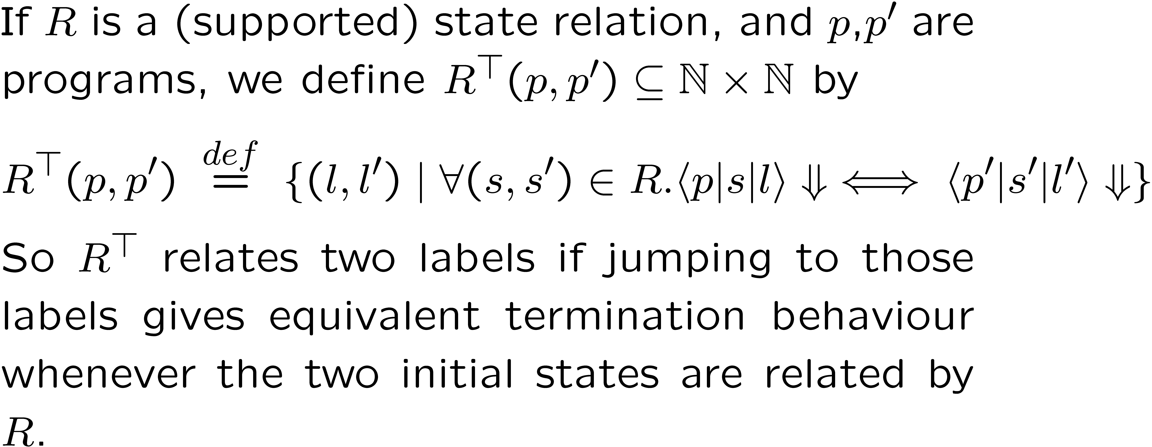
Perping

Slide 10
Specification of Allocation

Slide 11
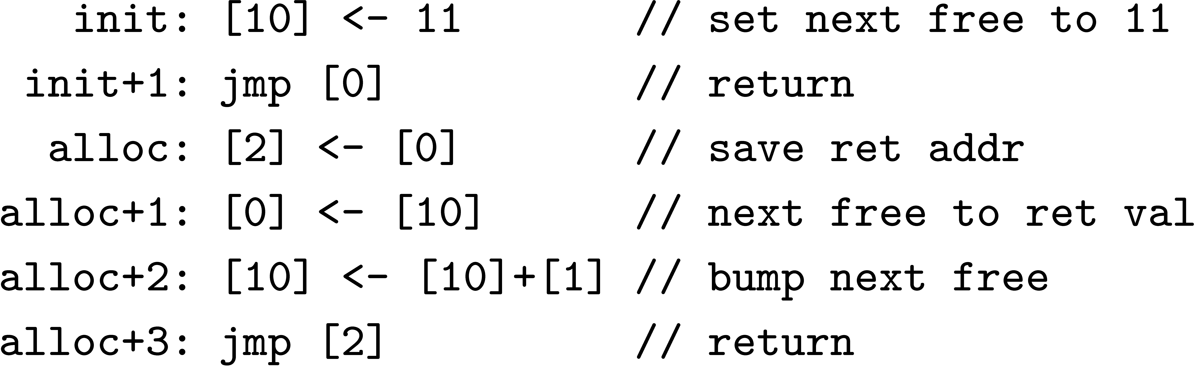
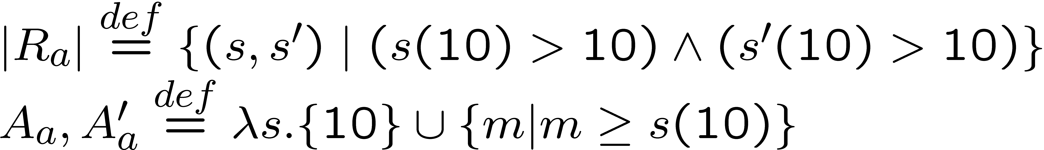
Verification of Allocation
Correctness: For any programs p,p’ extending the module above, Γ_{a}(p,p’) holds.
Proof is relational Hoare-style reasoning, using assumed separation conditions.

Slide 12
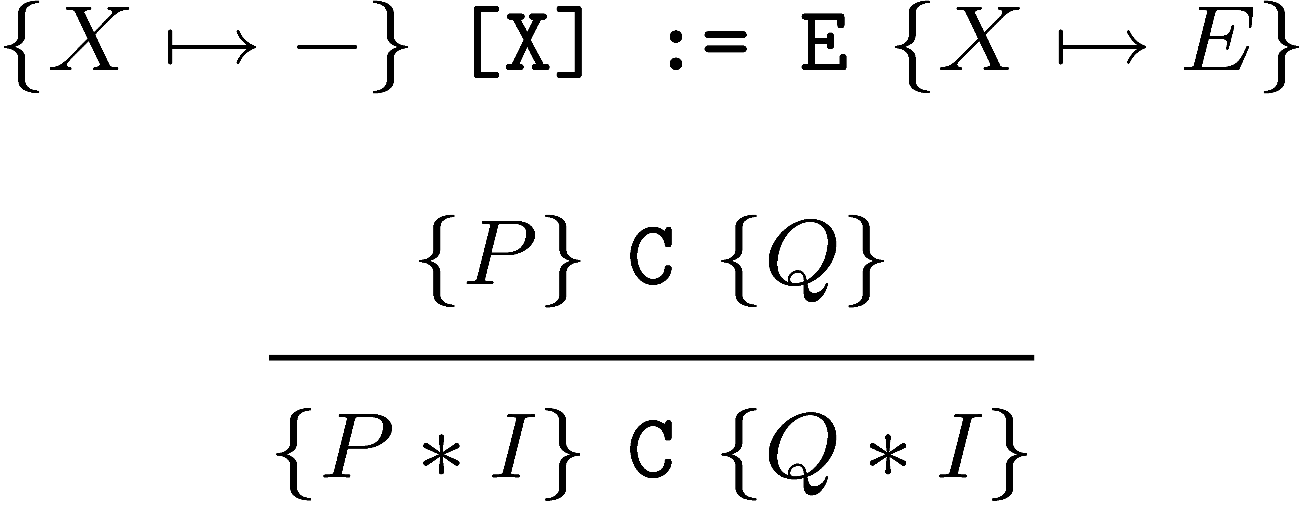
Framing
Lemma kdoubleupdate :
forall p p' j n n' v v' (krint:kT(nat->nat->Prop)) krold I s s',
rel (kRelTensor (Twolockrel krold n n') I p p' j) s s' ->
krint p p' j v v' ->
rel (kRelTensor (Twolockrel krint n n') I p p' j)
(update s n v) (update s' n' v').
Versus:

Slide 13
Factorial client
fact: ifz [5] branch just1
[1] <- 3 // size of our stack frame
[0] <- afram // return for alloc call
jmp alloc // new block in 0
afram: [[0]] <- [5] // save parameter
[[0]+1] <- [6] // save return address
[[0]+2] <- [7] // save frame of caller
[7] <- [0] // new frame
[5] <- [5]-1 // setup param for rec call
[6] <- back // ret addr for rec call
jmp fact // make rec call
back: [5] <- [5]*[[7]] // return value (dealloc preserves)
[0] <- [[7]+1] // retaddr for tail call via dealloc
[2] <- [7] // copy 7 (start of block for deallocate)
[7] <- [[7]+2] // restore caller’s 7 (dealloc won't mess)
[1] <- 3 // size of frame
jmp dealloc // reclaim frame and tail call
just1: [5] <- 1
jmp [6]

Slide 14
Definition factspec Ra p p' :=
forallrn (fun Rc => forallorn (fun r7 => kPerp (kRelList (
(kR_topwith A04 A04)
:: (kOnelocrel (fun v v' => v=v') 5)
:: (Onelockrel (kPerp (kRelList ( (kOnelocrel (fun v v' => v=v') 5)
:: (kR_topwith A04 A04)
:: Rc
:: Ra
:: (kR_topat 6)
:: Onelockrel r7 7
:: nil))) 6)
:: (Onelockrel r7 7)
:: Rc
:: Ra
:: nil)) p p')).
Lemma factthm : forall alloc dealloc fact p p' Ra,
program_extends_fragment p (factcode fact alloc dealloc)
-> program_extends_fragment p' (factcode fact alloc dealloc)
-> allocspec Ra p p’ alloc alloc
-> deallocspec Ra p p' dealloc dealloc
-> factspec Ra p p' fact fact.

Slide 15
Indexing
Actually, everything’s indexed by natural numbers (step counts)
Quantification over relations that are down-closed
Justifies recursion/linking
Definition kPerp (r:kAccrel) p p' (k:nat) l l' := forall j s s',
j < k -> rel (r p p' j) s s' ->
(((nstepterm j p s l) -> (terminates p' s' l')) /\
((nstepterm j p' s' l') -> (terminates p s l))).

Slide 16
Formalization
First version of general framework + verification of trivial allocator module + factorial client
  Took me about 4 months
  8500 lines of very embarrassing Coq
    >200 lines of proof per machine instruction ☹
  which is clearly ridiculous

Slide 17
Observations
Trying to just “pick it up” by using it for something new is not a good plan
  Not quite like programming or paper proving
    Non-trivial new skill you really have to learn seriously
    Need to really think about how to set things up
    Mistake to try to learn as little as possible to get your work done
Foundational angst
  Bool/Prop? Set/Type? Decidable?
  Extensionality? (Constructivism fine, though)
  Prover choice
Docs & examples over focussed on extraction and incomprehensible to novice
Ltac dcase x := generalize (refl_equal x); pattern x at -1; case x.
Tactical proving is aspect oriented programming
Bugs and glitches

Slide 18
What didn’t work
Over-shallow embeddings
  State relations
  Program fragments
Trying to fix that with too much tactical stuff

Slide 19
What did work
Having ongoing work in machine-readable form at all times
  Especially good for collaboration (though prover use itself is potential barrier)
Modifying and replaying proofs
Messy proofs
  Can blast things through with confidence before you’ve really understood them
  Is this an advantage?
“Knitting” (though beware the cut-free proof)
Records containing proofs
Setoids
Deeper embeddings and computational reflection
  Focus, permute, join, split, extract instruction

Slide 20
Subsequently…
Proofs for paper on PER semantics for effect analysis
  A few hundred lines, 2 days, easy, found bugs in paper proofs
Compiler correctness for simple imperative language with heap allocated data
  Revised, refactored and improved relational logic
  More use of notation, implicit args, tactics
  Order of magnitude improvement over previous proofs
    ~ 20 lines of proof per line of assembly
    Getting to be almost pretty…
  Still trying actually to do new stuff in Coq, rather than mechanize stuff we’ve completed on paper
    3 steps forward, 2 steps back

Slide 21
Conclusions
Frustrating, hurts your brain
Exhilarating, expands your brain
Time consuming, eats your brain
Addictive, warps your brain

Slide 22
Is the move to machine-checking
  A sign of stagnation and navel-gazing?
    There really is more to life than preservation & progress and α−conversion
  Of maturity?
  A brave new frontier for research?
  Enabling PL theory to scale to real artefacts?

Slide 23
It is (probably) the future
But not quite ready to become the norm
  Needs to fade into the background
Wood/trees hammer/nail
Do big things where we actually care about the result (SML, TCP)
Coq is the programming language of choice for the discriminate-ing hacker

Slide 24
Thanks:
Benjamin Leperchey (Paris 7)
Noah Torp-Smith (ITU Copenhagen)
Uri Zarfaty (Imperial)
Georges Gonthier (MSRC)
Questions?

Slide 26
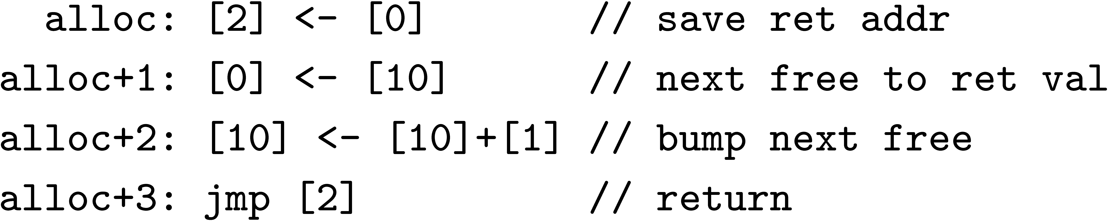
The simplest useful allocator
r
n
…
h
…
0
1
2
…
10
11
…
…
h
r: code expecting block in 0

Slide 27
The simplest useful allocator
r
n
r
…
h
…
0
1
2
…
10
11
…
…
h
r: code expecting block in 0

Slide 28
The simplest useful allocator
h
n
r
…
h
…
0
1
2
…
10
11
…
…
h
r: code expecting block in 0

Slide 29
The simplest useful allocator
h
n
r
…
h+n
…
0
1
2
…
10
11
…
…
h
r: code expecting block in 0

Slide 30
The simplest useful allocator
h
n
r
…
h+n
…
0
1
2
…
10
11
…
…
h
r: code expecting block in 0

Slide 31
What’s the spec?
Involves:
  Separation
  First class code pointers
  Independence
And we want to be modular

Slide 32
Relationally (before)
r
n
…
h
…
0
1
2
…
10
11
…
…
h
Rc
Ra
r’
n
…
h’
…
0
1
2
…
10
11
…
…
h’
alloc: …
alloc: …
r: code using block
r’: code using block

Slide 33
Relationally (after)
h
n
r
…
h+n
…
0
1
2
…
10
11
…
…
h
Rc
Ra
ANY
h’
n
r’
…
h’+n
…
0
1
2
…
10
11
…
…
h’
alloc: …
alloc: …
r: code using block
r’: code using block

