Slide 1
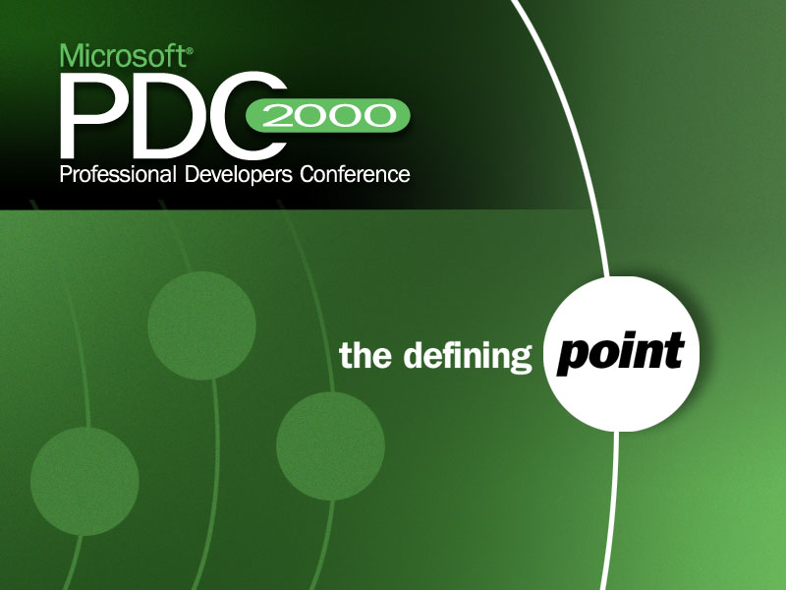

Slide 2

Research Languages on the .NET Platform
Nick Benton
Microsoft Research,
Cambridge UK

Slide 3
The Programming Language Landscape
C, C++, Visual Basic, Java, JScript, Perl, Cobol,... account for most commercial and industrial programming
but occupy only part of the space of programming language designs:
  Functional
  Logic
  Constraint
  Concurrent
  Component
  Distributed
  Domain-specific
    Graphics
    Music
    Text-processing
    Database Queries

Slide 4
The Problem (1)
For programming language researchers
  Lots of work to implement a compiler for a new programming language. Much of it often not very specific to the language in question
    garbage collection
    threading
    linking
    development environment
    backend optimizations
  And if you want to be able to do anything in the new language, you have to implement a rich collection of libraries as well

Slide 5
The Problem (2)
For developers
  Libraries & interlanguage working features in research compilers are never good enough. Gluing new code to old often involves
    autogenerated stubs
    lowest common denominator data representations
    hairy make scripts
    so might just as well write the whole thing in C++
  And the development environments are usually pretty feeble too

Slide 6
The Opportunity
The .NET Common Language Runtime provides a rich set of services to compiler writers
  So it's much easier to get a working system with good performance
Sharing a sophisticated type system, memory manager, loader, etc. makes high-level interlanguage working easy
  So you can access useful libraries and application components written in other languages straight away

Slide 7
The Project
Microsoft has been working with leading programming language researchers from around the world, with the aim of
Getting their favourite languages to target the .NET platform
Demonstrating interlanguage working
Providing early feedback

Slide 8
Haskell
Oz
Caml
Mercury
Standard ML
Component Pascal
Lightning Oberon
Scheme
Eiffel

Slide 9


