Slide 1
Polyphonic C#
Nick Benton, Luca Cardelli and Cedric Fournet
Microsoft Research
Cambridge

Slide 2
Programming in a networked world
Developers now have to work in a
  Concurrent
  Distributed
  High latency
  (& low reliability, security sensitive, multi-everything)
environment.
Which is hard
And they’re mostly not very good at it
  Try using Outlook over dialup ☹

Slide 3
Asynchronous concurrency
Synchronous concurrent programming is hard enough, but asynchronous concurrency is increasingly important
Distribution => concurrency + latency
=> asynchrony
=> more concurrency
Message-passing, event-based programming, dataflow models
For programming languages, coordination (orchestration) languages & frameworks, workflow

Slide 4
Language support for concurrency
Make invariants and intentions more apparent (part of the interface)
Good software engineering
Allows the compiler much more freedom to choose different implementations
Also helps other tools

Slide 5
.NET Today
Multithreaded execution environment with lock per object
C# has “lock” keyword, libraries include traditional shared-memory synchronization primitives (mutexes, monitors, r/w locks)
Delegate-based asynchronous calling model, events, messaging
Higher level frameworks built on that
Hard to understand, use and get right
  Different models at different scales
  Support for asynchrony all on the caller side – little help building code to handle messages (must be thread-safe, reactive, and deadlock-free)

Slide 6
Polyphonic C#
An extension of the C# language with new concurrency constructs
Based on the join calculus
  A foundational process calculus like the π-calculus but better suited to asynchronous, distributed systems
A single model which works both for
  local concurrency (multiple threads on a single machine)
  distributed concurrency (asynchronous messaging over LAN or WAN)

Slide 7
The Language

Slide 8
In one slide:
Objects have both synchronous and asynchronous methods.
Values are passed by ordinary method calls:
  If the method is synchronous, the caller blocks until the method returns some result (as usual).
  If the method is async, the call completes at once and returns void.
A class defines a collection of synchronization patterns (chords), which define what happens once a particular set of methods have been invoked on an object:
  When pending method calls match a pattern, its body runs.
  If there is no match, the invocations are queued up.
  If there are several matches, an unspecified pattern is selected.
  If a pattern containing only async methods fires, the body runs in a new thread.

Slide 9
A Simple Buffer
class Buffer {
String get() & async put(String s) {
return s;
}
}

Slide 10
A Simple Buffer
class Buffer {
String get() & async put(String s) {
return s;
}
}
An ordinary (synchronous) method with no arguments, returning a string

Slide 11
A Simple Buffer
class Buffer {
String get() & async put(String s) {
return s;
}
}
An ordinary (synchronous) method with no arguments, returning a string
An asynchronous method (hence returning no result), with a string argument

Slide 12
A Simple Buffer
class Buffer {
String get() & async put(String s) {
return s;
}
}
An ordinary (synchronous) method with no arguments, returning a string
An asynchronous method (hence returning no result), with a string argument
Joined together in a chord

Slide 13
A Simple Buffer
class Buffer {
String get() & async put(String s) {
return s;
}
}
Calls to put() return immediately (but are internally queued if there’s no waiting get()).
Calls to get() block until/unless there’s a matching put()
When there’s a match the body runs, returning the argument of the put() to the caller of get().
Exactly which pairs of calls are matched up is unspecified.

Slide 14
A Simple Buffer
class Buffer {
String get() & async put(String s) {
return s;
}
}
Does example this involve spawning any threads?
  No. Though the calls will usually come from different pre-existing threads.
So is it thread-safe? You don’t seem to have locked anything…
  Yes. The chord compiles into code which uses locks. (And that doesn’t mean everything is synchronized on the object.)
Which method gets the returned result?
  The synchronous one. And there can be at most one of those in a chord.

Slide 15
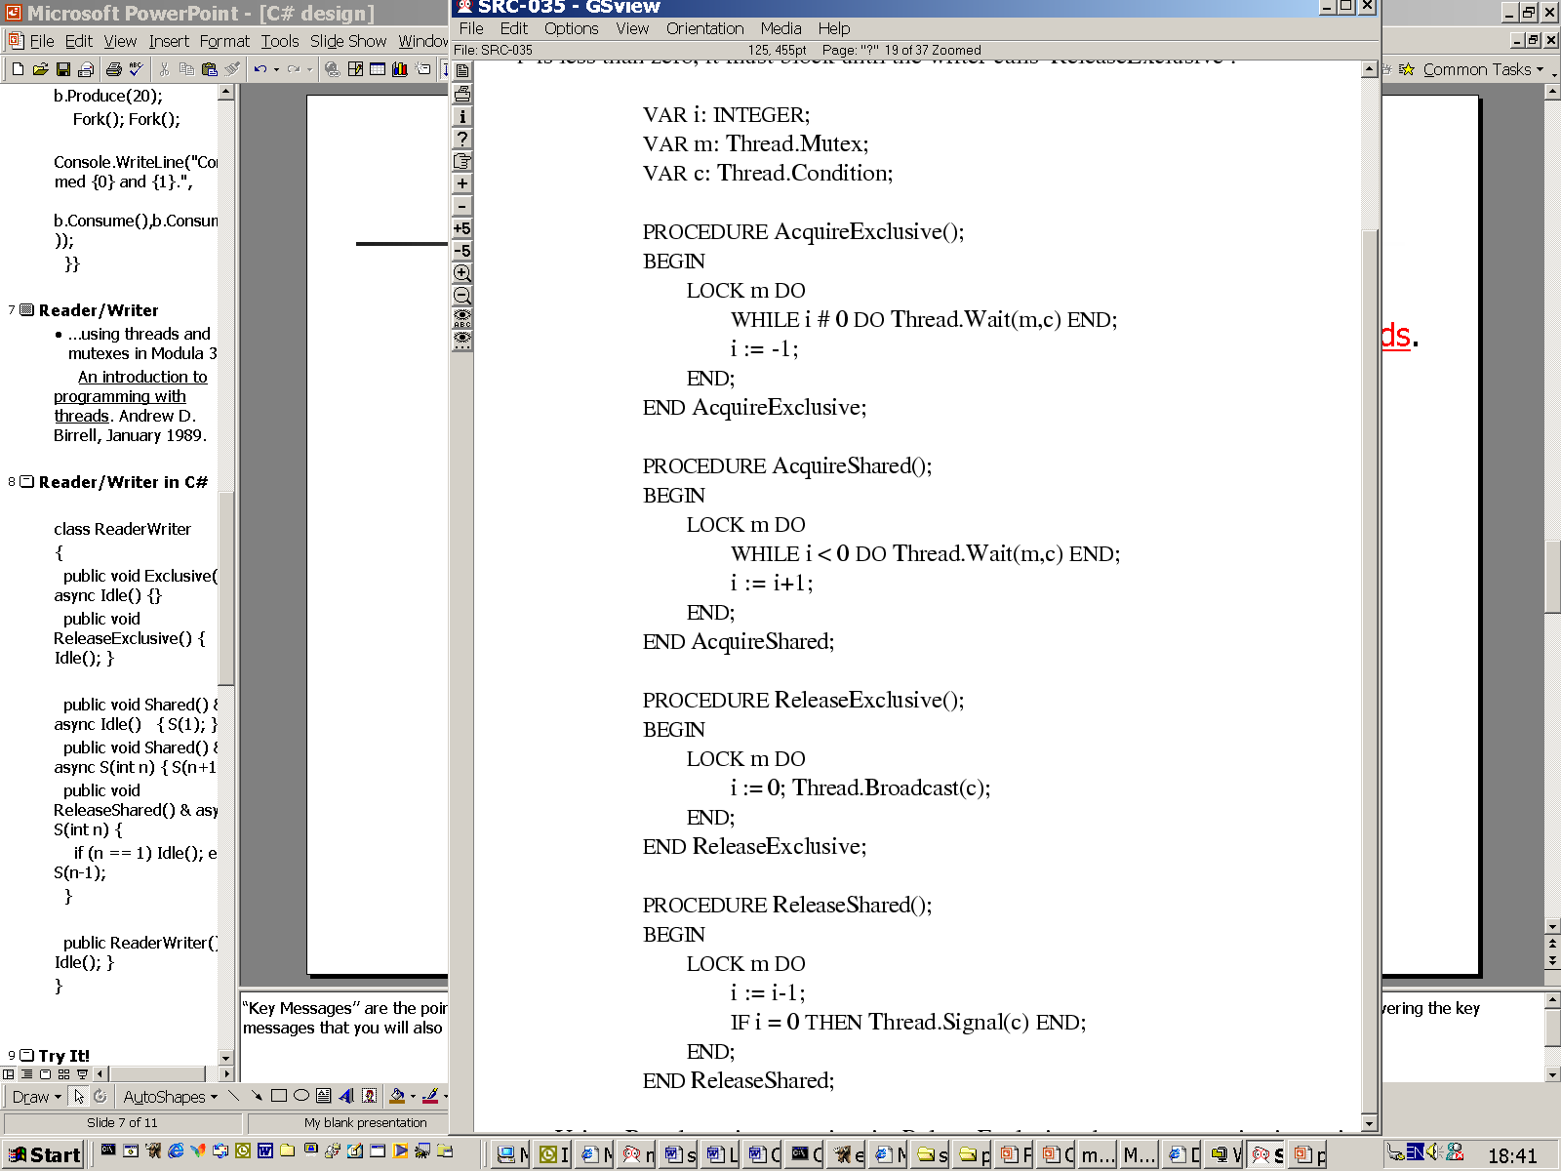
Reader/Writer
…using threads and mutexes in Modula 3
An introduction to programming with threads. Andrew D. Birrell, January 1989.

Slide 16
Reader/Writer in five chords
class ReaderWriter {
void Exclusive() & private async Idle() {}
void ReleaseExclusive() { Idle(); }
void Shared() & private async Idle() { S(1); }
void Shared() & private async S(int n) { S(n+1); }
void ReleaseShared() & private async S(int n) {
if (n == 1) Idle(); else S(n-1);
}
ReaderWriter() { Idle(); }
}
A single private message represents the state:
none ←→ Idle() ←→ S(1) ←→ S(2) ←→ S(3) …
Notes:
It is easy to reason on the invariants at that level.

Slide 17
Asynchronous Service Requests and Responses
The service might export an async method which takes parameters and somewhere to put the result:
  a buffer, or a channel, or
  a delegate (O-O function pointer)
delegate async IntCB(int v);
class Service {
public async request(String arg, IntCB callback) {
int result;
// do something interesting…
callback(result);
}
}
Notes:
Could make the delegate type be async which requires the callback to be non-blocking

Slide 18
Asynchronous Service Requests and Responses - join
class Join2 {
void wait(out int i, out int j)
& async first(int r1)
& async second(int r2) {
i = r1; j = r2; return;
}
}
// client code:
int i,j;
Join2 x = new Join2();
service1.request(arg1, new IntCB(x.first));
service2.request(arg2, new IntCB(x.second));
// do something useful
// now wait until both results have come back
x.wait(i,j);
// do something with i and j

Slide 19
Asynchronous Service Requests and Responses - select
class Select {
int wait()
& async reply(int r) {
return r;
}
}
// client code:
int i;
Select x = new Select();
service1.request(arg1, new IntCB(x.reply));
service2.request(arg2, new IntCB(x.reply));
// do something useful
// now wait until one result has come back
i = x.wait();
// do something with i

Slide 20
Active Objects
public abstract class ActiveObject : MarshalByRefObject {
protected bool done;
abstract protected void processmessage();
public ActiveObject () {
done = false; mainloop();
}
async mainloop() {
while (!done) { processmessage(); }
}
}

Slide 21
…continued
class Stock : ActiveObject {
override protected void processmessage()
& public async bid(BidOffer thebid) {
// process bid messages
}
override protected void processmessage()
& public async register(Client who) {
// process registration requests
}
…
}

Slide 22
Extending C# with chords
Classes can declare methods using generalized
chord-declarations instead of method-declarations.
chord-declaration ::= method-header [ & method-header ]* body
method-header ::= attributes modifiers [return-type | async] name (parms)
Interesting well-formedness conditions:
  At most one header can have a return type (i.e. be synchronous).
  The inheritance restriction.
  “ref” and “out” parameters cannot appear in async headers.

Slide 23
Implementation

Slide 24
Example: Sum of Squares
add(1)
total(0,8)
add(4)
SumOfSquares
add(9)
add(64)

Slide 25
Sum of Squares
total(1,7)
add(4)
SumOfSquares
add(9)
add(64)

Slide 26
Sum of Squares Code
class SumOfSquares {
private async loop(int i) {
if (i > 0) {
add(i * i);
loop(i - 1);
}
}
private int total(int r, int i) & private async add(int dr) {
int rp = r + dr;
if (i > 1) return total(rp, i - 1);
return rp;
}
public SumOfSquares(int x) {
loop(x);
int i = total(0, x);
System.Console.WriteLine("The result is {0}.", i);
}
}
Notes:
Show translation in Emacs.

Slide 27
Sum of Squares Translation
using System;
using System.Collections;
using System.Threading;
class SyncQueueEntry{
public int pattern;
public System.Threading.Thread mythread;
public System.Object joinedentries;
}
class SumOfSquares{
Queue Q_totalint_int_ = new Queue();
Queue Q_addint_ = new Queue();
class loopint__runner{
SumOfSquares parent;
int field_0;
public loopint__runner(SumOfSquares p_p,int p_0) {
parent = p_p;
field_0 = p_0;
Thread t = new Thread(new ThreadStart(this.doit));
t.Start();
}
void doit() {
parent.loopint__worker(field_0);
}
}
private void loopint__worker(int i) {
if (i >= 1) {add(i * i);
loop(i - 1);
}
}
static void Main() {
SumOfSquares s = new SumOfSquares();
int thesum = s.sum(10);
Console.WriteLine(thesum);
}
public int sum(int x) {
loop(x);
return total(0, x);
}
private int total(int sync_p_0,int sync_p_1) {
SyncQueueEntry qe = new SyncQueueEntry();
int matchindex=0;
System.Threading.Monitor.Enter(Q_totalint_int_);
if (!(Q_addint_.Count ==0)) {
qe.joinedentries = (int) (Q_addint_.Dequeue());
System.Threading.Monitor.Exit(Q_totalint_int_);
matchindex = 0;
goto joinlabel;
}// enqueue myself and sleep;
qe.mythread = Thread.CurrentThread;
Q_totalint_int_.Enqueue(qe);
System.Threading.Monitor.Exit(Q_totalint_int_);
try {
Thread.Sleep(Timeout.Infinite);
} catch (ThreadInterruptedException) {}
// wake up here
matchindex = qe.pattern;
joinlabel:
switch (matchindex) {
case 0: int r = sync_p_0;
int i = sync_p_1;
int dr = (int)(qe.joinedentries);
int rp = r + dr;
if (i > 1) {return total(rp, i - 1);
}
return rp;
}
throw new System.Exception();
}
private void add(int p_0) {
Object qe = p_0;
System.Threading.Monitor.Enter(Q_totalint_int_);
if (!(Q_totalint_int_.Count ==0)) {
SyncQueueEntry sqe = (SyncQueueEntry) (Q_totalint_int_.Dequeue());
sqe.joinedentries = qe;
System.Threading.Monitor.Exit(Q_totalint_int_);
sqe.pattern = 0;
sqe.mythread.Interrupt();
return;
}
Q_addint_.Enqueue(qe);
System.Threading.Monitor.Exit(Q_totalint_int_);
return;
}
private void loop(int i) {
loopint__runner r = new loopint__runner(this,i);
}
}

Slide 28
Sum of Squares Translation
using System;
using System.Collections;
using System.Threading;
class SyncQueueEntry{
public int pattern;
public System.Threading.Thread mythread;
public System.Object joinedentries;
}
class SumOfSquares{
Queue Q_totalint_int_ = new Queue();
Queue Q_addint_ = new Queue();
class loopint__runner{
SumOfSquares parent;
int field_0;
public loopint__runner(SumOfSquares p_p,int p_0) {
parent = p_p;
field_0 = p_0;
Thread t = new Thread(new ThreadStart(this.doit));
t.Start();
}
void doit() {
parent.loopint__worker(field_0);
}
}
private void loopint__worker(int i) {
if (i >= 1) {add(i * i);
loop(i - 1);
}
}
static void Main() {
SumOfSquares s = new SumOfSquares();
int thesum = s.sum(10);
Console.WriteLine(thesum);
}
public int sum(int x) {
loop(x);
return total(0, x);
}
private int total(int sync_p_0,int sync_p_1) {
SyncQueueEntry qe = new SyncQueueEntry();
int matchindex=0;
System.Threading.Monitor.Enter(Q_totalint_int_);
if (!(Q_addint_.Count ==0)) {
qe.joinedentries = (int) (Q_addint_.Dequeue());
System.Threading.Monitor.Exit(Q_totalint_int_);
matchindex = 0;
goto joinlabel;
}// enqueue myself and sleep;
qe.mythread = Thread.CurrentThread;
Q_totalint_int_.Enqueue(qe);
System.Threading.Monitor.Exit(Q_totalint_int_);
try {
Thread.Sleep(Timeout.Infinite);
} catch (ThreadInterruptedException) {}
// wake up here
matchindex = qe.pattern;
joinlabel:
switch (matchindex) {
case 0: int r = sync_p_0;
int i = sync_p_1;
int dr = (int)(qe.joinedentries);
int rp = r + dr;
if (i > 1) {return total(rp, i - 1);
}
return rp;
}
throw new System.Exception();
}
private void add(int p_0) {
Object qe = p_0;
System.Threading.Monitor.Enter(Q_totalint_int_);
if (!(Q_totalint_int_.Count ==0)) {
SyncQueueEntry sqe = (SyncQueueEntry) (Q_totalint_int_.Dequeue());
sqe.joinedentries = qe;
System.Threading.Monitor.Exit(Q_totalint_int_);
sqe.pattern = 0;
sqe.mythread.Interrupt();
return;
}
Q_addint_.Enqueue(qe);
System.Threading.Monitor.Exit(Q_totalint_int_);
return;
}
private void loop(int i) {
loopint__runner r = new loopint__runner(this,i);
}
}
class SumOfSquares{
Queue Q_totalint_int_ = new Queue();
Queue Q_addint_ = new Queue();
…

Slide 29
Sum of Squares Translation
using System;
using System.Collections;
using System.Threading;
class SyncQueueEntry{
public int pattern;
public System.Threading.Thread mythread;
public System.Object joinedentries;
}
class SumOfSquares{
Queue Q_totalint_int_ = new Queue();
Queue Q_addint_ = new Queue();
class loopint__runner{
SumOfSquares parent;
int field_0;
public loopint__runner(SumOfSquares p_p,int p_0) {
parent = p_p;
field_0 = p_0;
Thread t = new Thread(new ThreadStart(this.doit));
t.Start();
}
void doit() {
parent.loopint__worker(field_0);
}
}
private void loopint__worker(int i) {
if (i >= 1) {add(i * i);
loop(i - 1);
}
}
static void Main() {
SumOfSquares s = new SumOfSquares();
int thesum = s.sum(10);
Console.WriteLine(thesum);
}
public int sum(int x) {
loop(x);
return total(0, x);
}
private int total(int sync_p_0,int sync_p_1) {
SyncQueueEntry qe = new SyncQueueEntry();
int matchindex=0;
System.Threading.Monitor.Enter(Q_totalint_int_);
if (!(Q_addint_.Count ==0)) {
qe.joinedentries = (int) (Q_addint_.Dequeue());
System.Threading.Monitor.Exit(Q_totalint_int_);
matchindex = 0;
goto joinlabel;
}// enqueue myself and sleep;
qe.mythread = Thread.CurrentThread;
Q_totalint_int_.Enqueue(qe);
System.Threading.Monitor.Exit(Q_totalint_int_);
try {
Thread.Sleep(Timeout.Infinite);
} catch (ThreadInterruptedException) {}
// wake up here
matchindex = qe.pattern;
joinlabel:
switch (matchindex) {
case 0: int r = sync_p_0;
int i = sync_p_1;
int dr = (int)(qe.joinedentries);
int rp = r + dr;
if (i > 1) {return total(rp, i - 1);
}
return rp;
}
throw new System.Exception();
}
private void add(int p_0) {
Object qe = p_0;
System.Threading.Monitor.Enter(Q_totalint_int_);
if (!(Q_totalint_int_.Count ==0)) {
SyncQueueEntry sqe = (SyncQueueEntry) (Q_totalint_int_.Dequeue());
sqe.joinedentries = qe;
System.Threading.Monitor.Exit(Q_totalint_int_);
sqe.pattern = 0;
sqe.mythread.Interrupt();
return;
}
Q_addint_.Enqueue(qe);
System.Threading.Monitor.Exit(Q_totalint_int_);
return;
}
private void loop(int i) {
loopint__runner r = new loopint__runner(this,i);
}
}
private void add(int p_0) {
System.Threading.Monitor.Enter(Q_totalint_int_);
if (!(Q_totalint_int_.Count ==0)) {
SyncQueueEntry sqe =
(SyncQueueEntry)(Q_totalint_int_.Dequeue());
sqe.joinedentries = p_0;
System.Threading.Monitor.Exit(Q_totalint_int_);
sqe.pattern = 0;
sqe.mythread.Interrupt();
return;
}
Q_addint_.Enqueue(p_0);
System.Threading.Monitor.Exit(Q_totalint_int_);
return;
}

Slide 30
Current Work
Examples and test cases
  Web combinators, adaptive scheduler, web services (Terraserver), active objects and remoting (stock trader)
  Generally looking at integration with existing mechanisms and frameworks
Language design
  Direct syntactic support for timeouts
Solid Implementation

Slide 31
Predictable Demo:
Dining Philosophers
eating
waiting
to eat
waiting
to eat
thinking
eating
Notes:
“Key Messages’’ are the points that support your demo and bring out the unique qualities of your technology. Keep in mind that at the same time you are delivering the key messages that you will also be delivering your technology demo.

Slide 32
Code extract
class Room {
public Room (int size) { hasspaces(size); }
public void enter() & private async hasspaces(int n) {
if (n > 1) hasspaces(n-1);
else isfull();
}
public void leave() & private async hasspaces(int n) {
hasspaces(n+1);
}
public void leave() & private async isfull() { hasspaces(1); }
}
Notes:
RUN demo here…

Slide 33
Conclusions
A clean, simple, new model for asynchronous concurrency in C#
  Declarative, local synchronization
  Applicable in both local and distributed settings
  Efficiently compiled to queues and automata
  Easier to express and enforce concurrency invariants
  Compatible with existing constructs, though they constrain our design somewhat
  Solid foundations
  Works well in practice
For more information, contact me nick@microsoft.com or see http://research.microsoft.com/~nick
Notes:
The “Call to Action”’ is used for telling the audience what their next step is, based on what they heard/see so far. For example, their “next step” might be to fill out a contact sheet as noted above for continued follow up. Bottom line is that you want to direct the audience to do something with the information they just heard instead just saying “Cool Demo” and moving on. The Call to Action is used to turn a passive listener into an active participant, focusing on using the technology in their next product feature.

Slide 34
TimeoutBuffer
class TimeoutBuffer {
TimeoutBuffer(int delay) {
Timer t = new Timer(new TimerCallBack(this.tick), delay);
empty();
}
async empty() & void put(Object o) {has(o);}
async empty() & void tick() {timeout();}
async timeout() & void put(Object o) {timeout();}
async timeout() & Object get() {timeout(); throw new TimeOutExn();}
async has(Object o) & Object get() {has(o); return o;}
async has(Object o) & void tick() {has(o);}
}
Notes:
Morally speaking, the callback should be an async message, but that works much better if the simple optimization of NOT spawning a thread to run the body of an all async chord IF that body only makes other async calls

Slide 35
Why only one synchronous method in a chord?
JoCaml allows multiple synchronous methods to be joined, as in the following rendezvous
But in which thread does the body run? In C#, thread identity is “very” observable, since threads are the holders of particular re-entrant locks. So we rule this out in the interests of keeping & commutative. (Of course, it’s still easy to code up an asymmetric rendezvous in Polyphonic C#.)
int f(int x) & int g(int y) {
return y to f;
return x to y;
}

Slide 36
The problem with inheritance
class C {
virtual void f() & virtual async g() {…}
virtual void f() & virtual async h() {…}
}
class D : C {
override async g() { …}
}
We’ve “half” overridden f
Too easy to create deadlock or async leakage
void m(C x) { x.g(); x.f();}
…
m(new D());

Slide 37
The Inheritance Restriction
Inheritance may be used as usual, with a restriction
to prevent the partial overriding of patterns:
  For a given class, two methods f ang g are co-declared if there is a chord in which they are both declared.
  Whenever a method is overriden,
  every codeclared method must also be overriden.
  Hence, the compiler rejects patterns such as
  public virtual void f() & private async g() {…}
  In general, inheritance and concurrency do not mix well.
  Our restriction is simple; it could be made less restrictive.

Slide 38
Types etc.
async is a subtype of void
Allow covariant return types on those two:
  An async method may override a void one
  A void delegate may be created from an async method
  An async method may implement a void method in an interface
async methods are automatically given the [OneWay] attribute, so remote calls are non-blocking

Slide 39
Compiling chords
Since synchronization is statically defined for every class, we can compile it efficiently (state automata).
  We cache the synchronization state in a single word.
  We use a bit for every (polyphonic) method.
  We pre-compute bitmasks for every pattern.
  Simple version just looks up queue state directly
For every polyphonic method, we allocate a queue
for storing delayed threads (or pending messages).
The compilation scheme can be optimized:
  Some states are not reachable.
  Empty messages only need to be counted.
  The content of (single, private) messages can be stored in local variables. Requires some analysis.
Notes:
Optimize for the case when the synchronization succeeds.

Slide 40
Implementation issues
When compiling a polyphonic class, we add
  private fields for the synchronization state and the queues;
  private methods for the body of asynchronous patterns;
  some initialization code.
The code handling the join patterns must be thread-safe.
  We use a single lock (from the first queue) to protect the state word and all queues.
  This is independent from the object lock and only held briefly whilst queues are being manipulated.
For asynchronous methods, there’s an auxiliary class for storing the pending messages.

Slide 41
Adding synchronization code
When an asynchronous method is called:
  add the message content to the queue;
  if the method bit is 0, set it to 1 in the synchronization state
  and check for a completed pattern:
    For every pattern containing the method,
    compare the new state to the pattern mask.
    If there is a match, then wake up a delayed thread
    (or start a new thread if the pattern is entirely asynchronous).
When a synchronous method is called:
  if the method bit is 0, set it to 1 in the synchronization state
  and check for a completed pattern
    For every pattern containing the method,
    compare the new state to the pattern mask.
    If there is a match, dequeue the asynchronous arguments,
    adjust the mask, and run the body for that pattern.
  Otherwise, enqueue the thread, go to sleep, then retry.
Notes:
Anyway, return at once in the case of an asynchronous method.

