Slide 1

What Computers Can't Compute
Dr Nick Benton
Queens' College &
Microsoft Research
nick@microsoft.com
Notes:
This talk is about fundamental limits on what computers can do, and is an informal summary of a 1B lecture course
However, everything I’m going to talk about predates the invention of the modern stored-program computer – it arises from attempts to understand the foundations of mathematics around the turn of the century (the story goes back at least to Aristotle, but we have to start somewhere…)

Slide 2
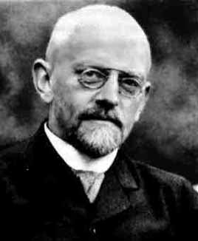
Hilbert's programme:
To establish the foundations of mathematics, in particular by clarifying and justifying use of the infinite:
``The definitive clarification of the nature of the infinite has become necessary, not merely for the special interests of the individual sciences but for the honour of human understanding itself.''
David Hilbert
(1862-1943)
Aimed to reconstitute infinitistic mathematics in terms of a formal system which could be proved (finitistically) consistent, complete and decidable.
Notes:
One of the greats. Prof. at Gottingen.
Significant contributions to geometry, functional analysis, algebra, mathematical physics
1900 speech to International Congress of Mathematicians in Paris was a landmark - 23 problems for the new century, had a great impact on the subsequent development of the field. (e.g. decision procedure for solvability of Diophantine equations resolved negatively in 1970)

Slide 3
Consistent: It should be impossible to derive a contradiction (such as 1=2).
Complete: All true statements should be provable.
Decidable: There should be a (definite, finitary, terminating) procedure for deciding whether or not an arbitrary statement is provable. (The Entscheidungsproblem)
There is the problem. Seek its solution. You can find it by pure reason, for in mathematics there is no ignorabimus.
Wir müssen wissen, wir werden wissen
Notes:
Hilbert was confident that his program was achievable.
Wished to tame the inifinite by concentrating on proofs (which are inherently finite)

Slide 4
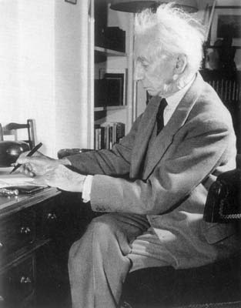
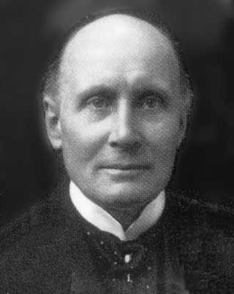
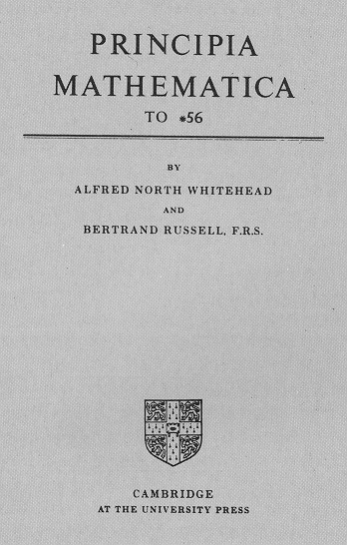
Bertrand Russell
(1872-1970)
Alfred Whitehead
(1861-1947)
Russell's paradox showed inconsistency of naive foundations such as Frege's: {X | X∉X}
  "The set of sets which are not members of themselves"
Theory of Types and Principia Mathematica (1910,1912,1913)
Notes:
Philosopher, logician, essayist, social activist.
Dismissed from Trinity after being convicted of anti-war activities and from City College, New York after public protest and a judgement that he was "morally unfit" for the post.
Logicism - the theorems of mathematics are all reducible to those of logic.
re. PM,it's a monumental achievement. Russell remarks that his intellect "never quite recovered from the strain of writing it" - "I have been ever since definitely less capable of dealing with difficult abstractions than before“
‘next to Aristotle’s Organon, it is the most influential book on logic ever written’
Some disagreement with Hilbert about the precise axioms used (esp. axiom of infinity)
Theory of types leads to important ideas in modern logic and programming language design
Another approach was that of the intuitionists (constructivists) such as Brouwer, who took a much harder line on the validity of proofs based on infinity and the law of the excluded middle. Although intuitionism is not a popular philosophy amongst mathematicians, it has tremendous importance in computer science.

Slide 5
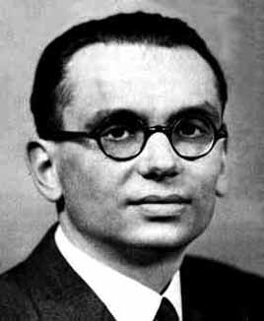
Kurt Gödel
(1906-1978)
Uber formal unentscheidbare Sätze der Principia Mathematica und verwandter Systeme (1931)
Any sufficiently strong, consistent formal system must be
  Incomplete
  Unable to prove its own consistency
Notes:
Born Brno, worked Vienna then Princeton.
This was a significant blow to Hilbert’s programme, but still left open the question of decidability
We’ll come back to Godel’s proof later
Starved himself to death after becoming convinced that he was being poisoned.

Slide 6
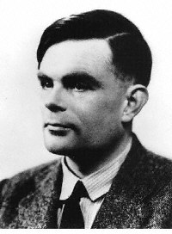
Alan Turing
(1912-1954)
On computable numbers with an application to the Entscheidungsproblem (1936)
Church, Kleene, Post
Notes:
Kings undergraduate and then fellow
Computability theory (this talk)
Artificial intelligence (famous 1950 paper in Mind, Computing Machinery and Intelligence, the Turing test)
Code breaking at Bletchley (Enigma)
Early computers (Bombe,ACE)
Morphogenesis (forerunner of modern non-linear dynamics pdes for growth and form)
Also a world-class distance runner: 2hr46min marathon
Suicide after official persecution (arrest, hormone treatment, loss of clearance) for his homosexuality

Slide 7
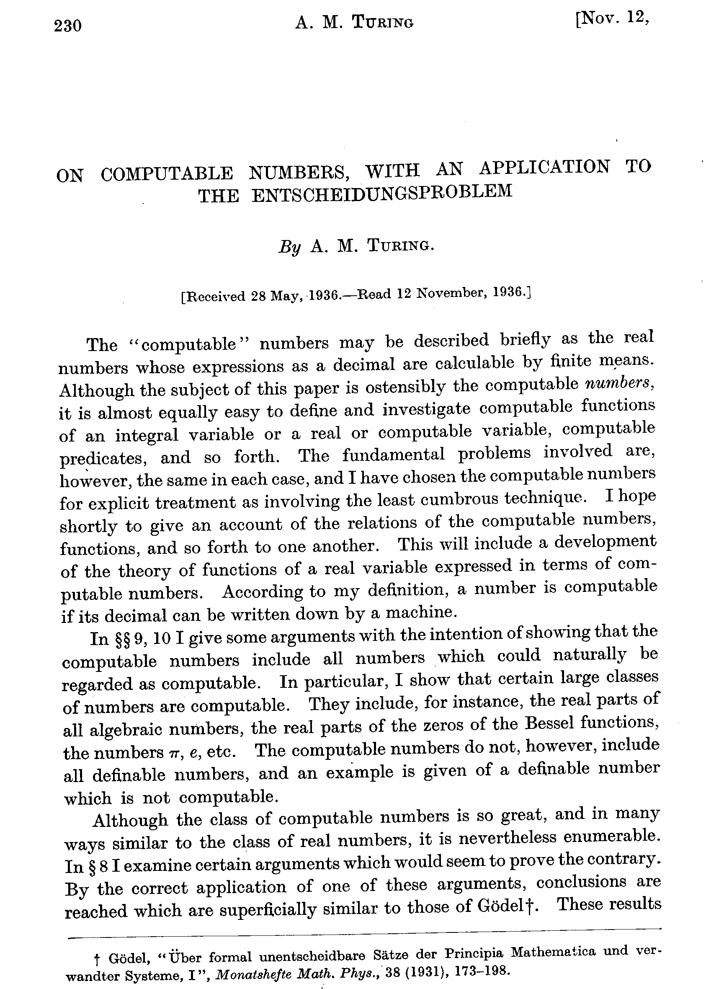
Notes:
In fact, Turing was just beaten to publication by Church – the editors made him revise the paper to cite Church (with whom he went to work at Princeton soon after). Church’s work uses an apparently completely different formulation of computation (actually, the one with which I work…)

Slide 8
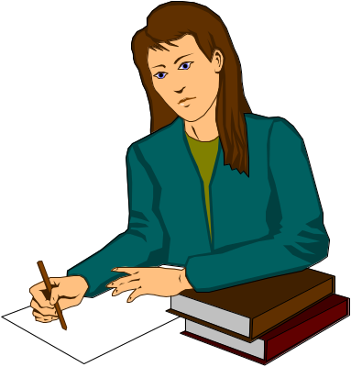

Turing's Model of a Mathematician
⟨x,y,⇒⟩
Finite state brain
Finite alphabet of symbols
Infinite supply of notebooks
⟨y,z,⇐⟩
⟨x,y,⇐⟩
x
Notes:
Could equally well say model of a computer here – remember, all this work was done when computer meant ‘person who computes’
Clear precursor of Turing’s work on AI here too.

Slide 9
The Turing Machine
T
A
C
A
G
C
T
C
G
1
 | - | A | C | G | T
0 | HALT | HALT | HALT | HALT | HALT
1 | -,<=,0 | A,=>,1 | C,=>,1 | G,=>,2 | T,=>,1
2 | -,<=,0 | A,=>,1 | C,<=,3 | G,=>,2 | T,=>,1
3 |  |  |  | T,=>,4
4 |  |  | A,=>,1
Replaces GC with TA
Notes:
This is just one particularly simple TM
Note that I’ve chosen a suggestive alphabet!

Slide 10
The Turing Machine
T
A
C
A
G
C
T
C
G
1
 | - | A | C | G | T
0 | HALT | HALT | HALT | HALT | HALT
1 | -,<=,0 | A,=>,1 | C,=>,1 | G,=>,2 | T,=>,1
2 | -,<=,0 | A,=>,1 | C,<=,3 | G,=>,2 | T,=>,1
3 |  |  |  | T,=>,4
4 |  |  | A,=>,1
Replaces GC with TA

Slide 11
The Turing Machine
T
A
C
A
G
C
T
C
G
1
 | - | A | C | G | T
0 | HALT | HALT | HALT | HALT | HALT
1 | -,<=,0 | A,=>,1 | C,=>,1 | G,=>,2 | T,=>,1
2 | -,<=,0 | A,=>,1 | C,<=,3 | G,=>,2 | T,=>,1
3 |  |  |  | T,=>,4
4 |  |  | A,=>,1
Replaces GC with TA

Slide 12
The Turing Machine
T
A
C
A
G
C
T
C
G
1
 | - | A | C | G | T
0 | HALT | HALT | HALT | HALT | HALT
1 | -,<=,0 | A,=>,1 | C,=>,1 | G,=>,2 | T,=>,1
2 | -,<=,0 | A,=>,1 | C,<=,3 | G,=>,2 | T,=>,1
3 |  |  |  | T,=>,4
4 |  |  | A,=>,1
Replaces GC with TA

Slide 13
The Turing Machine
T
A
C
A
G
C
T
C
G
2
 | - | A | C | G | T
0 | HALT | HALT | HALT | HALT | HALT
1 | -,<=,0 | A,=>,1 | C,=>,1 | G,=>,2 | T,=>,1
2 | -,<=,0 | A,=>,1 | C,<=,3 | G,=>,2 | T,=>,1
3 |  |  |  | T,=>,4
4 |  |  | A,=>,1
Replaces GC with TA

Slide 14
The Turing Machine
T
A
C
A
G
C
T
C
G
2
 | - | A | C | G | T
0 | HALT | HALT | HALT | HALT | HALT
1 | -,<=,0 | A,=>,1 | C,=>,1 | G,=>,2 | T,=>,1
2 | -,<=,0 | A,=>,1 | C,<=,3 | G,=>,2 | T,=>,1
3 |  |  |  | T,=>,4
4 |  |  | A,=>,1
Replaces GC with TA

Slide 15
The Turing Machine
T
A
C
A
G
C
T
C
G
3
 | - | A | C | G | T
0 | HALT | HALT | HALT | HALT | HALT
1 | -,<=,0 | A,=>,1 | C,=>,1 | G,=>,2 | T,=>,1
2 | -,<=,0 | A,=>,1 | C,<=,3 | G,=>,2 | T,=>,1
3 |  |  |  | T,=>,4
4 |  |  | A,=>,1
Replaces GC with TA

Slide 16
The Turing Machine
T
A
C
A
G
C
T
C
G
3
 | - | A | C | G | T
0 | HALT | HALT | HALT | HALT | HALT
1 | -,<=,0 | A,=>,1 | C,=>,1 | G,=>,2 | T,=>,1
2 | -,<=,0 | A,=>,1 | C,<=,3 | G,=>,2 | T,=>,1
3 |  |  |  | T,=>,4
4 |  |  | A,=>,1
Replaces GC with TA

Slide 17
The Turing Machine
T
A
C
A
T
C
T
C
G
4
 | - | A | C | G | T
0 | HALT | HALT | HALT | HALT | HALT
1 | -,<=,0 | A,=>,1 | C,=>,1 | G,=>,2 | T,=>,1
2 | -,<=,0 | A,=>,1 | C,<=,3 | G,=>,2 | T,=>,1
3 |  |  |  | T,=>,4
4 |  |  | A,=>,1
Replaces GC with TA

Slide 18
The Turing Machine
T
A
C
A
T
C
T
C
G
4
 | - | A | C | G | T
0 | HALT | HALT | HALT | HALT | HALT
1 | -,<=,0 | A,=>,1 | C,=>,1 | G,=>,2 | T,=>,1
2 | -,<=,0 | A,=>,1 | C,<=,3 | G,=>,2 | T,=>,1
3 |  |  |  | T,=>,4
4 |  |  | A,=>,1
Replaces GC with TA

Slide 19
The Turing Machine
T
A
C
A
T
A
T
C
G
1
 | - | A | C | G | T
0 | HALT | HALT | HALT | HALT | HALT
1 | -,<=,0 | A,=>,1 | C,=>,1 | G,=>,2 | T,=>,1
2 | -,<=,0 | A,=>,1 | C,<=,3 | G,=>,2 | T,=>,1
3 |  |  |  | T,=>,4
4 |  |  | A,=>,1
Replaces GC with TA

Slide 20
Another example: Binary Addition
Notes:
749 + 106 = 855 (I think)

Slide 21

So particular Turing Machine is specified by
Its alphabet
Its transition table
Each TM then defines a partial function from Tapes to Tapes.
Given a machine M and a tape T, there are two possible things
that can happen when we run machine M on input tape T:
EITHER the machine simply runs forever without stopping, OR
The machine eventually stops with an output tape T’
M
T
T’

Slide 22
Since we can represent natural numbers on the tape (using decimal, binary, roman numerals, whatever), we can write TMs to compute (partial) functions from ℕ to ℕ.
The word function has at least two senses.
Mathematical. A function is a set of pairs, giving all the (argument, result) combinations together. So the ‘square’ function, for example, looks like {(0,0), (1,1), (2,4), (3,9),…}.
Computational. A function is a procedure, method, algorithm, operation, formula for computing the result from the argument. There’s some kind of causal relation between input and output.
Investigating the relationship between these two views (the denotational and the operational) is central to theoretical computer science.
Notes:
Sense 2 actually splits into 2 – there’s a difference between a procedure and a formula

Slide 23

Not all mathematical functions
are computable by a Turing machine. (we’ll see an example soon)
But all other notions of computation which people have invented turn out to give exactly the same set of computable functions.
That this is the essential meaning of ‘computable’ is known as the Church-Turing Hypothesis, though this is clearly not a rigorous notion.

Slide 24
Turing’s first result.
Since a particular TM is specified by a finite amount of information, we can encode it as a finite string of symbols in some alphabet (equivalently as a natural number).
We’ll write ⎡M⎤ for the code of machine M. (the details of the coding scheme are unimportant…)
But we can write ⎡M⎤ onto the tape, so one TM can take as input the code of another one (or even itself).
There is a Universal Turing Machine, U

Slide 25
For any machine M and tapes T and T’
M
T
T’
If and only if
U
⎡M⎤,T
T’
Notes:
Nowadays we’re used to the idea of a computer as a universal machine, that all kinds of things can be reduced to bit patterns and processed by the same computer (computer programs, text, sounds, images, money). But this was a surprising idea in the 30s and it inspired Turing’s later work on real computers. John von Neumann also realised that programs were data in the 1945 EDVAC report.
The universal machine is not outrageously complicated, but it’s a bit too hairy to explain here…

Slide 26
Turing’s second result
The ‘Halting Problem’ is undecidable
There is NO machine H which computes whether or not any other machine will halt on a given input:
M
YES
iff
T
T’
⎡M⎤,T
H
M
NO
iff
T
Notes:
Now the main technical content of this talk: I’ll try to explain the essential idea of Turing’s proof

Slide 27
Proof of the undecidability of the halting problem
We’ll assume that there is such a machine, H, and derive a contradiction.
First, we define a copy machine (this is easy):
COPY
T
T,T

Slide 28
COPY
H
YES
NO
H’
Now modify H so that it goes into a loop instead of printing ‘yes’
…plug the copy machine into the front
…and call the resulting machine H ’
What happens when we feed H’ its own code?

Slide 29
⎡H’⎤, ⎡H’⎤
COPY
H
YES
⎡H’⎤
NO
H’
Machine H’ terminates on input ⎡H’⎤ if and only if
The modified H terminates on input ⎡H’⎤ ,⎡H’⎤ , which happens if and only if
The original H prints ‘no’ on input ⎡H’⎤ ,⎡H’⎤ , which happens if and only if
Machine H’ does not terminate on input ⎡H’⎤
Contradiction!

Slide 30
⎡H’⎤, ⎡H’⎤
COPY
H
YES
⎡H’⎤
NO
H’
Hence our original assumption, that H exists, must be false.
Notes:
Note that the function which takes as input the code for a machine and an input tape and returns yes or no depending on whether that machine halts or not is a perfectly well-defined function in the mathematical sense, but we have shown that no computer program can compute it.
Isn’t that beautiful?

Slide 31
Corollaries of Turing’s result
It’s uncomputable whether an arbitrary machine halts when given an empty initial tape.
In fact, all ‘interesting’ properties of computer programs are uncomputable. For example
  It’s impossible to write a perfect virus checker.
  The `full employment theorem’ for compiler writers.
The Entscheidungsproblem is unsolvable:
  Roughly, because ‘Turing machine M halts on tape T’ is expressible as a logical formula which, if true, will be provable (because it only requires a finite demonstration). Hence if there were a decision procedure for the provability of arbitrary propositions, there’d be one for the halting problem.
  This is the ‘full employment theorem’ for mathematicians.
Notes:
Impossibility of perfect virus checkers, etc. shouldn’t make you panic – it *is* quite possible to write conservative approximations, e.g. a virus checker which reliably detects all viruses but which also rejects some harmless programs.

Slide 32
Further developments of Turing’s work
Complexity theory.
  From ‘what can we compute?’ to `how fast can we compute?’. Turing machines are still a basic concept in this huge area of computer science.
Higher-type recursion theory and synthetic domain theory.
  Once we add types, the notion of computable becomes rather more subtle. Developments in this area have led to ‘mathematical universes’ in which computability is built-in from the start, and these have been proposed as good places in which to model and reason about computer programs.
Notes:
For some reason, complexity theory is more an American than a European field these days
SDT is pretty esoteric, but it’s local, fascinating and there’s a line Turing – Gandy – Hyland
Busy Beaver problem is of no use, but still attracts considerable interest!
It’s been suggested that analogue computation offers a way of computing the non-computable, but it’s not clear that it’s even theoretically realisable

Slide 33
Other developments
Philosophy and Artificial Intelligence
  Implications of Gödel’s and Turing’s work for the philosophy of mind and the possibility of ‘thinking machines’ are still hotly debated. See for example Roger Penrose’s The Emperor’s New Mind and Shadows of the Mind.
Really crazy stuff…
  DNA and restriction enzyme implementation of TMs
  It has been suggested that one could compute the uncomputable by sending computers through wormholes in space so that they run for an infinite amount of time in a finite amount of the observer’s time ☺.
Notes:
Much of the Penrose et al debate is bad tempered and ill-informed “Why are academic arguments so ferocious? Because there’s so little at stake”
Of course, Turing himself was very interested in such questions, and there’s quite a sub-argument about what he himself really thought.

Slide 34
Proof of Gödel's Incompleteness Theorem.
One can encode the propositions and rules of inference of a formal system as natural numbers, so that statements about the system become statements about arithmetic.
Thus, if the system is sufficiently powerful to prove things about arithmetic, it can talk (indirectly) about itself.
The key idea is then to construct a proposition P which, under this interpretation, asserts
P is not provable
Then P must be true (for if P were false, P would be provable and hence, by consistency, true - a contradiction!)
So P is true and unprovable, i.e. the system is incomplete.
Notes:
Do this slide if there’s time.
Note that this relies on a similar kind of self-reference as Turing’s proof. The trick is known as diagonalisation and is originally due to Cantor.

Slide 35
Further Reading
Popular
  Alice’s Adventures in Wonderland and Through the Looking Glass (And What Alice Found There). Lewis Carroll.
  Godel, Escher, Bach: an Eternal Golden Braid. Douglas R. Hofstadter (Basic Books,1979)
  Alan Turing: the Enigma. Andrew Hodges (1983)
    http://www.turing.org.uk/
  To Mock a Mockingbird and What is the Name of this Book?. Raymond Smullyan
Academic
  The Undecidable: Basic papers on undecidable propositions, unsolvable problems and computable functions. Martin Davis (Raven Press,1965)
  From Frege to Gödel: A Sourcebook in Mathematical Logic. J. van Heijenoort (Harvard,1967)
Notes:
Alice in Wonderland is the best book on programming for the layman. But that’s because Alice in Wonderland is the best book on anything for the layman (Alan Perlis)
Hofstadter’s book won the Pulitzer Prize. It’s a bit pretentious but enjoyable.
Hodge’s book is very good. Became the play and film Breaking the Code starring Derek Jacobi which actually does a good job of explaining the mathematics too.
The two academic books collect together most of the classic original papers.
And VISIT BLETCHLEY before it becomes a theme park

