Slide 1
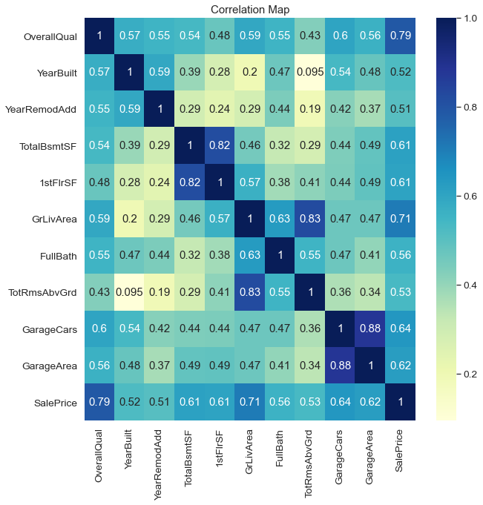
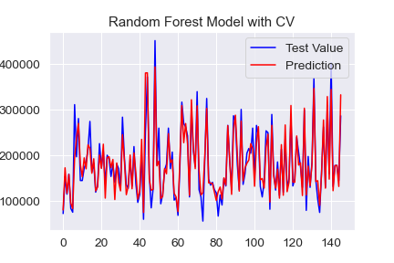
Daniel

Slide 2
Comparison
Model | Training R² | Testing R² | MSE | Accuracy | No. Features
Lasso | 0.834 | 0.865 | 0.145 |  | 15
OLS |  |  |  |  | 33
Random Forest | 0.978 | 0.867 | 729555657.23 |  | 10
Random Forest CV | 0.917 | 0.883 | 654125368.41 | 89.55% | 10
Simple OLS | 0.618 | 0.686 | 1814796444.73 |  | 1

Slide 3
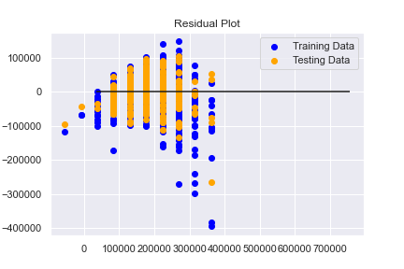
Simple Model
Model Type | Training R² | Testing R² | MSE
Single Feature OLS | 0.618 | 0.686 | 1814796444.73

