Slide 1

New York Census Dashboard
Daniel Bradley, Nate Berman & Peter Shapiro

Slide 2
Overall Objective
Create a tool to help analyze various data sets that make up the various counties in New York. This tool can be used to help others draw their own conclusions

Slide 3
Research Questions
Where in NY is obesity most prevalent?
Choropleth Map
How is population correlated with income.
Interactive Time Series
What is the population make-up of each county?
Pie Chart

Slide 4
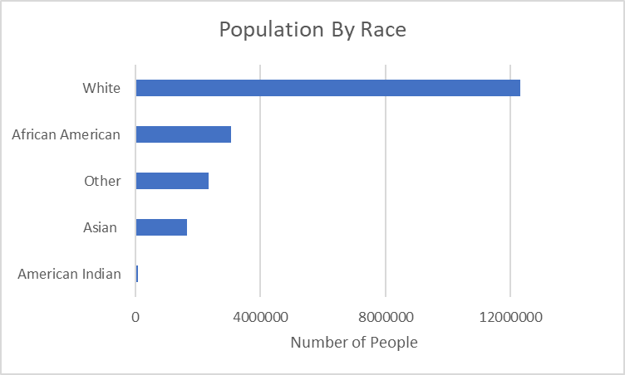
The Population Makeup Of Each County

Slide 5
Data Used
US Census (financial data)
https://data.census.gov/cedsci/
NY - Race by County (population data)
https://data.census.gov/cedsci/table?q=race&hidePreview=true&tid=ACSSE2018.K200201&vintage=2018&tp=true&moe=false&g=0400000US36.050000
NY - Community Health Indicator Reports (CHIRS)
https://health.data.ny.gov/Health/Community-Health-Indicator-Reports-CHIRS-Latest-Da/54ci-sdfi

