Slide 1
Better Analytics with R and RStudio
Mar 1, 2020

Slide 2
Overview
Why use R (vs Excel)?
What is R?
What is RStudio?
Data processing tutorial + practice
Plotting intro + practice
Advanced plotting examples
Shiny demo (time permitting)

Slide 3
Challenges with Using Excel
Readability
Error Prone
Version Control
Interpreting someone else’s Excel files can be a challenge.
Particularly when they contain complex functions that are difficult to reverse engineer.
Formula and calculation errors can be hard to identify.
Version control features and lacking or under utilized.
Notes to yourself or other users is limited as well.

Slide 4
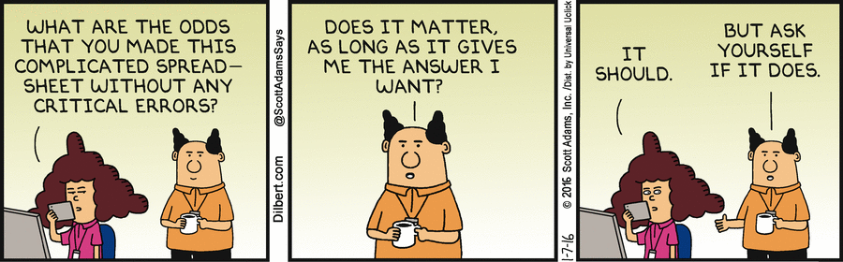
Figuring Out Someone’s Excel Sheet

Slide 5
Excel Functions are Very Hard to Parse
Who has seen an abomination like this thing?
=IF($F$10=”Y”,(IF($C$9=0,”$0.00?,IF($C$9<113,’Revenues & Costs’!$B$3,IF($C$9<281, (‘Revenues & Costs’!$C$3),IF($C$9<451,($C$9*’Revenues & Costs’!$D$3),IF($C$9<851, ($C$9*’Revenues & Costs’!$E$3),IF($C$9<1201,($C$9*’Revenues & Costs’!$F$3), IF($C$9>1201,($C$9*’Revenues & Costs’!$G$3)))))))))*2, IF($C$9=0,”$0.00?, IF($C$9<113,’Revenues & Costs’!$B$3,IF($C$9<281,(‘Revenues & Costs’!$C$3),IF($C$9<451, ($C$9*’Revenues & Costs’!$D$3),IF($C$9<851,($C$9*’Revenues & Costs’!$E$3),IF($C$9<1201, ($C$9*’Revenues & Costs’!$F$3),IF($C$9>1201,($C$9*’Revenues & Costs’!$G$3)))))))))+ IF($C$11=1,0,($C$11*10)*$C$12*’Revenues & Costs’!$B$5)+($F$7*’Revenues & Costs’!$B$6)

Slide 6
Mistakes Can be Easy to Miss, and Expensive
Fidelity investments missed a minus sign and made a $2.6B calculation error, forcing the cancelation of dividend payments to customers.
The 2012 London Olympics oversold thousands of tickets due to an single cell being off.
Barclay’s used an excel sheet as a list of contracts to buy, but hid rather than deleted the ones they didn’t want to buy. The court ruled they had to pay for them anyway.
JP Morgan was hit with $6.5B in losses and fines when a copy/paste error underestimated the downside of a synthetic portfolio.
AstraZeneca mistakenly released highly confidential finance information to external analysts due to template error.
Harvard economists produced pro-austerity research with significant excel calculation errors that affected budget decisions for several countries from 2010-2012.

Slide 7
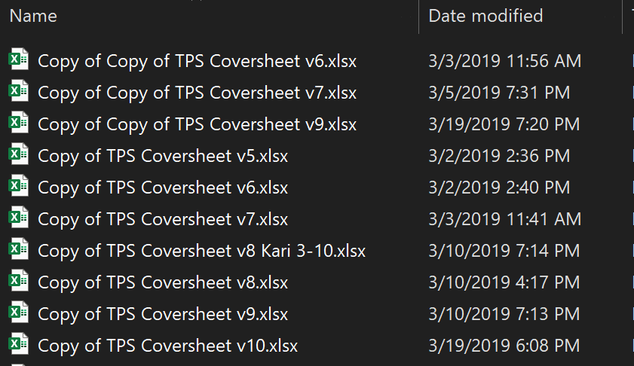
Excel’s Version Control is Lacking
Version control depends on external tools.
Email chains, and file_ver_2.xlsx don’t make for reliable version controls.
No consistent or standard way to leave notes or guidance to future users (yourself included).

Slide 8

Opening a Spreadsheet from Last Year

Slide 9
There must be a better way!

Slide 10
What is R? What is RStudio?
R is:
Free, open source software
Built specifically with statistics and data analytics in mind
The most robust data visualization solution
Thousands of packages to help with general to weirdly specific tasks
Strong community of users
RStudio is:
Front end user interface for R
Easily import data from a variety of sources
Built in help tools
Frameworks for reporting, sharing and visualizing data and analytics
Free for individuals with enterprise support options

Slide 11
But I can’t write code!

Slide 12
Actually, You Already Do
Function | Excel Formula | R Code
Column Sum | =SUM(column) | sum(dataframe$column)
If Statement | =IF(test, true, false) | ifelse(test, true, false)
Min/Max | =MIN(data)/=MAX(data) | min(data)/max(data)
Count | =COUNT(data) | count(data)
Combine Tables | =VLOOKUP(table, source, target, exact) | left_join(table1, table2, key)
Any Excel formula will have an equivalent in R, but the reverse is not the case.

Slide 13
The “Tidy Data” Structure
R uses what is called “Tidy Data”
A common data structure is required
Universal and easily shareable
Standardized data formatting (for everything other than Excel)
Requirements:
Each variable must have its own column.
Each observation must have its own row.
Each value must have its own cell.

Slide 14
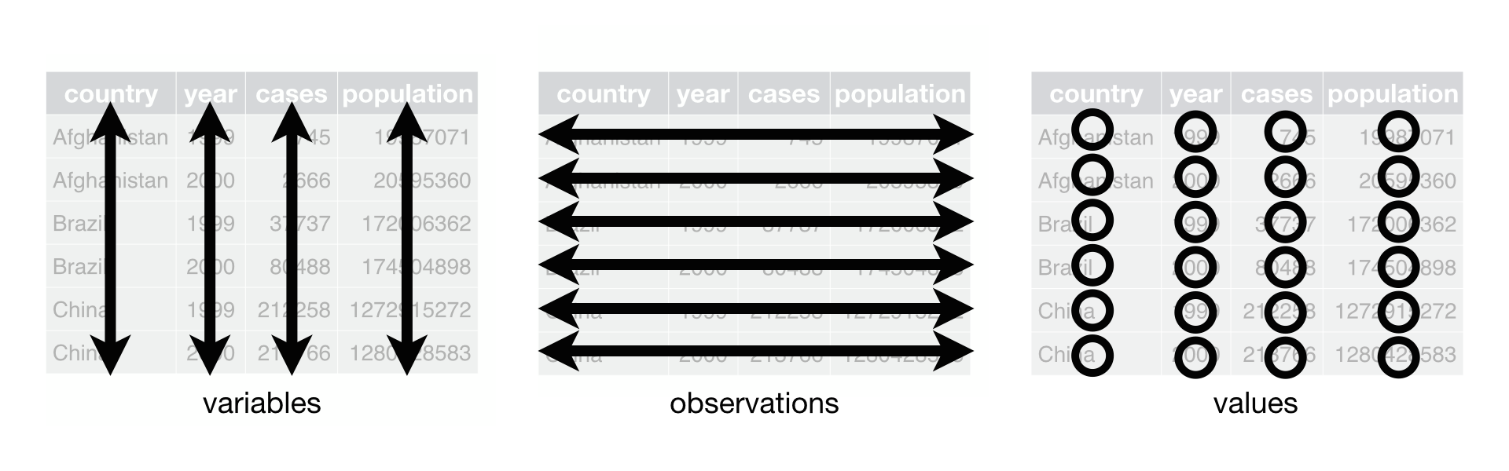
Tidy Data

Slide 15
R 101
Notes:
Switch over to RStudio and go through the R basics tutorial section

Slide 16
Basic R Practice Problems
Load the video game sales data into R.
Look at the head and tail of the dataframe.
What is the mean sales in North America? Which game did the best and the worst?
What are the different platforms in this dataset?
How many unique publishers are there?

Slide 17

The Tidyverse
Group of R packages for data science
Developed by Hadley Wickam and RStudio
Very clear, concise syntax
Import
Clean
Manipulate
Model
Visualize
Report

Slide 18
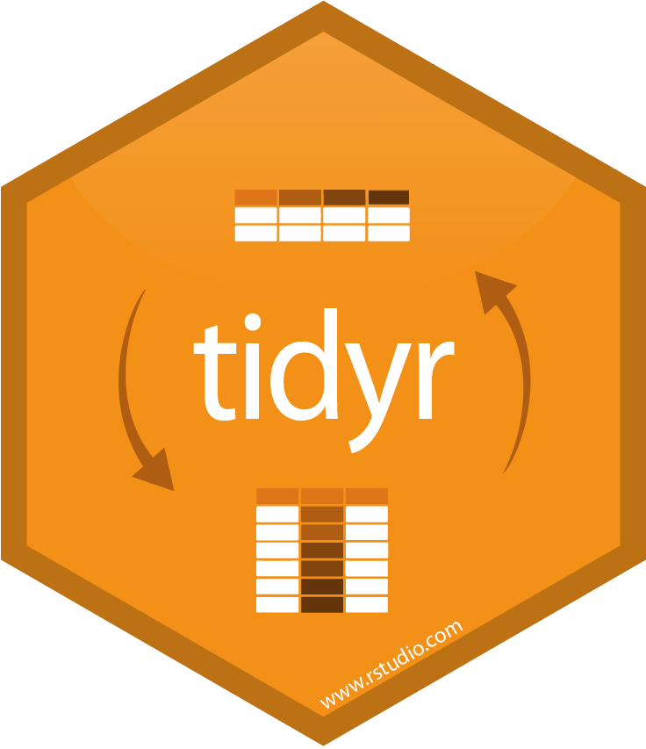
tidyr - The Data Cleanup Maestro
Part of the tidyverse
Clean up messy data
Spread out or gather up columns
Handle missing data
Split cells into multiple columns or rows

Slide 19
tidyr demo

Slide 20

dplyr - The Data Manipulation Workhorse
Part of the tidyverse
Group, aggregate and cluster
Filter, slice or sample
Summarize
Create new variables
Join or append multiple datasets

Slide 21
dplyr - The Pipe Operator aka %>%
Improves overall readability and usability
Automatically loaded with tidyr or dplyr
Executes functions sequentially
Output of a function is the input of the next function
Eliminates nested functions
Nested:
funC(funB(funA(data)))
Piped:
data %>%
funA() %>%
funB() %>%
funC()

Slide 22
dplyr example
>filter() selects a portion of the dataset
>group_by() groups the data
>summarize() performs operations on grouped data
>mutate() creates new columns
sales_data %>%
filter(Date >= “2020-01-01”) %>%
group_by(GSC, Region) %>%
summarize(Tot_Sales = sum(Sales),
Tot_Quant = sum(Quantity)) %>%
mutate(Net_Price = Tot_Sales / Tot_Quant)

Slide 23
dplyr demo

Slide 24
dplyr and tidyr practice
What are total sales by Year? By Year and Region?
Which Genre has the highest sales?
Since 2010, which Publisher has the highest sales?
Which Publisher has been the most successful in each Region?
Challenge:
Find the games that were released on more than one platform. On how many platforms was it released? On which did it sell the best?
Hint: look into arrange(), slice() and n_distinct() functions

Slide 25

ggplot2 - ‘Grammar of Graphics’
Easily plot tidy data
Highly customizable plots
Huge array of available visualizations
Popular for professional data visualizations
“Opinionated”

Slide 26
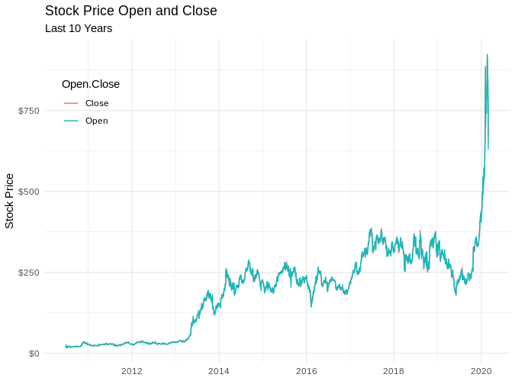
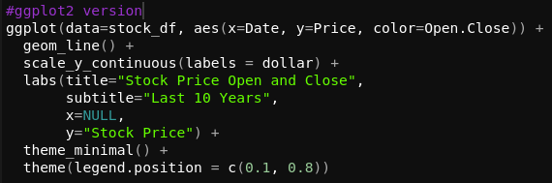
ggplot2 example

Slide 27

Plotly - Interactive Visualizations
Open source data visualization
Straightforward syntax
Interactive elements
Great for dashboards, exploratory analysis
Cross platform

Slide 28
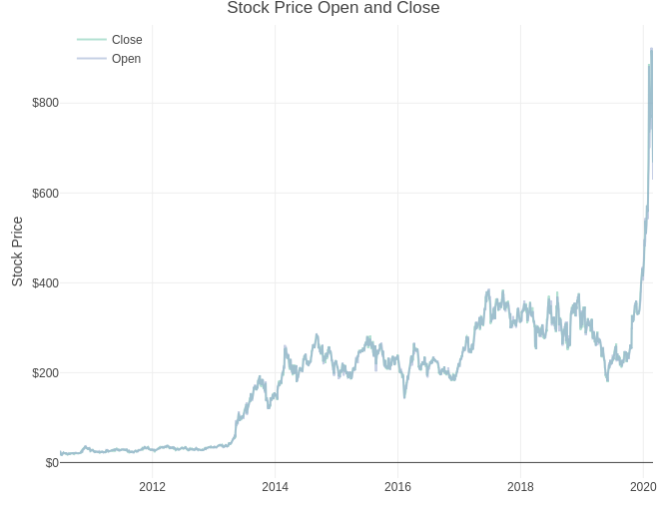
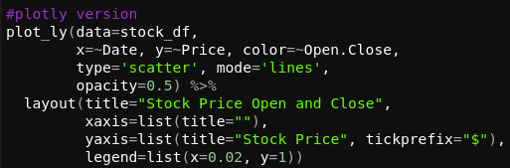
Plotly Example

Slide 29
Plotly and ggplot2 Practice
With the ‘diamonds’ dataset, make a scatter plot of carat vs price and colored by clarity
With ‘diamonds’ make a box plot carat on y, cut on x. (Break out by color for extra practice)
Add axis labels and titles to one of the previous charts. (You can use the stock charts above as a reference)
With ‘diamonds’ make any chart you’d like, but incorporate some sort of faceting.
Challenge:
Convert the ‘UCBAdmissions’ dataset to a data frame (like with Titanic). Create a visualization that shows the number of students admitted or rejected by gender and department.

Slide 30
Advanced Plotting Demos
Pareto Plot
Parallel Coordinates / Sankey Plot
Funnel Diagram
Treemap
Waterfall chart
Sunburst

Slide 31
Additional Resources
R for Data Science: https://r4ds.had.co.nz/
ggplot2 reference: https://ggplot2.tidyverse.org/
ggplot2 extensions: http://www.ggplot2-exts.org/gallery/
The R graph gallery: https://www.r-graph-gallery.com/index.html
Plotly: https://plot.ly/r/
Shiny: https://shiny.rstudio.com/

