Slide 1

MT-3001 Graph Theory Project
21K-4523 Nabiha Rajani
21K-4899 Asad Tariq
21K-3455 Fatima Ashraf
Instructor: Engr. Usama Antuley

Slide 2
Dijkstra’s Algorithm and Google Maps
Based on the research paper:
Lanning, D. R., Harrell, G. K., & Wang, J. (2014). Dijkstra’s algorithm and Google maps. Proceedings of the 2014 ACM Southeast Regional Conference on - ACM SE ’14. doi:10.1145/2638404.2638494

Slide 3
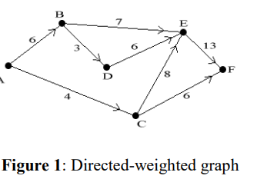
Dijkstra’s Algorithm Review
Formulated by computer scientist Edger Dijkstra in 1956.
Used to find the shortest path between two nodes in a graph.
Nodes (vertices) and arcs (ordered pairs of nodes).
Calculates the shortest path from a starting node to a finishing node.
Arcs are labelled with weights
Weights can represent various factors, not necessarily measuring distance.
Designed for graphs with nonnegative weights.
Applicable to various scenarios where finding the shortest path is crucial.

Slide 4
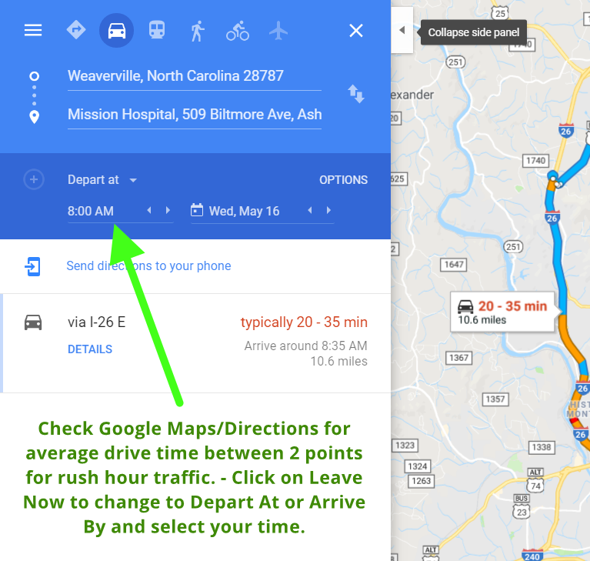
Factors In Calculating Weights
The weights are just arbitrary numbers.
Traffic flow, prices, and scheduling all can be optimized through Dijkstra’s Algorithm.
Besides the routing aspect, Dijkstra’s Algorithm can be used in currency exchange, operational scheduling, traffic planning, etc.

Slide 5
Digital Maps and Pathfinding with Dijkstra’s Algorithm
Google Maps functionality can be understood through a simplified example.
Nodes in this context represent intersections, and arcs represent streets on a small scale.
Dijkstra's Algorithm can find the shortest distance from the starting point to the destination in this scenario.
In the case of Google Maps, the algorithm provides information on the shortest route in terms of both distance and time.
Scaling up, cities become nodes, and interstates become arcs in a larger scenario.
Dijkstra's Algorithm, as well as Google Maps, is capable of finding the shortest path and/or shortest time between cities on a larger scale.
Google Maps has many features, but in the context of pathfinding algorithms we will be keeping in mind directions and transit

Slide 6

GOOGLE MAPS
The implementation can produce directions for different ways of transportation, from driving to biking and walking.
Google Maps has even implemented the best routes for truckers that minimize the number of right turns.
This was all possible due to Dijkstra’s Algorithm.
Google Maps is going further with mapping.
We now have street views of locations and satellite imagery

Slide 7

OPTICAL NETWORK
WDM is a technology used in fiber-optic communication
In WDM, multiple channels of data (each on a different wavelength) can be transmitted simultaneously over a single optical fiber.
The physical infrastructure is represented as a graph.
nodes correspond to network elements (such as routers or switches)
The edges represent the optical fibers connecting these elements.

Slide 8
The edge weights represent maximum available bandwidth.
Dijkstra's algorithm is used to find the shortest path from a source node to all other nodes in the network based on the weights assigned to the edges.
The shortest path used to establish a lightpath.
Lightpath is a dedicated wavelength channel between the source and destination nodes.
WDM networks often face changing traffic patterns and network conditions.
The algorithm can be periodically re-run to adapt to these changes

Slide 9
In an EON, the lanes(optical spectrum) can be of different sizes
These to carry varying amounts of data(frequency slots).
Dijkstra algorithm finds the shortest route
It makes sure the lanes along the way are big enough to handle the amount of data you want to send.
EON can adapt to changes, if some lanes are busy, new ones open up.
Dijkstra's algorithm can be used again to adjust your route based on these changes
So, your data gets to its destination quickly and efficiently.

Slide 10
AUTOMATED GUIDED VEHICLES
AGVs are autonomous vehicles used in industrial applications to transport materials within a facility.
The environment in which AGVs operate is represented as a graph, where locations that AGVs visit are nodes.
The paths between these locations are edges.
Edge weights represent factors such as distance, energy consumption, or time required to traverse a particular path.
Dijkstra algorithm finds efficient path from a starting point to a destination, considering the weights.

Slide 11
If the AGV is electric and energy efficiency is crucial, the weights could represent energy consumption.
In a dynamic environment, the graph might change over time.
For AGVs, this could happen when the load they carry changes, affecting their weight and energy consumption
. Dijkstra's algorithm can be adapted to handle these changes dynamically
It recalculates the optimal paths based on the updated weights.

Slide 12

BIOINFORMATICS COMPARISON OF BIOLOGICAL SEQUENCES
In bioinformatics, the comparison of biological sequences, such as DNA and RNA is a fundamental task.
The sequences are represented as graphs,
Each node corresponds to a position in the sequence.
The edges represent possible alignments.
The weights of the edges are assigned based on the similarity or dissimilarity between the elements.
A lower weight indicates a better alignment.

Slide 13
Dijkstra's algorithm can be used to find the optimal alignment between two sequences, revealing the similarity and dissimilarity
Homology Detection:
The algorithm identifies homologous genes or proteins by aligning their sequences. Homologous sequences share a common ancestry and often have similar functions.
Phylogenetic Analysis:
By aligning sequences from different species, Dijkstra's algorithm contributes to phylogenetic analysis
It helps scientists to understand the evolutionary relationships between organisms.

Slide 14
References
https://www.irjet.net/archives/V7/i11/IRJET-V7I11200.pdf
Mount, D. W. (2004). "Bioinformatics: Sequence and Genome Analysis." Cold Spring Harbor Laboratory Press.
S. Kim, H. Jin, M. Seo and D. Har, "Optimal Path Planning of Automated Guided Vehicle using Dijkstra Algorithm under Dynamic Conditions”

