Slide 1
Address Book
CIS634 Software Engineering Project Presentation
Bhanu Prasad Neerukonda – 2815052
Abhinav Krishna Kommineni – 2811582
Venkatesh Arla – 2826613
Shashi Preetham Ganta - 2829023

Slide 2
BRIEF
This project involved creating an address book site using Django, a python framework. The user can signup himself on the site and can create a contact or access the existing contacts that user created. The user can keep track of contact details such as phone number, email-ID, address, etc. of user’s friends, family, colleagues, and others.
Features of site include:
Login : The user can login using email and password.
Add/Delete a contact : Can add or delete an existing contact.
Edit a contact : Open the contact card and edit the details using a form.
Search contact by name : The user can search his contacts using name.
Add a picture to the contact : Add a picture to the contact card.
Export the contacts of the user to a CSV file.
The site uses SQLite database to store the data and retrieve.

Slide 3
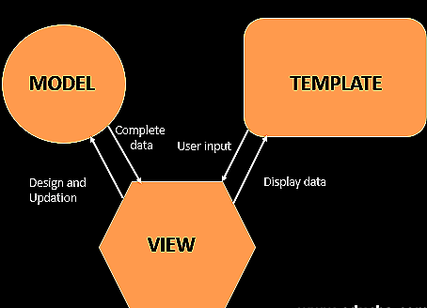
Software Architecture
The architecture used in the project is MVT (Model View Template) which is similar to MVC (Model View Controller)
Model: The model is going to act as the interface of your data. It is responsible for maintaining data. It is the logical data structure behind the entire application and is represented by a database (generally relational databases such as MySQL, Postgres)
View: The View is the user interface — what you see in your browser when you render a website. It is represented by HTML/CSS/Javascript.
Template: A template consists of static parts of the desired HTML output as well as some special syntax describing how dynamic content will be inserted.

Slide 4
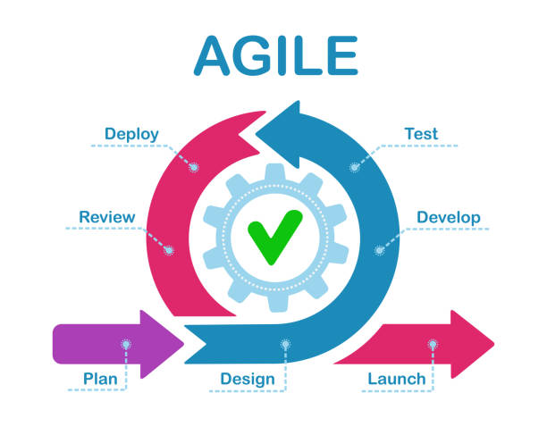
SDLC
We followed Agile methodology to complete the project with a sprint duration of one week.
We as a team had sprint meetings every week and have discussed, planned and implemented the features of the site

Slide 5
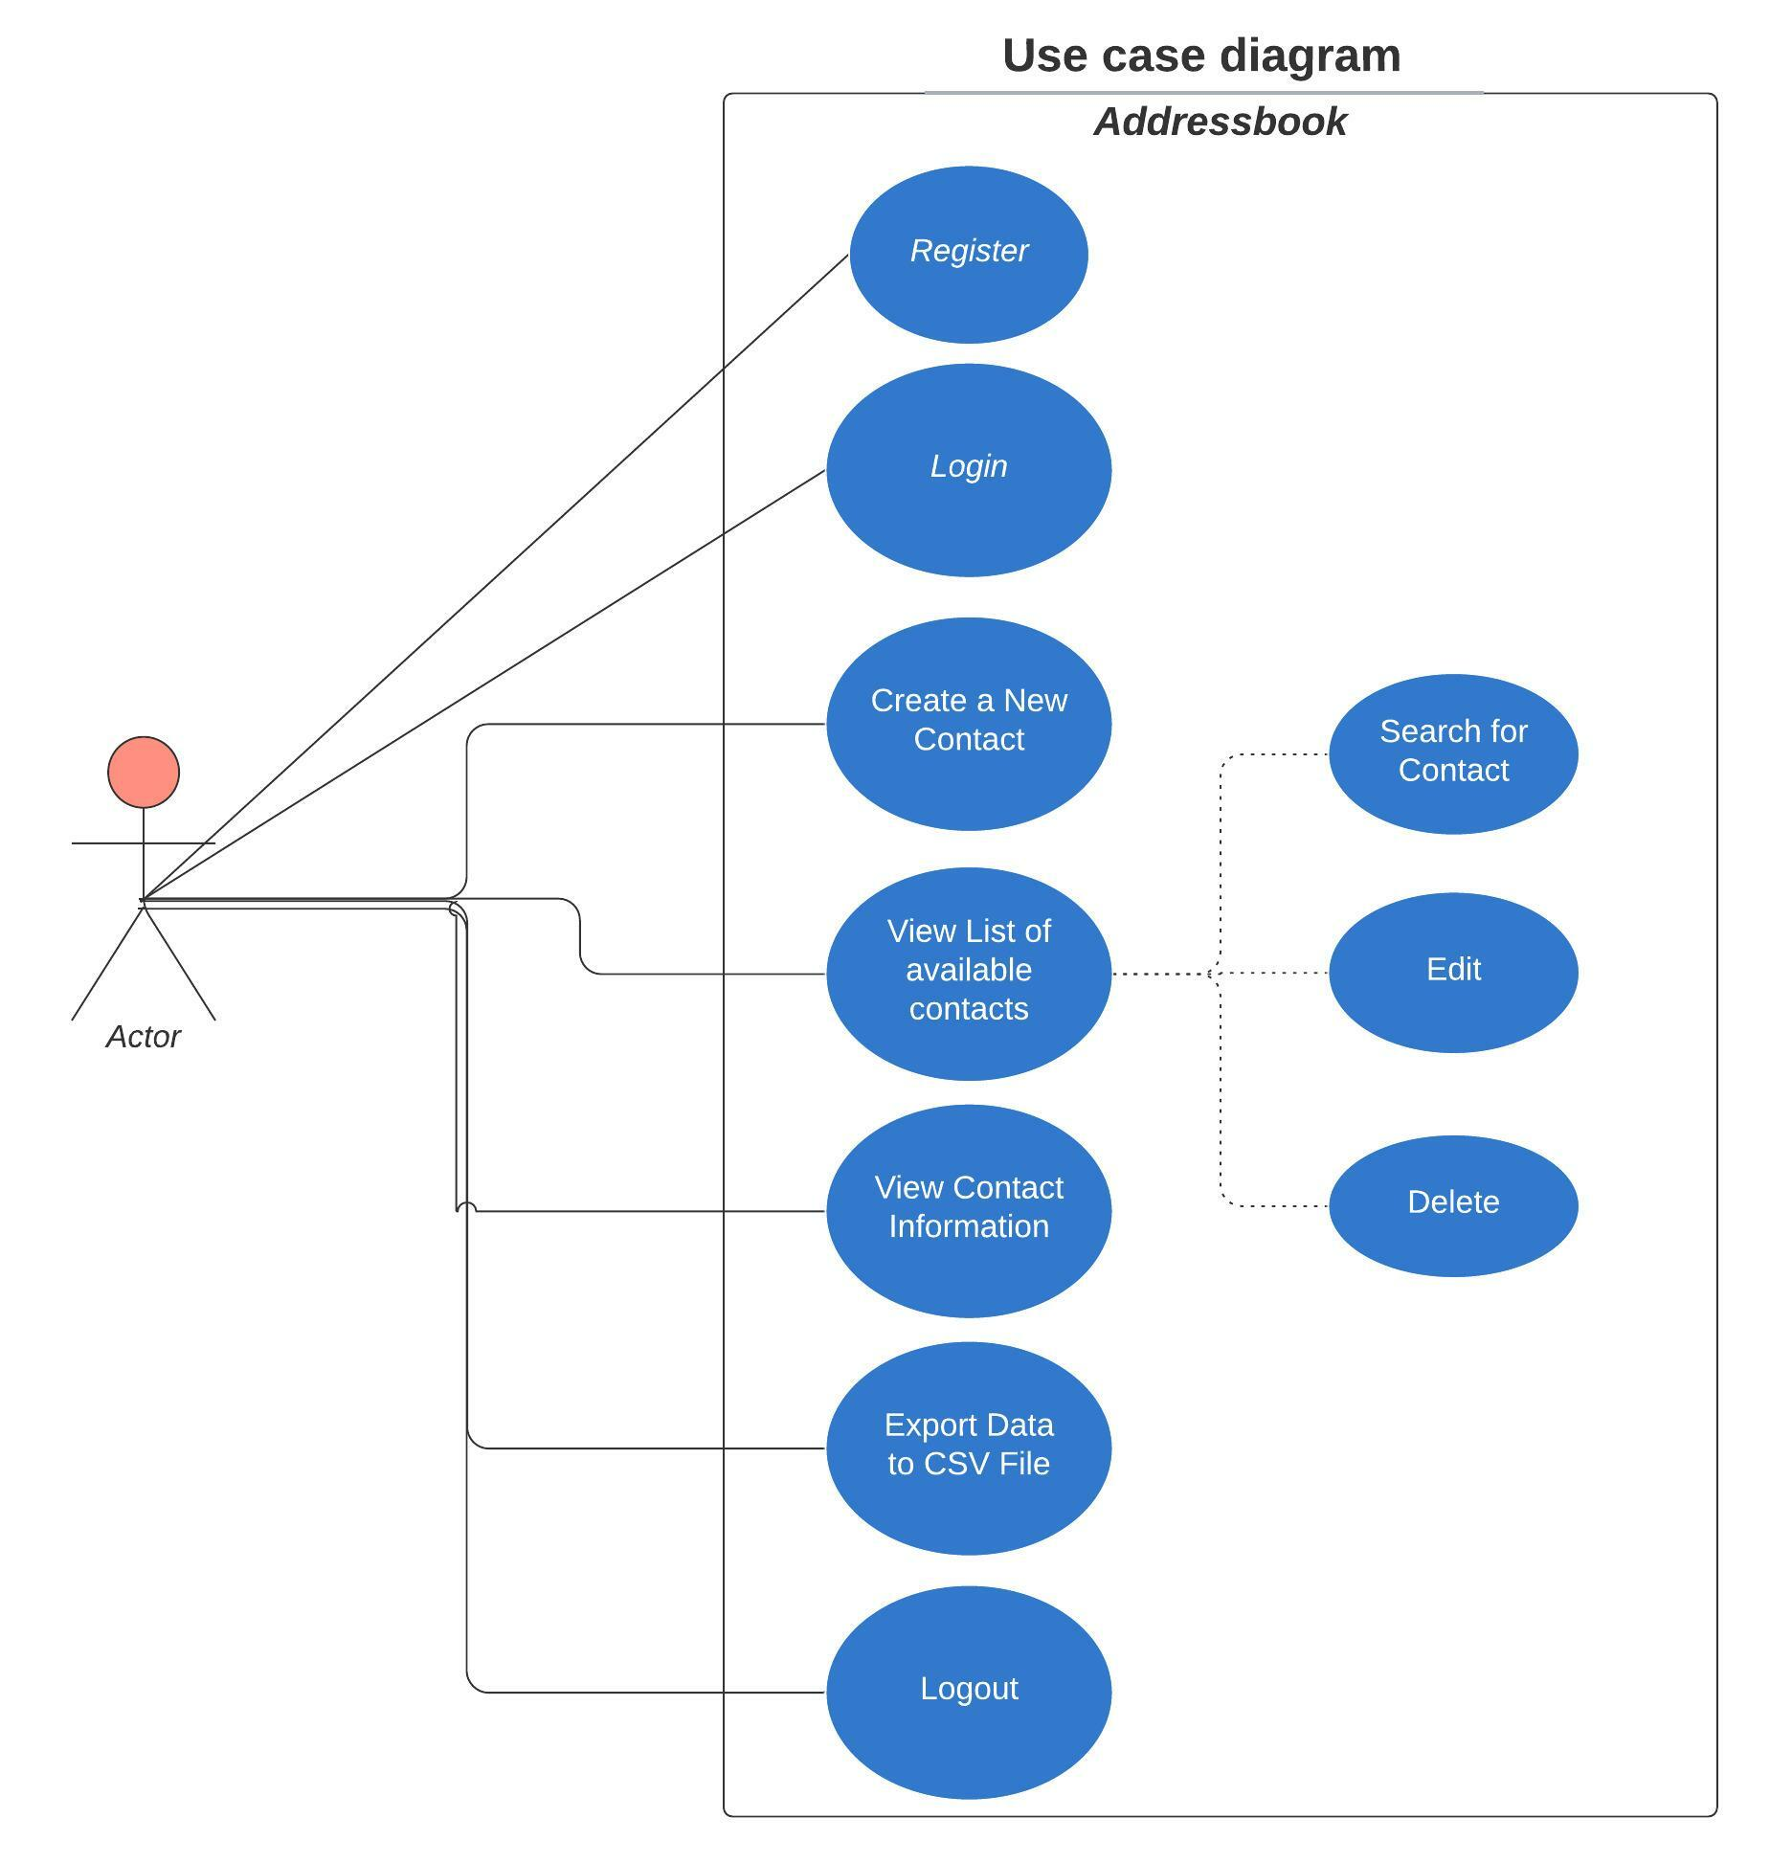
USE CASE

Slide 6
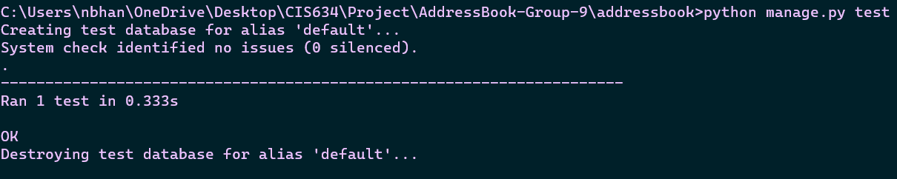
Testing
We used Django framework’s inbuilt testing libraries to test the functionality of the application.
It uses unittest module built-in to the Python standard library
We have developed test case to test the functionality of our database.
It can be used by using the following command in the terminal ‘python manage.py test’

Slide 7
Thank You

