Slide 1


NBHS
FEEDBACK
THAT MOVES
LEARNING
Effective Feedback • Student Ownership • ASPEN
Students should know where they are, what is working, and what they need to do next.
Padlet
Classroom feedback and an up-to-date gradebook should tell the same story.
Notes:
FACILITATOR — 1 minute
Welcome staff. Emphasize that this is one schoolwide message being used across all departments. Frame ASPEN as part of the feedback system—not a separate compliance topic.

Slide 2
Today: one shared language for feedback
The goal is consistency for students across every classroom.
Recognize
what makes feedback useful to students
1
Practice
turning vague comments into actionable next steps
2
Match
the feedback method to the need
3
4
Connect
classroom feedback to an accurate, current ASPEN gradebook
Notes:
FACILITATOR — 2 minutes
Review the four outcomes quickly. Tell participants the session is intentionally practical: they will evaluate examples, revise feedback, and check their own ASPEN gradebook.

Slide 3
Padlet
Question 1: Would this help you improve?
At your table: decide whether each comment gives a student a usable next step.
A: “Good job!”
B: “Check #4.”
?
?
C. “Your claim is clear. Now explain how the evidence proves it.”
D. “82%”
?
?
E. “You need more detail.”
F: “Your setup is correct. Recheck the sign before solving.”
?
?
Key question: Could the student do something different or better because of this feedback?
Notes:
FACILITATOR — 4 minutes
Give tables 60–90 seconds to discuss. Then ask for quick reactions. Do not over-discuss every card. Land on the key idea: feedback is useful only when students can act on it.

Slide 4
Effective feedback has four qualities
It does not need to be long—but it should move the learning forward.
⏱
◎
→
↔
TIMELY
SPECIFIC
ACTIONABLE
CONNECTED
Close enough to the learning that the student can still use it.
Names what is working or what needs attention.
Gives the student a clear next step.
Links to the learning goal, skill, criteria, rubric, or standard.
Praise has value. Feedback changes the work.
“You worked hard on this.” ≠ “Your evidence is strong; now explain how it supports your claim.”
Notes:
FACILITATOR — 4 minutes
Walk through the four qualities. Make the distinction between praise and feedback without devaluing encouragement. The aim is for students to understand what is working and what to do next.

Slide 5
Feedback does not always look the same
Padlet
Question 2: Choose the method that gives the student the clearest, most efficient information.
IN-THE-MOMENT VERBAL
Quick correction, prompt, or question during learning
“Your setup is right. Recheck the sign.”
WRITTEN
One or two high-leverage comments on student work
“Add evidence here, then explain why it matters.”
WHOLE-CLASS
Address a common misconception efficiently
“Many of us are quoting evidence without analyzing it.”
PEER-TO-PEER
Students use clear criteria to respond to one another
2 rubric criteria before submitting
SELF-FEEDBACK
Students assess their own work against criteria
Highlight where you met the success criteria
ASPEN / GRADEBOOK
Communicates current evidence of learning over time
Clear assignment + current grade/status
Notes:
FACILITATOR — 4 minutes
Emphasize that individual written feedback is only one form. Sometimes whole-class feedback is stronger and more efficient. Briefly invite one example from the department of where they already use a different mode effectively.

Slide 6
Match the feedback to the need
Padlet
Efficiency matters. The goal is not more comments—it is more useful information.
Question 3: Choose one scenario. What feedback move did you use—or would you use—in your classroom?
ONE STUDENT
IS STUCK
MANY STUDENTS
SHARE A MISCONCEPTION
WORK IS STILL
IN PROGRESS
QUALITY CRITERIA
ARE CLEAR
PROGRESS OVER
TIME
→
→
→
→
Individual prompt
or conference
Whole-class
feedback + model
Verbal / written
next step
Peer or self
feedback
ASPEN + current
evidence
One misconception repeated 15 times does not require 15 identical written comments.
Notes:
FACILITATOR — 3 minutes
Move quickly. This slide reinforces efficiency. Use the example: if many students have the same misconception, stop and provide targeted whole-class feedback rather than repeating the same comment on every paper.

Slide 7
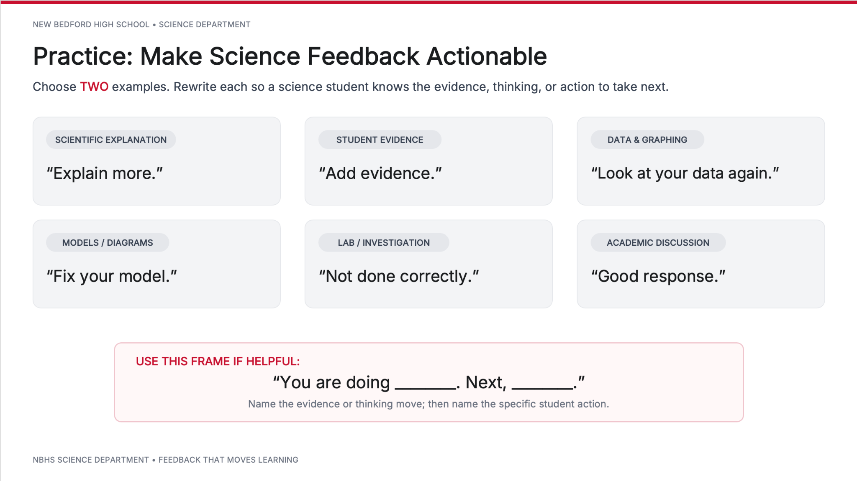
Padlet
Notes:
FACILITATOR — 7 minutes
Create dept slide and don’t show this one
Tables select any two examples and rewrite them. Encourage content-specific language from the department. After 4–5 minutes, ask two tables to share one revision each. Listen for timely, specific, actionable, and connected feedback.

Slide 8
Possible stronger versions
Notice: the feedback points to the next move without doing the thinking for the student.
ELA
You selected strong evidence. Now explain what the author’s word choice reveals.
MATH
Your equation is set up correctly. Recheck where you distributed the negative sign.
SCIENCE
You identified the pattern. Use the collision model to explain why it happened.
HISTORY
You identified one cause. Add a second piece of evidence to support your argument.
CTE / TECH
Your measurement is accurate. Check the alignment against the specifications before continuing.
ART / PE
Your technique is consistent. Identify one adjustment that would improve control / impact.
World Languages
You’re answering accurately. Now challenge yourself to answer in a complete sentence in (target language) before switching to English.
Notes:
FACILITATOR — 4 minutes
Add World Languages
Reveal examples only after participants have done the work. These are not “the answers.” Invite participants to compare their versions to the four qualities and identify what makes the stronger examples actionable.

Slide 9
Feedback should release the thinking back to students
Do not “fix” the work for them. Point them toward the thinking they need to do.
FEEDBACK THAT TAKES OVER
FEEDBACK THAT RETURNS THE WORK
“Change your sentence to:
The evidence demonstrates that…”
“Your evidence is strong. Explain how it proves your claim.”
Teacher does the revision.
Student copies the thinking.
Teacher identifies the leverage point.
Student does the thinking.
Notes:
FACILITATOR — 3 minutes
Connect this to the schoolwide instructional focus: students should be released to do the learning and the thinking. Strong feedback identifies the leverage point without completing the work for the student.

Slide 10
ASPEN is part of the feedback system
An updated gradebook helps students and families see the same story we are telling in class.
TEACHER
FEEDBACK
ASPEN
UPDATED
LEARNING
EVIDENCE
STUDENT
ACTION
NEXT
DECISION
If ASPEN is weeks behind, students are making decisions with old information.
Notes:
FACILITATOR — 3 minutes
Make the bridge explicit: ASPEN is not separate from feedback. It is one place students and families look for evidence of current progress. An outdated gradebook communicates outdated information.

Slide 11

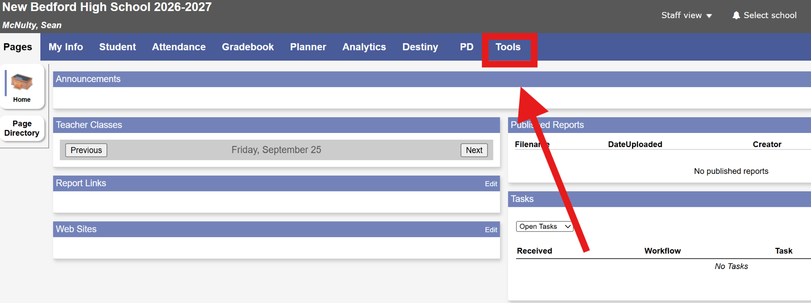
How to create special codes
Standardizing gradebook codes across NBHS
Step 1: Login to Aspen
Step 2: On the homepage of Aspen, navigate to the “Tools” option
Step 3: Click “Special Codes” on the left column
Step 4: Under special codes, click the “option” button and then choose “add”
NEW BEDFORD HIGH SCHOOL • FEEDBACK THAT MOVES LEARNING
ROW 200

Slide 12
How to create special codes
Standardizing gradebook codes across NBHS
Step 4: Under special codes, click the “option” button and then choose “add”
Step 5: On the homepage of Aspen, navigate to the “Tools” option
Step 3: Click “Special Codes” on the left column
NEW BEDFORD HIGH SCHOOL • FEEDBACK THAT MOVES LEARNING
ROW 200

Slide 13
Grading Codes
Standardized gradebook entries and their calculation rules in ASPEN
Abs
E
M
Absent
Excused
Missing Grade
NOT EXEMPT
from calculation
EXEMPT
from calculation
NOT EXEMPT
from calculation
Student was absent for the assessment and needs to complete it.
Assignment is excused and does not impact the overall grade calculation.
Work was not turned in when due and currently counts against the average.
NEW BEDFORD HIGH SCHOOL • FEEDBACK THAT MOVES LEARNING
ROW 200

Slide 14
Two gradebooks. Two different messages.
What can the student accurately conclude from each one?
CURRENT + CLEAR
STALE + UNCLEAR
DATE
ASSIGNMENT
GRADE
DATE
ASSIGNMENT
GRADE
9/8
Quiz: Linear Functions
84
9/8
Quiz
84
9/10
Practice: Graphing
MISSING
9/10
Assignment
—
9/12
Problem Set #2
92
9/12
Assignment
—
9/15
Retake: Quiz
91
9/15
Quiz
—
9/18
Exit Ticket
88
9/18
Exit Ticket
—
Which one helps a student answer: “Where am I? What needs my attention?”
Notes:
FACILITATOR — 3 minutes
Ask participants to name what is different: clear assignment names, missing work identified, retake reflected, current evidence entered. Avoid turning this into a debate about one grading practice; focus on clarity and currency.

Slide 15
Gradebook check
Open ASPEN. Look at your gradebook through the eyes of a student or family member.
Can I tell what I have completed?
Can I tell what is missing?
Does my current grade reflect current evidence?
Are there assignments waiting to be entered?
Are assignment titles clear enough to understand?
Are revisions / retakes reflected when appropriate?
Take one concrete action now: enter, correct, clarify, or identify what you need to update next.
Notes:
FACILITATOR — 3 minutes
Participants should actually open ASPEN. Give them quiet time to scan one course/section and identify one concrete action. The expectation is reflection and accuracy—not public sharing of grades.

Slide 16
What students should experience across NBHS
1
I know what quality looks like.
2
I receive feedback that is specific enough to use.
3
I am expected to act on feedback—not just receive it.
4
My teacher uses the most efficient feedback method for the need.
5
ASPEN gives me a current, understandable picture of my progress.
Notes:
FACILITATOR — 2 minutes
Close the content by naming the shared student experience. These are schoolwide expectations, even though feedback will look different by discipline.

Slide 17
One shift…
Padlet
Small, visible changes create a more useful feedback system for students.
MY FEEDBACK SHIFT
MY ASPEN ACTION
Tomorrow, one change I will make to the way I provide feedback is…
One action I need to take in ASPEN is…
Notes:
FACILITATOR — 2 minutes
Ask participants to jot both commitments. They may share with a partner if time allows. End on the throughline: feedback and ASPEN should tell students the same current story about their learning.

