Slide 1
SCIENCE DEPARTMENT PLC • MONDAY, OCTOBER 26, 2026 • 41 MINUTES
Experience the Writing Benchmark
as a Student
TODAY’S OUTCOME
A completed benchmark, task analysis, color-coded CER, and anticipated student responses.
Use the attached Biology HS-LS2-1 benchmark as a shared model: complete it, analyze the texts and visuals, color-code the CER, and anticipate how students may respond.
Shared model: Biology Benchmark #1 asks students to use a fruit-fly population graph and food web to explain carrying capacity and write a Claim–Evidence–Reasoning response.
Lesson Internalization Tool: Every Day Questions 1, 3, and 4; Team Deep Dive Steps 2–4.
01

Slide 2

One Benchmark, One Coherent Learning Cycle
0:00–3:00 • 3 MIN
The Biology benchmark is a shared model. Every course team applies the same instructional moves to an appropriate standard, article, data display, investigation, or constructed-response task.
MONDAY
Experience + analyze
Complete the benchmark, annotate sources, color-code CER, and anticipate responses.
TUESDAY
Plan for learning
Build the lesson arc, access, facilitation, and feedback from Monday’s evidence.
WED. PD
Teach the routine
Model CUBS and color-coded CER as student-facing science literacy supports.
FRIDAY
Read student work
Analyze completed writing, give written feedback, and identify the next step.
MASTERY
Respond precisely
Choose a targeted next learning experience and evidence check.
→
→
→
→
Instructional focus: the task and evidence guide the conversation. Do not rank students, teachers, courses, or sections; avoid broad reteach plans.
02

Slide 3
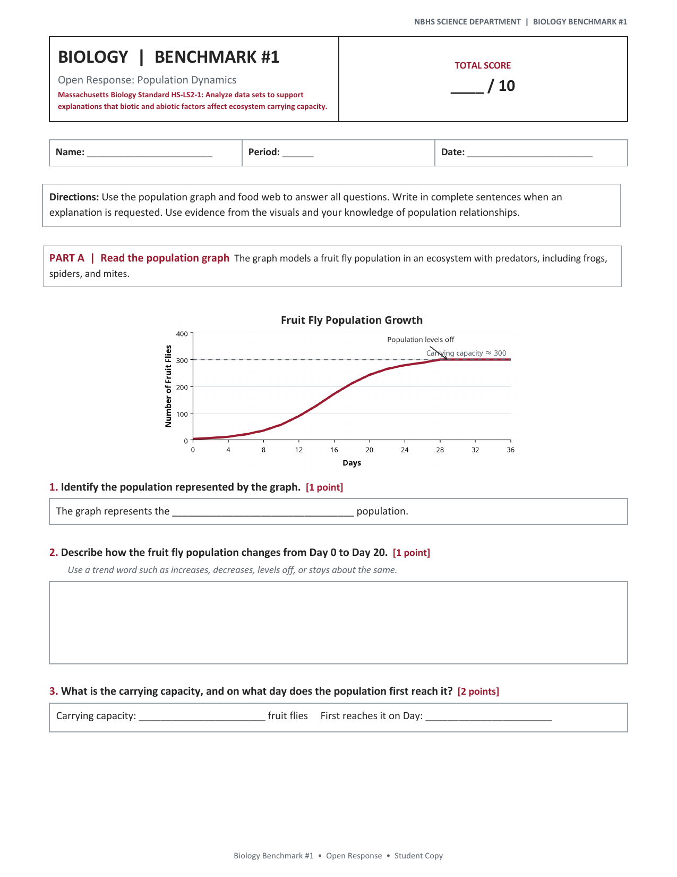
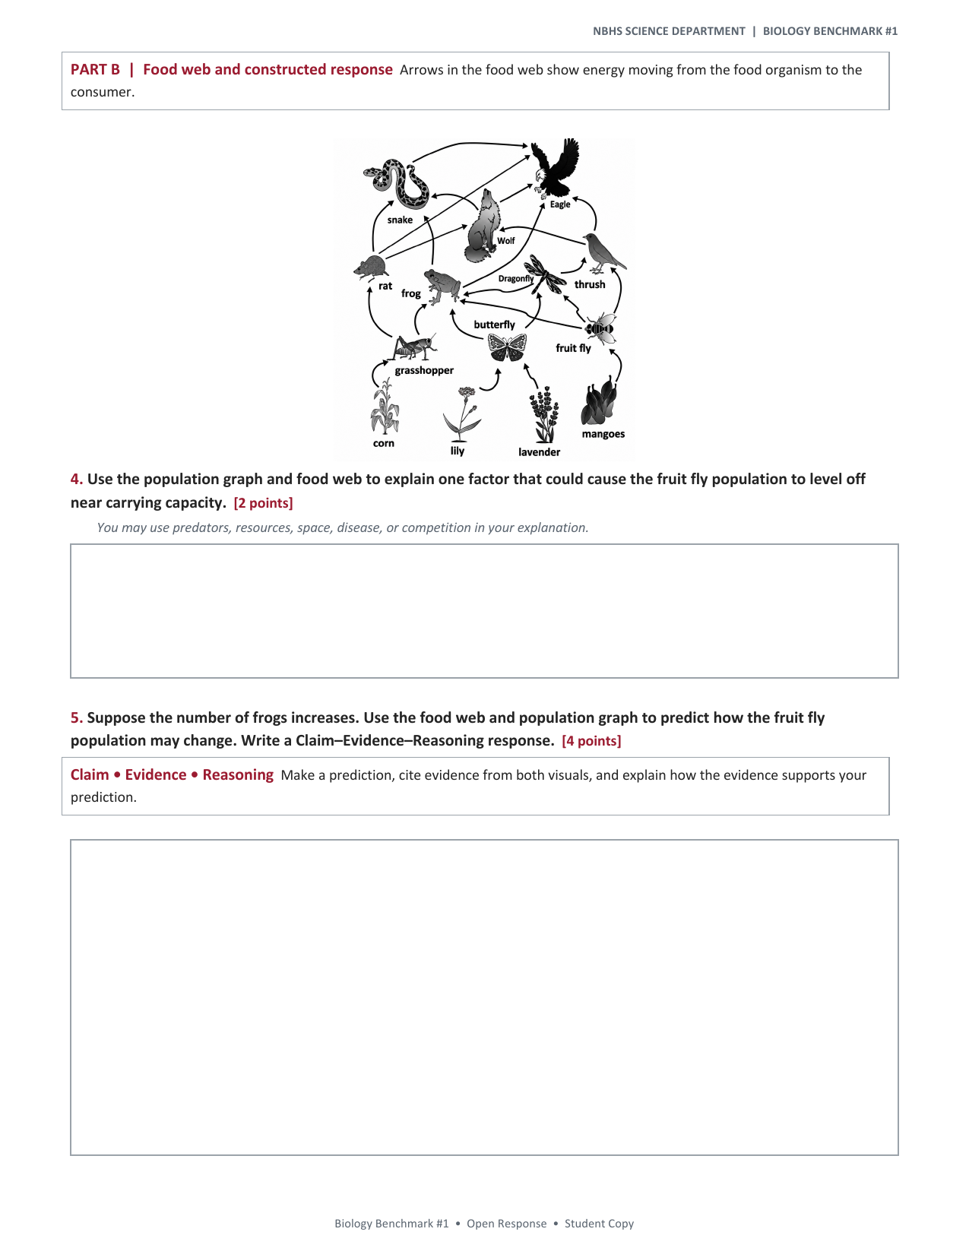
Complete the Benchmark as a Student
3:00–17:00 • 14 MIN
Work silently and independently first. Respond to the attached Biology Benchmark #1 exactly as a student would; other course teams notice the transferable task demands they will apply to their own task.
WORK AS A STUDENT
Read the graph and food web.
Answer all five questions.
Write the CER for Question 5.
Transfer: the shared model is Biology; each science team will apply this same experience-and-analyze move to its own standards-aligned task.
03

Slide 4
Analyze the Task, Texts, and Visuals With CUBS
17:00–24:00 • 7 MIN
CUBS is a brief student-facing way to slow down the source analysis before writing. Use the graph, food web, and Question 5 prompt to notice what the response must draw on.
C — CIRCLE
Circle the main question or central science idea.
What is the task asking students to predict or explain?
U — UNDERLINE
Underline supporting data and relationships.
Which graph trend and food-web evidence could a student use?
B — BOX
Box unfamiliar or high-leverage vocabulary.
For example: carrying capacity, predator, consumer, population.
S — SUMMARIZE
State the science idea the visuals help answer.
Record a question students may still need to resolve.
Reflection prompt: What does this strategy reveal about the reading, visual-analysis, vocabulary, and evidence-selection work students must do before they can write?
04

Slide 5
Color-Code the CER and Anticipate Student Responses
24:00–31:00 • 7 MIN
Use your own Question 5 response or an anticipated response. Color-code the thinking to see what meeting the standard requires and what may be missing or confused for students.
CLAIM
EVIDENCE
REASONING
Complete: answers the prediction with an accurate conclusion.
Anticipate: a vague prediction, an unsupported answer, or a claim that ignores the food-web relationship.
Complete: selects accurate details from the graph and food web.
Anticipate: a detail is copied without relevance, inaccurate, or drawn from only one visual.
Complete: explains why the selected evidence supports the scientific prediction.
Anticipate: evidence is listed but not connected to population relationships or carrying capacity.
Share the reflection: Which mistake reflects a science misconception, a source-analysis need, or a writing/reasoning barrier? What would students need to do next?
05

Slide 6
Reflect With the Lesson Internalization Tool
31:00–39:00 • 8 MIN
1. Every Day Question 1 — What are students learning and how will they show it? Name the standard, prompt, texts/visuals, student product, and clear bar for mastery.
INDIVIDUAL-FIRST REFLECTION
8 min
2. Every Day Question 3 / Deep Dive Steps 2–4 — What might students do? Record one likely complete response, partial response, question, or mistake and why it may occur.
Record your own analysis first. Then share one high-leverage implication with colleagues.
3. Every Day Question 4 — How will students experience the lesson? Identify the access support, facilitation move, and feedback/revision opportunity students need while remaining responsible for the science thinking.
06

Slide 7
CLOSE + CARRY FORWARD • 39:00–41:00 • 2 MIN
Bring the analysis forward. Tuesday turns it into instruction.
BRING
Your completed benchmark or course-equivalent task analysis.
NAME
One anticipated student response, question, or mistake.
HOLD
The standard, mastery bar, and task demand visible.
PLAN
One lesson, access, and feedback decision.
Tuesday: use Monday’s evidence to plan how students will learn, receive feedback, revise, and move toward standard mastery.
07

