Slide 1

NBHS Science Department
Science Literacy · Writing Benchmarks, Success Criteria & Student Evidence

Slide 2
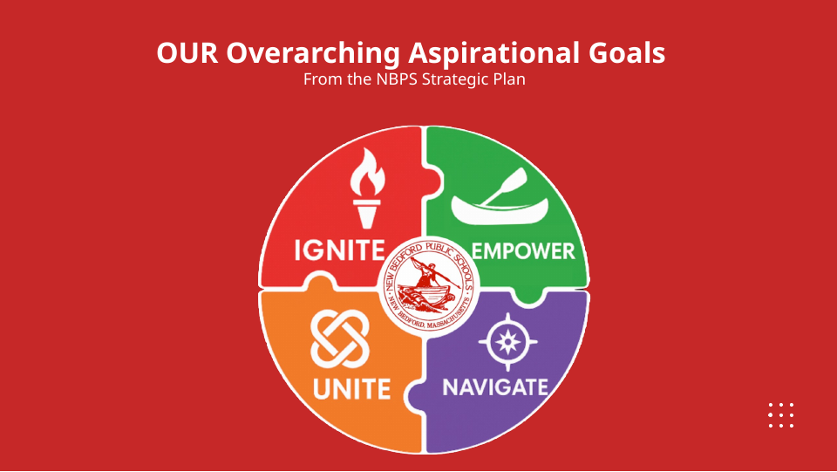

Slide 3
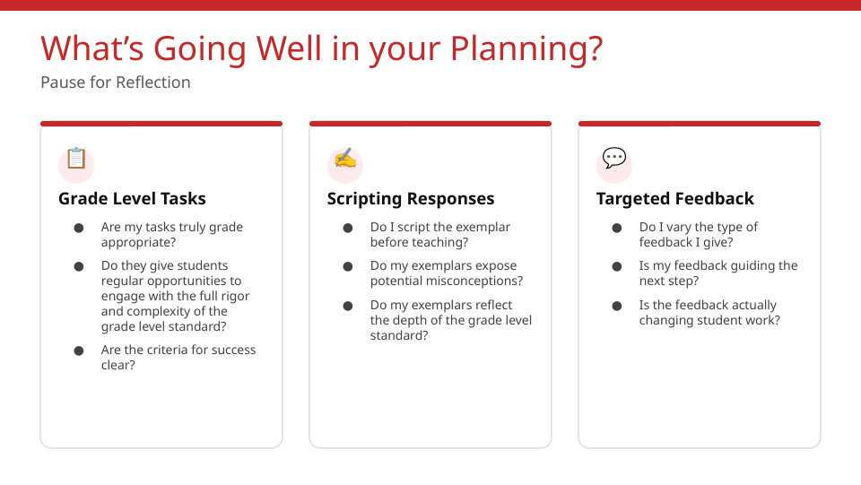

Slide 4


Slide 5


Slide 6
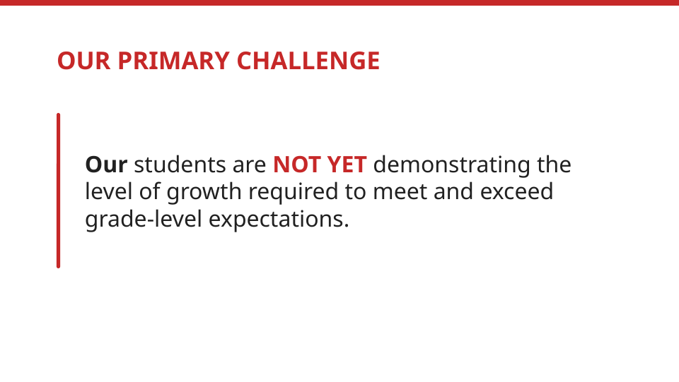

Slide 7
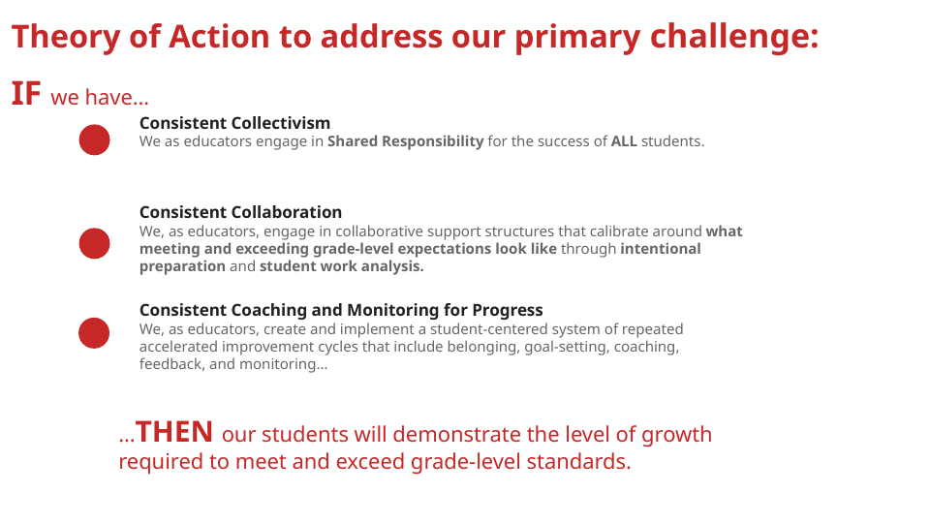

Slide 8
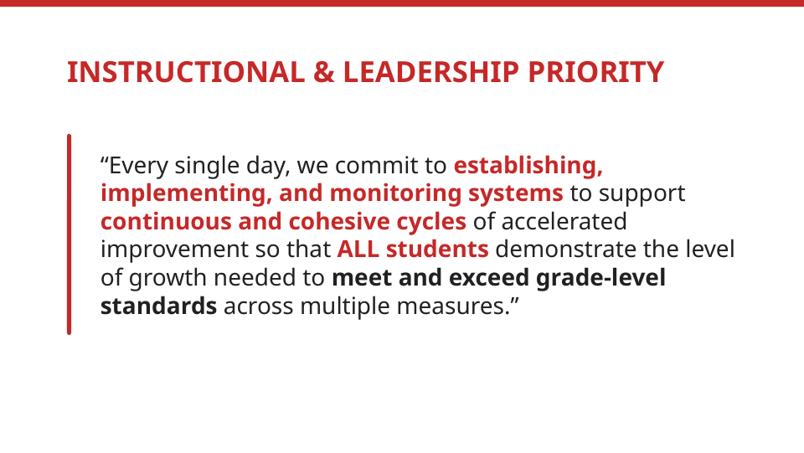

Slide 9
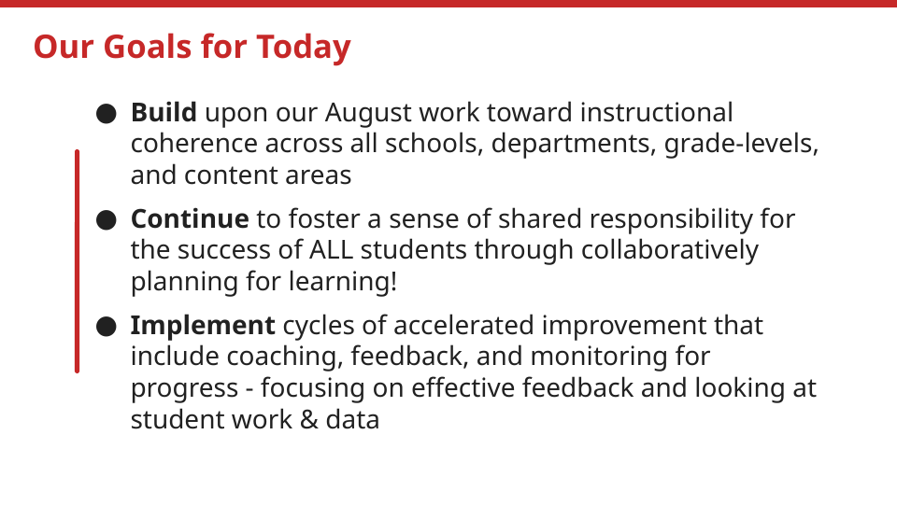

Slide 10
Science Literacy: Our Agenda for Today
Today’s sessions move from a writing benchmark to anticipated student thinking and supports, student-facing success criteria, a ready-to-teach lesson, feedback that prompts action, and a focused evidence check for Friday’s PLC.
ONE WEEK · ONE SCIENCE LITERACY CYCLE
Monday PLC: draft the benchmark → Tuesday PD (today): refine it, write criteria, plan the lesson and feedback → Friday PLC: analyze current student work and adjust the next lesson
Time | Session | Instructional focus
7:30–7:50 | Launch: vision, mission & reflection | Shared purpose and professional collaboration
7:50–8:05 | Reading: why drafting matters, then discussion | Connect the reading to the task and benchmark
8:05–8:35 | Session 1 · refine the benchmark | Clarify what strong independent work shows
8:35–9:15 | Session 2 · anticipate thinking & plan supports | Expected response, likely thinking, and literacy supports
9:15–9:25 | BREAK | Break · 10 minutes
9:25–9:37 | Teacher sharing · how students see quality | Share a strategy and identify student action
9:37–10:10 | Session 3 · success criteria | Write observable, student-friendly indicators
10:10–11:00 | Criteria visible and placed in the lesson | Plan when students will see, use, and revisit criteria
Time | Session | Instructional focus
11:00–12:00 | LUNCH | Lunch · 60 minutes
12:00–12:15 | Re-entry and synthesis | Reconnect the benchmark, criteria, and lesson
12:15–1:05 | Session 4 · ready-to-teach lesson | Embed criteria, literacy supports, checks, and pacing
1:05–1:35 | Session 5 · feedback that prompts action | Name the strength, next step, and student response
1:35–1:45 | BREAK | Break · 10 minutes
1:45–2:05 | Plan student action after feedback | Protect time to revise, explain, model, or practice
2:05–2:30 | Session 6 · Friday evidence and reflection | Select student samples and name the inquiry question
Use the working tool to keep each step connected: benchmark → anticipated thinking → success criteria → lesson plan → feedback → Friday evidence.
NBHS SCIENCE DEPARTMENT · DEPARTMENT AGENDA · SCIENCE LITERACY · NOVEMBER 3, 2026
10

Slide 11
Science Literacy: Our Department Plan
Use the next sessions to turn shared priorities into practical classroom plans: refine a writing benchmark, define success criteria, embed them in an upcoming lesson, and plan feedback that prompts student action.
Focus the work
Create usable products
Keep the real science task, the grade-level standard, and the thinking students must do independently at the center of every decision.
Leave with a writing benchmark, an expected response guide and student-thinking plan, student-facing criteria, a ready-to-teach lesson plan, and a Friday evidence focus.
Our Monday–Tuesday–Friday cycle
When | What teams do | Product
Monday PLC | Select the task, draft the response, anticipate student thinking. | Benchmark draft
Tuesday PD | Refine the benchmark, anticipate student thinking, plan supports, share practice, write criteria, and plan the lesson and feedback. | Five products
Friday PLC | Sort student work, name one learning pattern, plan feedback and the next instruction. | Next evidence check
NBHS SCIENCE DEPARTMENT · SCIENCE LITERACY PLANNING
11

Slide 12
Three Levers We Use While Planning for Learning
These four questions guide everything we do today, in every science course and at every grade level.
Planning question | What the team does
What do we want all students to know and be able to do? | Identify the task or question, the standard, the science and engineering practice, and the language demand.
How will we get them all there? | Plan the launch, the supports, the opportunities for practice, and the protected time for feedback.
How will we know when they all have it? | Name the success criteria, then collect the student work that demonstrates the learning.
What will we do when they don’t? | Anticipate misconceptions and prepare the feedback and instruction that respond to them.
NBHS SCIENCE DEPARTMENT · NBPS THEORY OF ACTION
12

Slide 13
One Coherent Monday–Tuesday–Friday Learning Cycle
Tuesday is not a standalone training day. It is the middle of one improvement cycle built on a real task your team already selected.
1
2
3
4
Monday PLC
Tuesday PD
Wednesday–Thursday
Friday PLC
Selected the task, drafted the writing benchmark, anticipated student thinking.
Refine the benchmark, anticipate student thinking, plan supports, write criteria, plan the lesson.
Teach the lesson, give feedback, protect revision time, collect student work.
Analyze student work, plan feedback, adjust the next learning experience.
Today’s focus: strengthen the target so that Friday’s student work can actually show whether the learning happened.
NBHS SCIENCE DEPARTMENT · DISTRICT PD · NOVEMBER 3, 2026
13

Slide 14
The Five Teacher Products for Today
Every team leaves Tuesday with five connected products. These science-literacy tools make students’ reading, writing, reasoning, and evidence use visible — not separate paperwork.
PRODUCT 1
PRODUCT 2
PRODUCT 3
Refined writing benchmark
Expected response guide & student-thinking plan
Student-facing success criteria
A course-alike example of the explanation, argument, data analysis, model, or lab conclusion students should produce.
Essential response elements, likely strengths and needs, plus the supports students will use.
Three to five observable indicators, strengthened by a peer-shared routine for making quality visible.
PRODUCT 4
PRODUCT 5
Ready-to-teach lesson plan
Friday evidence and reflection record
Planned for Wednesday or Thursday, with feedback, protected thinking time, and time for students to act on the feedback.
The Lesson Internalization reflection, the student samples to bring, and the team commitment with its inquiry question.
All five are captured on one double-sided tool you complete across the day: the Science Literacy Working Tool.
NBHS SCIENCE DEPARTMENT · DISTRICT PD · NOVEMBER 3, 2026
14

Slide 15
Teacher Working Tool — Plan the Next Lesson
One double-sided tool with twelve numbered prompts, completed across the day. Every session has its own prompt, and each prompt names the product it builds. The matching number appears on the session slides.
SIDE A · MORNING · PROMPTS 1–6
SIDE B · AFTERNOON · PROMPTS 7–12
1 · Writing benchmark — the elements of a strong response
2 · Expected response and likely thinking — strengths, needs, evidence
3 · Reading and writing supports — CUBS, color-coded CER, annotation, frames
4 · How students see quality — one routine to share and adapt
5 · Student-facing success criteria — three to five observable indicators
6 · Criteria placed in the lesson — where students meet and use them
7 · What the morning produced — the change and the open question
8 · Ready-to-teach lesson plan — task, strategy, criteria, checks, feedback
9 · Feedback and student action — one moment tied to a criterion
10 · Revision after feedback — what students revise and the evidence
11 · Friday evidence and next step — samples and the evidence question
12 · Reflection and commitment — what worked and what is tried first
Bring the completed tool to Friday’s PLC. Use the student samples and the planning notes to address student needs in reading, writing, and scientific explanation.
NBHS SCIENCE DEPARTMENT · WORKING TOOL · COMPLETED ACROSS TUESDAY’S SESSIONS
15

Slide 16
Full Run of Day · Tuesday, November 3, 2026
Department PD 7:30–11:00 · Lunch 11:00–12:00 · Department PD 12:00–2:30 · two scheduled breaks
Morning · Reflect, draft the response, refine the target
Afternoon · Plan the lesson and the evidence
Time | Block | Output
7:30–7:50 | Launch: vision, mission, theme & reflection | Shared purpose
7:50–8:05 | Professional reading: Drafting a Student Response Matters, then discussion | Shared rationale
8:05–8:35 | Session 1: refine the writing benchmark | Product 1
8:35–9:15 | Session 2: anticipate student thinking and plan supports | Product 2 · response guide
9:15–9:25 | BREAK | —
9:25–9:37 | Teacher sharing: how students see quality | Shared practice
9:37–10:10 | Session 3: write student-facing success criteria | Product 3
10:10–11:00 | Criteria visible and placed in the lesson plan | Lesson draft
Time | Block | Output
12:00–12:15 | Re-entry and synthesis of the morning work | Shared workflow
12:15–1:05 | Session 4: ready-to-teach lesson plan, with criteria and supports embedded | Product 4
1:05–1:35 | Session 5: feedback that prompts student action | Product 4
1:35–1:45 | BREAK | —
1:45–2:05 | Plan the student action after feedback | Revision plan
2:05–2:30 | Session 6: Friday evidence, reflection, commitment | Product 5
The longest blocks are course-alike collaboration. Both breaks are protected, and presentation stays short so teams can plan and calibrate together.
NBHS SCIENCE DEPARTMENT · DISTRICT PD · NOVEMBER 3, 2026
16

Slide 17
Morning Roadmap · 7:30–11:00
Reflect together, draft the response the task requires, refine the benchmark, then write success criteria teams will place directly into the lesson plan.
7:30–7:50
7:50–8:05
8:05–8:35
8:35–9:15
Launch & reflect
Read & discuss
Session 1 · Benchmark
Session 2 · Anticipate thinking
Vision, mission, and theme, then table discussion: what is already going well in your planning?
Professional reading on why drafting a student response matters, then table discussion.
Test the response against the standard and the depth of the task.
Identify likely strengths and needs, then select the reading and writing supports students will use.
9:15–9:25 · BREAK — ten minutes to reset before the success-criteria work.
9:25–9:37
9:37–10:10
10:10–11:00
Teacher sharing
Session 3 · Criteria
Make criteria visible and place them in the lesson
Share how students see quality, name the student action, adapt one move.
Write three to five observable indicators students can use.
Decide how students will see and use the criteria, map where the task, benchmark, and criteria appear in the upcoming lesson, and identify the strength and next step feedback will name.
The longest blocks are course-alike collaboration. Presentation is kept short so teams can plan together.
NBHS SCIENCE DEPARTMENT · DISTRICT PD · NOVEMBER 3, 2026
17

Slide 18
What Makes a Task Worthy of Grade-Level Work?
Test your team’s selected task against this comparison. If the task lowers the demand, revise the task before you plan the lesson.
A worthy grade-level task | Not yet worthy
Requires thinking, reasoning, and evidence | Primarily requires completion
Matches the depth of the standard | Mentions the standard but reduces the rigor
Students make decisions and use academic language in context | The teacher or a template makes the decisions; vocabulary recall substitutes for thinking
Creates productive struggle and makes understanding visible | Breaks the task into so many steps that little thinking remains
NBHS SCIENCE DEPARTMENT · HIGH-QUALITY TASKS · ALL COURSES
18

Slide 19
Why Drafting a Student Response Matters
Drafting the response is not creating a response for students to copy. It is how the team experiences the thinking the task requires before planning instruction, criteria, and feedback.
What drafting the response reveals
How it strengthens the planning work
Clarifies the full depth of the grade-level standard
Reveals the cognitive demand of the task
Identifies the academic language students need
Defines the evidence of learning to look for
Surfaces the partial understandings and misconceptions to plan for
Anticipates misconceptions and productive struggle
Makes success criteria concrete instead of abstract
Prepares feedback that moves learning forward
Protects independent demonstration of learning
Gives course-alike teams an agreed mastery bar to calibrate against
We do not draft responses to make the task easier for students.
Responses are drafted so instruction, success criteria, and feedback are strong enough for students to do the challenging thinking independently.
NBHS SCIENCE DEPARTMENT · WHY DRAFT THE STUDENT RESPONSE · ADAPTED FROM NBPS DISTRICT PD
19

Slide 20
PROFESSIONAL READING · READ BEFORE THE DISCUSSION
WORKING TOOL · PREPARE FOR #1
Why Drafting a Student Response Matters
Drafting a response means experiencing the thinking students will be asked to do. Planning shifts from “What will students do?” to “What will students need to know, understand, and independently demonstrate?”
What drafting clarifies
What drafting strengthens
The full depth of the grade-level standard
The cognitive demand students will meet
The academic language students need, aligned to WIDA standards
The evidence of learning to look for in student work
The misconceptions and productive struggle to plan for
What students must demonstrate independently
Success criteria that make quality concrete
Anticipation of misconceptions and productive struggle
Feedback that advances learning without doing the thinking
Shared calibration of the grade-level standard across course-alike teams
Clear decisions about which supports can be gradually removed
A planning lens that stays open to different valid approaches
Responses are not drafted to make the task easier for students.
They are drafted so instruction, success criteria, and feedback are strong enough for students to do the challenging thinking independently. The benchmark is not a response for students to copy; it stays open to different valid approaches.
NBHS SCIENCE DEPARTMENT · PROFESSIONAL READING · NOVEMBER 3, 2026
20

Slide 21
Read, Discuss, Apply
WORKING TOOL · PREPARE FOR #1
The reading is short and purposeful. The discussion connects it directly to the task selected for this learning cycle, then carries the thinking into Session 1.
READ · 5 MINUTES
DISCUSS · 5 MINUTES
APPLY · 5 MINUTES
Read the article
Compare notes
Carry it into Session 1
Read Drafting a Student Response Matters. Mark one purpose that fits the task students will complete next.
At the table, compare which purposes matter most for this task and what changes in the planning as a result.
Decide what the benchmark must include so success criteria stay specific and feedback advances learning.
Discussion prompts
Which purpose will matter most for this task, and why? Where has drafting a response changed a plan or a lesson? What should the benchmark include so students receive clear criteria and useful, actionable feedback?
NBHS SCIENCE DEPARTMENT · PROFESSIONAL READING DISCUSSION · NOVEMBER 3, 2026
21

Slide 22
Session 1 · Refine the Writing Benchmark
WORKING TOOL · COMPLETE #1
Read Monday’s draft against the standard, not against personal preference. Name what the response must show before you improve the wording.
Test the draft against these demands
Calibration process
Does it meet the full depth of the standard and practice?
Is the science accurate and complete?
Is the evidence or data specific and sufficient?
Is the reasoning explicit rather than implied?
Is the academic vocabulary precise and used in context?
Is the organization clear enough for students to follow?
Could a student produce this independently at grade level?
Silent review: read each draft through the standard.
Gap analysis: what depth or evidence is missing?
Key elements: agree on what earns “meets or exceeds.”
Combine the strongest elements into one course-alike benchmark.
Anchor: if we have not done the thinking the task requires, we cannot recognize evidence of grade-level learning.
NBHS SCIENCE DEPARTMENT · PRODUCT 1 · REFINED WRITING BENCHMARK
22

Slide 23
Session 2 · Anticipate Student Thinking & Plan Supports
WORKING TOOL · COMPLETE #2 AND #3
Element | What to write | Why it matters
Expected response guide | Essential science, evidence, reasoning, vocabulary, and organization the task requires | Defines the target before teaching
Likely strengths | What students may do well and can build on | Starts from what exists
Likely needs | Partial understandings, misconceptions, evidence-selection errors, language demands | Plans support without lowering rigor
Planned supports | CUBS, color-coded CER, annotation, sentence frames, vocabulary support, or an exemplar | Names the support students will use
Working Tool #2, then #3
#2: expected response and likely thinking. #3: select the reading and writing supports students will use.
NBHS SCIENCE DEPARTMENT · PRODUCT 2 · EXPECTED RESPONSE GUIDE & STUDENT-THINKING PLAN
23

Slide 24
Success Criteria: No Secrets to Success
WORKING TOOL · COMPLETE #5
Students should not have to guess what strong work looks like. Criteria make quality visible before students begin, without lowering the demand of the task.
What success criteria are
What they are not
Three to five observable indicators of quality for this task
Written for students, in language they can use while working
Tied to the benchmark, so the exemplar and criteria agree
Connected to the learning objective and the depth of the standard
A tool students use to monitor and strengthen their own work
The learning objective restated in student-friendly words
A list of task steps or directions to follow
Points, percentages, or compliance behaviors
A checklist that replaces student thinking
A scoring guide hidden from students until the work is graded
When criteria are clear and transparent, feedback becomes focused and actionable. Students can name what they did well and what to improve next.
NBHS SCIENCE DEPARTMENT · SUCCESS CRITERIA · SOURCE: NBPS DISTRICT PD
24

Slide 25

Success Criteria in Action
WORKING TOOL · COMPLETE #5
One familiar task shows the difference between a list of directions and true success criteria. The task stays the same; only the transparency of quality changes.
Task and figure
Create a grocery list
Why this matters for science
The original task asked students to use the flyer, choose foods from different categories, record names and prices, total the cost, and stay within $50.
The criteria name observable evidence, not effort or completion.
They stay tied to the task, so students use them while working.
They separate “what to do” from “how well it must be done.”
They make feedback specific, because there is a shared target.
They keep the thinking with students instead of replacing it.
Directions only
“Create a grocery list using the flyer and keep it under $50.” A student cannot tell what quality looks like or where to aim.
Clear success criteria
Now apply the pattern
Foods chosen from protein, fiber, carbohydrate, and treat categories; name and price recorded for each; total cost accurate and within budget.
Translate this to the science task: what observable evidence will show that a written response meets the standard?
NBHS SCIENCE DEPARTMENT · SUCCESS CRITERIA · EXAMPLE: NBPS DISTRICT PD
25

Slide 26
Session 3 · Share, Notice & Write Success Criteria
WORKING TOOL · COMPLETE #4, THEN #5
Begin with teacher expertise already in the room. Share one routine that helps students recognize quality, then adapt an idea for the upcoming science-literacy task.
12-MINUTE PEER-SHARING ACTIVITY · FOUR MINUTES PER STEP
1 · SHARE · 4 MINUTES
2 · NOTICE · 4 MINUTES
3 · ADAPT · 4 MINUTES
Bring one example
Name the student action
Choose one useful move
Describe one way you have helped students see what quality looks like.
Examples: an exemplar, checklist, visual, color coding, discussion, or self-check.
Listen for what students say, do, check, or revise because the criteria are visible.
Name the feature that makes the routine usable for students.
Select one idea that fits your upcoming task. Keep the rigor; adjust the support.
Record it in the Science Literacy Working Tool.
NEXT · 33 MINUTES OF COURSE-ALIKE WORK
Write three to five observable, student-friendly indicators tied directly to the benchmark. Criteria make quality visible; they never replace the intellectual work.
NBHS SCIENCE DEPARTMENT · SUCCESS CRITERIA · PRODUCT 3
26

Slide 27
How Students See and Use the Criteria
Choose one route that fits your task and your students. The criteria must be usable during the work, not only after it.
Through documents
Through models of quality
Through visuals
Rubric with levels of quality
Checklist of requirements
“Did I?” self-check questions
Concise “To be successful, I will…” list
Quality indicators for the product
Annotation or scoring guide
Exemplar or annotated exemplar
Multiple exemplars
Before-and-after example
Non-example or counterexample
Anchor papers and student work
Teacher think-aloud or live modeling
Anchor chart or posted look-fors
Visual checklist
Graphic organizer or flowchart
Color-coded criteria on the task
Criteria embedded in the materials
Displayed on the board or slides
One route per task is enough. Choose the route students will actually use while they work, and name it in the lesson plan.
NBHS SCIENCE DEPARTMENT · MAKING CRITERIA VISIBLE
27

Slide 28
From Success Criteria to the Lesson Plan
WORKING TOOL · COMPLETE #6
Success criteria are only useful if they are written well and then built into the lesson where students will actually use them.
What success criteria are — and what they are not
Five steps to incorporate them into the lesson plan
They are three to five observable indicators of what quality looks like in this task.
They are written for students, in language students can use while they work.
They are tied to the benchmark, so the exemplar and the criteria say the same thing.
They are not the learning target, a list of task steps, or a checklist that replaces student thinking.
They are not points, percentages, or compliance behaviors.
# | In the lesson plan, show…
1 | Where the criteria are introduced and how students will read them
2 | How the benchmark or exemplar is used to make the criteria concrete
3 | Where students use the criteria during the work — checking their own or a partner’s draft
4 | Where feedback is tied directly to a named criterion
5 | Where students act on the criteria during revision
Quality test: could a student use it to improve their own work without asking what it means?
If a criterion is not visible somewhere in the lesson, students will not use it. Plan the moment it appears.
NBHS SCIENCE DEPARTMENT · SUCCESS CRITERIA · PRODUCT 3
28

Slide 29
Afternoon Roadmap · 12:00–2:30
WORKING TOOL · COMPLETE #7
Build the learning experience. The benchmark and the criteria must be visibly embedded in the lesson, not stored only in a planning document.
12:00
12:15
1:05
1:35
1:45
Re-entry
Lesson planning
Feedback
Break
Evidence
Name the morning decision that changes the lesson and the part that still needs clarity.
Plan the real lesson with protected thinking and writing time.
Draft feedback that names a strength and one next step.
Ten minutes before planning student action.
Plan student action, Friday’s evidence, and reflect.
Pacing check: what requires teacher modeling, when will students think and write, when will feedback occur, and when will students act on it?
NBHS SCIENCE DEPARTMENT · DISTRICT PD · NOVEMBER 3, 2026
29

Slide 30
Session 4 · Build the Ready-to-Teach Lesson
WORKING TOOL · COMPLETE #8
A lesson plan is ready when the task, benchmark, and criteria are visible inside it — with protected student thinking time.
Walk your plan through the five criteria steps: introduced → made concrete with the benchmark → used during the work → named in feedback → acted on in revision.
Launch and modeling
Protected student work time
Connect the learning goal and task, introduce the success criteria, and use the benchmark to show what quality looks like. Model only the thinking students cannot yet do alone.
Students independently read, analyze, model, argue, calculate, or write. Checks for understanding occur during, not only after.
Feedback and revision
Access and pacing
Students receive one specific strength and one high-leverage next step, then revise or practice while the learning is still fresh.
Supports increase access without lowering cognitive demand. Name what can be shortened or moved without reducing rigor.
NBHS SCIENCE DEPARTMENT · PRODUCT 4 · LESSON PLAN
30

Slide 31
Why Feedback Drives Improvement for All Students
Feedback tells students their work matters and shows them that when they revise, the work gets better. That is how the whole department improves together.
Feedback must be specific
Feedback must be manageable
Name the criterion and point to the exact place in the work. Specific feedback tells students what to repeat, not just what to fix.
One high-leverage next step is more useful than a list of every error. Students cannot act on more than they can hold.
Feedback must return the thinking
Feedback must be followed by action
A question that asks students to explain, check, or revise keeps the intellectual work with the learner.
Students need scheduled time to revise, redo, or practice. Without that time, feedback stays advice.
Feedback moves from keeping students on task to deepening their engagement and learning.
NBHS SCIENCE DEPARTMENT · ADAPTED FROM NBPS DISTRICT PD
31

Slide 32
Session 5 · Plan Feedback and Student Action
WORKING TOOL · COMPLETE #9, THEN #10
Feedback should move students from keeping on task to deepening their learning — and it should be usable quickly.
STEP ONE
Name a strength with evidence
Show exactly where the work met the criterion, so the student can repeat the move.
STEP TWO
Choose one next step
Prioritize the improvement that unlocks the most learning rather than listing every error.
STEP THREE
Return the thinking
Ask a question that requires students to explain, check, or revise rather than receive the answer.
STEP FOUR
Protect the student action
Students revise an explanation, add evidence, improve reasoning, recheck data, or practice again.
Feedback has value only when students receive time and structure to act on it.
NBHS SCIENCE DEPARTMENT · FEEDBACK THAT MOVES LEARNING
32

Slide 33
Looking at Student Work: Draft → Compare → Feedback → Repeat
WORKING TOOL · COMPLETE #11
Friday begins with current student work from our own classes — never hypothetical samples. Planning the evidence today lets Friday continue the improvement cycle rather than start a new conversation.
STEP 1
STEP 2
STEP 3
STEP 4
Draft it
Compare it
Plan feedback
Repeat it
Establish the expected response for the grade-level task, with the evidence and reasoning the standard requires.
Read current student work against the criteria. What meets the standard, what trends appear, and where does the thinking stop short?
Name the feedback that moves every group forward and the next instructional step it requires.
Build the next evidence check into the coming week so the cycle stays continuous and cohesive.
Today produces what Friday needs
Task, refined benchmark, expected response guide, success criteria, and three to five samples of current student work. Teams sort the work, name one learning pattern, and decide the feedback and next instruction.
NBHS SCIENCE DEPARTMENT · BRIDGE TO FRIDAY PLC, NOVEMBER 6 · SOURCE: NBPS DISTRICT PD
33

Slide 34
Session 6 · Prepare Friday’s Evidence Set
WORKING TOOL · COMPLETE #11
Friday becomes a continuation of this work when the evidence is planned today, not collected by accident.
Decide before you teach
Questions Friday must answer
What work will students produce that shows the standard?
Which three to five samples will travel to Friday’s PLC?
Will samples span the range of performance in the class?
Which success criteria will the team read against?
What common evidence source will ground the conversation?
What will students do with the feedback before Friday?
1. What did students do independently?
2. Where does the work meet the criteria, and where does it stop short?
3. What is the one learning pattern the team will act on?
4. What will students do next because of the feedback?
Bring the task, the benchmark, the criteria, and three to five samples — Friday is a working session, not a report-out.
Protected time is the plan: students must have the chance to revise before their work arrives, or the evidence measures the lesson rather than the learning.
NBHS SCIENCE DEPARTMENT · BRIDGE TO FRIDAY PLC, NOV 6
34

Slide 35
Documents to Complete Today
Every document below is completed during the collaboration blocks. Nothing here is meant to be finished after the PD day.
Document / product | What it contains | When
Science Literacy Working Tool | Double-sided record of all five products and the closing reflection | All day
Refined writing benchmark | Course-alike example of expected student work | Morning
Expected response guide & student-thinking plan | Essential response elements, likely strengths and needs, and planned literacy supports | Morning
Student-facing success criteria | Three to five observable indicators students will use | Morning
Lesson plan, feedback, revision, evidence plan | Ready-to-teach plan with pacing, feedback, student action, and Friday’s evidence set | Afternoon
NBHS SCIENCE DEPARTMENT · LESSON INTERNALIZATION TOOL
35

Slide 36



Collaboration Norms and Professional Behavior
Our collaboration is how we take shared responsibility for the success of every student, in every science course.
Work productively for the full session
Complete your own thinking first, then use course-alike time to calibrate expectations and agree on the mastery bar.
Keep evidence and student work at the center
Describe what the work shows before deciding what to teach next. Ground every claim in the task, the standard, or a sample.
This work is never a ranking
Benchmarks, criteria, and student samples are tools for planning and feedback — not measures of students, teachers, classes, or courses.
Leave with one agreed action and one question, not a list of concerns.
NBHS SCIENCE DEPARTMENT · COLLABORATION NORMS
36

Slide 37
SCIENCE LITERACY · REFLECTION & COMMITMENT
WORKING TOOL · COMPLETE #12
Reflect, Commit, and Carry the Work Forward
Use the reflection prompts already familiar from our PLCs. Each teacher completes the tool; each course-alike team names one commitment.
Reflection prompts
Materials to bring to Friday
What must students know, do, and communicate? Does the benchmark show full rigor?
What criteria will students use to recognize quality?
What strengths, misconceptions, and language demands do we expect?
What feedback will move thinking forward, and what will students do in response?
Is there protected time to read, think, write, receive feedback, and revise?
What evidence will we bring to Friday’s PLC?
The task students completed
The refined benchmark and expected response guide
Student-facing success criteria
Three to five student samples across the range of performance
The Lesson Internalization Tool
Team commitment: one action before Friday and one question student work will answer.
Thank you for the collaboration and for keeping student work at the center of our decisions.
NBHS SCIENCE DEPARTMENT · REFLECT AND COMMIT
37

