Slide 1


ANGULAR FRAMEWORK
Here starts the lesson!

Slide 2

01
ECMAScript
(ES2015)

Slide 3

The learning process
1
Template string
4
Destructuring & Rest
2
Arrow function
5
Speard operator
3
Scoped variable

Slide 4
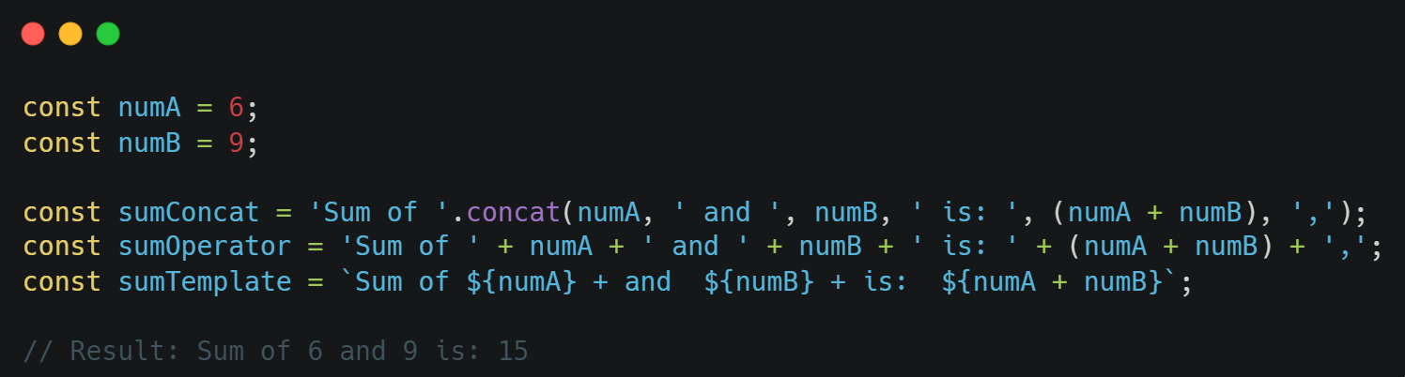
1. Template string
Interpolation expression:
A template string is represented by a pair of backticks (`)
The syntax of a template string allows the use of JavaScript expressions
in a string by enclosing them in `${}`.

Slide 5
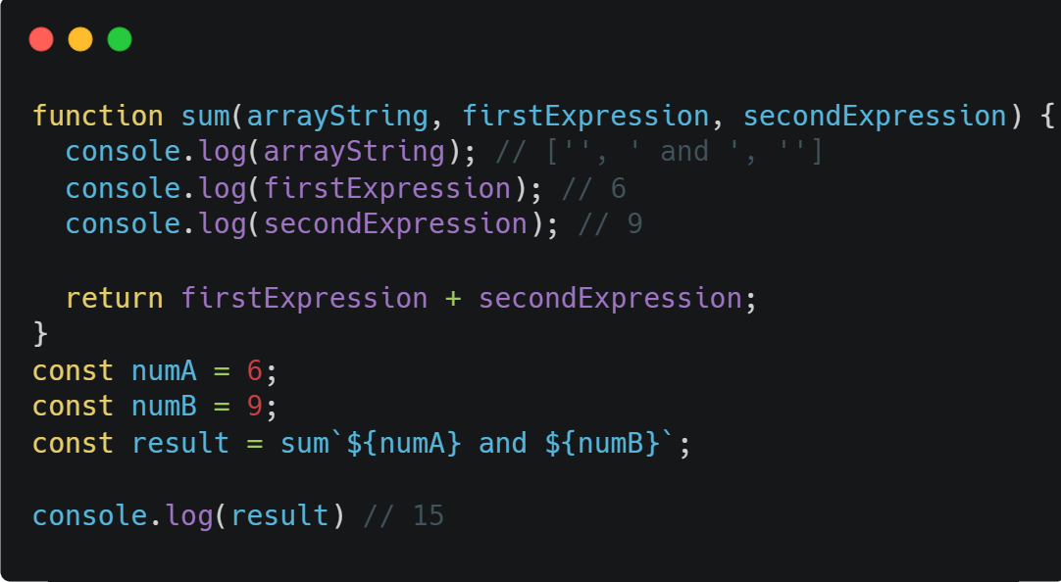
Template string
1. Template string
Tagged Template Literals:
ES6 allows you to handle template strings with a function
The return of function can be anything

Slide 6
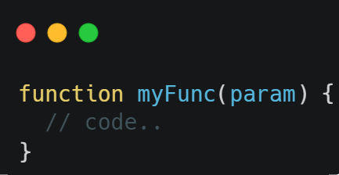
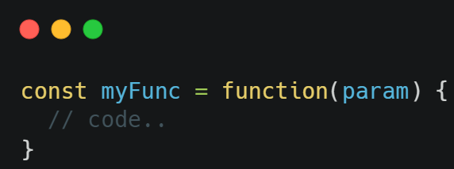
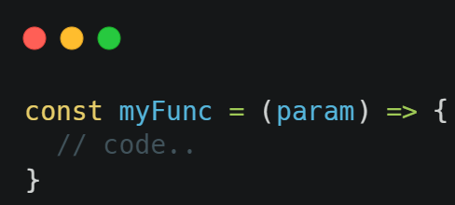
2. Arrow function
Declaration function:
Expression function:
Arrow function:

Slide 7
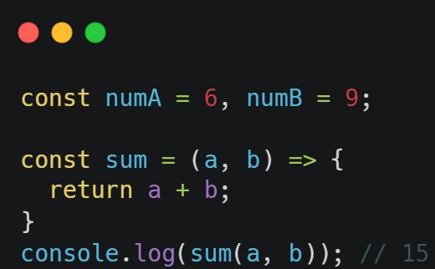
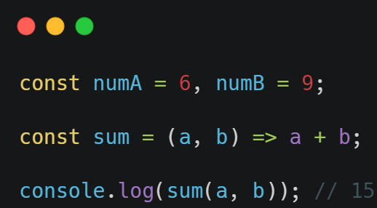
Arrow function
2. Arrow function
Syntax:
Is a shorthand syntax for declaring a function
The most commonly used are callbacks
Can’t be used as a constructor function
Can’t use “this” key in arrow function

Slide 8
3. Scoped Variable
 | var | let | const
Origins | Pre ES2015 | ES2015 (ES6) | ES2015 (ES6)
Scope | Global | Block | Block
Update | Yes | Yes | No
Hoisting | Yes | No | No

Slide 9
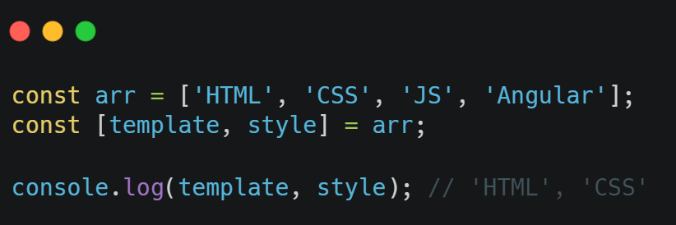
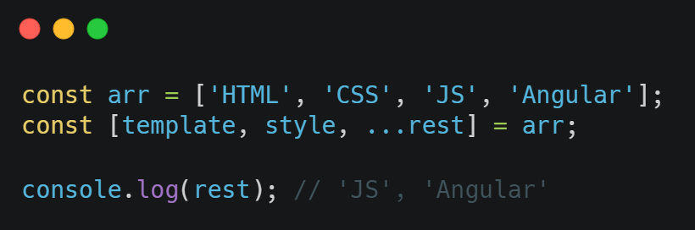
4. Destructuring & Rest
Destructuring:
Allows to take values from an array or object and assign them to individual variables.
Rest:
Usually used with “destructuring” to get the elements of an array or object

Slide 10
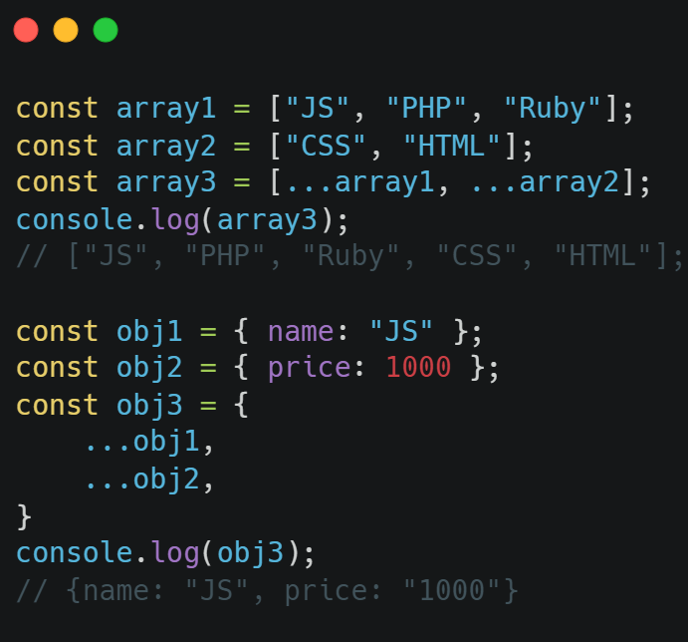
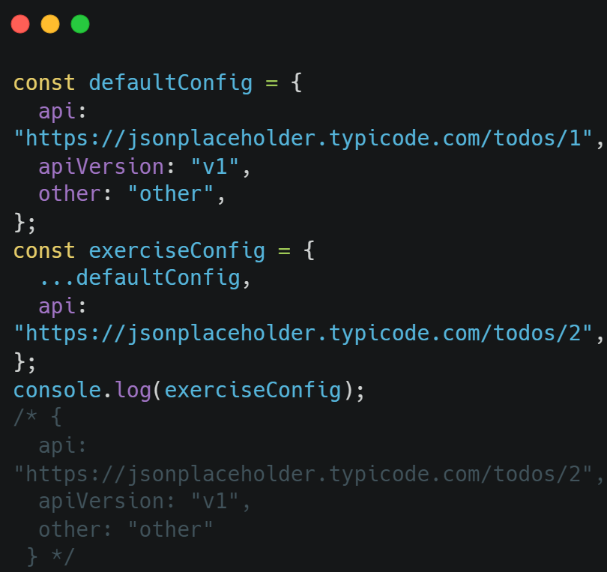
5. Spread operator
Concatenate arrays or objects and override object
The Spread operator is represented by three dots “...”

Slide 11


Thanks you!!!

