Slide 1


ANGULAR FRAMEWORK
Here starts the lesson!

Slide 2

Table of Contents!
ECMAScript 6
Typescript
Basic Angular Architecture
RxJS
Some outstanding feature of ES2015
Common concepts used in Angular applications
Overview of the eight major building blocks
Reactive programing & Importance concept about RxJS

Slide 3

01
ECMAScript
(ES2015)

Slide 4

The learning process
1
Template string
4
Destructuring & Rest
2
Arrow function
5
Speard operator
3
Scoped variable

Slide 5
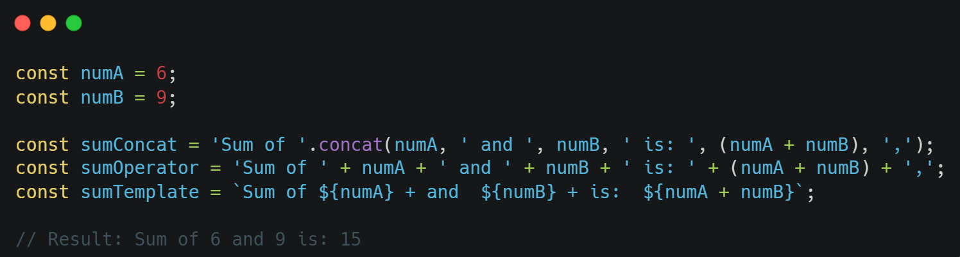
1. Template string
Interpolation expression:
A template string is represented by a pair of backticks (`)
The syntax of a template string allows the use of JavaScript expressions
in a string by enclosing them in `${}`.

Slide 6
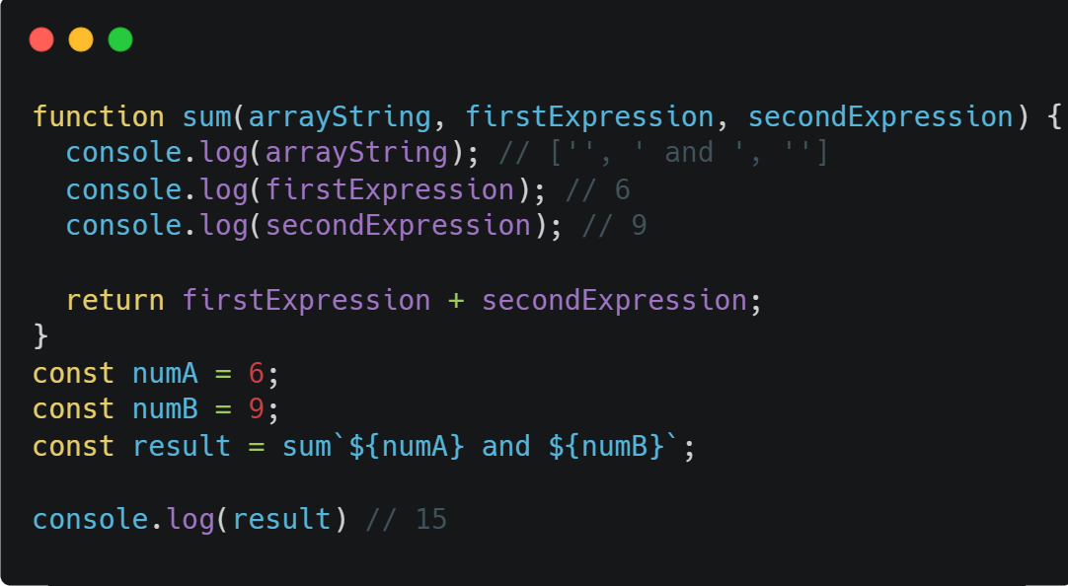
Template string
1. Template string
Tagged Template Literals:
ES6 allows you to handle template strings with a function
The return of function can be anything

Slide 7
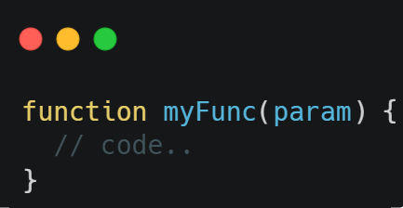
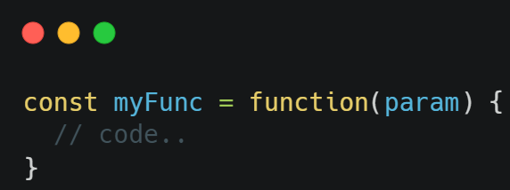
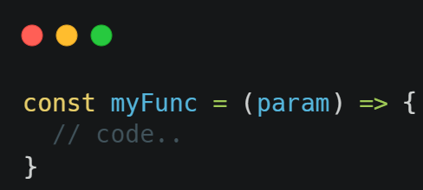
2. Arrow function
Declaration function:
Expression function:
Arrow function:

Slide 8
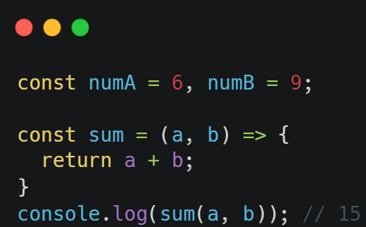
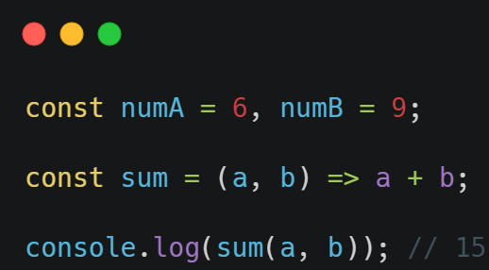
Arrow function
2. Arrow function
Syntax:
Is a shorthand syntax for declaring a function
The most commonly used are callbacks
Can’t be used as a constructor function
Can’t use “this” key in arrow function

Slide 9
3. Scoped Variable
 | var | let | const
Origins | Pre ES2015 | ES2015 (ES6) | ES2015 (ES6)
Scope | Global | Block | Block
Update | Yes | Yes | No
Hoisting | Yes | No | No

Slide 10
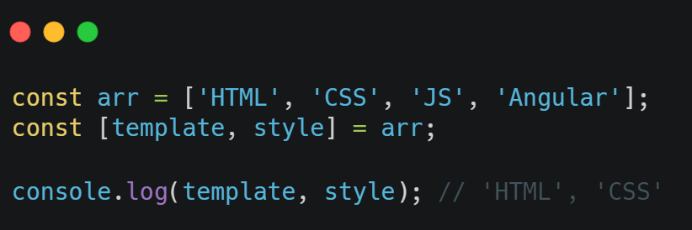
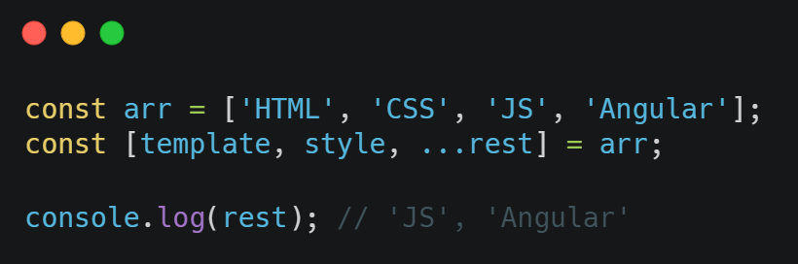
4. Destructuring & Rest
Destructuring:
Allows to take values from an array or object and assign them to individual variables.
Rest:
Usually used with “destructuring” to get the elements of an array or object

Slide 11
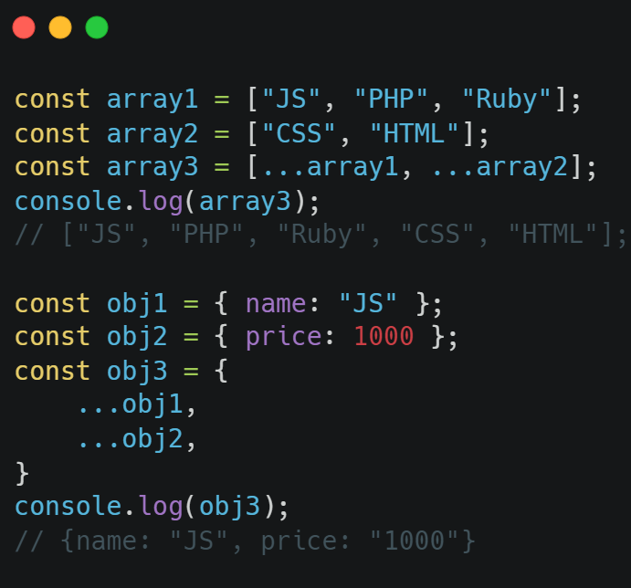
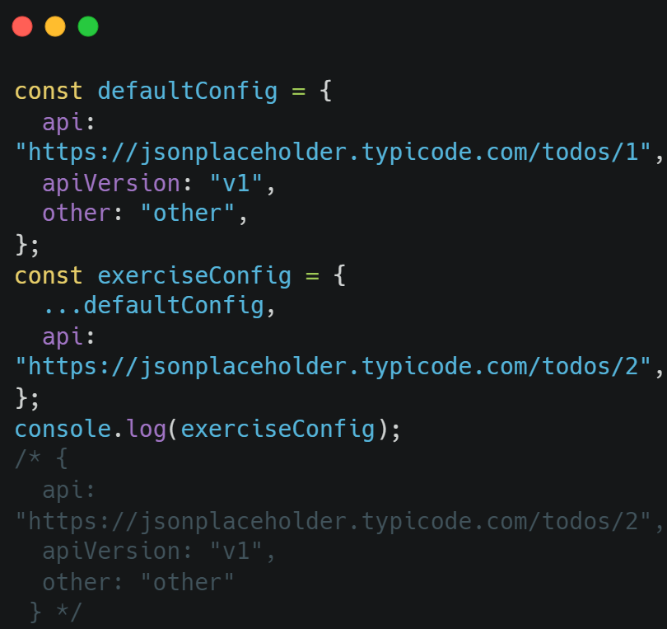
5. Spread operator
Concatenate arrays or objects and override object
The Spread operator is represented by three dots “...”

Slide 12
Table of Contents!
ECMAScript 6
Typescript
Some outstanding feature of ES2015
Common concepts used in Angular applications

Slide 13
02
TypeScript

Slide 14
The learning process
1
Type Annotation and Data types
4
Type Interface
2
Classes
3
Interface

Slide 15
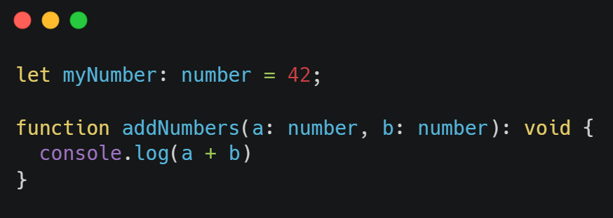

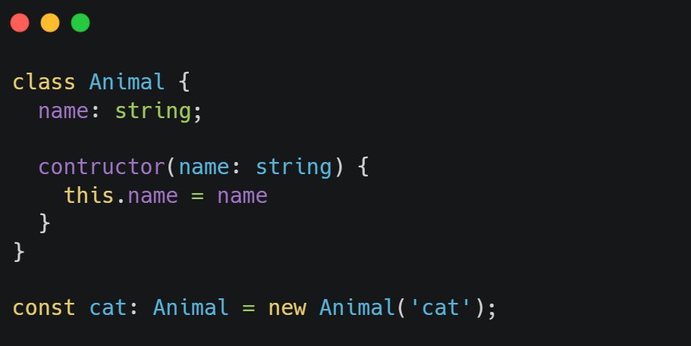

Type Annotation
Type Annotation in TypeScript is a way to specify data types for variables, parameters, and return values of functions
Type Annotations:
        + Basic data types like number, string
        + Object data types like object, array
+ User-defined custom data types

Slide 16

Data type in TypeScript
String, Number, Boolean
Array, Object
Void
Enum
Union
Tuple
Any
We can specify the type of the variables, function parameters and object properties.

Slide 17
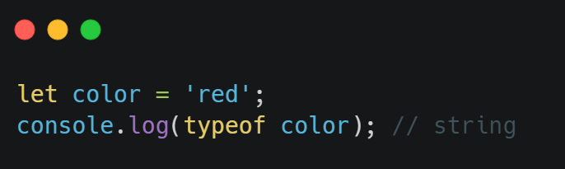
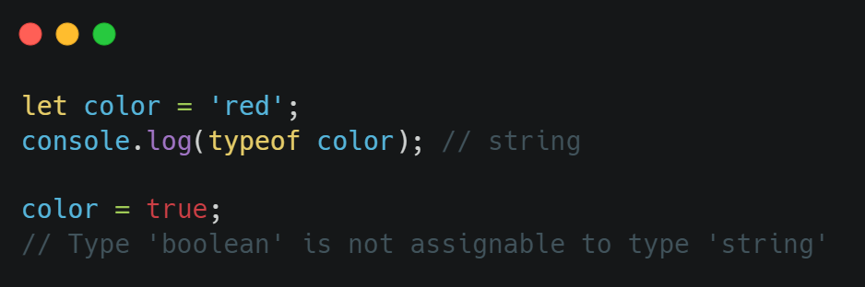
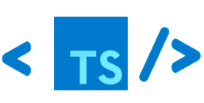
automatically infers variable types
Type Interface
JS it is not mandatory to specify the type of a variable

Slide 18
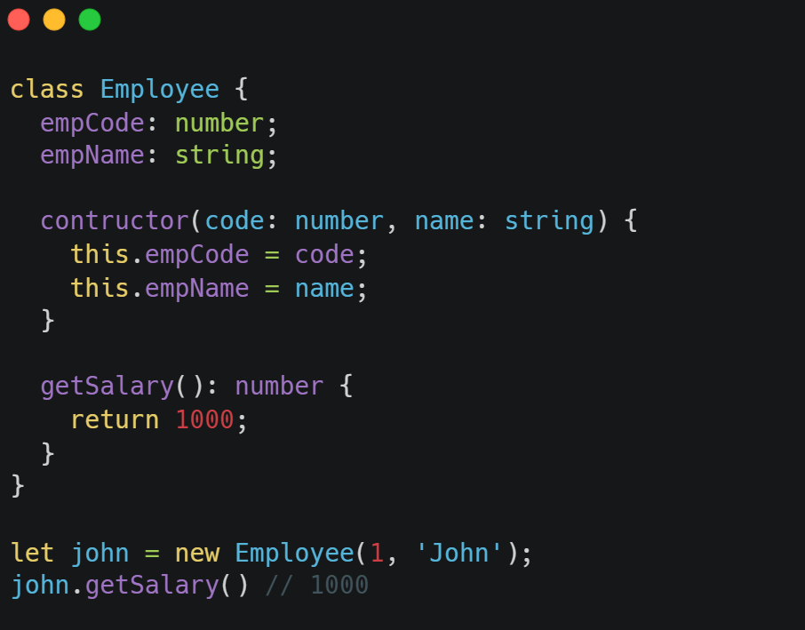

About Classes
TypeScript introduced classes to avail the benefit of object-oriented techniques
The class in TypeScript is compiled to plain JavaScript functions by the TypeScript compiler
A class can include the following:
+ Constructor
+ Properties
+ Methods

Slide 19
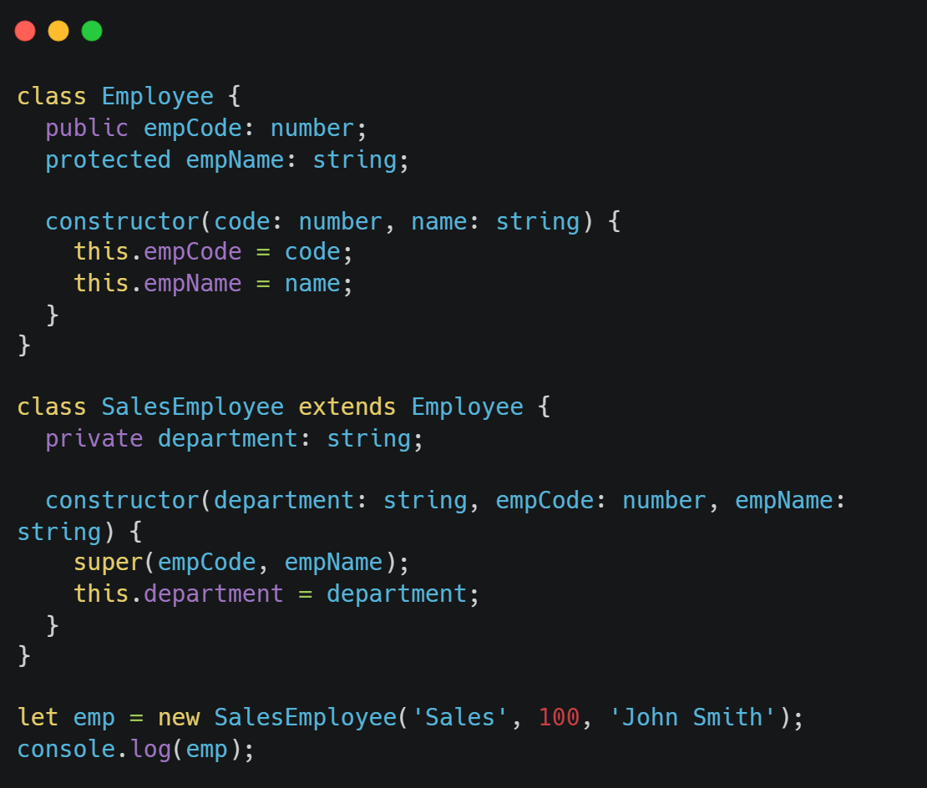
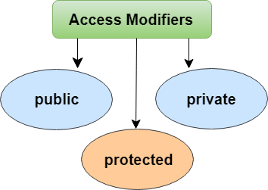
About Classes

Slide 20
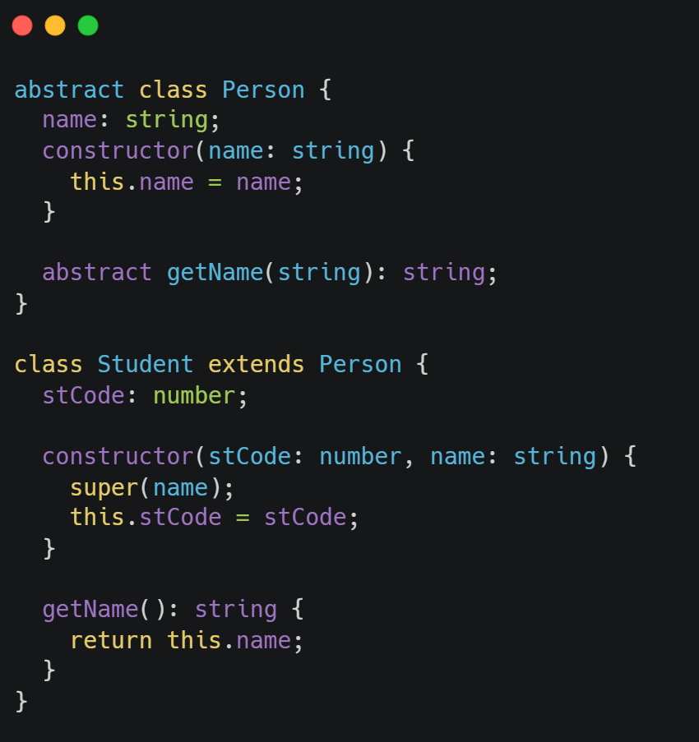
About Classes
Abstract classes are mainly for inheritance
We cannot create an instance of an abstract class.
An abstract class typically includes one or more abstract methods or property declarations

Slide 21
Interface
Defines
Abstract
It defines the syntax for classes to follow
Mandatory overriding of properties and methods

Slide 22
Table of Contents!
ECMAScript 6
Typescript
Basic Angular Architecture
Some outstanding feature of ES2015
Common concepts used in Angular applications
Overview of the eight major building blocks

Slide 23
03
Basic
Angular Architecture

Slide 24
The learning process
1
Architecture
4
Change Detection
2
MVVM
3
State management

Slide 25
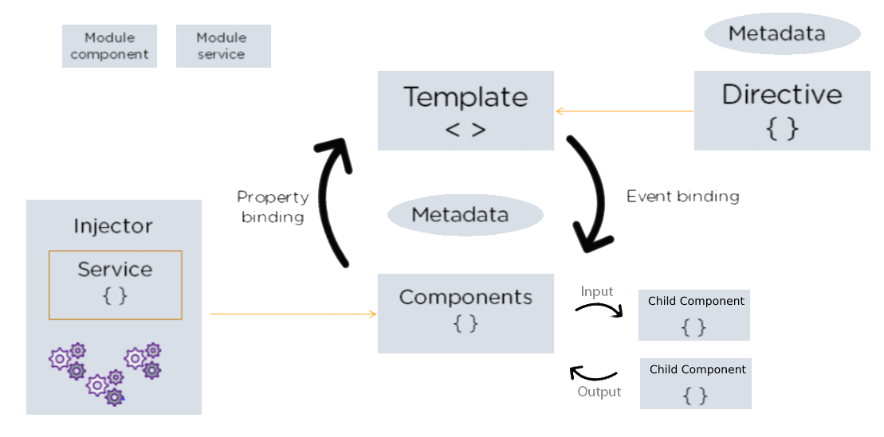
Concepts we should not forget
Architect:
Angular architecture provides a way to organize and manage source code in Angular projects. This architecture includes the following components:

Slide 26
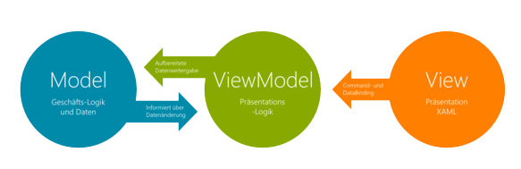
Concepts we should not forget
MVVM Pattern:
MVVM is a common pattern in web applications and can be applied in Angular using components such as Model, View, and ViewModel, combined with Reactive Extensions (RxJS) for asynchronous data handling and updated user interface.

Slide 27
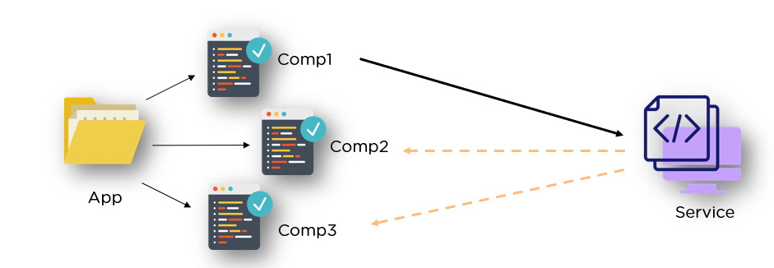
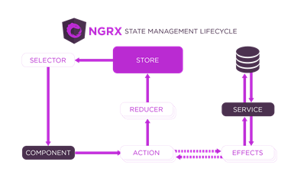
Concepts we should not forget
State management by Service:
State management by NgRx:

Slide 28
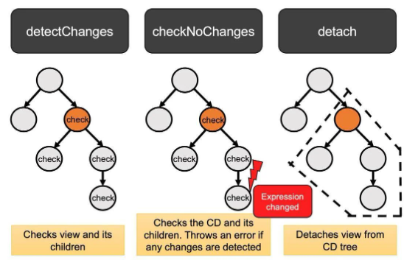
* Change detection
Service
Component
Change detection
Services cannot depend on each other
Automated change detection strategy

Slide 29
Table of Contents!
ECMAScript 6
Typescript
Basic Angular Architecture
RxJS
Some outstanding feature of ES2015
Common concepts used in Angular applications
Overview of the eight major building blocks
Reactive programing & Importance concept about RxJS

Slide 30
04
RxJS
(Reactive Programing)

Slide 31
The learning process
1
Concept
4
Subscription
2
Observable
5
Pipe operator
3
Observer

Slide 32
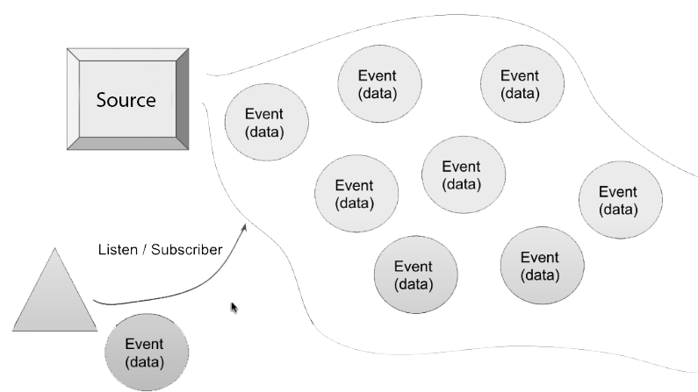
Stream
All models of sending and receiving data aka producer and consumer

Slide 33
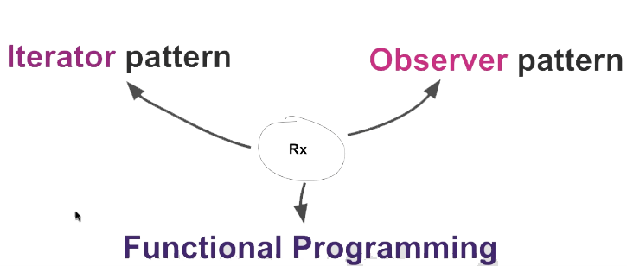
Stream Structure

Slide 34

Content of the topic
Observable
Observer
Subscription
Source of events in the future
Where to receive events
Called when canceling the event emitter
Pipe Operator
Where to convert data

Slide 35
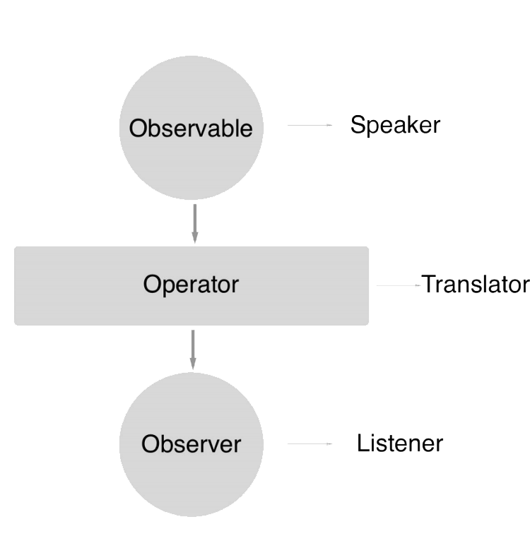


Workflow

Slide 36


Thanks you!!!

