Slide 1
ANGULAR FRAMEWORK
Nguyen Binh Hong Son
nbhson@tma.com.vn
Source: angular.io
Starts
the lesson!

Slide 2
What is Angular?
Angular is a platform that helps you create an advanced web application in HTML using Typescript
It helps you to structure your code, separate your concerns and remove trivial code.

Slide 3

The learning process
1
Architecture
4
HTTP & API
2
Routing & Navigation
5
Testing & Debugging
3
Forms & validation
6
Performance

Slide 4



01
Angular Architecture

Slide 5
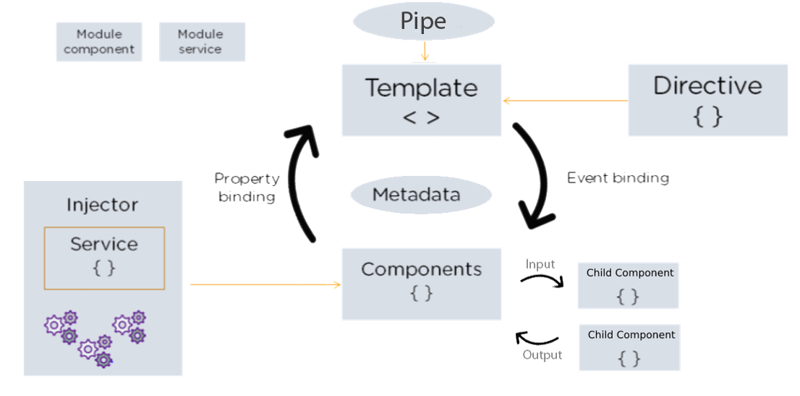

1. Architecture
Angular architecture provides a way to organize and manage source code in Angular projects.
Modules
Components
Templates
Metadata
Dada binding
Directive
Pipe
Service
DI

Slide 6
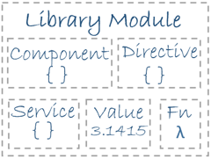
1.1 Module
Angular applications are based on Modules.
Angular Modules helps organizing the application
Declares which components, services etc that belongs together.
Every Angular applications have at least one module - the RootModule by convention named AppModule.
A module is implemented as a class (@NgModule).
Demo

Slide 7
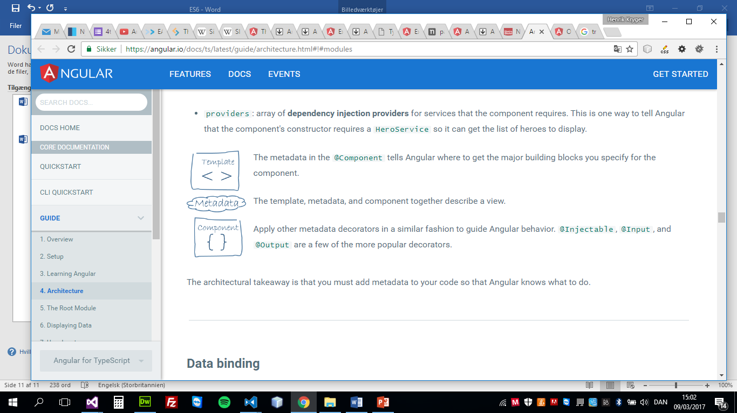
1.2 Component
An application written in Angular is assembled by components
We create components and arrange them to create the view of the application.
A component consists of three parts:
A template (html)
A decorator
A typescript class (ts)

Slide 8
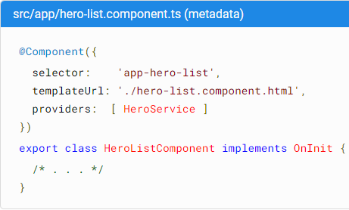
1.3 Metadata
Metadata tells Angular how to process a class.
In TypeScript, you attach metadata by using a decorator
To tell Angular that it’s a component, attach metadata to the class

Slide 9
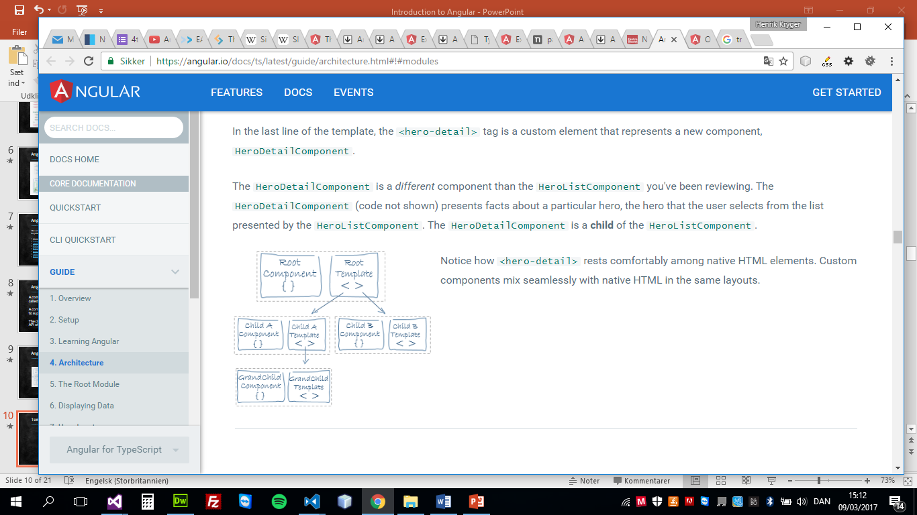
1.4 Template
We define the component's view with its template.
A template is a form of HTML that tells Angular how to render the component view.
Demo

Slide 10
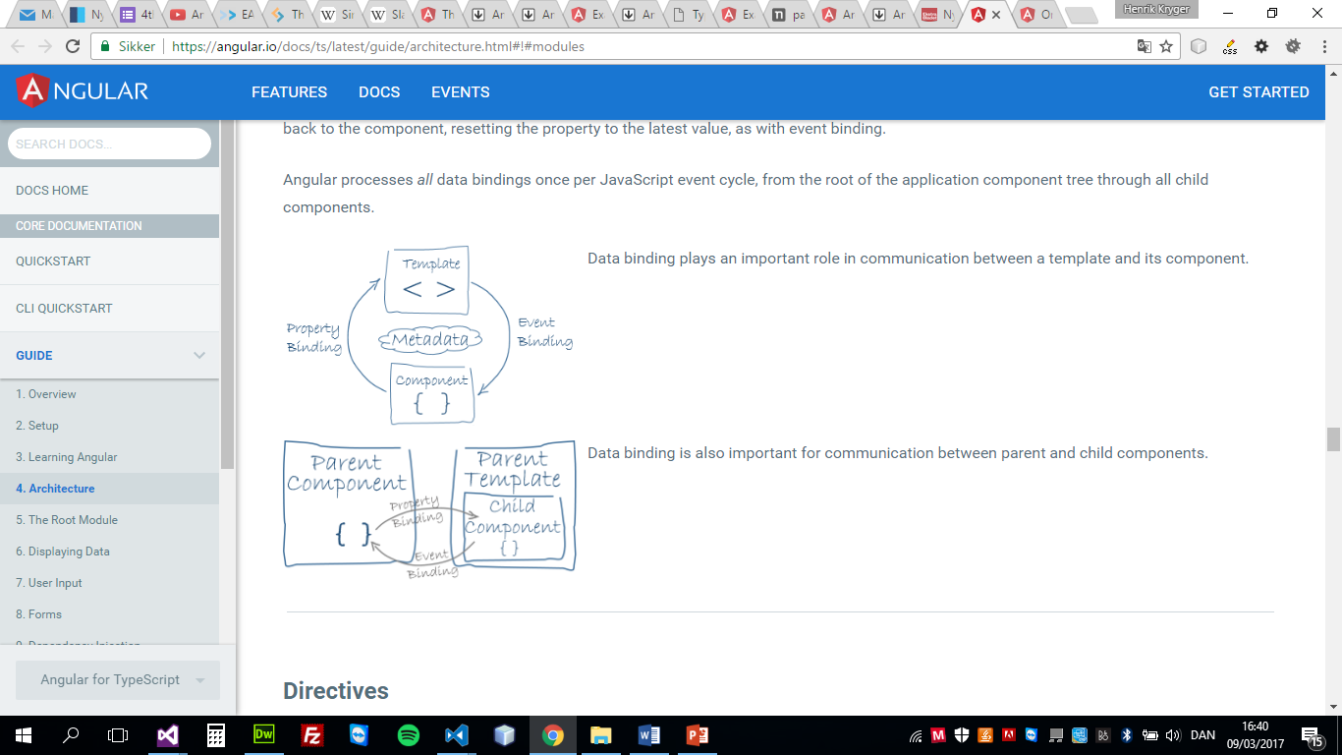
1.5 Data binding
Angular supports data binding, a mechanism for coordinating parts of a template with parts of a component.
There are 3 types of data binding in Angular:
Interpolation
Property (style, class)
Event

Slide 11
1.5.1 Component Interaction
Passing data from parent to child using:
@Input()
Property-binding
Passing data from child to parent using:
@Output()
EventEmitter
Demo

Slide 12
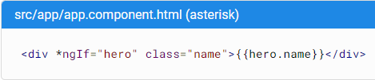
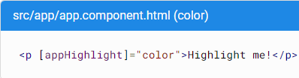
1.6 Directive
Angular templates are dynamic. When Angular renders them, it transforms the DOM according to the instructions given by directives.
A directive is a class with a @Directive decorator
Two other kinds of directives:
Structural directives
Attribute directives.
Demo

Slide 13


1.7 Pipe
Pipe is a component that allows you to process display data before it is displayed in the template.
A directive is a class with a @Pipe decorator
Demo

Slide 14
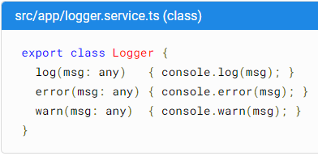
1.8 Service
Service is a broad category encompassing any value, function, or feature that your application needs.
Component classes should be clean. Components don't fetch data from the server, validate user input, or log directly to the console. They delegate such tasks to services.
A service in Angular is defined with @Injectable decorator

Slide 15
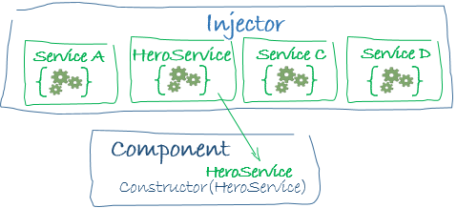

1.9 Dependency Injection (DI)
Dependency injection is a way to supply a new instance of a class with the dependencies it requires. Most dependencies are services.
Angular uses dependency injection to provide new components with the services they need.
Demo

Slide 16

### Exercise
User management
Setup environment:
Angular CLI: 15.2.1 (npm install -g @angular/cli@^14.0.6)
Node: >= 16.19.0
Repository:
Gitlab: https://gitlab.tma.com.vn/angular/angular-exercise
Start app:
Step 1: npm install to install the dependencies
Step 2: npm run start:db to run the database
Step 3: npm start to start the application

Slide 17
02
Routing & Navigation

Slide 18
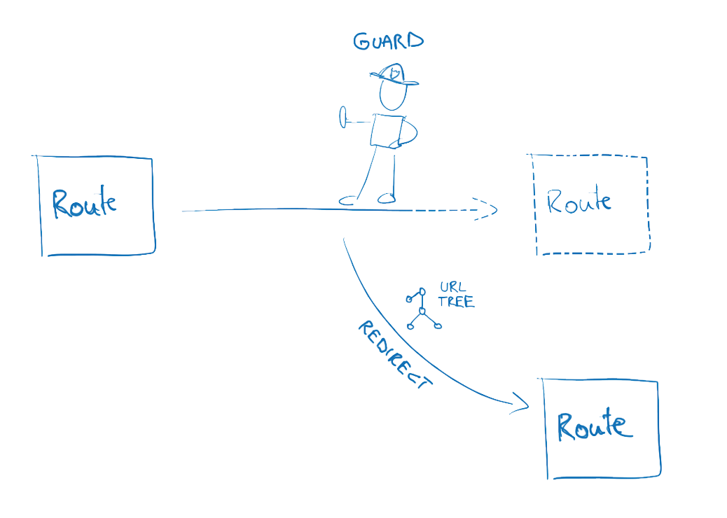

2. Routing & Navigation
Routing params is a way to pass parameters between components via URL.
When a URL is accessed, Angular Router will identify that URL and return the corresponding Component
Learn how to access and get route information
Snapshot
Query parameters
And how to protect routes (Guard)
CanActivate

Slide 19
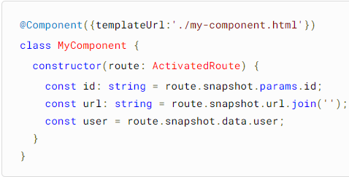
2.1 How to access get routes information
Snapshot:
If the URL is “user/123", where "123" is the id of the user, Angular Router will extract the value "123" and pass it to the corresponding Component.

Slide 20
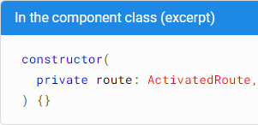
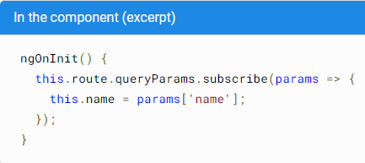
2.1 How to access get routes information
Query params:
For example "/user?id=1", "id" is the name of the parameter and "1" is the value of that parameter.
To get the parameter's value from the URL, you can use the ActivatedRoute object and snapshot.queryParamMap.get('id')
Demo

Slide 21
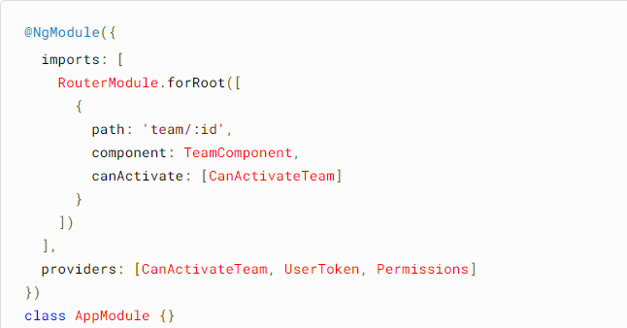
2.2 How to protect routes
To protect the Router from unauthorized access, Angular provides many security mechanisms including Authentication, Authorization and Guard
Guard ensure that only users with access rights are allowed to access protected routes
Demo

Slide 22
03
Form & Validation

Slide 23
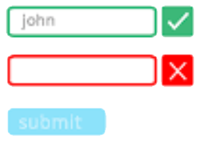
3. Forms & Validation
Forms in Angular is a feature that allows users to enter data into fields on your website.
Forms in Angular include 3 types
Template driven-form
Reactive form
Type form (v14)

Slide 24
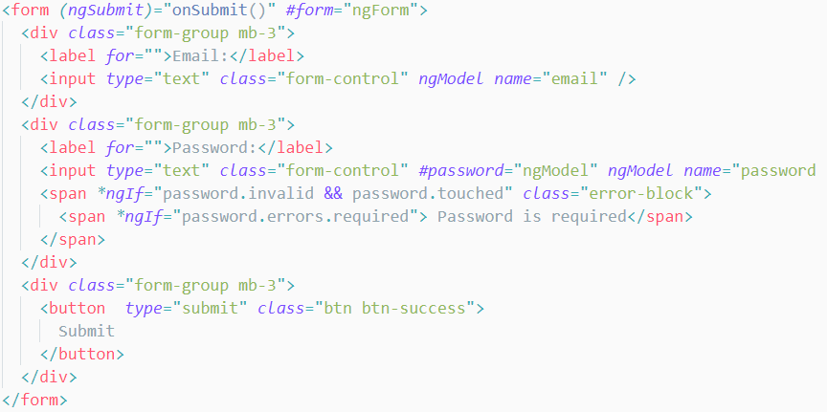
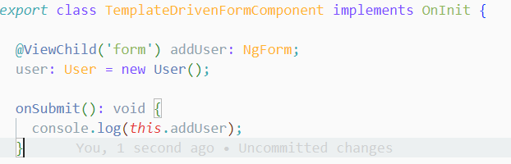
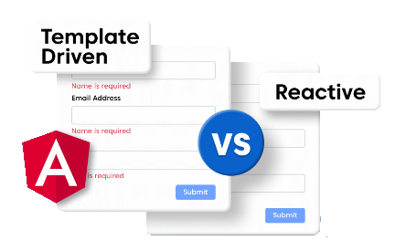
3.1 Template driven-from
Angular template-driven form is commonly used for simple or small-scale application
use ngModel to build form
store data in template
validation in template
Demo

Slide 25
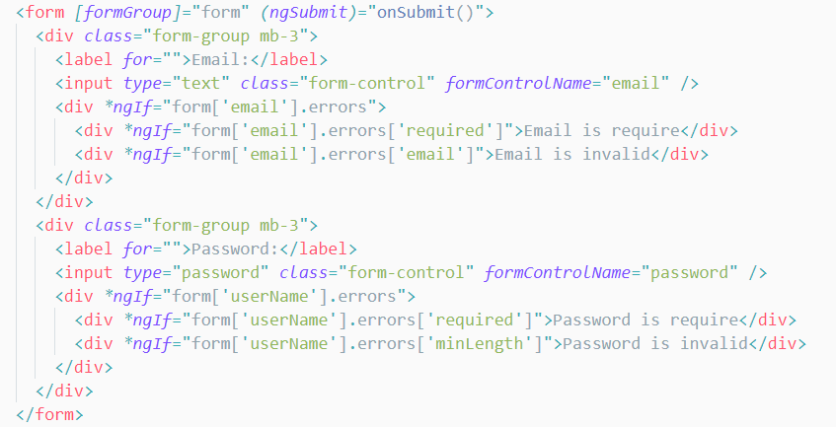
3.1 Reactive from
The angular reactive form is used for Validators and handles complex situations.
use Reactive Programing to build form

Slide 26
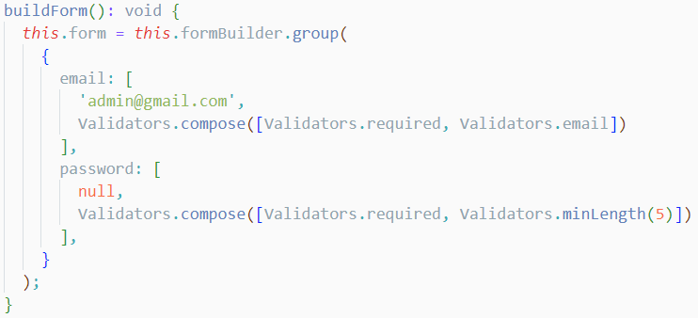
3.1 Reactive from
The angular reactive form is used for Validators and handles complex situations.
store data in model
validation in component
Demo

Slide 27
3. Forms & Validation
Forms in Angular is a feature that allows users to enter data into fields on your website.
Forms in Angular include 3 types
Template driven-form
Reactive form
Type form (v14)
 | Template driven | Reactive
Build | ngModel | Reactive Programing
Storage | Template | Model
Validation | Template | Component
Use for | Simple or small-scale application | Validators and handle complex situations.

Slide 28
04
HTTP & API

Slide 29
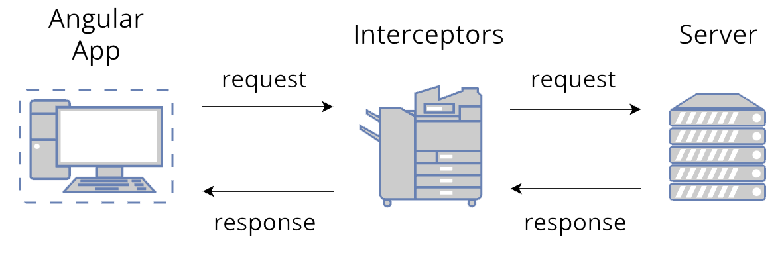

4. HTTP & API
Angular provides a client HTTP API for Angular applications, the HttpClient service class
API (Application Programming Interface) is an intermediary method that connects different applications and libraries

Slide 30
05
Testing & Debugging

Slide 31
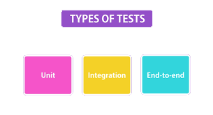

5. Testing & Debugging
Testing in Angular: Angular provides testing frameworks to help simplify the testing process, including Karma, Jasmine or Jest
Debugging in Angular: When developing Angular applications, debugging is an indispensable part

Slide 32
06
Performance

Slide 33
6. Performance
Improving the performance of an Angular application is important because:
Improve user experience: If your app runs slow, users won't have a good experience and may abandon your app.
Increased reliability: If your application runs slow or crashes, it can cause errors and reduce product reliability.
Competition: help your product stand out and compete better in the market.
Some ways to improve performance in Angular
Use lazy loading
Use trackBy
Use ChangeDetectionStrategy
Demo

Slide 34


Thanks you!!!

