Slide 1
ANGULAR FRAMEWORK
Nguyen Binh Hong Son
nbhson@tma.com.vn
Source: rxjs.dev
Starts
the lesson!

Slide 2



02
RxJS
(Reactive Programing)

Slide 3
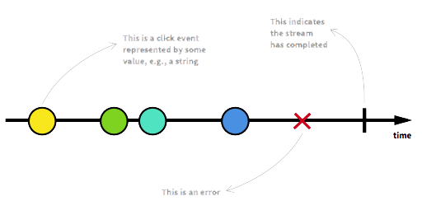
# What is Reactive Programming?
      Reactive Programming is programming with asynchronous data streams
Reactive programming has many benefits:
Increased scalability
Increased performance
Easy error management

Slide 4
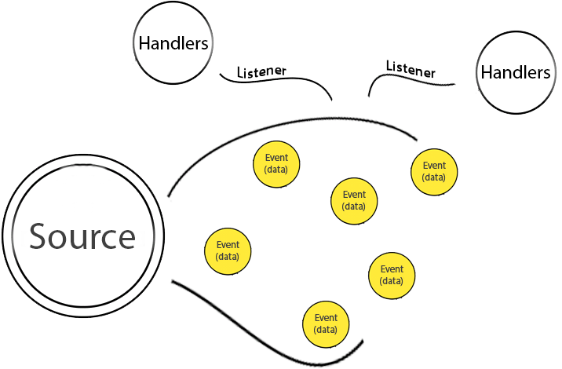
# Producer-Comsumer model
Used to solve problems related to synchronization and data processing in multi-processing and multi-threading applications.
Producers and consumers are independent objects or processes that can run concurrently.

Slide 5

Content of the topic
Observable
Observer
Subscription
Source of events in the future
Where to receive events
Called when canceling the event emitter
Pipe Operator
Where to transform data

Slide 6
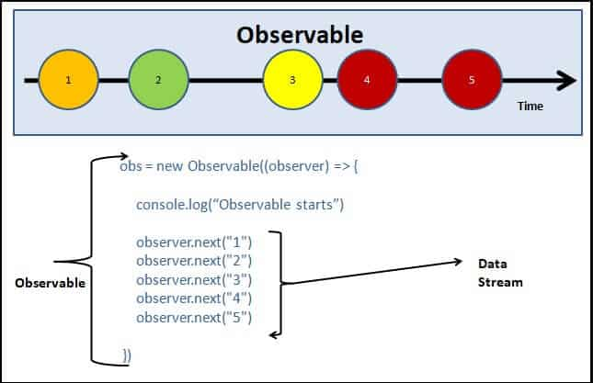
Observable
An Observable is an object that can emit events and allows you to register handler functions for those events.
An Observable can emit values or events, one or many times over a period of time.
It emits the complete signals when the stream completes or an error signal if the stream errors out.

Slide 7
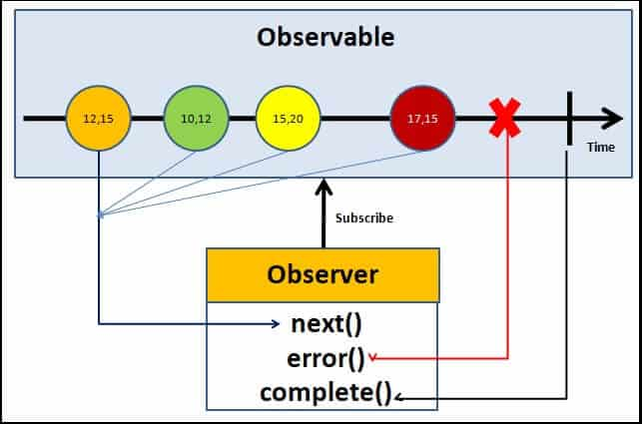
Observer
The observers communicate with the Observable using callbacks
The observer must subscribe with the observable to receive the value from the observable.
The observer receives the data from the observer via the next() callback
They also receive the errors and completion events from the Observable via the error() & complete() callbacks
Demo

Slide 8

Subscription
We need to unsubscribe to close the observable when we no longer require it. If not it may lead to memory leak & Performance degradation.
Subscription is an object in RxJS that is used to track subscriptions to Observables.
You can use the Subscription object to unsubscribe, meaning to stop tracking notifications from the Observable.
Demo

Slide 9
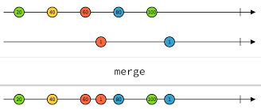
Pipe
# Filter:
filter(), find(), every()
first(), last(), single()
Pipes let you combine multiple functions into a single function.
# Timer:
interval(), timeout(), timer()
throttleTime(), debounceTime()
An operator is a function that takes an Observable as its input and returns another Observable as its output.
# Combination:
forkJoin(), concat(), merge()
# Handle errors:
throwError(), catchError()
Demo

Slide 10

### Exercise
User management
Setup environment:
Angular CLI: 15.2.1 (npm install -g @angular/cli@^14.0.6)
Node: >= 16.19.0
Repository:
Gitlab: https://gitlab.tma.com.vn/angular/angular-exercise
Start app:
Step 1: npm install to install the dependencies
Step 2: npm run start:db to run the database
Step 3: npm start to start the application

Slide 11


Thanks you!!!

