Slide 1



Some things are naturally parallel

Slide 2
Sequential Execution Model / SISD
int a[N]; // N is large
for (i =0; i < N; i++)
out[i] = out[i] * fade;
Flow of control / Thread
One instruction at the time
Optimizations possible at the machine level
time

Slide 3
Data Parallel Execution Model / SIMD
int a[N]; // N is large
for all elements do in parallel
out[i] = a[i] * fade;
time
This has been tried before: ILLIAC III, UIUC, 1966
http://ieeexplore.ieee.org/xpls/abs_all.jsp?arnumber=4038028&tag=1
http://ed-thelen.org/comp-hist/vs-illiac-iv.html

Slide 4
Single Program Multiple Data / SPMD
int a[N]; // N is large
for all elements do in parallel
new = a[i] * fade
if (new > 255) out[i] = new;
time
Code is statically identical across all threads
Execution path may differ
The model used in today’s Graphics Processors

Slide 5
SPMD Execution Order Undefined
All in parallel
Sequential
Any other order

Slide 6
Programming Model
for index in RANGE
Kernel(index)
RANGE can be 1D, 2D, or 3D
Use 1D for the time being

Slide 7
1D Range – Execution Model
int a[N]; // N is large
for all elements of an array
a[i] = a[i] * fade
Lots of independent computations
Kernel
RANGE (grid)
THREADs

Slide 8
Exposing Locality to Programmer
RANGE (grid)
block
Threads within a group can co-operate and coordinate

Slide 9
Intra-Block communication and synchronization
thread 10 thread 11
a[10] = in[10] a[11] = in[11]
barrier barrier
a[10] += a[11]
communication
synchronization
RANGE (grid)
block

Slide 10
GPGPU Processor – Basic Unit
SHARED MULTIPROCESSOR
FETCH
DECODE SCHEDULE
WARP
REG
REG
REG
REG
REG
REG
REG
32
REG
REG
REG
REG
REG
REG
REG
MEM
LOCAL
MEM
EXEC
EXEC
EXEC
EXEC
EXEC
REG
EXEC
REG
REG
REG
CACHE

Slide 11
WARP Execution and Control Flow Divergence
if (in[i] == 0) out[i] = sqrt(x);
else out[i] = 10;
WARP
in[i] == 0
in[i] == 0
idle
TIME
out[i] = sqrt(x)
out[i] = 10

Slide 12
Control Flow Divergence Contd.
WARP
WARP #1
WARP #2
in[i] == 0
in[i] == 0
in[i] == 0
idle
TIME
BAD SCENARIO
Good Scenario

Slide 13
GPGPU Processor – Overall Architecture
Block Scheduler
SHARED MULTIPROCESSOR
SHARED MULTIPROCESSOR
SHARED MULTIPROCESSOR
FETCH
FETCH
FETCH
DECODE SCHEDULE
DECODE SCHEDULE
DECODE SCHEDULE
WARP
REG
REG
REG
WARP
REG
REG
REG
WARP
REG
REG
REG
REG
REG
REG
REG
REG
REG
REG
REG
REG
REG
REG
REG
REG
REG
REG
REG
32
REG
REG
REG
32
REG
REG
REG
32
REG
REG
REG
REG
MEM
LOCAL
MEM
REG
MEM
LOCAL
MEM
REG
REG
REG
REG
EXEC
REG
EXEC
REG
EXEC
MEM
LOCAL
MEM
EXEC
EXEC
EXEC
EXEC
EXEC
EXEC
EXEC
EXEC
EXEC
EXEC
REG
EXEC
REG
EXEC
REG
EXEC
REG
EXEC
REG
EXEC
REG
REG
REG
REG
REG
REG
REG
CACHE
CACHE
CACHE
Shared Cache
Global Memory

Slide 14
Why are threads useful? Parallelism
Concurrency:
Do multiple things in parallel
Uses more hardware → Gets higher performance
Application must have parallelism
Needs more functional units

Slide 15
Why are threads useful #2 – Tolerating stalls
Often a thread stalls, e.g., memory access
Multiplex the same functional unit
Get more performance at a fraction of the cost

Slide 16
GPGPU Processor – Basic Unit
SHARED MULTIPROCESSOR
FETCH
DECODE SCHEDULE
Warp Pool
WARP
REG
REG
REG
REG
REG
REG
REG
32
REG
REG
REG
REG
REG
REG
REG
MEM
LOCAL
MEM
EXEC
EXEC
EXEC
EXEC
EXEC
REG
EXEC
REG
REG
REG
CACHE

Slide 17
GPU: bandwidth optimized – latencies are long
A GPU ADD takes 24 GPU cycles (true of GTX280)
CPU ADD 1 cycle
The GPU cycle is roughly 4x of a CPU cycle
For the systems in the lab (GTX480)
Need ~100 threads to break even
1000s of threads for GPU to be better

Slide 18
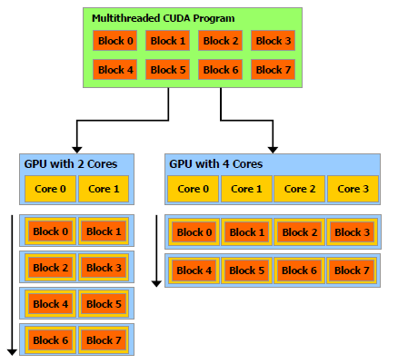
Architecture Scalability

Slide 19
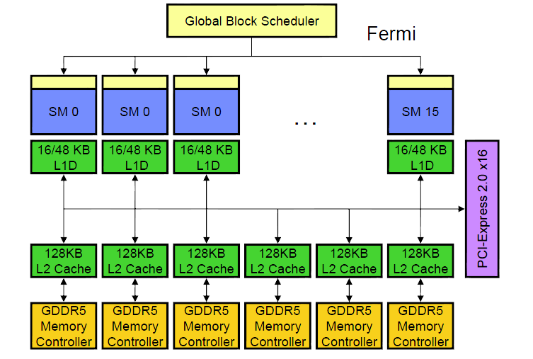
GF100 Architecture Overview -- Compute
64-bit

Slide 20
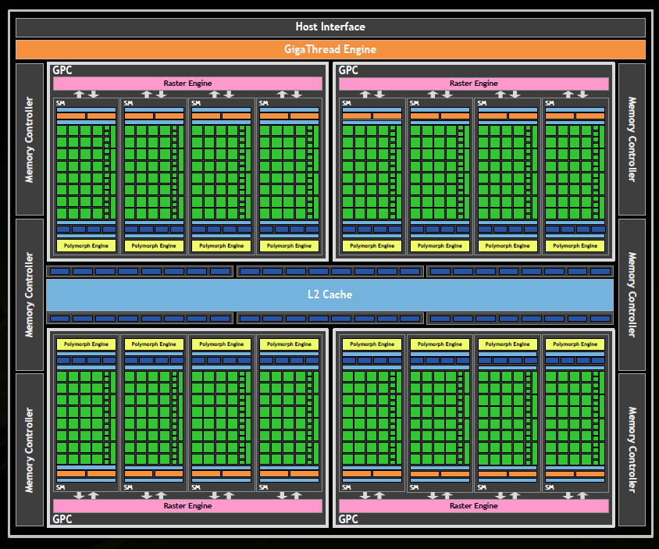
GF100 Architecture - Complete
512 CUDA cores
16 PolyMorph Engines
4 raster units
64 texture units
48 ROP units
384-bit GDDR5
6 channels
64-bit / channel

Slide 21
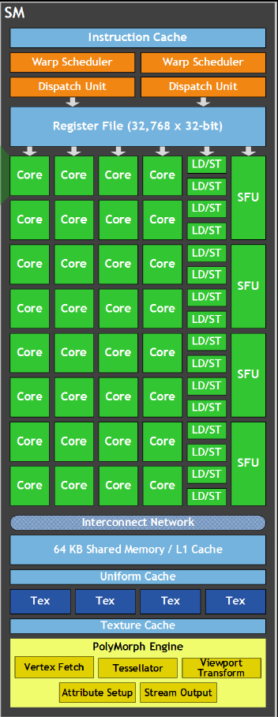
SM Architecture
Streaming Multiprocessor (SM)
32 Streaming Processors (SP)
32 INT or FP (32-bit)
16 DP (64-bit)
4 Super Function Units (SFU)
16 Load/Store Units
Multi-threaded instruction dispatch
Up to1536 threads active
32 (threads) x 48
24,576 threads for all SMs
Up to 8 concurrent blocks
1024 threads/block limit
Shared instruction fetch per 32 threads
Cover latency of texture/memory loads
80+ GFLOPS
16K/48K KB shared memory
48K/16K L1 cache
DRAM texture and memory access

Slide 22
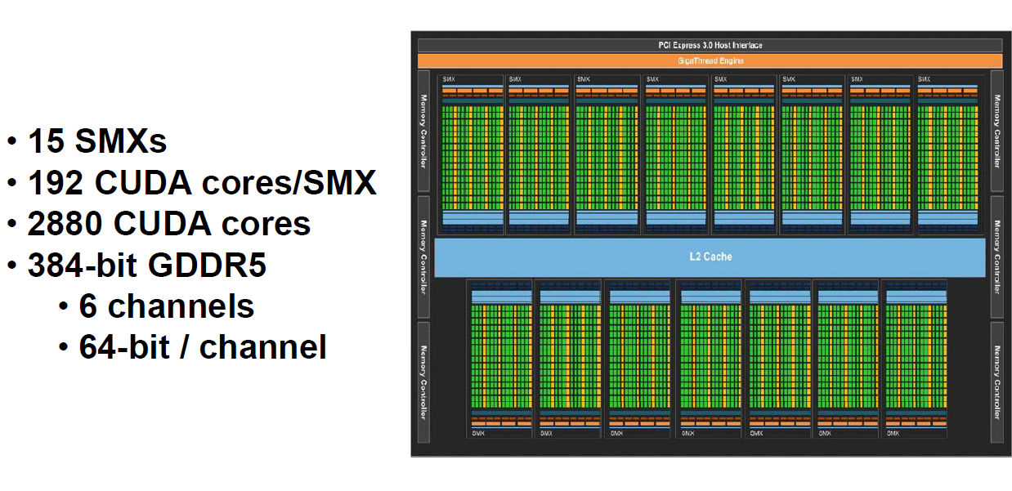
GK110 Architecture GTX7xx series

Slide 23
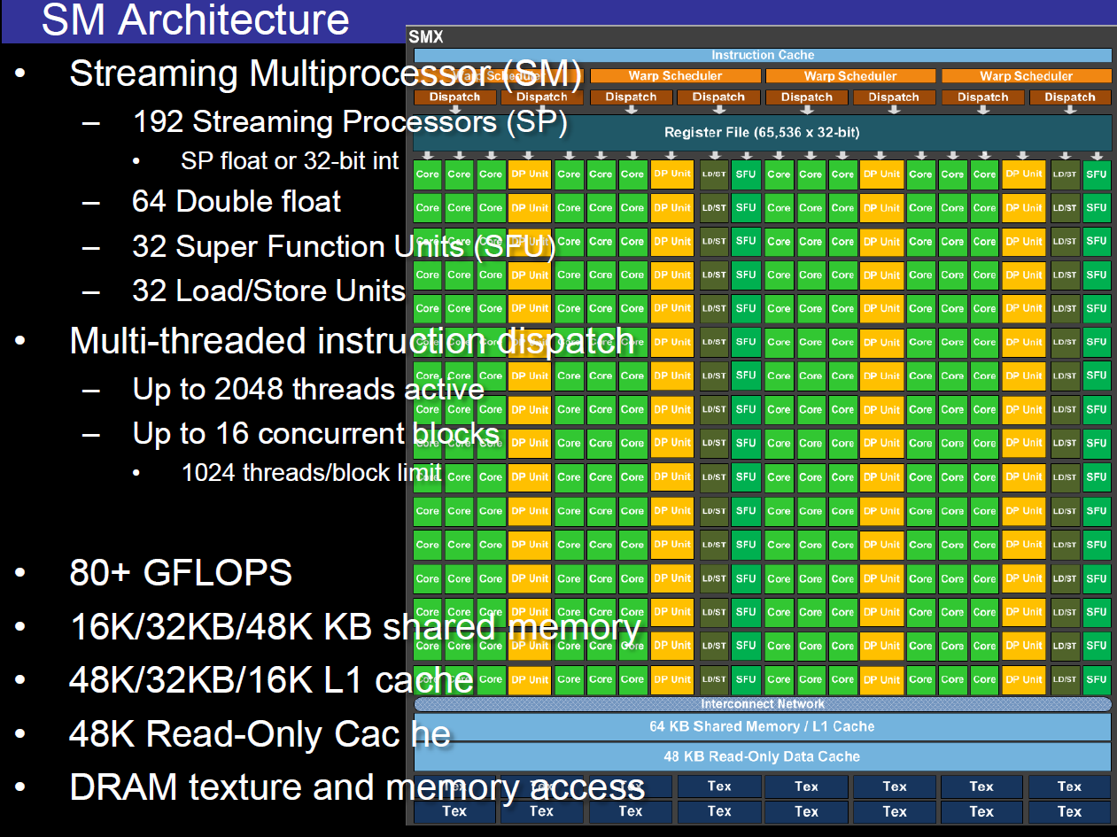

Slide 24
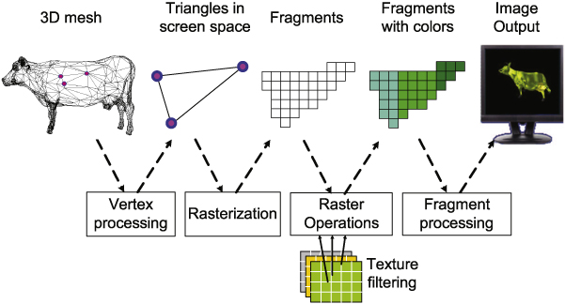
Why GPUs now? Why not before?

Slide 25
Programmer’s view
GPU as a co-processor
(CPU data is from 2008 – matches our lab machines)
CPU
GPU
3GB/s – 8GB.s
177.4GB/sec / 288.4GB/sec
Memory
6.4GB/sec – 31.92GB/sec
8B per transfer
GPU Memory
1GB / 3GB
GTX480 / GTX780 (6 of those)
Key Suppliers: Nvidia and AMD

Slide 26
Execution Timeline
CPU / Host
GPU / Device
1. Copy to GPU mem
2. Launch GPU Kernel
2’. Synchronize with GPU
3. Copy from GPU mem
time

Slide 27
Programmer’s view
First create data on CPU memory
CPU
GPU
Memory
GPU Memory

Slide 28
Programmer’s view
Then Copy to GPU
CPU
GPU
Memory
GPU Memory

Slide 29
Programmer’s view
GPU starts computation → runs a kernel
CPU can also continue
CPU
GPU
Memory
GPU Memory

Slide 30
Programmer’s view
CPU and GPU Synchronize
CPU
GPU
Memory
GPU Memory

Slide 31
Programmer’s view
Copy results back to CPU
CPU
GPU
Memory
GPU Memory
GTX780: kernels can spawn kernels

Slide 32
Programming Languages
CUDA
NVidia
Has market lead
OpenCL
Many including Nvidia
CUDA superset
Somewhat different syntax
Can target many different devices, e.g., CPUs + programmable accelerators
Fairly new
Both are evolving

Slide 33
Computation partitioning:
At the highest level:
Think of computation as a series of loops:
for (i = 0; i < big_number; i++)
a[i] = some function
for (i = 0; i < big_number; i++)
a[i] = some other function
for (i = 0; i < big_number; i++)
a[i] = some other function
Kernels

Slide 34
Some things are naturally parallel

Slide 35
My first CUDA Program
__global__ void arradd (float *a, float fade, int N)
{
int i = blockIdx.x * blockDim.x + threadIdx.x;
if (i < N) a[i] = a[i] * fade;
}
int main()
{
float h[N];
float *d;
cudaMalloc ((void **) &a, SIZE);
cudaThreadSynchronize ();
cudaMemcpy (d, h, SIZE, cudaMemcpyHostToDevice));
arradd <<< n_blocks, block_size >>> (d, 10.0, N);
cudaThreadSynchronize ();
cudaMemcpy (h, d, SIZE, cudaMemcpyDeviceToHost));
CUDA_SAFE_CALL (cudaFree (a));
}
GPU
CPU

Slide 36
Per Kernel Computation Partitioning
Computation Grid: 2D Case
Threads within a block can communicate/synchronize
Run on the same core
Threads across blocks can’t communicate
Shouldn’t touch each others data
Behavior undefined
thread
Block

Slide 37
Per Kernel Computation Partitioning
Computation Grid: 2D Case
One thread can process multiple data elements
Other mappings are possible and often desirable
More on this when we talk about how to optimize for performance
thread
Block

Slide 38
Fade example
Each thread will process one pixel
for all elements do in parallel
out[i] = a[i] * fade;

Slide 39
Code Skeleton
CPU:
Initialize image from file
Allocate IN and OUT buffers on GPU
Copy image to
Launch GPU kernel
Reads IN
Produces OUT
Copy Out back to CPU
Write image to a file
GPU:
Launch a thread per pixel

Slide 40
GPU Kernel pseudo-code
__global__ void fade (unsigned char *in, unsigned char *out, float f, int xmax, int ymax)
{
unsigned int v = in[x][y];
v = v * f;
if (v > 255) v = 255;
out[x][y] = v;
}
This is the program for one thread
It processes one pixel

Slide 41

How does a thread know which pixel to process?
blockDim.x
gridDim.x
threadIdx.x
blockDim.y
blockIdx.y
blockIdx.x
threadIdx.y
gridDim.y

Slide 42
gridDim
gridDim.x = 7, gridDim.y = 6
How many blocks per dimension

Slide 43
blockDim
blockDim.x= 7, blockDim.y = 7
How many threads in a block per dimension

Slide 44
blockIdx
blockIdx = coordinates of block in the grid
blockIdx.x = 2, blockIdx.y = 3
blockIdx.x = 5, blockIdx.y = 1
(0,0)

Slide 45
threadIdx
threadIdx = coordinates of thread in the block
threadidx.x= 2, threadIdx.y = 3
threadIdx.x = 5, threadIdx.y = 4
(0,0)

Slide 46
How does a thread know which pixel to process?
blockDim.x
gridDim.x
threadIdx.x
blockDim.y
blockIdx.y
blockIdx.x
threadIdx.y
gridDim.y
x = blockIdx.x * blockDim.x + threadIdx.x
y = blockIdx.y * blockDim.y + threadIdx.y

Slide 47
GPU Kernel pseudo-code
__global__ void fade (unsigned char *in, unsigned char *out, float f, int xmax, int ymax)
{
int x = blockDim.x * blockIdx.x + threadIdx.x;
int y = blockDim.y * blockIdx.y + threadIdx.y;
unsigned int v = in[x][y];
v = v * f;
if (v > 255) v = 255;
out[x][y] = v;
}

Slide 48
GPU Kernel pseudo-code w/ limits
__global__ void fade (unsigned char *in, unsigned char *out, float f, int xmax, int ymax)
{
int x = blockDim.x * blockIdx.x + threadIdx.x;
int y = blockDim.y * blockIdx.y + threadIdx.y
if ( (x >= xmax) || (y>= ymax) ) return;
unsigned int v = in[x][y];
v = v * f;
if (v > 255) v = 255;
out[x][y] = v;
}

Slide 49
Programmer’s view: Memory Model

Slide 50
CUDA API: Example
int a[N];
for (i =0; i < N; i++)
a[i] = a[i] + x;
Allocate CPU Data Structure
Initialize Data on CPU
Allocate GPU Data Structure
Copy Data from CPU to GPU
Define Execution Configuration
Run Kernel
CPU synchronizes with GPU
Copy Data from GPU to CPU
De-allocate GPU and CPU memory

Slide 51
My first CUDA Program / Skeleton
__global__ void arradd (float *a, float f, int N)
{
int i = blockIdx.x * blockDim.x + threadIdx.x;
if (i < N) a[i] = a[i] + float;
}
int main()
{
float h_a[N];
float *d_a;
cudaMalloc ((void **) &a_d, SIZE);
cudaMemcpy (d_a, h_a, SIZE, cudaMemcpyHostToDevice));
arradd <<< n_blocks, block_size >>> (d_a, 10.0, N);
cudaThreadSynchronize ();
cudaMemcpy (h_a, d_a, SIZE, cudaMemcpyDeviceToHost));
cudaFree (a_d);
}
GPU
CPU

Slide 52
1. Allocate CPU Data container
float *ha;
main (int argc, char *argv[])
{
int N = atoi (argv[1]);
ha = (float *) malloc (sizeof (float) * N);
...
}
No memory allocated on the GPU side
Pinned memory allocation results in faster CPU to/from GPU copies
But pinned memory cannot be paged-out
cudaMallocHost (…)

Slide 53
2. Initialize CPU Data (dummy)
float *ha;
int i;
for (i = 0; i < N; i++)
ha[i] = i;

Slide 54
3. Allocate GPU Data container
float *da;
cudaMalloc ((void **) &da, sizeof (float) * N);
Notice: no assignment side
NOT: da = cudaMalloc (…)
Assignment is done internally:
That’s why we pass &da
Space is allocated in Global Memory on the GPU

Slide 55
GPU Memory Allocation
The host manages GPU memory allocation:
cudaMalloc (void **ptr, size_t nbytes)
Must explicitly cast to (void **)
cudaMalloc ((void **) &da, sizeof (float) * N);
cudaFree (void *ptr);
cudaFree (da);
cudaMemset (void *ptr, int value, size_t nbytes);
cudaMemset (da, 0, N * sizeof (int));
Check the CUDA Reference Manual

Slide 56
4. Copy Initialized CPU data to GPU
float *da;
float *ha;
cudaMemCpy ((void *) da, // DESTINATION
(void *) ha, // SOURCE
sizeof (float) * N, // #bytes
cudaMemcpyHostToDevice); // DIRECTION

Slide 57
Host/Device Data Transfers
The host initiates all transfers:
cudaMemcpy( void *dst, void *src, size_t nbytes, enum cudaMemcpyKind direction)
Asynchronous from the CPU’s perspective
CPU thread continues
In-order processing with other CUDA requests
enum cudaMemcpyKind
cudaMemcpyHostToDevice
cudaMemcpyDeviceToHost
cudaMemcpyDeviceToDevice

Slide 58
5. Define Execution Configuration
How many blocks and threads/block
int threads_block = 64;
int blocks = N / threads_block;
if (blocks % N != 0) blocks += 1;
Alternatively:
blocks = (N + threads_block – 1) / threads_block;

Slide 59
6. Launch Kernel & 7. CPU/GPU Synchronization
Instructs the GPU to launch blocks x threads_block threads:
arradd <<<blocks, threads_block>> (da, 10f, N);
cudaThreadSynchronize (); // forces CPU to wait
arradd: kernel name
<<<…>>> execution configuration
(da, x, N): arguments
256 byte limit / No variable arguments
Not sure this is still true (will check)

Slide 60
CPU/GPU Synchronization
CPU does not block on cuda…() calls
Kernel/requests are queued and processed in-order
Control returns to CPU immediately
Good if there is other work to be done
e.g., preparing for the next kernel invocation
Eventually, CPU must know when GPU is done
Then it can safely copy the GPU results
cudaThreadSynchronize ()
Block CPU until all preceding cuda…() and kernel requests have completed

Slide 61
8. Copy data from GPU to CPU & 9. DeAllocate Memory
float *da;
float *ha;
cudaMemCpy ((void *) ha, // DESTINATION
(void *) da, // SOURCE
sizeof (float) * N, // #bytes
cudaMemcpyDeviceToHost); // DIRECTION
cudaFree (da);
// display or process results here
free (ha);

Slide 62
The GPU Kernel
__global__ darradd (float *da, float x, int N)
{
int i = blockIdx.x * blockDim.x + threadIdx.x;
if (i < N) da[i] = da[i] + x;
}
BlockIdx: Unique Block ID.
Numerically asceding: 0, 1, …
BlockDim: Dimensions of Block = how many threads it has
BlockDim.x, BlockDim.y, BlockDim.z
Unused dimensions default to 0
ThreadIdx: Unique per Block Index
0, 1, …
Per Block

Slide 63
My first CUDA Program
__global__ void arradd (float *a, float f, int N)
{
int i = blockIdx.x * blockDim.x + threadIdx.x;
if (i < N) a[i] = a[i] + float;
}
int main()
{
float h_a[N];
float *d_a;
cudaMalloc ((void **) &a_d, SIZE);
cudaThreadSynchronize ();
cudaMemcpy (d_a, h_a, SIZE, cudaMemcpyHostToDevice));
arradd <<< n_blocks, block_size >>> (d_a, 10.0, N);
cudaThreadSynchronize ();
cudaMemcpy (h_a, d_a, SIZE, cudaMemcpyDeviceToHost));
CUDA_SAFE_CALL (cudaFree (a_d));
}
GPU
CPU

Slide 64
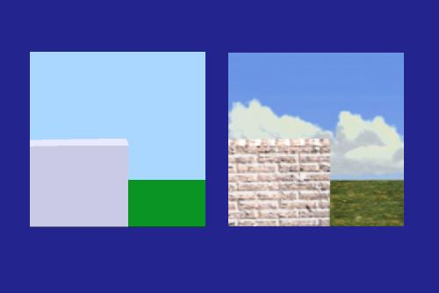
Texture Unit
Painting with images

