Slide 1
CPU
MEMORY
DEVICE
LOAD.DATATYPE ADDRESS → VALUE
STORE.DATATYPE ADDRESS, VALUE

Slide 2
32
Address A31-A0
ADDRESS
8
DataOut Do7-Do0
DATA
8
DataIn Di7-Di0
Processor
To Memory and Devices
R/W
ME
CONTROL`
ACK
32
IRQ IRQ31-IRQ0

Slide 3
MEMORY READ #1
32
Address A31-A0
ADDRESS
8
DataOut Do7-Do0
DATA
8
DataIn Di7-Di0
Processor
To Memory and Devices
R/W
ME
CONTROL`
ACK
32
IRQ IRQ31-IRQ0

Slide 4
MEMORY READ #2
32
Address A31-A0
ADDRESS
8
DataOut Do7-Do0
DATA
8
DataIn Di7-Di0
Processor
To Memory and Devices
R/W
ME
CONTROL`
ACK
32
IRQ IRQ31-IRQ0

Slide 5
MEMORY WRITE #1
32
Address A31-A0
ADDRESS
8
DataOut Do7-Do0
DATA
8
DataIn Di7-Di0
Processor
To Memory and Devices
R/W
ME
CONTROL`
ACK
32
IRQ IRQ31-IRQ0

Slide 6
MEMORY WRITE #2
32
Address A31-A0
ADDRESS
8
DataOut Do7-Do0
DATA
8
DataIn Di7-Di0
Processor
To Memory and Devices
R/W
ME
CONTROL`
ACK
32
IRQ IRQ31-IRQ0

Slide 7
BYTES, HALF-WORDS, WORDS
30
Address A31-A2
ADDRESS
32
DataOut Do31-Do0
DATA
32
DataIn Di31-Di0
4
ByteEnable
Processor
To Memory and Devices
R/W
ME
CONTROL`
ACK
32
IRQ IRQ31-IRQ0

Slide 8
 | BE0 | BE1 | BE2 | BE3
 | D0 – D7 | D8 – D15 | D15 – D23 | D24—D31
x…x00
x…x01
x…x10
x…x11
x…x00
x…x10
x…x00

Slide 9
Operation | A31-A2 | BE3-BE0
LOAD.WORD 10000 | 0…0100 | 1111
LOAD.HWORD 10000 | 0…0100 | 0011
LOAD.HWORD 10010 | 0…0100 | 1100
LOAD.BYTE 10000 | 0…0100 | 0001
LOAD.BYTE 10001 | 0…0100 | 0010
LOAD.BYTE 10010 | 0…0100 | 0100
LOAD.BYTE 10011 | 0…0100 | 1000
LOAD.BYTE 11010 | 0…0110 | 0100
LOAD.BYTE 11101 | 0…0111 | 0010

Slide 10
MEMORY READ #1
30
Address A31-A2
ADDRESS
32
DataOut Do31-Do0
DATA
32
DataIn Di31-Di0
4
ByteEnable
Processor
To Memory and Devices
R/W
ME
CONTROL`
ACK
32
IRQ IRQ31-IRQ0

Slide 11
MEMORY READ #2
30
Address A31-A2
ADDRESS
32
DataOut Do31-Do0
DATA
32
DataIn Di31-Di0
4
ByteEnable
Processor
To Memory and Devices
R/W
ME
CONTROL`
ACK
32
IRQ IRQ31-IRQ0

Slide 12
MEMORY WRITE #1
30
Address A31-A2
ADDRESS
32
DataOut Do31-Do0
DATA
32
DataIn Di31-Di0
4
ByteEnable
Processor
To Memory and Devices
R/W
ME
CONTROL`
ACK
32
IRQ IRQ31-IRQ0

Slide 13
MEMORY WRITE #2
30
Address A31-A2
ADDRESS
32
DataOut Do31-Do0
DATA
32
DataIn Di31-Di0
4
ByteEnable
Processor
To Memory and Devices
R/W
ME
CONTROL`
ACK
32
IRQ IRQ31-IRQ0

Slide 14
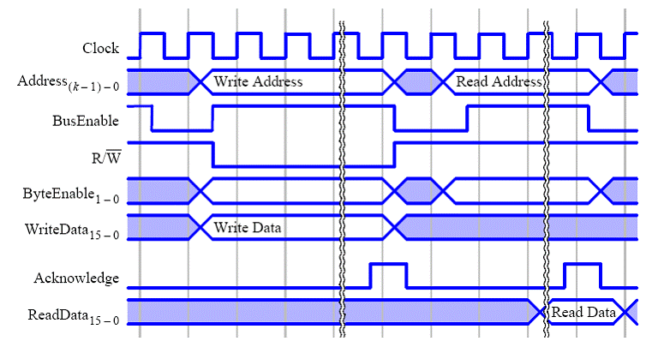

Slide 15
.text
I1: movhi r8, r0, %hi(0x200000) ← assume it’s @ 0x1000
I2: ori r8, r8, %lo(0x200000)
I3: ldh r9, 2(r8)
I4: addi r9, r9, 1
I5: sth r9, 0(r8)
Load.word 0x1000 → fetch I1
Load.word 0x1004 → fetch I2
Load.word 0x1008 → fetch I3
Load.hword 0x200002 → ldh r9, 2(r8)
Load.word 0x100c → fetch I4
Load.word 0x1010 → fetch I5
Store.hword 0x200000, value → sth r9, 0(r8)

Slide 16
Load.word 0x1000
30
Address A31-A2 = 0000 0000 0000 0000 0001 0000 0000 00
32
DataOut Do31-Do0
32
DataIn Di31-Di0 =
4
ByteEnable = 1
Processor
R/W = 1
ME = 1
ACK
32
IRQ IRQ31-IRQ0

Slide 17
Load.word 0x1000
30
Address A31-A2 = 0000 0000 0000 0000 0001 0000 0000 00
32
DataOut Do31-Do0
32
DataIn Di31-Di0 = movhi r8, r0, %hi(0x200000)
4
ByteEnable = 1
Processor
R/W = 1
ME = 1
ACK = 1
32
IRQ IRQ31-IRQ0

Slide 18
CONNECTING MULTIPLE DEVICES
30
Address A31-A2
32
DataOut Do31-Do0
32
DataIn Di31-Di0
Processor
4
ByteEnable
R/W
ME
ACK
32
IRQ IRQ31-IRQ0

Slide 19
CONNECTING MULTIPLE DEVICES
30
Address A31-A2
32
DataOut Do31-Do0
32
DataIn Di31-Di0
4
ByteEnable
Processor
R/W
ME
ACK
32
IRQ IRQ31-IRQ0

Slide 20
CONNECTING MULTIPLE DEVICES
30
Address A31-A2
32
DataOut Do31-Do0
32
DataIn Di31-Di0
4
ByteEnable
Processor
R/W
ME
ACK
32
IRQ IRQ31-IRQ0

Slide 21
CONNECTING MULTIPLE DEVICES
30
Address A31-A2
DataOut Do31-Do0
32
32
Data D31-D0
32
4
ByteEnable
DataIn Di31-Di0
R/W
ME
ACK
Processor
32
IRQ IRQ31-IRQ0

Slide 22
A Write I/O Register
STORE.WORD 0x00300000, 0xfabfadad
A31-A0
32
8
Do7-Do0
Di7-Di0
8
D0-D31
BE
4
Processor
R/W
ME
W
ACK
IRQ IRQ31-IRQ0
32

Slide 23
A Write I/O Register
STORE.WORD 0x00300000, 0xfabfadad
A31-A0
32
8
Do7-Do0
Di7-Di0
8
D0-D31
BE
4
Processor
R/W
0
STORE
ME
1
W
ACK
IRQ IRQ31-IRQ0
32

Slide 24
A Write I/O Register
STORE.WORD 0x00300000, 0xfabfadad
A31-A0
32
8
Do7-Do0
Di7-Di0
8
D0-D31
BE
4
WORD
Processor
R/W
STORE
ME
1
W
ACK
IRQ IRQ31-IRQ0
32

Slide 25
A Write I/O Register
STORE.WORD 0x00300000, 0xfabfadad
A31-A0
32
== 0x30 0000 (upper 32 bits)
8
Do7-Do0
Di7-Di0
8
D0-D31
BE
4
WORD
Processor
R/W
STORE
ME
1
W
ACK
IRQ IRQ31-IRQ0
32

Slide 26
A Write I/O Register
STORE.WORD 0x00300000, 0xfabfadad
A31-A0
32
== 0x30 0000 (upper 32 bits)
8
Do7-Do0
Di7-Di0
8
D0-D31
BE
4
WORD
Processor
R/W
STORE
ME
1
W
ACK
IRQ IRQ31-IRQ0
32

Slide 27
A Write I/O Register
STORE.WORD 0x00300000, 0xfabfadad
A31-A0
32
== 0x30 0000 (upper 32 bits)
8
Do7-Do0
Di7-Di0
8
D0-D31
BE
4
WORD
Processor
R/W
0
STORE
ME
1
W
ACK
IRQ IRQ31-IRQ0
32

Slide 28
A Write I/O Register
STORE.WORD 0x00300000, 0xfabfadad
A31-A0
32
== 0x30 0000 (upper 32 bits)
8
Do7-Do0
Di7-Di0
8
D0-D31
BE
4
WORD
Processor
R/W
0
STORE
ME
1
W
ACK
1
IRQ IRQ31-IRQ0
32

Slide 29
Word address match
STORE.WORD 0x00300000, 0xfabfadad
A31-A2 = 0000 0000 0011 0000 0000 0000 0000 0000

Slide 30
A Read I/O Register
STORE.WORD 0x00300000, 0xfabfadad
A31-A0
32
8
Do7-Do0
Di7-Di0
8
D0-D31
BE
4
Processor
R/W
ME
R
ACK
IRQ IRQ31-IRQ0
32

Slide 31
Mutiplexing the Data In and Data Out

Slide 32
BUS vs. Point to Point

