Slide 1
Independence Instruction Set Architectures
Conventional ISA
Instructions execute in order
No way of stating
Instruction A is independent of B
Must detect at runtime → cost: time, power, complexity
Idea:
Change Execution Model at the ISA model
Allow specification of independence
VLIW Goals:
Flexible enough
Match well technology
Vectors and SIMD
Only for a set of the same operation

Slide 2
VLIW
Instruction format
Very Long Instruction Word
#1 defining attribute
The four instructions are independent
Some parallelism can be expressed this way
Extending the ability to specify parallelism
Take into consideration technology
Recall, delay slots
This leads to →
#2 defining attribute: NUAL
Non-unit assumed latency
ALU1
ALU2
MEM1
control

Slide 3
NUAL vs. UAL
Unit Assumed Latency (UAL)
Semantics of the program are that each instruction is completed before the next one is issued
This is the conventional sequential model
Non-Unit Assumed Latency (NUAL):
At least 1 operation has a non-unit assumed latency, L, which is greater than 1
The semantics of the program are correctly understood if exactly the next L-1 instructions are understood to have issued before this operation completes
NUAL: Result observation is delayed by L cycles

Slide 4
#2 Defining Attribute: NUAL
Assumed latencies for all operations
ALU1
ALU2
MEM1
control
ALU1
ALU2
MEM1
control
ALU1
ALU2
MEM1
control
ALU1
visible
ALU2
MEM1
control
visible
visible
ALU1
ALU2
MEM1
control
ALU1
ALU2
MEM1
visible
control
Glorified delay slots
Additional opportunities for specifying parallelism

Slide 5
#3 DF: Resource Assignment
The VLIW also implies allocation of resources
The spec. inst format maps well onto the following datapath:
ALU1
ALU2
MEM1
control
ALU
ALU
cache
Control
Flow
Unit

Slide 6
VLIW: Definition
Multiple independent Functional Units
Instruction consists of multiple independent instructions
Each of them is aligned to a functional unit
Latencies are fixed
Architecturally visible
Compiler packs instructions into a VLIW also schedules all hardware resources
Entire VLIW issues as a single unit
Result: ILP with simple hardware
compact, fast hardware control
fast clock
At least, this is the goal

Slide 7
VLIW Example
FU
I-fetch &
Issue
FU
Memory
Port
Memory
Port
Multi-ported
Register
File

Slide 8
VLIW Example
Instruction format
ALU1
ALU2
MEM1
control
Program order and execution order
ALU1
ALU2
MEM1
control
ALU1
ALU2
MEM1
control
ALU1
ALU2
MEM1
control
Instructions in a VLIW are independent
Latencies are fixed in the architecture spec.
Hardware does not check anything
Software has to schedule so that all works

Slide 9
Compilers are King
VLIW philosophy:
“dumb” hardware
“intelligent” compiler
Key technologies
Predicated Execution
Trace Scheduling
If-Conversion
Software Pipelining

Slide 10
Predicated Execution
Instructions are predicated
if (cond) then perform instruction
In practice
calculate result
if (cond) destination = result
Converts control flow dependences to data dependences
if ( a == 0)
b = 1;
else b = 2;
true; pred = (a == 0)
pred; b = 1
!pred; b = 2

Slide 11
Predicated Execution: Trade-offs
Is predicated execution always a win?
Is predication meaningful for VLIW only?

Slide 12
Trace Scheduling
Goal:
Create a large continuous piece or code
Schedule to the max: exploit parallelism
“Fact” of life:
Basic blocks are small
Scheduling across BBs is difficult
But:
While many control flow paths exist
There are few “hot” ones

Slide 13
Trace Scheduling
Trace Scheduling
Static control speculation
Assume specific path
Schedule accordingly
Introduce check and repair code where necessary
First used to compact microcode
FISHER, J. Trace scheduling: A technique for global microcode compaction. IEEE Transactions on Computers C-30, 7 (July 1981), 478--490.

Slide 14
Trace Scheduling: Example
Assume A→C is the common path
A
A
schedule
A&C
B
C
Repair
C
B
Expand the scope/flexibility of code motion

Slide 15
Trace Scheduling: Example #2
bA
bB
bA
bB
bC
bC
bD
check
bD
bE
repair
bC
bD
repair
bE
all OK

Slide 16
Trace Scheduling Example
test = a[i] + 20;
If (test > 0) then
sum = sum + 10
else
sum = sum + c[i]
c[x] = c[y] + 10
test = a[i] + 20
sum = sum + 10
c[x] = c[y] + 10
if (test <= 0) then goto repair
…
assume delay
Straight code
repair:
sum = sum – 10
sum = sum + c[i]

Slide 17
SIMD
Single Instruction Multiple Data

Slide 18
SIMD: Motivation Contd.
Recall:
Part of architecture is understanding application needs
Many Apps:
for i = 0 to infinity
a(i) = b(i) + c
Same operation over many tuples of data
Mostly independent across iterations

Slide 19



Some things are naturally parallel

Slide 20
Sequential Execution Model / SISD
int a[N]; // N is large
for (i =0; i < N; i++)
a[i] = a[i] * fade;
Flow of control / Thread
One instruction at the time
Optimizations possible at the machine level
time

Slide 21
Data Parallel Execution Model / SIMD
int a[N]; // N is large
for all elements do in parallel
a[i] = a[i] * fade;
time
This has been tried before: ILLIAC III, UIUC, 1966
http://ieeexplore.ieee.org/xpls/abs_all.jsp?arnumber=4038028&tag=1
http://ed-thelen.org/comp-hist/vs-illiac-iv.html

Slide 22
SIMD Processing
SCALAR
(1 operation)
SIMD
(N operations)
r2
r2
r2
r2
r2
r1
r2
r1
r1
r1
r1
r1
+
+
+
+
+
+
r3
r3
r3
r3
r3
r3
add r3, r1, r2
add r3, r1, r2

Slide 23
TIME
C1
C2
C3
C4
C5
C6
C7
C8
C9
C10
fetch
decode
rf
exec
wb
exec
wb
exec
wb
fetch
decode
rf
exec
wb
exec
wb
exec
wb

Slide 24
TIME
C1
C2
C3
C4
C5
C6
C7
C8
C9
C10
fetch
decode
rf
exec
wb
exec
wb
exec
wb
fetch
decode
rf
exec
wb
exec
wb
exec
wb
fetch
decode
rf
exec
wb
exec
wb
exec
wb

Slide 25
SIMD Architecture
CU
μCU
regs
PE
PE
PE
ALU
MEM
MEM
MEM
Replicate Datapath, not the control
All PEs work in tandem
CU orchestrates operations

Slide 26
Multimedia extensions
SIMD in modern CPUs

Slide 27
MMX: Basics
Multimedia applications are becoming popular
Are current ISAs a good match for them?
Methodology:
Consider a number of “typical” applications
Can we do better?
Cost vs. performance vs. utility tradeoffs
Net Result: Intel’s MMX
Can also be viewed as an attempt to maintain market share
If people are going to use these kind of applications we better support them

Slide 28
Multimedia Applications
Most multimedia apps have lots of parallelism:
for I = here to infinity
out[I] = in_a[I] * in_b[I]
At runtime:
out[0] = in_a[0] * in_b[0]
out[1] = in_a[1] * in_b[1]
out[2] = in_a[2] * in_b[2]
out[3] = in_a[3] * in_b[3]
…..
Also, work on short integers:
in_a[i] is 0 to 256 for example (color)
or, 0 to 64k (16-bit audio)

Slide 29
Observations
32-bit registers are wasted
only using part of them and we know
ALUs underutilized and we know
Instruction specification is inefficient
even though we know that a lot of the same operations will be performed still we have to specify each of the individually
Instruction bandwidth
Discovering Parallelism
Memory Ports?
Could read four elements of an array with one 32-bit load
Same for stores
The hardware will have a hard time discovering this
Coalescing and dependences

Slide 30
MMX Contd.
Can do better than traditional ISA
new data types
new instructions
Pack data in 64-bit words
bytes
“words” (16 bits)
“double words” (32 bits)
Operate on packed data like short vectors
SIMD
First used in Livermore S-1 (> 20 years)

Slide 31
MMX:Example
Up to 8 operations (64bit) go in parallel
Potential improvement: 8x
In practice less but still good
Besides another reason to think your machine
is obsolete

Slide 32
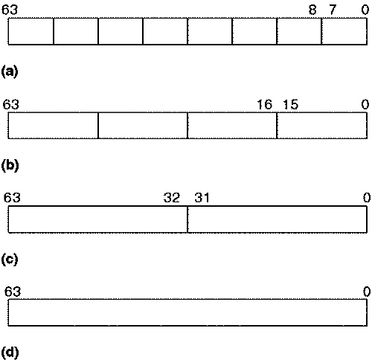
Data Types

Slide 33


Slide 34


Slide 35
Vector Processors
SCALAR
(1 operation)
VECTOR
(N operations)
r1
r2
v1
v2
+
+
r3
v3
vector
length
add r3, r1, r2
vadd.vv v3, v1, v2
Scalar processors operate on single numbers (scalars)
Vector processors operate on vectors of numbers
Linear sequences of numbers
From. Christos Kozyrakis, Stanford

Slide 36
TIME
C1
C2
C3
C4
C5
C6
C7
C8
C9
C10
fetch
decode
rf
exec
wb
rf
exec
wb
rf
exec
wb
fetch
decode
rf
exec
wb
rf
exec
wb
rf
exec
wb
fetch
decode
rf
exec
wb
rf
exec
wb
rf
exec
wb

Slide 37
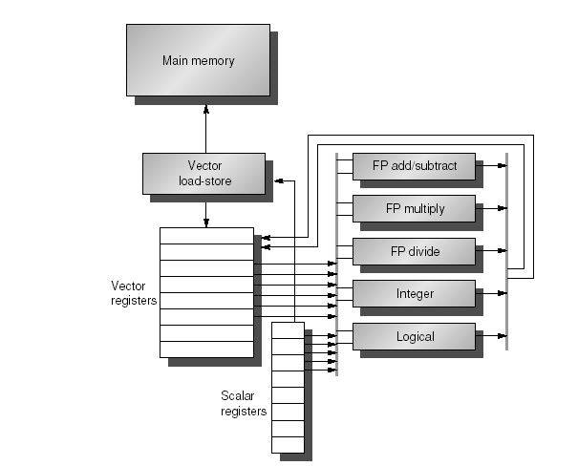
Example of Simple Vector Processor

Slide 38
What’s in a Vector Processor
A scalar processor (e.g. a MIPS processor)
Scalar register file (32 registers)
Scalar functional units (arithmetic, load/store, etc)
A vector register file (a 2D register array)
Each register is an array of elements
E.g. 32 registers with 32 64-bit elements per register
MVL = maximum vector length = max # of elements per register
A set for vector functional units
Integer, FP, load/store, etc
Some times vector and scalar units are combined (share ALUs)

Slide 39
Vector Code Example
Y[0:63] = Y[0:63] + a * X[0:63]
LD R0, a
VLD V1, 0(Rx) V1 = X[]
VLD V2, 0(Ry) V2 = Y[]
VMUL.SV V3, R0, V1 V3 = X[]*a
VADD.VV V4, V2, V3 V4 = Y[]+V3
VST V4, 0(Ry) store in Y[]

