Slide 1
Introduction to CUDA Programming
Intel’s Sandy Bridge Architecture
Andreas Moshovos
Winter 2012
Based on David Kanter’s article: http://realworldtech.com/page.cfm?ArticleID=RWT091810191937

Slide 2
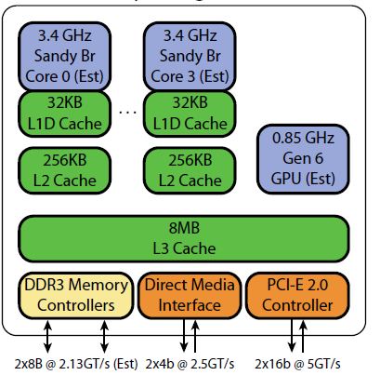
Chip Architecture
32nm

Slide 3
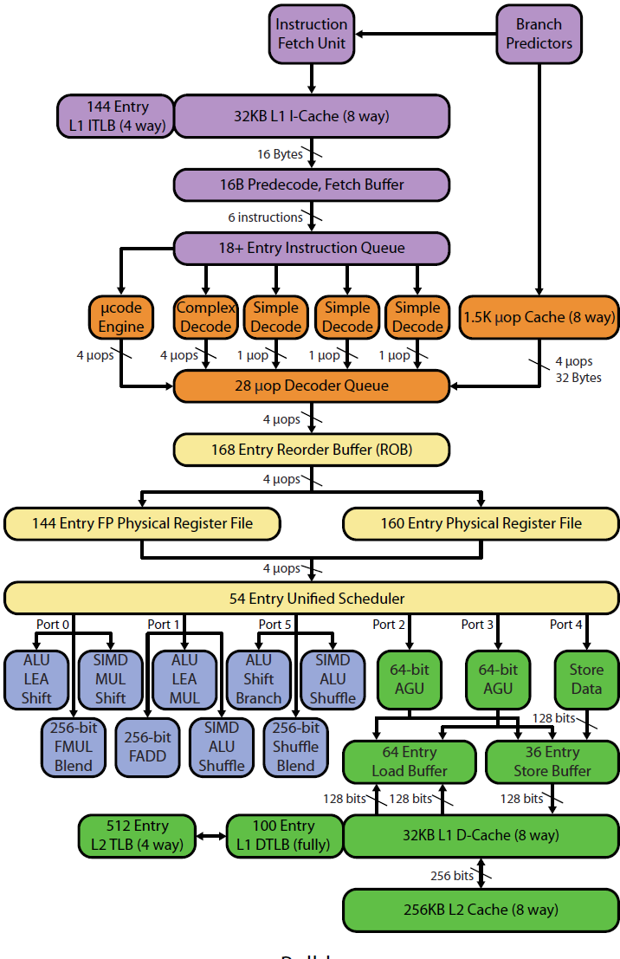
Overall Core Architecture

Slide 4
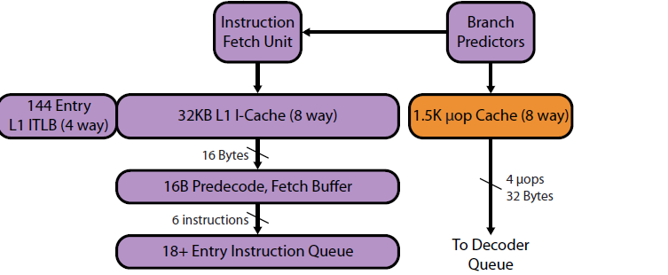
Core Architecture – Instruction Fetch

Slide 5
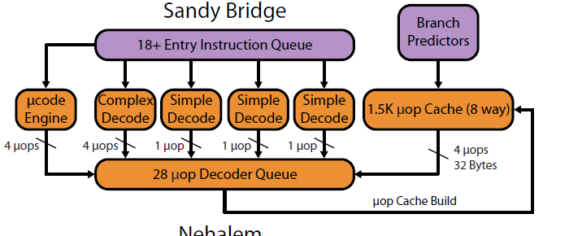
Instruction Decode

Slide 6
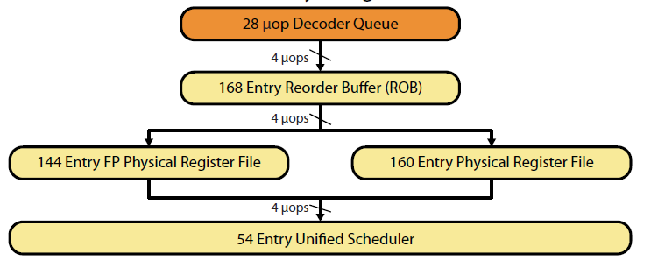
Out-of-Order Execution

Slide 7
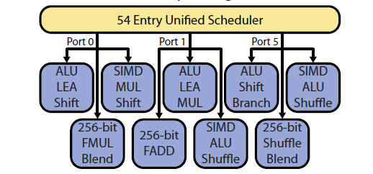
Execution Units – Scalar, SIMD, FP and AVX (vector)

Slide 8
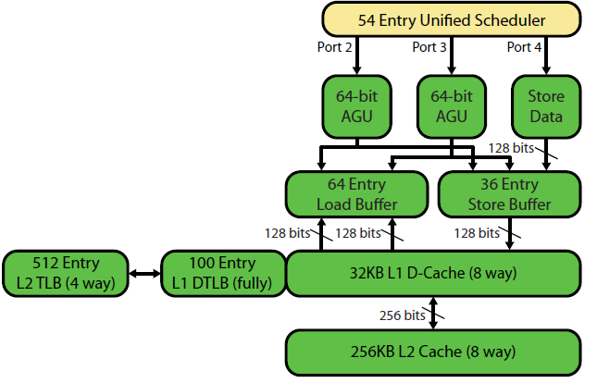
Memory Access Units
L1 load to use latency is 4 cycles
Banked to support multiple accesses
Poor man’s multiporting?
L2 load to use latency is 12 cycles

Slide 9
L3 and ring interconnect
CPUs, GPU and system agent
Communicate via a ring
Each CPU has an 2MB 8-way SA L3 slice
Static hash of addresses to slices
Latency varies: which core to which slice
26-31 cycles
Max bandwidth: 435.2GB/s at 3.4Ghz

Slide 10
Overall Core Architecture

