Slide 1
SRAM Memory External Interface
A0-A9
D0
R/W!
E
1Kbit SRAM
GEOMETRY: ( ROWS , COLS ) == ADDRESSES x DATA WIDTH
CAPACITY

Slide 2
Making Wider Memories
WANT HAVE
A0-A9
D0-D1
A0-A9
D0
R/W!
R/W!
E
E
1Kx2bit SRAM
1Kx1bit SRAM

Slide 3
Making Wider Memories
D0
D0-D1
A0-A10
A0-A9
D0
R/W!
E
R/W!
D1
A0-A9
D0
R/W!
E
E
2Kx1bit SRAM

Slide 4
Making Taller Memories
WANT HAVE
A0-A10
D0
A0-A9
D0
R/W!
R/W!
E
E
2Kx1bit SRAM
1Kx1bit SRAM

Slide 5
Making Taller Memories
WANT HAVE
A0-A10
D0
A0-A9
D0
R/W!
R/W!
E
E
2Kx1bit SRAM
1Kx1bit SRAM

Slide 6
Making Taller Memories
A0-A10
D0
A0-A9
D0
R/W!
R/W!
E
E
2Kx1bit SRAM
1Kx1bit SRAM

Slide 7
Address Mapping
0 00000 00000
1K rows
0 11111 11111
2K rows
1 00000 00000
1 11111 11111

Slide 8
Address Mapping
0 XXXXX XXXXX
1K rows
2K rows
A10
1 XXXXX XXXXX

Slide 9
Making Taller Memories
D0
D0
A0-A10
A0-A9
A0-A9
D0
R/W!
A10
E
R/W!
A0-A9
D0
A0-A9
D0
R/W!
E
E
2Kx1bit SRAM

Slide 10
Making Taller Memories
A0-A11
D0
A0-A9
D0
R/W!
R/W!
E
E
4Kx1bit SRAM
1Kx1bit SRAM

Slide 11
Address Mapping
00 00000 00000
1K rows
00 11111 11111
01 00000 00000
4K rows
01 11111 11111
10 00000 00000
10 11111 11111
11 00000 00000
11 11111 11111

Slide 12
Address Mapping
00 XXXXX XXXXX
1K rows
01 XXXXX XXXXX
4K rows
10 XXXXX XXXXX
11 XXXXX XXXXX

Slide 13
Making Taller Memories
A0-A11
A0-A9
D0
D0
A0-A9
D0
A11-A10
R/W!
E
R/W!
A0-A9
D0
A0-A9
D0
R/W!
E
E
A0-A9
D0
A0-A9
D0
R/W!
E
A0-A9
D0
A0-A9
D0
R/W!
E

Slide 14
Where is the decoder?
D0
D0
A0-A10
A0-A9
A0-A9
D0
R/W!
A10
E
R/W!
A0-A9
D0
A0-A9
D0
R/W!
E
E
2Kx1bit SRAM

Slide 15
Memory External Interface
A0-A9
D0
R/W!
E
1Kbit SRAM

Slide 16
SRAM Internal Organization
A0-A9
SRAM bit
Decoder
R/W!
Wire delay = f(length^2)
E
D0
Sense Amp

Slide 17
SRAM Internal Organization
A0-A9
A0-A4
32x32 array
As square as possible
Row Decoder
R/W!
A5-A9
Column Mux
D0
E

Slide 18
Wider Data Bus
A0-A9
A0-A4
32x32 array
32x32 array
32x32 array
Row Decoder
32x32 array
Row Decoder
Row Decoder
Row Decoder
R/W!
A5-A9
Column Mux
Column Mux
Column Mux
D3
Column Mux
D2
D1
E
D0

Slide 19
Wider Data Bus
A0-A9
A0-A4
32x32 array
As square as possible
Row Decoder
R/W!
A5-A9
Column Mux
D0-D3
D0-D3
E

Slide 20
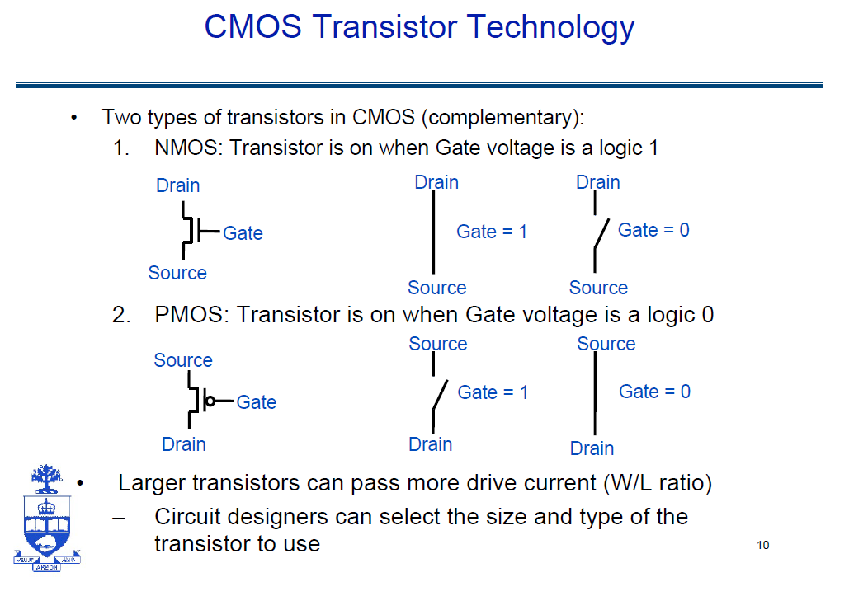
From prof. Gulak’s Slides

Slide 21
SRAM Bit Cell
row select
6T Cell
bitline
bitline!
bit-cell array
2^{n} row x 2^{m}-col
(n≈m to minmize
overall latency)
n
2^{n}
Read Sequence
1. precharge all bitlines
2. address decode
3. drive row select
4. selected bit-cells drive bitlines
5. diff. sensing and col. select
n+m
m
2^{m} diff pairs
sense amp and mux
1
From Prof. Sankaralingam, UWisc-Madison

Slide 22
SRAM Bit Cell - Precharge
Vdd
Vdd
wordline
bitline
bitline!

Slide 23
SRAM Bit Cell – Decode Row and Select
row select
bitline
bitline!

Slide 24
SRAM Bit Cell – Mux and Sense
row select
bitline
bitline!

Slide 25
SRAM Bit Cell – Mux and Sense
row select
bitline
bitline!

Slide 26
SRAM Bit Cell – Writes
0
1
row select
bitline
bitline!

Slide 27
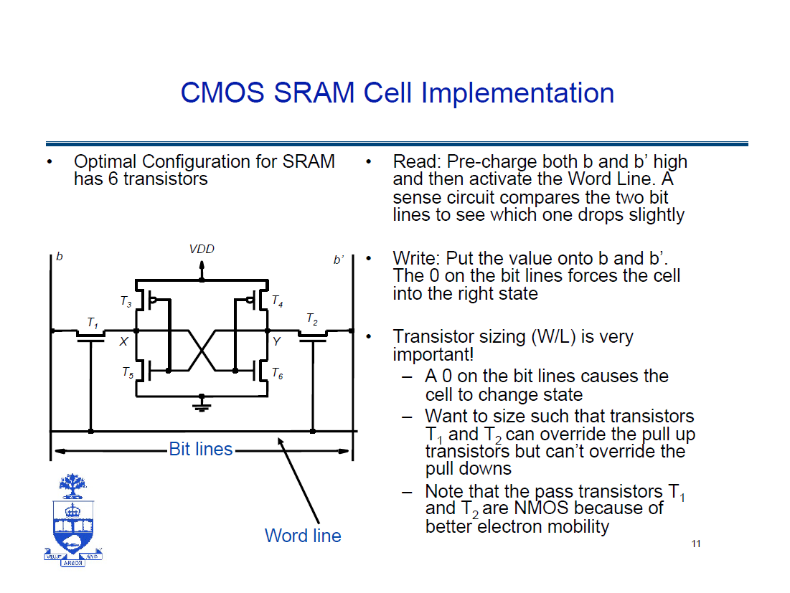
From prof. Gulak’s Slides

Slide 28
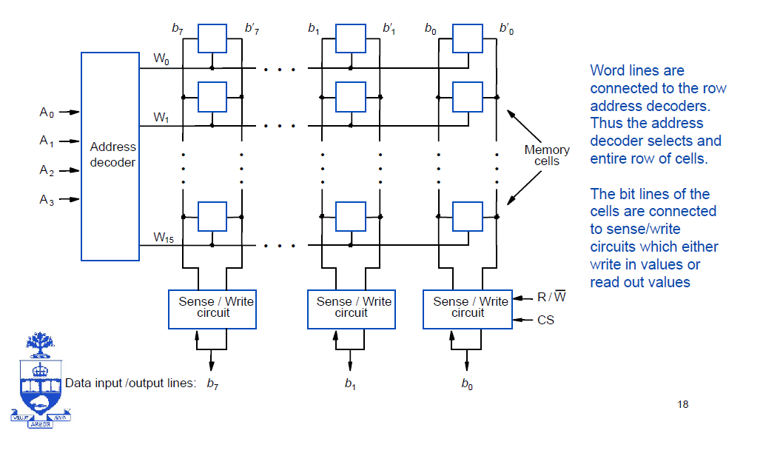
Memory Array
From prof. Gulak’s Slides

Slide 29
Decoders
users.ece.utexas.edu/~adnan/vlsi-05-backup/lec13SRAM.ppt‎

Slide 30
Larger Decoders
For N>4 NAND becomes slow
Use 2-input gates hierarchically
users.ece.utexas.edu/~adnan/vlsi-05-backup/lec13SRAM.ppt‎

Slide 31
Pre-Decoding
Many gates are redundant
Saves area

Slide 32
Dynamic RAM
Value is stored on a capacitor C – A single pass transistor T connects C to the bit line when the cell is being read or written
C experiences leakage meaning the charge stored on C will slowly leak out, thus destroying the value
To prevent this DRAM cells need to be periodically refreshed – Memory controller goes through and reads all the cells and then writes the same values back
DRAM cells have a different manufacturing process than processors so it’s difficult and expensive to incorporate them onto the same chip
wordline
_bitline
RAS
bit-cell array
2^{n} row x 2^{m}-col
(n≈m to minmize
overall latency)
n
2^{n}
m
2^{m}
sense amp and mux
1
A DRAM die comprises
of multiple such arrays
CAS
From Prof. Sankaralingam, UWisc-Madison

Slide 33
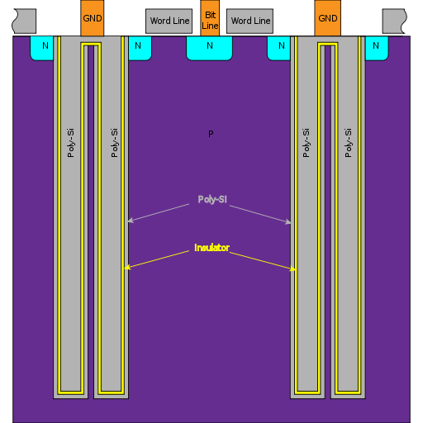
wordline
_bitline
From http://en.wikipedia.org/wiki/File:DRAM_trench_structure_configuration1_1.svg

Slide 34
DRAM Notes
Read:
Bit line is pre-charged and then word line is activated. If there is a 1 in the capacitor, then the bit line remains high. Otherwise it gets pulled down
Write:
Bit line is driven to the write value and either charges or drains the capacitor writing the value into it.
Refresh adds overhead:
Usually each cell has to be refreshed every 64ms
Cell is unavailable for 2-4% of refresh period (i.e. 1.2 to 2.4 ms of each 64ms period)
Memory controller tries to schedule refreshes so they don’t interfere with regular memory traffic
Self-Refreshing memories

Slide 35
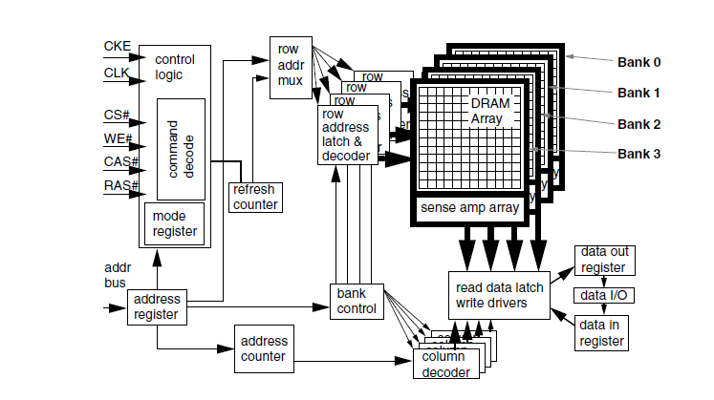
Synchronous DRAM
http://search.library.utoronto.ca/details?6949501
Memory Systems
Cache, DRAM, Disk
About this Book
Author(s): Bruce Jacob, Spencer W. Ng, David T. Wang and Samuel Rodriguez

Slide 36
Synchronous DRAM (SDRAM)
RAS’
CAS’
Column
Row
Data
Data
Data
BURST
From Prof. Sankaralingam, UWisc-Madison

Slide 37
DDR2 (Double Data Rate
RAS’
CAS’
Column
Row
Data
Data
Data
From Prof. Sankaralingam, UWisc-Madison

Slide 38
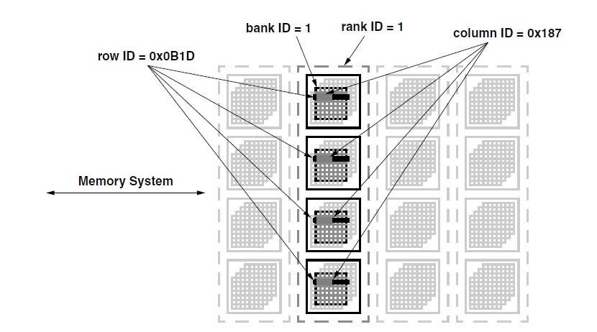
Addressing in Modern DRAM

Slide 39
DRAM Organization Alternatives
128MB DRAM Capacity
64-bit data bus
1Gbit capacity
64MBit w/ 4-bit data bus?
64Mbit w/ 8-bit data bus?
128Mbit w/ 16-bit data bus?

Slide 40
DRAM Organization Alternatives
128MB DRAM Capacity
64-bit data bus
1Gbit capacity
64MBit w/ 4-bit data bus?
64 bit bus? 16 devices
16 x 64Mb = 1Gbit
64Mbit w/ 8-bit data bus?
64-bit bus? 8 devices
Capacity? 8 x 64Mbit = 512Mbit → 2 ranks
128Mbit w/ 16-bit data bus?
64-bit bus? 4 devices
1Gbit capacity

Slide 41
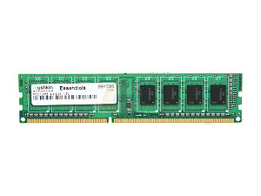
Home > Computer Hardware > Memory > Desktop Memory > Mushkin Enhanced > Item#: N82E16820146744
Mushkin Enhanced Essentials 2GB 240-Pin DDR3 SDRAM DDR3 1333 (PC3 10666) Desktop Memory Model 991586
DDR3 1333 (PC3 10666)
Timing 9-9-9-24
Cas Latency 9
Voltage 1.5V

Slide 42
DDR3 1333
Operates at 667 Mhz
Can tranfer data at double the rate
Bandwidth 1333 MT/sec
Mega transfers per second

Slide 43
DRAM Access Sequence
1. Precharge
2. Row Access
3. Column Access
4. Data Transfer
5. Close Row (write data back)

Slide 44
DRAM Timing
tCAS-tRCD-tRP-tRAS
tCAS:
column address strobe column to data appearing
tRCD:
RAS to CAS row to column
tRP:
RAS precharge, Precharge latency
tRAS:
Row Access Strobe: Shortest time between two Row activations

Slide 45
DDR3 Timing
Timing 9-9-9-24
tCAS-tRCD-tRP-tRAS

Slide 46
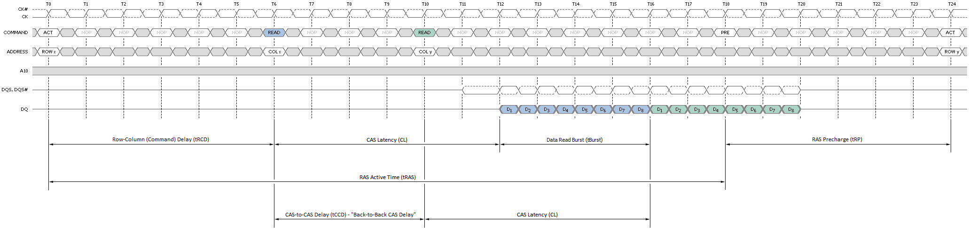
DDR DRAM Timing
Timing 9-9-9-24
tCAS-tRCD-tRP-tRAS
From anandtech: http://images.anandtech.com/doci/3851/Back%20to%20Back%20Burst%20Read%20with%20Page%20Close.png

Slide 47
Interleaved Main Memory
Divide memory into M banks and “interleave” addresses across them, so word A is
in bank (A mod M)
at word (A div M)
Interleaved memory increases memory BW without wider bus
Use parallelism in memory banks to hide memory latency
Bank 0
Bank 1
Bank 2
Bank n
word 0
word 1
word 2
word n-1
word n
word n+1
word n+2
word 2n-1
word 2n
word 2n+1
word 2n+2
word 3n-1
PA
Doubleword in bank
Bank
Word in doubleword
Copyright © 2002 Falsafi, from Hill, Smith, Sohi, Vijaykumar, and Wood

Slide 48
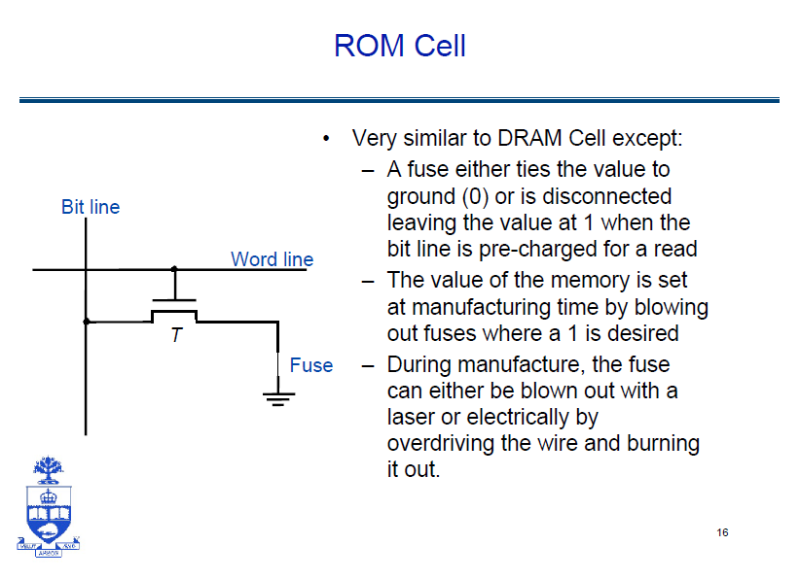

Slide 49
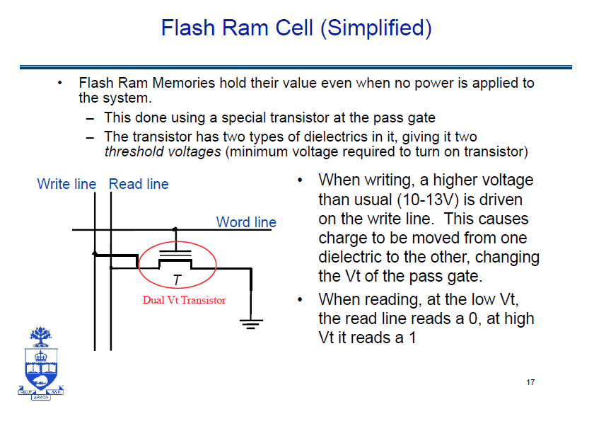

Slide 50
Flash Memory
gate
Floating gate
p
n
n

Slide 51
Flash Memory
“1”
“0”
- - - - - - - - - - -
Trapped charge
p
n
n
p
n
n
Floating gate changes threshold voltage
SLC → 2 states
MLC → more states

Slide 52
Flash Memory -- Reading
gate
Voltage
Floating gate
p
n
n

Slide 53
Flash Memory – Writing a “0”
gate
High Possitive
Voltage
- - - - - - - - - -
p
n
n

Slide 54
Flash Memory – Writing a “1”
gate
High negative
Voltage
p
n
n

Slide 55
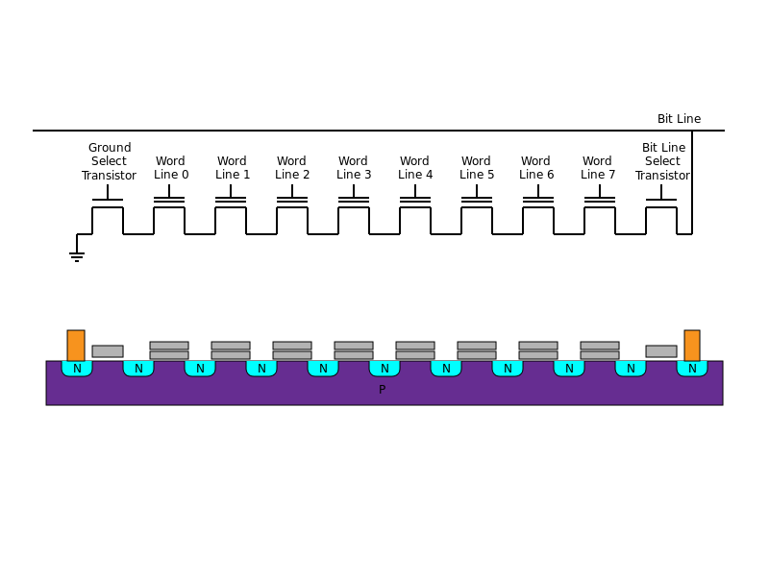
NAND FLASH

Slide 56
NAND FLASH Reading
Conduct no matter what value
Conduct only if no charge
Von
Von
Von
VA
Von
Von
Von
Von
Von
Von

Slide 57
NAND FLASH Erasing
Clear off all charge: negative
Von
Ve
Ve
Ve
Ve
Ve
Ve
Ve
Ve
Von

Slide 58
NAND FLASH Writing
Conduct no matter what value
High possitive
Von
Von
Von
VA
Von
Von
Von
Von
Von
Von

