Slide 1
TIME
C1
C2
C3
C4
C5
C6
C7
C8
C9
C10
fetch
decode
rf
exec
wb
fetch
decode
rf
exec
wb
fetch
decode
rf
exec
wb
fetch
decode
rf
exec
wb
fetch
decode
rf
exec
wb
fetch
decode
rf
exec
wb

Slide 2
S1Ld
S2Ld
S3Ld
2
IR4.6-7
PC1
PC2
PC3
IR4ld
8
8
IR3
8
IR4
R1B
ALU1
R1Sel
RFWrite
ALUop
0
8
00
3
IR1
0
8
01
8
ALU1
2
reg1
data1
1
R1
10
IMRead
1
1
RF
ALU2
0
WBin
2
0
ALU
PCSel
IR2
IR5-4
reg2
8
8
1
PC
ADDR
data2
1
R2
000
0
0
8
8
RwSel
1
111
regw
dataw
8
1
IM
8
R2B
Imm4
SE
001
Data_out
Imm5
010
N
Z
8
PCwrite
ZE
FlagWrite
1
Imm3
SE
011
MemRead
MemWrite
ADDR
Memory
Data_in
Data_out

Slide 3
BRANCHES: Calculate the target: we have to use the right PC
S1Ld
S2Ld
S3Ld
2
IR4.6-7
PC1
PC2
PC3
IR4ld
8
8
IR3
8
IR4
R1B
ALU1
R1Sel
RFWrite
ALUop
0
8
00
3
IR1
0
8
01
8
ALU1
2
reg1
data1
1
R1
10
IMRead
1
1
RF
ALU2
0
WBin
2
0
ALU
PCSel
IR2
IR5-4
reg2
8
8
1
PC
ADDR
data2
1
R2
000
0
8
8
regw
dataw
8
8
IM
8
R2B
111
1
Imm4
4
SE
8
001
Data_out
N
Z
8
PCwrite
Imm5
5
ZE
8
010
FlagWrite
1
Imm3
ZE
011
MemRead
MemWrite
ADDR
Memory
Data_in
Data_out

Slide 4
How about ORI? Can it write to K1?
S1Ld
S2Ld
S3Ld
2
IR4.6-7
PC1
PC2
PC3
IR4ld
8
8
IR3
8
IR4
R1B
ALU1
R1Sel
RFWrite
ALUop
0
8
00
3
IR1
0
8
01
8
ALU1
2
reg1
data1
1
R1
10
IMRead
1
1
RF
ALU2
0
WBin
2
0
ALU
PCSel
IR2
IR5-4
reg2
8
8
1
PC
ADDR
data2
1
R2
000
0
8
8
regw
dataw
8
8
IM
8
R2B
111
1
Imm4
4
SE
8
001
Data_out
N
Z
8
PCwrite
Imm5
5
ZE
8
010
FlagWrite
1
Imm3
ZE
011
MemRead
MemWrite
ADDR
Memory
Data_in
Data_out

Slide 5
How about ORI? Can it write to K1?
S1Ld
S2Ld
S3Ld
2
IR4.6-7
PC1
PC2
PC3
IR4ld
8
8
IR3
8
IR4
R1B
ALU1
R1Sel
RFWrite
ALUop
0
8
00
3
IR1
0
8
01
8
ALU1
2
reg1
data1
1
R1
10
IMRead
1
1
RF
ALU2
0
WBin
2
0
ALU
PCSel
IR2
IR5-4
reg2
8
8
1
ADDR
1
data2
1
R2
000
0
PC
8
8
RwSel
regw
dataw
8
111
8
1
IM
8
R2B
Imm4
4
SE
8
001
8
PCwrite
Data_out
Imm5
5
ZE
8
010
FlagWrite
N
Z
1
Imm3
ZE
011
MemRead
MemWrite
ADDR
Memory
Data_in
Data_out

Slide 6
S1Ld
S2Ld
S3Ld
2
IR4.6-7
PC1
PC2
PC3
IR4ld
8
8
IR3
8
IR4
R1B
ALU1
R1Sel
RFWrite
ALUop
0
8
00
3
IR1
0
8
01
8
ALU1
2
reg1
data1
1
R1
10
IMRead
1
1
RF
ALU2
0
WBin
2
0
ALU
PCSel
IR2
IR5-4
reg2
8
8
1
PC
ADDR
data2
1
R2
000
0
8
8
RwSel
regw
dataw
111
8
1
IM
8
R2B
Imm4
SE
001
Data_out
Imm5
010
N
Z
8
PCwrite
ZE
FlagWrite
1
Imm3
SE
011
ADD K1 K2
ADD K3 K1
ADD K0 K0
BZ 1
SUB K0 K1
NAND K2 K0
MemRead
MemWrite
ADDR
Memory
Data_in
Data_out

Slide 7
ADD K1 K2
S1Ld
S2Ld
S3Ld
2
IR4.6-7
PC1
PC2
PC3
IR4ld
8
8
IR3
8
IR4
R1B
ALU1
R1Sel
RFWrite
ALUop
0
8
00
3
IR1
0
8
01
8
ALU1
2
reg1
data1
1
R1
10
IMRead
1
1
RF
ALU2
0
WBin
2
0
ALU
PCSel
IR2
IR5-4
reg2
8
8
1
PC
ADDR
data2
1
R2
000
0
8
8
RwSel
regw
dataw
111
8
1
IM
8
R2B
Imm4
SE
001
Data_out
Imm5
010
N
Z
8
PCwrite
ZE
FlagWrite
1
Imm3
SE
011
ADD K1 K2
ADD K3 K1
ADD K0 K0
BZ 1
SUB K0 K1
NAND K2 K0
MemRead
MemWrite
ADDR
Memory
Data_in
Data_out
CYCLE 1

Slide 8
ADD K3 K1
ADD K1 K2
S1Ld
S2Ld
S3Ld
2
IR4.6-7
PC1
PC2
PC3
IR4ld
8
8
IR3
8
IR4
R1B
ALU1
R1Sel
RFWrite
ALUop
0
8
00
3
IR1
0
8
01
8
ALU1
2
reg1
data1
1
R1
10
IMRead
1
1
RF
ALU2
0
WBin
2
0
ALU
PCSel
IR2
IR5-4
reg2
8
8
1
PC
ADDR
data2
1
R2
000
0
8
8
RwSel
regw
dataw
111
8
1
IM
8
R2B
Imm4
SE
001
Data_out
Imm5
010
N
Z
8
PCwrite
ZE
FlagWrite
1
Imm3
SE
011
ADD K1 K2
ADD K3 K1
ADD K0 K0
BZ 1
SUB K0 K1
NAND K2 K0
MemRead
MemWrite
ADDR
Memory
Data_in
Data_out
CYCLE2

Slide 9
ADD K0 K0
ADD K3 K1
ADD K1 K2
S1Ld
S2Ld
S3Ld
2
IR4.6-7
PC1
PC2
PC3
IR4ld
8
8
IR3
8
IR4
R1B
ALU1
R1Sel
RFWrite
ALUop
0
8
00
3
IR1
0
8
01
8
ALU1
2
reg1
data1
1
R1
10
IMRead
1
1
RF
ALU2
0
WBin
2
0
ALU
PCSel
IR2
IR5-4
reg2
8
8
1
PC
ADDR
data2
1
R2
000
0
8
8
RwSel
regw
dataw
111
8
1
IM
8
R2B
Imm4
SE
001
Data_out
Imm5
010
N
Z
8
PCwrite
ZE
FlagWrite
1
Imm3
SE
011
ADD K1 K2
ADD K3 K1
ADD K0 K0
BZ 1
SUB K0 K1
NAND K2 K0
MemRead
MemWrite
ADDR
Memory
Data_in
Data_out
CYCLE3

Slide 10
BZ 1
ADD K0 K0
ADD K3 K1
ADD K1 K2
S1Ld
S2Ld
S3Ld
2
IR4.6-7
PC1
PC2
PC3
IR4ld
8
8
IR3
8
IR4
R1B
ALU1
R1Sel
RFWrite
ALUop
0
8
00
3
IR1
0
8
01
8
ALU1
2
reg1
data1
1
R1
10
IMRead
1
1
RF
ALU2
0
WBin
2
0
ALU
PCSel
IR2
IR5-4
reg2
8
8
1
PC
ADDR
data2
1
R2
000
0
8
8
RwSel
regw
dataw
111
8
1
IM
8
R2B
Imm4
SE
001
Data_out
Imm5
010
N
Z
8
PCwrite
ZE
FlagWrite
1
Imm3
SE
011
ADD K1 K2
ADD K3 K1
ADD K0 K0
BZ 1
SUB K0 K1
NAND K2 K0
MemRead
MemWrite
ADDR
Memory
Data_in
Data_out
CYCLE 4

Slide 11
SUB K0 K1
BZ 1
ADD K0 K0
ADD K3 K1
ADD K1 K2
S1Ld
S2Ld
S3Ld
2
IR4.6-7
PC1
PC2
PC3
IR4ld
8
8
IR3
8
IR4
R1B
ALU1
R1Sel
RFWrite
ALUop
0
8
00
3
IR1
0
8
01
8
ALU1
2
reg1
data1
1
R1
10
IMRead
1
1
RF
ALU2
0
WBin
2
0
ALU
PCSel
IR2
IR5-4
reg2
8
8
1
PC
ADDR
data2
1
R2
000
0
8
8
RwSel
regw
dataw
111
8
1
IM
8
R2B
Imm4
SE
001
Data_out
Imm5
010
N
Z
8
PCwrite
ZE
FlagWrite
1
Imm3
SE
011
ADD K1 K2
ADD K3 K1
ADD K0 K0
BZ 1
SUB K0 K1
NAND K2 K0
MemRead
MemWrite
ADDR
Memory
Data_in
Data_out
CYCLE 5

Slide 12
NAND K2 K0
SUB K0 K1
BZ 1
ADD K0 K0
ADD K3 K1
S1Ld
S2Ld
S3Ld
2
IR4.6-7
PC1
PC2
PC3
IR4ld
8
8
IR3
8
IR4
R1B
ALU1
R1Sel
RFWrite
ALUop
0
8
00
3
IR1
0
8
01
8
ALU1
2
reg1
data1
1
R1
10
IMRead
1
1
RF
ALU2
0
WBin
2
0
ALU
PCSel
IR2
IR5-4
reg2
8
8
1
PC
ADDR
data2
1
R2
000
0
8
8
RwSel
regw
dataw
111
8
1
IM
8
R2B
Imm4
SE
001
Data_out
Imm5
010
N
Z
8
PCwrite
ZE
FlagWrite
1
Imm3
SE
011
ADD K1 K2
ADD K3 K1
ADD K0 K0
BZ 1
SUB K0 K1
NAND K2 K0
MemRead
MemWrite
ADDR
Memory
Data_in
Data_out
CYCLE 6

Slide 13
ORI 0x3
NAND K2 K2
SUB K0 K1
BZ 1
ADD K0 K0
S1Ld
S2Ld
S3Ld
2
IR4.6-7
PC1
PC2
PC3
IR4ld
8
8
IR3
8
IR4
R1B
ALU1
R1Sel
RFWrite
ALUop
0
8
00
3
IR1
0
8
01
8
ALU1
2
reg1
data1
1
R1
10
IMRead
1
1
RF
ALU2
0
WBin
2
0
ALU
PCSel
IR2
IR5-4
reg2
8
8
1
PC
ADDR
data2
1
R2
000
0
8
8
RwSel
regw
dataw
111
8
1
IM
8
R2B
Imm4
SE
001
Data_out
Imm5
010
N
Z
8
PCwrite
ZE
FlagWrite
1
Imm3
SE
011
ADD K1 K2
ADD K3 K1
ADD K0 K0
BZ 1
SUB K0 K1
NAND K2 K0
ORI 0x3
MemRead
MemWrite
ADDR
Memory
Data_in
Data_out
CYCLE 7

Slide 14
NAND K2 K1
ORI 0x3
NAND K2 K1
SUB K0 K1
BZ1
S1Ld
S2Ld
S3Ld
2
IR4.6-7
PC1
PC2
PC3
IR4ld
8
8
IR3
8
IR4
R1B
ALU1
R1Sel
RFWrite
ALUop
0
8
00
3
IR1
0
8
01
8
ALU1
2
reg1
data1
1
R1
10
IMRead
1
1
RF
ALU2
0
WBin
2
0
ALU
PCSel
IR2
IR5-4
reg2
8
8
1
PC
ADDR
data2
1
R2
000
0
8
8
RwSel
regw
dataw
111
8
1
IM
8
R2B
Imm4
SE
001
Data_out
Imm5
010
N
Z
8
PCwrite
ZE
FlagWrite
1
Imm3
SE
011
ADD K1 K2
ADD K3 K1
ADD K0 K0
BZ 1
SUB K0 K1
NAND K2 K0
ORI 0x3
MemRead
MemWrite
ADDR
Memory
Data_in
Data_out
CYCLE 8

Slide 15
TIME
C1
C2
C3
C4
C5
C6
C7
C8
C9
C10
branch
decode
rf
exec
wb
squashed
fetch
decode
rf
bubble
bubble
fetch
decode
bubble
bubble
bubble
fetch
fetch
decode
rf
exec
wb
Redirected fetch
fetch
decode
rf
exec
wb

Slide 16
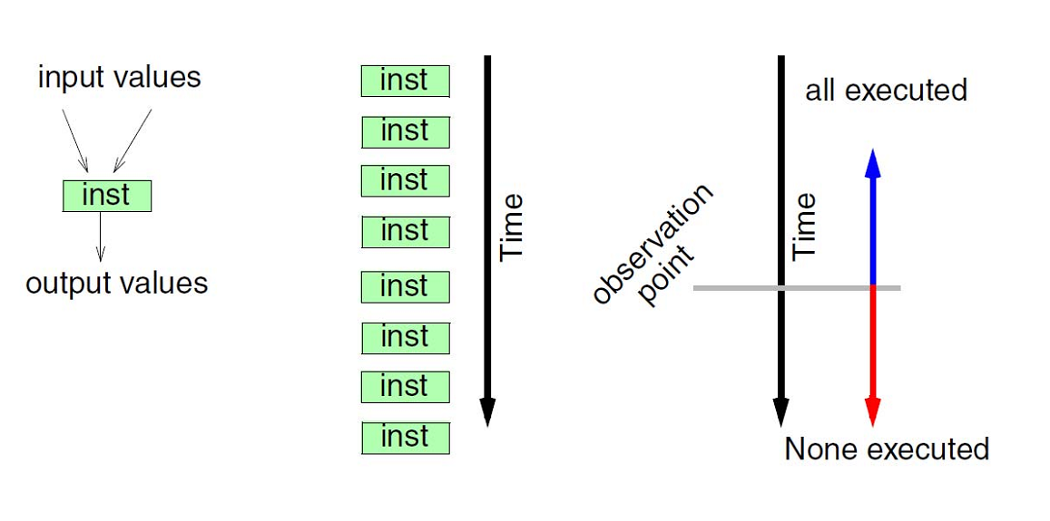
Sequential Execution Semantics
Contract: The machine should appear to behave like this.

Slide 17
PC
FLAGS
REGISTERS
TIME
C1
C2
C3
C4
C5
C6
C7
C8
C9
C10
fetch
decode
rf
exec
wb
fetch
decode
rf
exec
wb
fetch
decode
rf
exec
wb
fetch
decode
rf
exec
wb
fetch
decode
rf
exec
wb
fetch
decode
rf
exec
wb
MEMORY

Slide 18
Registers?
TIME
A
B
C1
C2
C3
C4
C5
C6
C7
C8
C9
C10
fetch
decode
rf
exec
wb
fetch
decode
rf
exec
wb
fetch
decode
rf
exec
wb
fetch
decode
rf
exec
wb
fetch
decode
rf
exec
wb
ADD K1 K2
ADD K3 K1
ADD K0 K0
ADD K3 K1
ADD K0 K1

Slide 19
Memory?
TIME
A
B
C1
C2
C3
C4
C5
C6
C7
C8
C9
C10
fetch
decode
rf
exec
wb
fetch
decode
rf
exec
wb
fetch
decode
rf
exec
wb
ADD K1 K2
ST K2 (K0)
LD K3 (K0)

Slide 20
PC?
How can we tell the PC has been updated?
How can we read the PC?
TIME
A
B
C1
C2
C3
C4
C5
C6
C7
C8
C9
C10
fetch
decode
rf
exec
wb
fetch
decode
rf
exec
wb
fetch
decode
rf
exec
wb
fetch
decode
rf
exec
wb
fetch
decode
rf
exec
wb
fetch
decode
rf
exec
wb
ADD K1 K2
ADD K3 K1
ADD K0 K0
ADD K3 K1
ADD K0 K1

Slide 21
Flags
How can we tell the flags have changed?
Who reads the flags?
TIME
A
B
C1
C2
C3
C4
C5
C6
C7
C8
C9
C10
fetch
decode
rf
exec
wb
fetch
decode
rf
exec
wb
fetch
decode
rf
exec
wb
fetch
decode
rf
exec
wb
fetch
decode
rf
exec
wb
fetch
decode
rf
exec
wb
ADD K1 K2
ADD K3 K1
ADD K0 K0
ADD K3 K1
ADD K0 K1

Slide 22
What if we allowed out-of-order changes?
TIME
A
B
C1
C2
C3
C4
C5
C6
C7
C8
C9
C10
fetch
decode
rf
exec
wb
fetch
decode
rf
exec
wb
fetch
decode
rf
exec
wb
fetch
decode
rf
exec
wb
fetch
decode
rf
exec
wb
fetch
decode
rf
exec
wb
SPECULATIVE UPDATES:
HISTORY FILE: allow update but keep old value
FUTURE FILE: Two copies: Running and Architectural

Slide 23
INTERRUPTS?
TIME
C1
C2
C3
C4
C5
C6
C7
C8
C9
C10
fetch
decode
rf
exec
wb
fetch
decode
rf
exec
wb
Div by 0
fetch
decode
rf
exec
wb
fetch
decode
rf
exec
wb
Illegal Access
fetch
decode
rf
exec
wb
fetch
decode
rf
exec
wb
Solution?

Slide 24
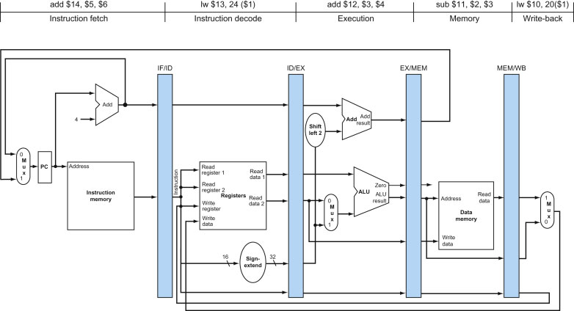
Canonical 5-Stage Pipeline
From: Patterson & Hennessy, Computer Organization: The Hardware/Software Interface, 5th Ed.

Slide 25
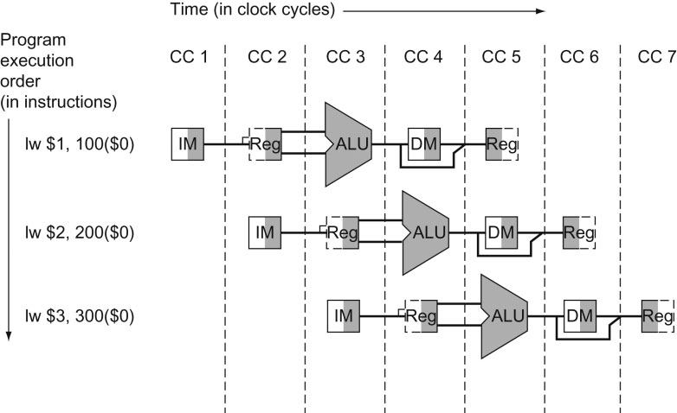
Canonical 5-Stage Pipeline
From: Patterson & Hennessy, Computer Organization: The Hardware/Software Interface, 5th Ed.

Slide 26
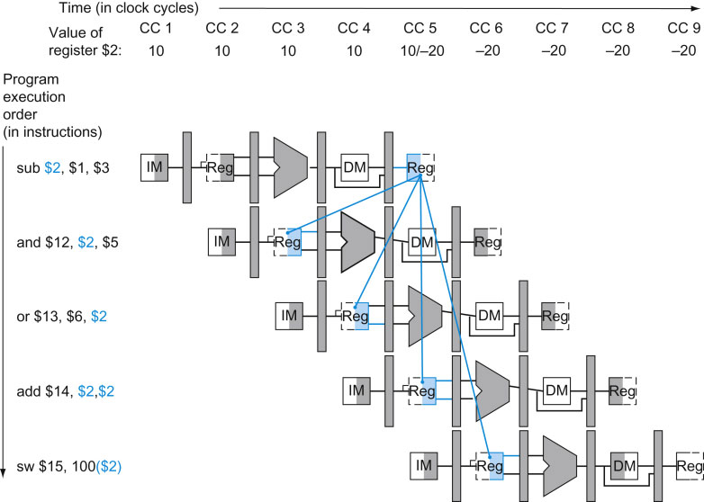
FIGURE 4.52 Pipelined dependences in a five-instruction sequence using simplified datapaths to show the dependences. All the dependent actions are shown in color, and “CC 1” at the top of the figure means clock cycle 1. The first instruction writes into $2, and all the following instructions read $2. This register is written in clock cycle 5, so the proper value is unavailable before clock cycle 5. (A read of a register during a clock cycle returns the value written at the end of the first half of the cycle, when such a write occurs.) The colored lines from the top datapath to the lower ones show the dependences. Those that must go backward in time are pipeline data hazards.
26
Copyright © 2014 Elsevier Inc. All rights reserved.

Slide 27
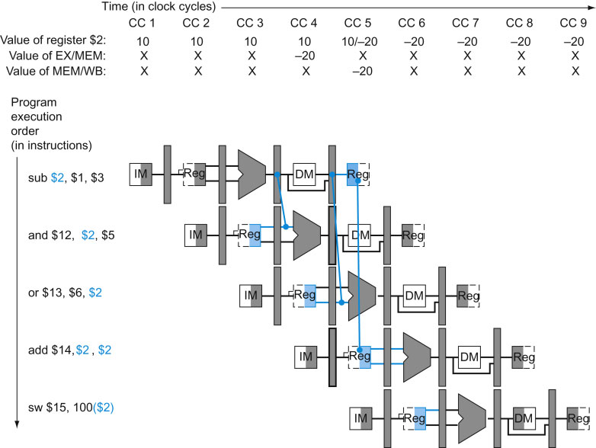
FIGURE 4.53 The dependences between the pipeline registers move forward in time, so it is possible to supply the inputs to the ALU needed by the AND instruction and OR instruction by forwarding the results found in the pipeline registers. The values in the pipeline registers show that the desired value is available before it is written into the register file. We assume that the register file forwards values that are read and written during the same clock cycle, so the add does not stall, but the values come from the register file instead of a pipeline register. Register file “forwarding”—that is, the read gets the value of the write in that clock cycle—is why clock cycle 5 shows register $2 having the value 10 at the beginning and −20 at the end of the clock cycle. As in the rest of this section, we handle all forwarding except for the value to be stored by a store instruction.
27
Copyright © 2014 Elsevier Inc. All rights reserved.

Slide 28
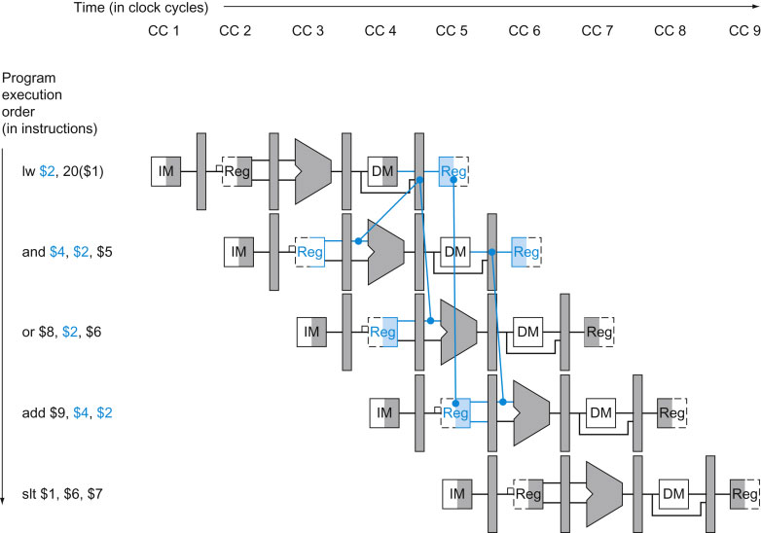
FIGURE 4.58 A pipelined sequence of instructions. Since the dependence between the load and the following instruction (and) goes backward in time, this hazard cannot be solved by forwarding. Hence, this combination must result in a stall by the hazard detection unit.
28
Copyright © 2014 Elsevier Inc. All rights reserved.

Slide 29
Superscalar vs. Pipelining
loop: ld r2, 10(r1)
add r3, r3, r2
sub r1, r1, 1
bne r1, r0, loop
Pipelining:
sum += a[i--]
time
fetch
decode
ld
fetch
decode
add
fetch
decode
sub
fetch
decode
bne
Superscalar:
fetch
decode
ld
fetch
decode
add
fetch
decode
sub
fetch
decode
bne

Slide 30
Data Dependences

Slide 31
Superscalar Issue
An instruction at decode can execute if:
Dependences
RAW
Input operand availability
WAR and WAW
Must check against Instructions:
Simultaneously Decoded
In-progress in the pipeline (i.e., previously issued)
Recall the register vector from pipelining
Increasingly Complex with degree of superscalarity
2-way, 3-way, …, n-way

Slide 32
Issue Rules
Stall at decode if:
RAW dependence and no data available
Source registers against previous targets
WAR or WAW dependence
Target register against previous targets + sources
No resource available
This check is done in program order

Slide 33
Issue Mechanism – A Group of Instructions at Decode
tgt
src1
src1
simplifications
may be possible
resource checking
not shown
Program order
tgt
src1
src1
tgt
src1
src1
Assume 2 source & 1 target max per instr.
comparators for 2-way:
3 for tgt and 2 for src (tgt: WAW + WAR, src: RAW)
comparators for 4-way:
2nd instr: 3 tgt and 2 src
3rd instr: 6 tgt and 4 src
4th instr: 9 tgt and 6 src

Slide 34
Preserving Sequential Semantics
loop: ld r2, 10(r1)
add r3, r3, r2
sub r1, r1, 1
bne r1, r0, loop
Pipelining:
sum += a[i--]
time
fetch
decode
ld
fetch
decode
add
fetch
decode
sub
fetch
decode
bne
Superscalar:
fetch
decode
ld
fetch
decode
add
fetch
decode
sub
fetch
decode
bne

Slide 35
Interrupts Example
Exception
raised
Exception
taken
fetch
decode
ld
fetch
decode
add
fetch
decode
div
fetch
decode
bne
fetch
decode
bne
Exception
raised
Exception
raised
Exception
taken
fetch
decode
ld
fetch
decode
add
fetch
decode
div
fetch
decode
bne
fetch
decode
bne

Slide 36
Superscalar Performance
Performance Spectrum?
What if all instructions were dependent?
Speedup = 0, Superscalar buys us nothing
What if all instructions were independent?
Speedup = N where N = superscalarity
Again key is typical program behavior
Some parallelism exists

Slide 37
“Real Life” Performance
SPEC CPU 2000: Simplescalar sim: 32K I$ and D$, 8K bpred

Slide 38
Independence ISA
Conventional ISA
Instructions execute in order
No way of stating
Instruction A is independent of B
Must detect at runtime → cost: time, power, complexity
Idea:
Change Execution Model at the ISA model
Allow specification of independence
VLIW Goals:
Flexible enough
Match well technology
Vectors and SIMD
Only for a set of the same operation

Slide 39
VLIW
Instruction format
Very Long Instruction Word
#1 defining attribute
The four instructions are independent
Some parallelism can be expressed this way
Extending the ability to specify parallelism
Take into consideration technology
Recall, delay slots
This leads to →
#2 defining attribute: NUAL
Non-unit assumed latency
ALU1
ALU2
MEM1
control

Slide 40
NUAL vs. UAL
Unit Assumed Latency (UAL)
Semantics of the program are that each instruction is completed before the next one is issued
This is the conventional sequential model
Non-Unit Assumed Latency (NUAL):
At least 1 operation has a non-unit assumed latency, L, which is greater than 1
The semantics of the program are correctly understood if exactly the next L-1 instructions are understood to have issued before this operation completes
NUAL: Result observation is delayed by L cycles

Slide 41
#2 Defining Attribute: NUAL
Assumed latencies for all operations
ALU1
ALU2
MEM1
control
ALU1
ALU2
MEM1
control
ALU1
ALU2
MEM1
control
ALU1
visible
ALU2
MEM1
control
visible
visible
ALU1
ALU2
MEM1
control
ALU1
ALU2
MEM1
visible
control
Glorified delay slots
Additional opportunities for specifying parallelism

Slide 42
#3 DF: Resource Assignment
The VLIW also implies allocation of resources
The spec. inst format maps well onto the following datapath:
ALU1
ALU2
MEM1
control
ALU
ALU
cache
Control
Flow
Unit

Slide 43
VLIW: Definition
Multiple independent Functional Units
Instruction consists of multiple independent instructions
Each of them is aligned to a functional unit
Latencies are fixed
Architecturally visible
Compiler packs instructions into a VLIW also schedules all hardware resources
Entire VLIW issues as a single unit
Result: ILP with simple hardware
compact, fast hardware control
fast clock
At least, this is the goal

Slide 44
VLIW Example
FU
I-fetch &
Issue
FU
Memory
Port
Memory
Port
Multi-ported
Register
File

Slide 45
VLIW Example
Instruction format
ALU1
ALU2
MEM1
control
Program order and execution order
ALU1
ALU2
MEM1
control
ALU1
ALU2
MEM1
control
ALU1
ALU2
MEM1
control
Instructions in a VLIW are independent
Latencies are fixed in the architecture spec.
Hardware does not check anything
Software has to schedule so that all works

Slide 46
Compilers are King
VLIW philosophy:
“dumb” hardware
“intelligent” compiler
Key technologies
Predicated Execution
Trace Scheduling
If-Conversion
Software Pipelining

Slide 47
Predicated Execution
Instructions are predicated
if (cond) then perform instruction
In practice
calculate result
if (cond) destination = result
Converts control flow dependences to data dependences
if ( a == 0)
b = 1;
else b = 2;
true; pred = (a == 0)
pred; b = 1
!pred; b = 2

Slide 48
Predicated Execution: Trade-offs
Is predicated execution always a win?
Is predication meaningful for VLIW only?

Slide 49
Trace Scheduling
Goal:
Create a large continuous piece or code
Schedule to the max: exploit parallelism
“Fact” of life:
Basic blocks are small
Scheduling across BBs is difficult
But:
While many control flow paths exist
There are few “hot” ones

Slide 50
Trace Scheduling
Trace Scheduling
Static control speculation
Assume specific path
Schedule accordingly
Introduce check and repair code where necessary
First used to compact microcode
FISHER, J. Trace scheduling: A technique for global microcode compaction. IEEE Transactions on Computers C-30, 7 (July 1981), 478--490.

Slide 51
Trace Scheduling: Example
Assume A→C is the common path
A
A
schedule
A&C
B
C
Repair
C
B
Expand the scope/flexibility of code motion

Slide 52
Trace Scheduling: Example #2
bA
bB
bA
bB
bC
bC
bD
check
bD
bE
repair
bC
bD
repair
bE
all OK

Slide 53
Trace Scheduling Example
test = a[i] + 20;
If (test > 0) then
sum = sum + 10
else
sum = sum + c[i]
c[x] = c[y] + 10
test = a[i] + 20
sum = sum + 10
c[x] = c[y] + 10
if (test <= 0) then goto repair
…
assume delay
Straight code
repair:
sum = sum – 10
sum = sum + c[i]

Slide 54
SIMD
Single Instruction Multiple Data

Slide 55
SIMD: Motivation Contd.
Recall:
Part of architecture is understanding application needs
Many Apps:
for i = 0 to infinity
a(i) = b(i) + c
Same operation over many tuples of data
Mostly independent across iterations

Slide 56



Some things are naturally parallel

Slide 57
Sequential Execution Model / SISD
int a[N]; // N is large
for (i =0; i < N; i++)
a[i] = a[i] * fade;
Flow of control / Thread
One instruction at the time
Optimizations possible at the machine level
time

Slide 58
Data Parallel Execution Model / SIMD
int a[N]; // N is large
for all elements do in parallel
a[i] = a[i] * fade;
time
This has been tried before: ILLIAC III, UIUC, 1966
http://ieeexplore.ieee.org/xpls/abs_all.jsp?arnumber=4038028&tag=1
http://ed-thelen.org/comp-hist/vs-illiac-iv.html

Slide 59
TIME
C1
C2
C3
C4
C5
C6
C7
C8
C9
C10
fetch
decode
rf
exec
wb
exec
wb
exec
wb
fetch
decode
rf
exec
wb
exec
wb
exec
wb

Slide 60
TIME
C1
C2
C3
C4
C5
C6
C7
C8
C9
C10
fetch
decode
rf
exec
wb
exec
wb
exec
wb
fetch
decode
rf
exec
wb
exec
wb
exec
wb
fetch
decode
rf
exec
wb
exec
wb
exec
wb

Slide 61
SIMD Architecture
CU
μCU
regs
PE
PE
PE
ALU
MEM
MEM
MEM
Replicate Datapath, not the control
All PEs work in tandem
CU orchestrates operations

Slide 62
Multimedia extensions
SIMD in modern CPUs

Slide 63
MMX: Basics
Multimedia applications are becoming popular
Are current ISAs a good match for them?
Methodology:
Consider a number of “typical” applications
Can we do better?
Cost vs. performance vs. utility tradeoffs
Net Result: Intel’s MMX
Can also be viewed as an attempt to maintain market share
If people are going to use these kind of applications we better support them

Slide 64
Multimedia Applications
Most multimedia apps have lots of parallelism:
for I = here to infinity
out[I] = in_a[I] * in_b[I]
At runtime:
out[0] = in_a[0] * in_b[0]
out[1] = in_a[1] * in_b[1]
out[2] = in_a[2] * in_b[2]
out[3] = in_a[3] * in_b[3]
…..
Also, work on short integers:
in_a[i] is 0 to 256 for example (color)
or, 0 to 64k (16-bit audio)

Slide 65
Observations
32-bit registers are wasted
only using part of them and we know
ALUs underutilized and we know
Instruction specification is inefficient
even though we know that a lot of the same operations will be performed still we have to specify each of the individually
Instruction bandwidth
Discovering Parallelism
Memory Ports?
Could read four elements of an array with one 32-bit load
Same for stores
The hardware will have a hard time discovering this
Coalescing and dependences

Slide 66
MMX Contd.
Can do better than traditional ISA
new data types
new instructions
Pack data in 64-bit words
bytes
“words” (16 bits)
“double words” (32 bits)
Operate on packed data like short vectors
SIMD
First used in Livermore S-1 (> 20 years)

Slide 67
MMX:Example
Up to 8 operations (64bit) go in parallel
Potential improvement: 8x
In practice less but still good
Besides another reason to think your machine
is obsolete

Slide 68
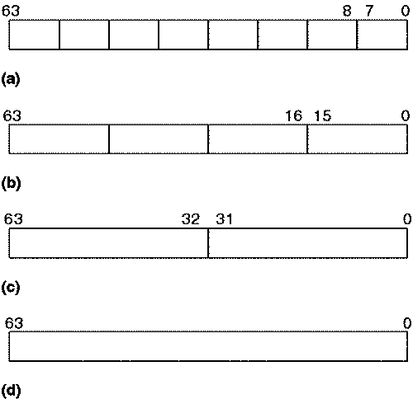
Data Types

Slide 69


Slide 70
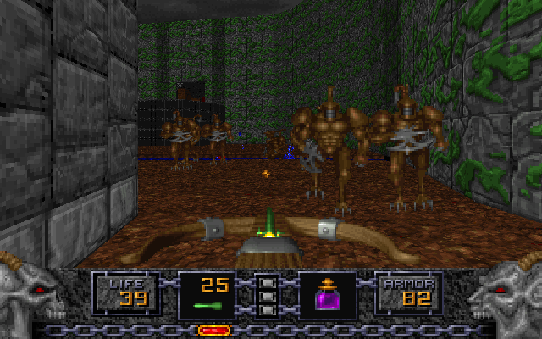

Slide 71
Vector Processors
SCALAR
(1 operation)
VECTOR
(N operations)
r1
r2
v1
v2
+
+
r3
v3
vector
length
add r3, r1, r2
vadd.vv v3, v1, v2
Scalar processors operate on single numbers (scalars)
Vector processors operate on vectors of numbers
Linear sequences of numbers
From. Christos Kozyrakis, Stanford

Slide 72
TIME
C1
C2
C3
C4
C5
C6
C7
C8
C9
C10
fetch
decode
rf
exec
wb
rf
exec
wb
rf
exec
wb
fetch
decode
rf
exec
wb
rf
exec
wb
rf
exec
wb
fetch
decode
rf
exec
wb
rf
exec
wb
rf
exec
wb

Slide 73
What’s in a Vector Processor
A scalar processor (e.g. a MIPS processor)
Scalar register file (32 registers)
Scalar functional units (arithmetic, load/store, etc)
A vector register file (a 2D register array)
Each register is an array of elements
E.g. 32 registers with 32 64-bit elements per register
MVL = maximum vector length = max # of elements per register
A set for vector functional units
Integer, FP, load/store, etc
Some times vector and scalar units are combined (share ALUs)

Slide 74
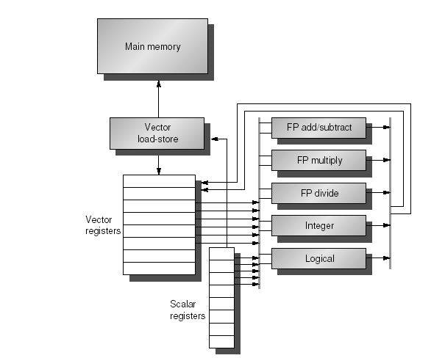
Example of Simple Vector Processor

Slide 75
Vector Code Example
Y[0:63] = Y[0:63] + a * X[0:63]
LD R0, a
VLD V1, 0(Rx) V1 = X[]
VLD V2, 0(Ry) V2 = Y[]
VMUL.SV V3, R0, V1 V3 = X[]*a
VADD.VV V4, V2, V3 V4 = Y[]+V3
VST V4, 0(Ry) store in Y[]

