Slide 1
Scrum Overview
By
Mike Cohn, Mountain Goat
Adapted by Rick Mercer

Slide 2

We’re losing the relay race
“The… ‘relay race’ approach to product development…may conflict with the goals of maximum speed and flexibility. Instead a holistic or ‘rugby’ approach—where a team tries to go the distance as a unit, passing the ball back and forth—may better serve today’s competitive requirements.”
Hirotaka Takeuchi and Ikujiro Nonaka, “The New New Product Development Game”, Harvard Business Review, January 1986.
Notes:
would be nice to include a quote from Wicked Problems here

Slide 3
Scrum in 68 words
Scrum is an agile process that allows us to focus on delivering the highest business value in the shortest time.
It allows us to rapidly and repeatedly inspect actual working software in two three week sprints (iterations) for us.
The product owner negotiates priorities with the team.
Teams self-organize to determine the best way to deliver the highest priority features.
Every sprint anyone can see real working software

Slide 4

Scrum origins
Jeff Sutherland
Initial scrums at Easel Corp in 1993
IDX and 500+ people doing Scrum
Ken Schwaber
ADM
Scrum presented at OOPSLA 96 with Sutherland
Author of three books on Scrum
Mike Beedle
Scrum patterns in PLOPD4
Ken Schwaber and Mike Cohn
Co-founded Scrum Alliance in 2002, initially within the Agile Alliance

Slide 5
Scrum has been used by (at least):
Microsoft
IBM
Yahoo
Google
Electronic Arts
High Moon Studios
Lockheed Martin
Philips
Siemens
Nokia
Capital One
BBC
Intuit
Amazon
Intuit
Nielsen Media
First American Real Estate
BMC Software
Ipswitch
John Deere
Lexis Nexis
Sabre
Salesforce.com
Time Warner
Turner Broadcasting
Oce

Slide 6
Scrum has been used for:
Commercial software
In-house development
Contract development
Fixed-price projects
Financial applications
ISO 9001-certified applications
Embedded systems
24x7 systems with 99.999% uptime requirements
the Joint Strike Fighter
Video game development
FDA-approved, life-critical systems
Satellite-control software
Websites
Handheld software
Mobile phones
Network switching applications
ISV applications
Some of the largest applications in use

Slide 7
Characteristics
Requirements are captured as items in a list of “product backlog” our requirements in the specs
Self-organizing teams
Product progresses in a series of “sprints” iterations
Product is designed, coded, and tested during each sprint
Uses generative rules to create an agile environment for delivering projects
One of the “agile processes”

Slide 8
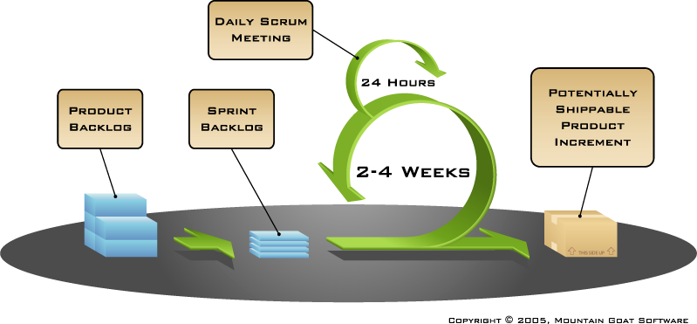
Putting it all together
Image available at www.mountaingoatsoftware.com/scrum

Slide 9

Sequential vs. overlapping development
Requirements
Design
Code
Test
Rather than doing all of one thing at a time...
...Scrum teams do a little of everything all the time
Source: “The New New Product Development Game” by Takeuchi and Nonaka. Harvard Business Review, January 1986.

Slide 10


No changes during a sprint
Change
Plan sprint durations around how long you can commit to keeping change out of the sprint

Slide 11
Scrum framework
Roles
Product owner
ScrumMaster
Team
Meetings
Sprint planning
Sprint review
Sprint retrospective
Daily scrum meeting
Components
Product backlog
Sprint backlog
Burndown charts

Slide 12
Scrum framework
Roles
Product owner
ScrumMaster
Team
Meetings
Sprint planning
Sprint review
Sprint retrospective
Daily scrum meeting
Components
Product backlog
Sprint backlog
Burndown charts

Slide 13

Product owner manager
Define the features of the product specification
Decide on release date and content 14-Dec
Be responsible for the profitability of the product (ROI) which 335 need not do
Prioritize features according to market value what you’re supposed to learn in 335
Adjust features and priority every iteration, as needed not in 335
Accept or reject work results or grade the projects

Slide 14

The ScrumMaster Rick and SLs, sort of
Represents management UofA to the project
Responsible for enacting Scrum values and practices summarized in grading criteria, schedule, meetings
Removes impediments respond if things are getting in the way
Ensure that the team is fully functional and productive summarized in grading criteria, schedule, meetings
Enable close cooperation across all roles and functions meetings
Shield the team from external interferences we’re not asking for more than 66 hours over 6 weeks

Slide 15





The team
Typically 5-9 people four or 3
Cross-functional:
Programmers, testers, user experience designers, etc. If this is the case, it was by luck

Slide 16
The team
Teams are self-organizing definitely in 335
Ideally, no titles but rarely a possibility
Membership should change only between sprints hopefully this does not happen in a 2 sprint project

Slide 17
Scrum framework
Roles
Product owner
ScrumMaster
Team
Meetings
Sprint planning
Sprint review
Sprint retrospective
Daily scrum meeting
Components
Product backlog
Sprint backlog
Burndown charts

Slide 18


Product backlog, or the requirements from your specs
Sprint planning meeting
Prioritize
Analyze and evaluate product backlog
Selected requirements to be completed in
iteration one
We did this just once, it’s just 6 week project after all
Sprint planning
Sprint
Backlog
our iteration requirements
Decide how to do it
You created tasks needed to complete the requirements

Slide 19

Sprint planning
Team selects items from the requirements they can commit to completing we did this for you (see final project page)
Select the most important requirements from the product backlog that you think you can complete in a Sprint iteration
High-level design is considered iteration 1 requirements
As a vacation planner, I want to see photos of the hotels.
Code the middle tier (8 hours)
Code the user interface (4)
Write test fixtures (4)
Code the foo class (6)
Update performance tests (4)

Slide 20
What’s Happening now?
Building something working on those tasks
Team should be in the same room ideally
Doing different things
Communicating
No hiding or promising to do something that won’t get done

Slide 21
The Daily Scrum
At start of day team meetings
Time Boxed: n minutes
Stand-up: to keep it short
Not for problem solving, which comes later
Whole world is invited PM and team only
Only team members, ScrumMaster, product owner, can talk
Helps avoid other unnecessary meetings

Slide 22

Everyone answers 3 questions
1
What did you do yesterday?
2
What will you do today?
3
Is anything in your way?
These are not status updates for ScrumMasters
They are commitments in front of the team

Slide 23
The work
Show me the code
Do it in with team
Program solo or pair
Ask questions of team
Complete tasks you promised you would do

Slide 24
Tasks
Individuals sign up for work of their own choosing during the Sprint Review your email to your PM
Work is never assigned
Track the progress of tasks with a Task Board
Defined ➔ In Progress ➔ Completed
Can add, change, or remove tasks
Update time remaining daily
When complete, mark the task as complete
Track progress with a burn down chart

Slide 25
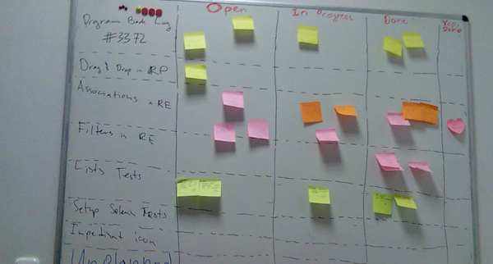
Can use sticky notes or Rally next slide

Slide 26
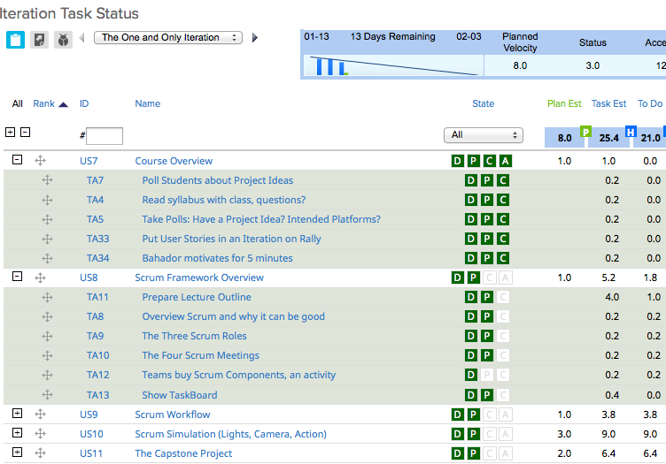

Slide 27
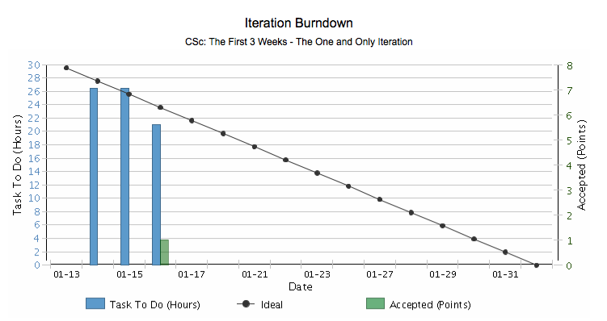

Slide 28
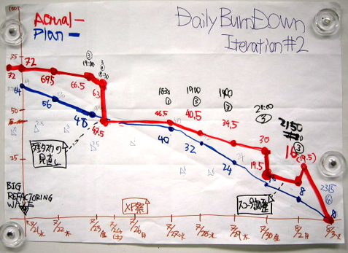
A hand drawn burn down chart

Slide 29
The Sprint review live grading with PM?
Team presents what it accomplished during the sprint
Typically takes the form of a demo of new features or underlying architecture
Informal
Time boxed
No powerpoints
Whole team participates
Invite the world team and PM only

Slide 30
Sprint Retrospective we’ll skip this
At the end of sprint take a look at what is and what is not working
Time boxed 10 minutes
Whole team participates PM and team only
ScrumMaster
Product owner
Team
Possibly customers and others

Slide 31

Start / Stop / Continue
Whole team gathers and discusses what they’d like to:
Start doing
Stop doing
This is just one of many ways to do a sprint retrospective.
Continue doing

Slide 32
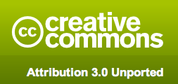
Copyright notice
You are free:
to Share―to copy, distribute and and transmit the work
to Remix―to adapt the work
Under the following conditions
Attribution. You must attribute the work in the manner specified by the author or licensor (but not in any way that suggests that they endorse you or your use of the work).
Nothing in this license impairs or restricts the author’s moral rights.
For more information see http://creativecommons.org/licenses/by/3.0/

Slide 33

Contact information
Presentation by: Mike Cohn
mike@mountaingoatsoftware.com
www.mountaingoatsoftware.com
(720) 890-6110 (office)
You can remove this (or any slide) but you must credit the source somewhere in your presentation. Use the logo and company name (as at bottom left, for example) or include a slide somewhere saying that portions (or all) of your presentation are from this source. Thanks.

