Slide 1
Design Pattern
Most of the slides are taken from Eric Freeman, Elisabeth Robson, Bert Bates, Kathy Sierra: Head First Design Patterns, O'Reilly Media 2004

Slide 2
Motivation
OO Principle
Encapsulation
Binding the data with the code that manipulates it.
It keeps the data and the code safe from external interference
Polymorphism
Polymorphism means to process objects differently based on their data type
In other words it means, one method with multiple implementation, for a certain class of action. And which implementation to be used is decided at runtime depending upon the situation i.e., data type of the object
Inheritance
Inheritance is the mechanism by which an object acquires the some/all properties of another object
It supports the concept of hierarchical classification

Slide 3
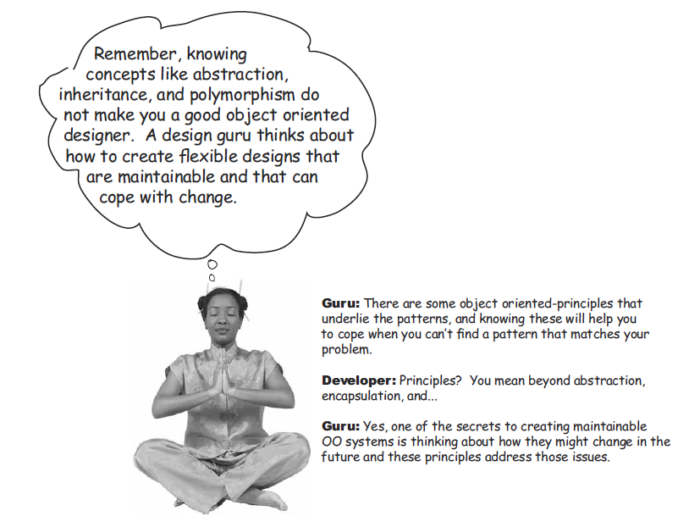
Is this enough to be a good designer?
Design Patterns help you to cope with this issue
By providing a set of solutions to common Design issues
By providing you a vocabulary to communicate with other programmers and developers
You can speed up your expertize by taking advantages by the experience of other developers

Slide 4
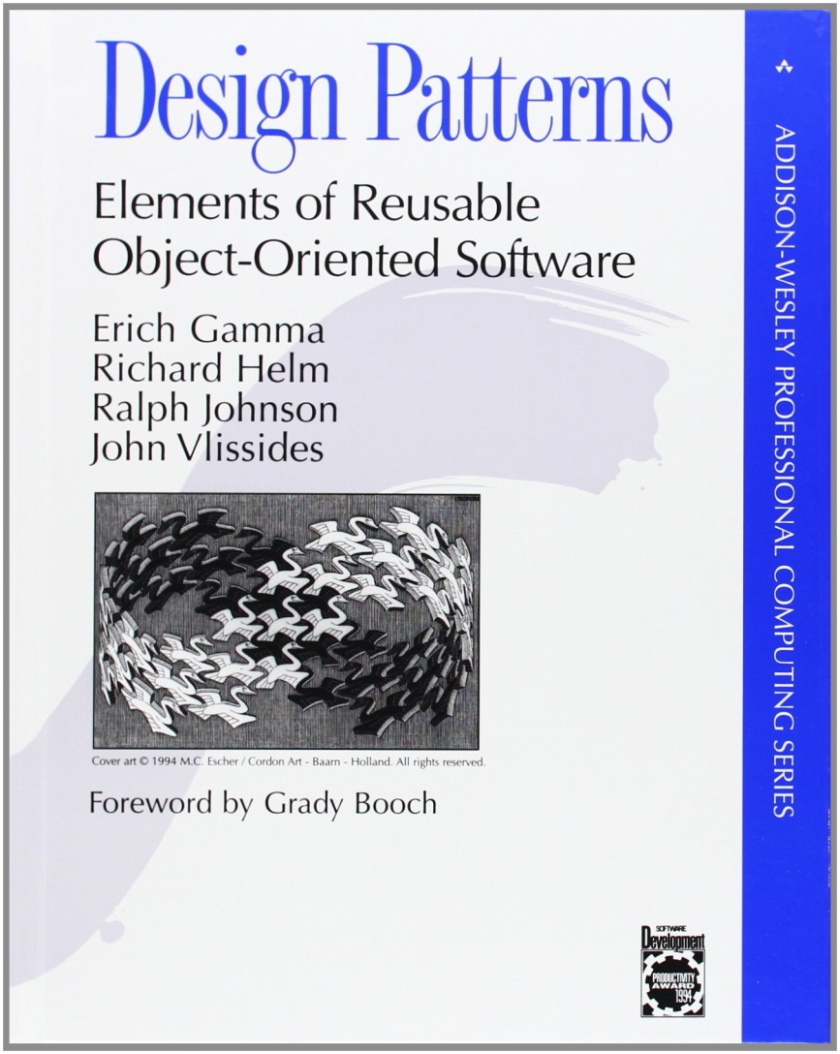
The history of the Design Pattern
The work published by the architect Christopher Alexander introduced the term “pattern” in 1977
Erich Gamma, Ph.D. Thesis, 1991
James Coplien, Advanced C++ Idioms, 1989
Gamma, Helm, Johnson, Vlissides Gang of Four - GoF, Design Patterns: Elements of Reusable Object-Oriented Software, 1991
Buschmann, Meunier, Rohnert, Sommerland, Stal, Pattern-Oriented Software Architecture: A System of Patterns, 1996
Conferenze PLoP, started in 1994

Slide 5
Definitions
...describes a problem which occurs over and over again in our environment, and then describes the core of the solution to that problem, in such a way that you can use this solution a million times over, without ever doing it the same way twice, C. Alexander
…the abstraction from a concrete form which keeps recurring in specific non-arbitrary contexts, D. Riehle
…both a thing and the instructions for making the thing, J. Coplien

Slide 6
Features
The pattern name is a handle we can use to describe a design problem, its solutions, and consequences.
Naming a pattern immediately increases our design vocabulary. It lets us design at a higher level of abstraction.
The problem describes when to apply the pattern.
It explains the problem and its context. It might describe specific design problems such as how to represent algorithms as objects.
The solution describes the elements that make up the design, their relationships, responsibilities, and collaborations.
The pattern provides an abstract description of a design problem and how a general arrangement of elements classes and objects in our case solves it.
The consequences are the results and trade-offs of applying the pattern.
they are critical for evaluating design alternatives and for understanding the costs and benefits of applying the pattern.

Slide 7
Describing Design Patterns - GoF
Pattern Name and Classification
The pattern's name conveys the essence of the pattern succinctly. A good name is vital, because it will become part of your design vocabulary.
Intent
What does the design pattern do? What is its rationale and intent? What particular design issue or problem does it address?
Also Known As
Other well-known names for the pattern, if any.
Motivation
A scenario that illustrates a design problem and how the class and object structures in the pattern solve the problem.
Applicability
What are the situations in which the design pattern can be applied? What are examples of poor designs that the pattern can address? How can you recognize these situations?

Slide 8
Describing Design Patterns - GoF (2)
Structure
A graphical representation of the classes in the pattern.
Participants
The classes and/or objects participating in the design pattern and their responsibilities.
Collaborations
How the participants collaborate to carry out their responsibilities.
Consequences
How does the pattern support its objectives? What are the trade-offs and results of using the pattern? What aspect of system structure does it let you vary independently?
Implementation
What pitfalls, hints, or techniques should you be aware of when implementing the pattern? Are there language-specific issues?

Slide 9
Describing Design Patterns- GoF (3)
Sample Code
Code fragments that illustrate how you might implement the pattern in C++ or Smalltalk.
Known Uses
Examples of the pattern found in real systems.
Related Patterns
What design patterns are closely related to this one? What are the important differences? With which other patterns should this one be used?

Slide 10
Organizing the Catalog- GoF
Scope |  | Purpose
 |  | Creational | Structural | Behavioral
 | Class | Factory Method | Adapter | Interpreter Template Method
 | Object | Abstract Factory Builder Prototype Singleton | Adapter Bridge Composite Decorator Facade Flyweight Proxy | Chain of Responsibility Command Iterator Mediator Memento Observer State Strategy Visitor

Slide 11
Organizing the Catalog- GoF (2)
Class Patterns describe how relationships between classes are defined via inheritance. Relationships in class patterns are established at compile time.
Object Patterns describe relationships between objects and are primarily defined by composition. Relationships in object patterns are typically created at runtime and are more dynamic and flexible.

Slide 12
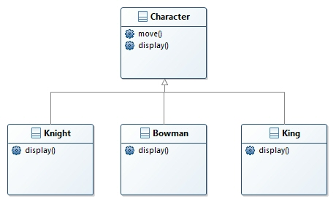
Design Pattern 1: Strategy
Motivating example
Our company makes role-playing games.
The initial system designer adopted standard OO modeling techniques for representing the various kinds of characters
Overriding allows the developer to provide a specific implementation for the methods

Slide 13
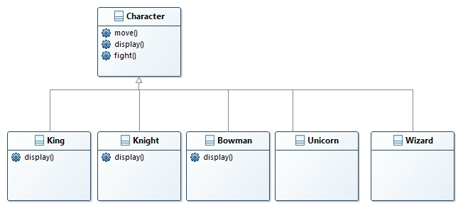
Motivating example issues with inheritance
We have to introduce a new method in the characters. Now they can “fight”
Not all classes have to fight!!!
Wizards cast spells, Unicorns do nothing!

Slide 14
Motivating example Solution
I could override the methods in the specific classes that don’t need it
But …
What happens when I introduce a new class representing Clerics? … and if I have to add a class for Trolls?
How is it possible to implement different “kinds of fight” and different kinds of “casting spell”?
What about if we have to change the “fight method” in all the 50 classes implementing it?
What happens if you realize that every 4-6 months you have to add new classes and modify the ones in the system?
Is it possible to model the application so that when we need to change it we could do so with the least possible impact on the existing code?

Slide 15
Design Principle
The one constant in software development:
No matter how well you design an application, over time an application must grow and change or it will die
Design Principle Identify the aspects of your application that vary and separate them from what stays the same.
Take the parts that vary and "encapsulate" them
This way you can alter the parts that vary without affecting those that don’t.
It forms the basis for almost every design pattern.
All patterns provide a way to let some part of a system vary independently of all other parts.

Slide 16
Design Principle (2)
Design Principle Program to an interface, not an implementation.
We’ll use an interface to represent the behavior
Each implementation of a behavior will implement one of those interfaces -- FightBehaviour
To exploit polymorphism by programming to a supertype so that the actual runtime object isn’t locked into the code.

Slide 17
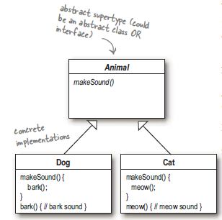
Programming to an interface
Programming to an implementation
Dog d = new Dog();
d.bark();
Programming to an interface
Animal animal = new Dog();
animal.makeSound();

Slide 18
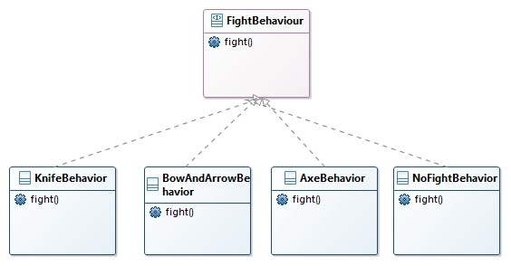
Implementing FightBehavior
public interface FightBehavior {
public void fight();
}
public class KnifeBehavior implements FightBehavior {
public void fight() {
System.out.println("I'm fighting with a knife!!");
}
}
The method fight() implements the specific task for the specific behavior.
With this design, other types of objects can reuse the behaviors because they are no longer hidden away in the Character classes
We can add new behaviors without modifying any of our existing behavior classes or touching any of the Character classes that use fight behaviors.

Slide 19
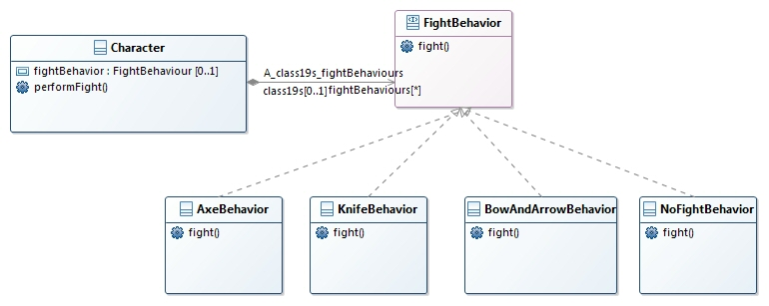
Integrating the FlightBehavior
public class Character{
FightBehavior fightBehavior;
// more
public void performFight() {
fightBehavior.fight();
}
}
Defining Character we don’t care about the specific behavior, we delegate the interface

Slide 20
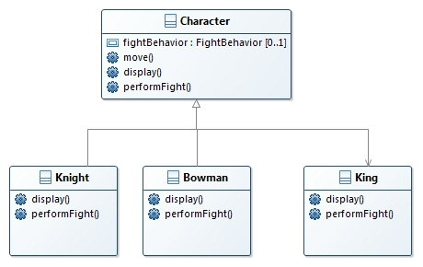
Implementing a specific Character
public class Character{
FightBehavior fightBehavior;
// more
public void performFight() {
fightBehavior.fight();
}
}
public class King extends Character {
public King() {
fightBehavior = new KnifeBehavior();
}
public void display() {
System.out.println("I'm a king");
}
}

Slide 21
Issue in this design
We are modeling the behavior of the character via its constructor
Program to an interface, not an implementation is a design principle!
Still, notice that while we are setting the behaviors to concrete classes, we could easily change that at runtime.
So, we still have a lot of flexibility here, but we’re doing a poor job of initializing the instance variables in a flexible way.
Since the fightBehavior instance variable is an interface type, we could dynamically assign a different FightBehavior implementation class at runtime.
(this is the advantages of polymorphism)

Slide 22
Implementation
public abstract class Character{
FightBehavior fightBehavior;
// more
public void Character() {
}
public void performFight() {
fightBehavior.fight();
}
public abstract void display();
public void move() {
System.out.println(“I’m moving!”);
}
}
public class King extends Character {
public King() {
fightBehavior = new KnifeBehavior();
}
public void display() {
System.out.println("I'm a king");
}
}
public interface FightBehavior {
public void fight();
}
public class KnifeBehavior implements FightBehavior {
public void fight() {
System.out.println("I'm fighting with a knife!!");
}
}
public class Simulator{
public static void main(String[] args) {
Character Lion= new king();
king.performFight();
}
}

Slide 23
Setting behavior dynamically
public abstract class Character{
FightBehavior fightBehavior;
//…
public void setFightBehavior(FightBehavior fb){
FightBehavior= fb;
}
}
public class King extends Character {
public King() {
fightBehavior = new KnifeBehavior();
}
}
public class Simulator{
public static void main(String[] args) {
Character lion= new King();
lion.performFight();
lion. setFightBehavior(new AxeBehavior());
lion.performFight()
}
}

Slide 24
The Big Picture
Instead of thinking of the character behaviors as a set of behaviors, we’ll start thinking of them as a family of algorithms.
In the simulator, the algorithms represent things a Character would do (different ways of fighting), but we could just as easily use the same techniques for other scenarios
a set of classes that implement the ways to compute state sales tax by different states.
When you put two classes together like we did you’re using composition (HAS-A instead of IS-A relationship).
Instead of inheriting their behavior, the characters get their behavior by being composed with the right behavior object.
Design Principle Favor composition over inheritance.

Slide 25
Key Points
Knowing the OO basics does not make you a good OO designer.
Good OO designs are reusable, extensible, and maintainable.
Patterns show you how to build systems with good OO design qualities. 
Patterns are proven object-oriented experience.
Patterns don’t give you code, they give you general solutions to design problems. You apply them to your specific application.
Patterns aren’t invented, they are discovered.
Most patterns and principles address issues of change in software. 
Most patterns allow some part of a system to vary independently of all other parts.
We often try to take what varies in a system and encapsulate it.
Patterns provide a shared language that can maximize the value of your communication with other developers

Slide 26
Strategy Pattern Description – GoF structure (partial)
Intent
Define a family of algorithms, encapsulate each one, and make them interchangeable. Strategy lets the algorithm vary independently from clients that use it.
Also Known As
Policy
Applicability
Use the Strategy pattern when
many related classes differ only in their behavior. Strategy provides a way to configure a class with one of many behaviors.
you need different variants of an algorithm.
an algorithm uses data that clients shouldn't know about. Use the Strategy pattern to avoid exposing complex, algorithm-specific data structures
a class defines many behaviors, and these appear as multiple conditional statements in its operations. Instead of many conditionals, move related conditional branches into their ownStrategy class.

Slide 27
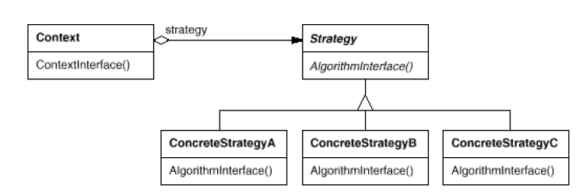
Structure
Participants
Strategy
declares an interface common to all supported algorithms. Context uses this interface to call the algorithm defined by a ConcreteStrategy.
ConcreteStrategy
implements the algorithm using the Strategy interface.
Context
is configured with a ConcreteStrategy object.
maintains a reference to a Strategy object.
may define an interface that lets Strategy access its data.

Slide 28
Strategy Pattern Description(3)
Consequences
Families of related algorithms. Hierarchies of Strategy classes define a family of algorithms or behaviors for contexts to reuse. Inheritance can help factor out common functionality of the algorithms.
An alternative to subclassing. Inheritance offers another way to support a variety of algorithms or behaviors.
You can subclass a Context class directly to give it different behaviors. But this hard-wires the behavior into Context.
It mixes the algorithm implementation with Context's, making Context harder to understand, maintain, and extend.
You wind up with many related classes whose only difference is the algorithm or behavior they employ.
Encapsulating the algorithm in separate Strategy classes lets you vary the algorithm independently of its context, making it easier to switch, understand, and extend.
Strategies eliminate conditional statements. The Strategy pattern offers an alternative to conditional statements for selecting desired behavior.

Slide 29
Strategy Pattern Description (4)
Communication overhead between Strategy and Context. The Strategy interface is shared by all Concrete Strategy classes whether the algorithms they implement are trivial or complex.
Henceit's likely that some Concrete Strategies won't use all the information passed to them through this interface. That means there will be times when the contextcreates and initializes parameters that never get used
Increased number of objects. Strategies increase the number of objects in an application.

Slide 30
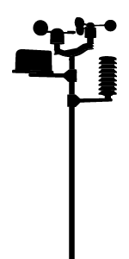

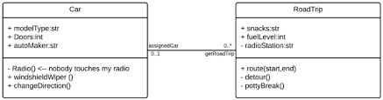

Design Pattern: Observer
The Observer Pattern is one of the most heavily used patterns in JDK:
It is a pattern that keeps your objects in the know when something they might care about happens.
Objects can even decide at runtime whether they want to be kept informed.
Motivation : the weather station
Display Devices
WeatherData Object
sensors
displays
pulls data
The same data has to be represented in different ways by different devices
Weather station

Slide 31
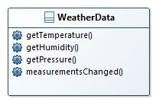
Motivation
The WeatherData object talks to the weather station and is used to update three display devices (current conditions weather statistics and forecast).
The measurementsChanged() method is called any
time new weather measurement data is available
public class WeatherData {
// instance variable declarations
public void measurementsChanged() {
}
// other WeatherData methods here
}
We need to implement three display elements that use the weather data, and make possible to add new displays

Slide 32
Motivation
The WeatherData object talks to the weather station and is used to update three display devices (current conditions weather statistics and forecast).
The measurementsChanged() method is called any
time new weather measurement data is available
public class WeatherData {
// instance variable declarations
public void measurementsChanged() {
float temp = getTemperature();
float humidity = getHumidity();
float pressure = getPressure();
Display1.update(temp, humidity, pressure);
Display2.update(temp, humidity, pressure);
Display3.update(temp, humidity, pressure);
}
// other WeatherData methods here
}
We need to implement three display elements that use the weather data, and make possible to add new displays
ERROR! We are coding the concrete implementation!
No way to change it without changing the software application

Slide 33
Motivation
The WeatherData object talks to the weather station and is used to update three display devices (current conditions weather statistics and forecast).
The measurementsChanged() method is called any
time new weather measurement data is available
public class WeatherData {
// instance variable declarations
public void measurementsChanged() {
float temp = getTemperature();
float humidity = getHumidity();
float pressure = getPressure();
Display1.update(temp, humidity, pressure);
Display2.update(temp, humidity, pressure);
Display3.update(temp, humidity, pressure);
}
// other WeatherData methods here
}
We need to implement three display elements that use the weather data, and make possible to add new displays
AREA OF CHANGE
We need to encapsulate it!!!

Slide 34
The publisher – subscriber mechanism
Think about a news paper
Newspapers are online and publish articles
You subscribe to a particular newspaper and when there is a new edition, it gets delivered to you
You unsubscribe when you don't want papers anymore, and they stop to be delivered
People can subscribe / unsubscribe dynamically

Slide 35
Publishers + Subscribers = Observer Pattern
Actors: the SUBJECT provides the data to the OBSERVERS.
NOT_OBSERVER
temp= 24
OBSERVER1
temp= 24
OBSERVER2
temp= 24
temp= 24
SUBJECT
OBSERVER3
Actually, the mechanism to transfer the data can be based on pull/push architecture
The Observer Pattern defines a one-to-many dependency between objects so that when one object changes state, all of its dependents are notified and updated automatically.

Slide 36
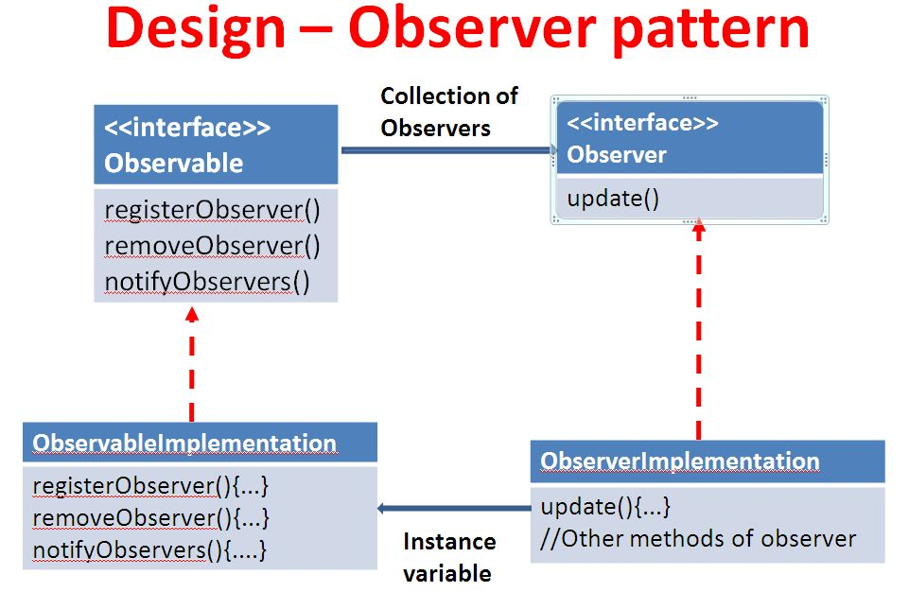
The Class Diagram
update() is called when the subject’s state change
This is the subject!
A concrete subject implements the Subject interface. The concrete subject implements a notifyObservers() method to update all the current observers whenever state changes
Concrete observers can be any class that implements the Observer interface. Each observer registers with a concrete subject to receive updates.

Slide 37
Loose Coupling
Design Principle Strive for loosely coupled designs between objects that interact.
Loosely coupled designs allow us to build flexible OO systems that can handle change because they minimize the interdependency between objects
The Observer Pattern provides an object design where subjects and observers are loosely coupled.
The only thing the subject knows about an observer is that it implements a certain interface (the Observer interface).
We can add, replace and remove new observers at any time.
We never need to modify the subject to add new types of observers.
We can reuse subjects or observers independently of each other.
If we have another use for a subject or an observer, we can easily reuse them because the two aren’t tightly coupled.
Changes to either the subject or an observer will not affect the other.

Slide 38
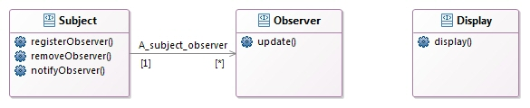
Implementing the Weather Station
public interface Subject {
public void registerObserver(Observer o);
public void removeObserver(Observer o);
public void notifyObservers();
}
public interface Observer {
public void update(float temp, float humidity, float pressure);
}
public interface DisplayElement {
public void display();
}

Slide 39
Implementing the Weather Station (2)
public class WeatherData implements Subject {
private ArrayList<Observer> observers;
private float temperature;
private float humidity;
private float pressure;
public WeatherData() {
observers = new ArrayList<Observer>();
}
public void registerObserver(Observer o) {
observers.add(o);
}
public void removeObserver(Observer o) {
int i = observers.indexOf(o);
if (i >= 0) {
observers.remove(i);
}
}
public void notifyObservers() {
for (Observer observer : observers) {
observer.update(temperature, humidity, pressure);
}
}
public void measurementsChanged() {
notifyObservers();
}
public void setMeasurements(float temperature, float humidity, float pressure) {
this.temperature = temperature;
this.humidity = humidity;
this.pressure = pressure;
measurementsChanged();
}
// other WeatherData methods here
}

Slide 40
Implementing the Weather Station (3)
public class Display1 implements Observer, DisplayElement {
private float temperature;
private float humidity;
private Subject weatherData;
public Display1(Subject weatherData) {
this.weatherData = weatherData;
weatherData.registerObserver(this);
}
public void update(float temperature, float humidity, float pressure) {
this.temperature = temperature;
this.humidity = humidity;
display();
}
public void display() {
System.out.println("Current conditions: " + temperature
+ "F degrees and " + humidity + "% humidity");
}
}

Slide 41
Implementing the Weather Station (4)
public class WeatherStation {
public static void main(String[] args) {
WeatherData weatherData = new WeatherData();
Display1 currentDisplay = new Display1(weatherData);
weatherData.setMeasurements(80, 65, 30.4f);
weatherData.setMeasurements(82, 70, 29.2f);
weatherData.setMeasurements(78, 90, 29.2f);
}
}

Slide 42
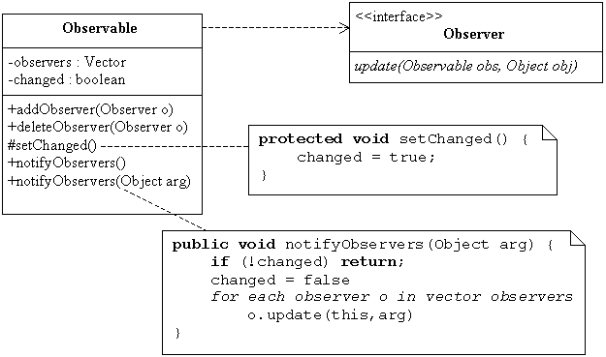
Java’s built-in Observer Pattern
To become an observer an object has to implement the Observer interface and call addObserver() on any Observable object. Likewise, to remove the object as an observer, just call deleteObserver().
To receive notification, an observer implements the method
update(Observable o, Object arg)
To send notification an observable has to:
Call the setChanged() method
Call one of two notifyObservers() methods: notifyObservers() or notifyObservers(Object arg)
If you want to “push” data to the observers, you pass it as a data object notifyObservers(arg). If not, then the Observer has to “pull” the data
it wants from the Observable object passed to it.

Slide 43
Re-implementing the weather station
import java.util.Observable;
public class WeatherData extends Observable {
private float temperature;
private float humidity;
private float pressure;
public WeatherData() { }
public void measurementsChanged() {
setChanged();
notifyObservers();
}
public void setMeasurements(float temperature, float humidity, float pressure) {
this.temperature = temperature;
this.humidity = humidity;
this.pressure = pressure;
measurementsChanged();
}
public float getTemperature() {
return temperature;
}
public float getHumidity() {
return humidity;
}
public float getPressure() {
return pressure;
}
}

Slide 44
Re-implementing the weather station (2)
import java.util.Observable;
import java.util.Observer;
public class Display1 implements Observer, DisplayElement {
Observable observable;
private float temperature;
private float humidity;
public Display1(Observable observable) {
this.observable = observable;
observable.addObserver(this);
}
public void update(Observable obs, Object arg) {
if (obs instanceof WeatherData) {
WeatherData weatherData = (WeatherData)obs;
this.temperature = weatherData.getTemperature();
this.humidity = weatherData.getHumidity();
display();
}
}
public void display() {
System.out.println("Current conditions: " + temperature
+ "F degrees and " + humidity + "% humidity");
}
}

Slide 45
Issues
Observable is a class
You can’t add on the Observable behavior to an existing class that already extends another superclass.
This limits its reuse potential.
setChanged() is protected
You cannot call it unless you have subclassed Observable
You cannot create an instance of the Observable class and compose it with your own objects
You have to subclass

Slide 46
Key Points
The Observer Pattern defines a one-to-many relationship between objects.
Subjects (Observables) update Observers using a common interface.
Observers are loosely coupled in that the Observable knows nothing about them, other than that they implement the Observer interface.
You can push or pull data from the Observable when using the pattern.
Don’t depend on a specific order of notification for your Observers.
Java has several implementations of the Observer Pattern, including the general purpose java.util.Observable.
Watch out for issues with the java.util.Observable implementation.
Don’t be afraid to create your own Observable implementation if needed.
Swing makes heavy use of the Observer Pattern, as do many GUI frameworks.
You’ll also find the pattern in many other places, including JavaBeans and RMI.

Slide 47
Observer Pattern Description – GoF structure (partial)
Intent
Define a one-to-many dependency between objects so that when one object changes state, all its dependents are notified and updated automatically.
Also Known As
Dependents, Publish-Subscribe
Applicability
Use the Observer pattern in any of the following situations:
When an abstraction has two aspects, one dependent on the other. Encapsulating these aspects in separate objects lets you vary and reuse them independently.
When a change to one object requires changing others, and you don't know how many objects need to be changed.
When an object should be able to notify other objects without making assumptions about who these objects are. In other words, you don't want these objects tightly coupled.

Slide 48
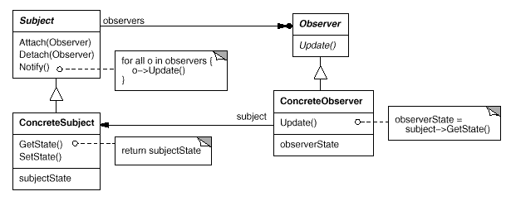
Structure
Participants
Subject
knows its observers. Any number of Observer objects may observe a subject.
provides an interface for attaching and detaching Observer objects.
Observer
defines an updating interface for objects that should be notified of changes in a subject.
ConcreteSubject
stores state of interest to ConcreteObserver objects and sends a notification to its observers when its state changes.
ConcreteObserver
maintains a reference to a ConcreteSubject object.
stores state that should stay consistent with the subject's.
implements the Observer updating

Slide 49
Observer Pattern Description(3)
Consequences
Abstract coupling between Subject and Observer.
Support for broadcast communication.
Unlike an ordinary request, the notification that a subject sends needn't specify its receiver. The notification is broadcast automatically to all interested objects that subscribed to it.
Unexpected updates.
Because observers have no knowledge of each other's presence, they can be blind to the ultimate cost of changing the subject.

Slide 50
The Decorator Pattern
Once you know the techniques of decorating, you’ll be able to give the objects new responsibilities without making any code changes to the underlying classes.
Motivation
You have to model the “pizzas” sold by a company. The pizza have some kinds of bases (Italian, Deep Pan, Stuffed Crust, whole wheat, …) and different toppings (mozzarella, pepperoni, mushroom, olive, pineapple).
Customers can combine bases and toppings as they prefer.
The final price of the pizza depends on the base and toppings selected.
Some combinations aren’t allowed in real Italian Pizzas!
;-)

Slide 51
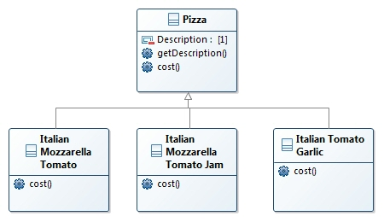

A possible representation
The Class is abstract
The method is abstract
Each subclass implements cost() to return the cost of the pizza.
What if we have a large amount of combinations?
What happens when the price of mozzarella goes up?
What if we add a new topping?

Slide 52
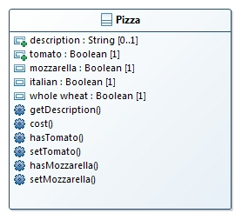
Possible improvement?
why do we need all these classes?
Can’t we just use instance variables and inheritance in the superclass to keep track of the condiments?
We have to create a subclass for each kind of base
The number of classes is reduced
Only a subset of the properties and methods has been introduced

Slide 53
Issue!
Price changes for condiments will force us to alter existing code.
New condiments will force us to add new methods and alter the cost method in the superclass.
We may have new pizzas. For some of these pizzas (sweet pizzas – dessert pizzas), the condiments may not be appropriate.
Sweet pizzas subclass will still inherit methods like hasMozzarella().
What if a customer wants a double Mozzarella?

Slide 54
The Open-Closed Principle
Design Principle Classes should be open for extension, but closed for modification.
While it may seem like a contradiction, there are techniques for allowing code to be extended without direct modification.
Applying the Open-Closed Principle EVERYWHERE is wasteful and unnecessary, and can lead to complex, hard-to-understand code.
There are some clever OO techniques for allowing systems to be extended, even if we can’t change the underlying code.
In the Observer Pattern ... by adding new Observers, we can extend the Subject at any time, without adding code to the Subject.

Slide 55
The Decorator Pattern
We start with a base and we “decorate it” run-time with condiments
The external cost() method is called
Cost() Italian Pizza Base
Cost() Tomato
Cost() Mozzarella
4.5
0.30
0.70
5.50

Slide 56
Key points
Decorators have the same supertype as the objects they decorate.
You can use one or more decorators to wrap an object.
Given that the decorator has the same supertype as the object it decorates, we can pass around a decorated object in place of the original (wrapped) object.
The decorator adds its own behavior either before and/or after delegating to the object it decorates to do the rest of the job.
Objects can be decorated at any time, so we can decorate objects dynamically at runtime with as many decorators as we like.

Slide 57
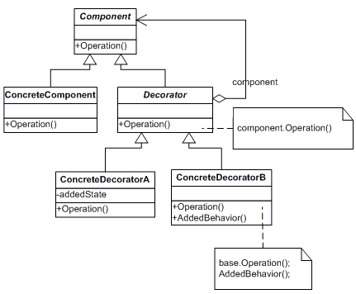
The Decorator Pattern
The Decorator Pattern attaches additional responsibilities to an object dynamically. Decorators provide a flexible alternative to subclassing for extending functionality.
Each decorator HAS-A (wraps) a component, which means the decorator has an instance variable that holds a reference to a component.

Slide 58
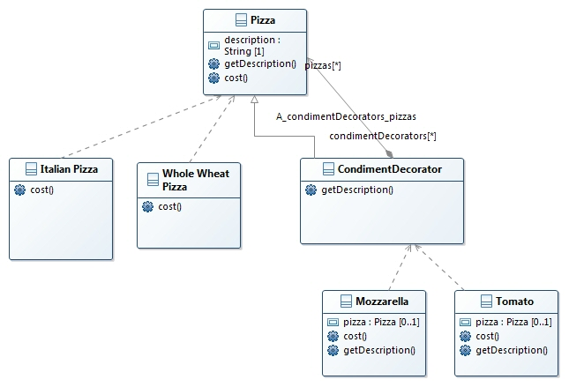
Decorating the Pizzas

Slide 59
The implementation
public abstract class Pizza{
String description = "Unknown Pizza";
public String getDescription() {
return description;
}
public abstract double cost();
}
public abstract class CondimentDecorator extends Pizza{
public abstract String getDescription();
}

Slide 60
Coding Pizzas and Condiments
public class Italian extends Pizza{
public Espresso() {
description = “Italian base";
}
public double cost() {
return 4.50;
}
}
public class WholeWheat extends Pizza{
public WholeWheat () {
description = " WholeWheat base";
}
public double cost() {
return 5.30;
}
}
public class Tomato extends CondimentDecorator {
Pizza pizza;
public Tomato(Pizza pizza) {
this.pizza = pizza;
}
public String getDescription() {
return pizza.getDescription() + ", Tomato";
}
public double cost() {
return pizza.cost() + .20;
}
}

Slide 61
Serving Pizzas
public class PizzaRest{
public static void main(String args[]) {
Pizza pizza = new Italian();
System.out.println(pizza.getDescription()
+ " euro" +pizza());
Beverage pizza2 = new Italian();
pizza2 = new Mozzarella(pizza2);
pizza2 = new Mozzarella(pizza2);
pizza2 = new Tomato(pizza2);
System.out.println(pizza2.getDescription()
+ " euro" + pizza2.cost());
}
}

Slide 62
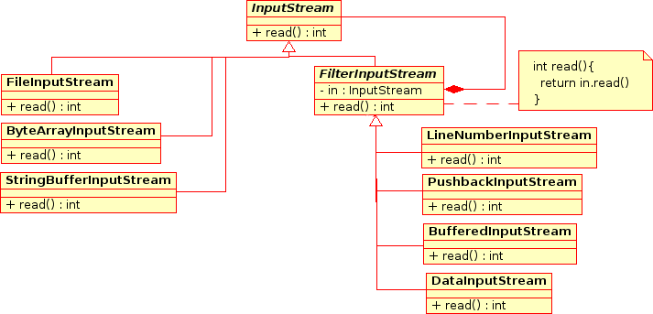
Real Example
Java IO API
http://zenit.senecac.on.ca/wiki/index.php/Decorator

Slide 63
Key Points
Inheritance is one form of extension, but not necessarily the best way to achieve flexibility in our designs.
In our designs we should allow behavior to be extended without the need to modify existing code.
Composition and delegation can often be used to add new behaviors at runtime.
The Decorator Pattern provides an alternative to subclassing for extending behavior.
The Decorator Pattern involves a set of decorator classes that are used to wrap concrete components.
Decorator classes mirror the type of the components they decorate.
Decorators change the behavior of their components by adding new functionality before and/or after (or even in place of) method calls to the component.
You can wrap a component with any number of decorators.
Decorators are typically transparent to the client of the component; that is, unless the client is relying on the component’s concrete type.
Decorators can result in many small objects in our design, and overuse can be complex.

Slide 64
Decorator Pattern Description – GoF structure (partial)
Intent
Attach additional responsibilities to an object dynamically. Decorators provide a flexible alternative to subclassing for extending functionality.
Also Known As
Wrapper
Applicability
Use Decorator
to add responsibilities to individual objects dynamically and transparently, that is, without affecting other objects.
for responsibilities that can be withdrawn.
when extension by subclassing is impractical. Sometimes a large number of independent extensions are possible and would produce an explosion of subclasses to support every combination. Or a class definition may be hidden or otherwise unavailable for subclassing

Slide 65
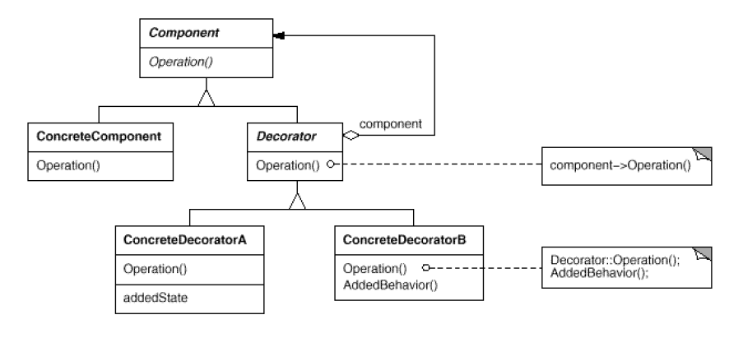
Structure
Participants
Component
defines the interface for objects that can have responsibilities added to them dynamically.
ConcreteComponent
defines an object to which additional responsibilities can be attached.
Decorator
maintains a reference to a Component object and defines an interface that conforms to Component's interface.
ConcreteDecorator
adds responsibilities to the component.

Slide 66
Decorator Pattern Description(3)
Consequences
More flexibility than static inheritance. The Decorator pattern provides more flexible way to add responsibilities to objects than can be had with static (multiple) inheritance.
With decorators, responsibilities can be added and removed at run-time simply by attaching and detaching them.
Decorators also make it easy to add a property twice.
Avoids feature-laden classes high up in the hierarchy. Decorator offers a pay-as-you-go approach to adding responsibilities.
Instead of trying to support all foreseeable features in a complex, customizable class, you can define a simple class and add functionality incrementally with Decorator objects.
A decorator and its component aren't identical.
Lots of little objects. A design that uses Decorator often results in systems composed of lots of little objects that all look alike.
The objects differ only in the way they are interconnected, not in their class or in the value of their variables.

Slide 67
Design Pattern 4: Factory
We aren’t supposed to program to an implementation, but every time we use new, that’s exactly what we are doing.
Character character = new King() WheatherData station = new WheatherData()
We aren’t supposed to program to an implementation, but every time we use new, that’s exactly what we are doing.
Character character … if (crown) { character = new King() } else if (horse){ character = new Knight() } …
When it comes time for changes or extensions, you’ll have to reopen this code and examine
what needs to be added (or deleted).
Often this kind of code ends up in several parts of the application making maintenance and
updates more difficult and error-prone.

Slide 68
What’s wrong with “new”?
Technically there’s nothing wrong with new.
It’s a fundamental part of Java.
The problem is to manage change and how change impacts our use of new
If your code is written to an interface,
it will work with any new classes implementing that interface through polymorphism.
When you have code that makes use of lots of concrete classes,
that code may have to be changed as new concrete classes are added.
The code will not be “closed for modification.” To extend it with new concrete types, you’ll have to reopen it.
So what can you do?
Design principle “identify the aspects that vary and separate them from what stays the same”.

Slide 69
Managing the concrete classes
Type of pizza
Pizza orderPizza(String type) {
Pizza pizza;
if (type.equals("cheese")) {
pizza = new CheesePizza();
} else if (type.equals("greek"){
pizza = new GreekPizza();
} else if (type.equals("pepperoni") {
pizza = new PepperoniPizza();
}
pizza.prepare();
pizza.bake();
pizza.cut();
pizza.box();
return pizza;
}
Based on the type of pizza,
the correct concrete class is
instantiated
Each pizza here has to implement
the Pizza interface.
This code is NOT closed for modification.
If the Pizza Shop changes its pizza offerings, we have to get into this code and modify it
We don’t expect this code will change

Slide 70
Encapsulating object creation
What we have to do is to take the creation code and move it out into another object that is only going to be concerned with
Pizza orderPizza(String type) {
Pizza pizza;
if (type.equals("cheese")) {
pizza = new CheesePizza();
} else if (type.equals("greek"){
pizza = new GreekPizza();
} else if (type.equals("pepperoni") {
pizza = new PepperoniPizza();
}
pizza.prepare();
pizza.bake();
pizza.cut();
pizza.box();
return pizza;
}
This will be part of an object Factory
Factories handle the details of object creation.
Once we have a SimplePizzaFactory, our orderPizza() method just becomes a client of that object.

Slide 71
Building a PizzaFactory
public class SimplePizzaFactory {
public Pizza createPizza(String type) {
Pizza pizza = null;
if (type.equals("cheese")) {
pizza = new CheesePizza();
} else if (type.equals("peperoni")) {
pizza = new PeperoniPizza();
} else if (type.equals("clam")) {
pizza = new ClamPizza();
} else if (type.equals("veggie")) {
pizza = new VeggiePizza();
}
return pizza;
}
}
Defining a simple factory as a
static method is a common
technique and is often called
a static factory.
In this case you can’t subclass
and change the behavior of
the create method (but you
can call it without creating
the factory object).
By encapsulating the pizza creating in one class, we now have only one place to make modifications when the implementation changes.

Slide 72
The new PizzaStore Class with the Factory Object
public class PizzaStore {
SimplePizzaFactory factory;
public PizzaStore(SimplePizzaFactory factory) {
this.factory = factory;
}
public Pizza orderPizza(String type) {
Pizza pizza;
pizza = factory.createPizza(type);
pizza.prepare();
pizza.bake();
pizza.cut();
pizza.box();
return pizza;
}
// other methods here
}
The Simple Factory isn’t actually a Design Pattern; it’s more of a programming idiom.
Some developers do mistake this idiom for the “Factory Pattern,” so be careful!

Slide 73
Extending the Factory
You want to extend the code for implementing it in different stores that implement different kinds of pizzas (in different regions, different kinds of pizzas are produced).
Easy to manage!
We can create different factories, for managing each region / city
NaplesPizzaFactory naFactory = new NaplesPizzaFactory();
PizzaStore naStore = new PizzaStore(naFactory);
naStore.orderPizza("Veggie");
MilanPizzaFactory milanFactory = new MilanPizzaFactory();
PizzaStore milanStore = new PizzaStore(milanFactory);
milanStore.orderPizza("Veggie");

Slide 74
A framework for the pizza store
We have to subclass the abstract class for each regional implementation
public abstract class PizzaStore {
public Pizza orderPizza(String type) {
Pizza pizza;
pizza = createPizza(type);
pizza.prepare();
pizza.bake();
pizza.cut();
pizza.box();
return pizza;
}
abstract Pizza createPizza(String type);
}
This is a call to a method, not a
call to a method in a Factory Object
The Factory method is in the class

Slide 75
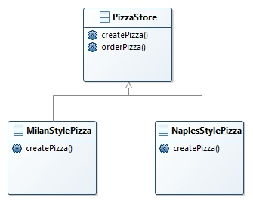
Allowing the subclasses to decide
Each subclass provides an implementation of the createPizza() method, overriding the abstract createPizza() method in PizzaStore, while all subclasses make use of the orderPizza() method defined in PizzaStore.
We could make the orderPizza() method final if we really wanted to enforce this.

Slide 76
Allowing the subclasses to decide (2)
The orderPizza() method has no idea which subclass is actually running the code and making the pizzas.
In other words, it’s decoupled!
When orderPizza() calls createPizza(), one of your subclasses will be called into action.
The kind of pizza is decided by the choice of pizza store you order from, MilanPizzaStore or NaplesStylePizzaStore.

Slide 77
A “real” PizzaStore
public class NaplesPizzaStore extends PizzaStore {
Pizza createPizza(String item) {
if (item.equals("cheese")) {
return new NaplesStyleCheesePizza();
} else if (item.equals("veggie")) {
return new NaplesStyleVeggiePizza();
} else if (item.equals("clam")) {
return new NaplesStyleClamPizza();
} else if (item.equals("pepperoni")) {
return new NaplesStylePepperoniPizza();
} else return null;
}
}
For each type of Pizza we create the Naples style.
Note that the orderPizza() method in the superclass has no clue which Pizza we are creating;
it just knows it can prepare, bake, cut, and box it!

Slide 78
The abstract Class PizzaStore
public abstract class PizzaStore {
public Pizza orderPizza(String type) {
Pizza pizza;
pizza = createPizza(type);
pizza.prepare();
pizza.bake();
pizza.cut();
pizza.box();
return pizza;
}
protected abstract Pizza createPizza(String type);
// other methods here
}
A factory method handles object creation and encapsulates it in a subclass. This decouples the client code in the superclass from the object creation code in the subclass.

Slide 79
Details
A factory method returns
a Product that is typically
used within methods
defined in the superclass.
A factory method may
be parameterized (or
not) to select among
several variations of a
product.
abstract Product factoryMethod(String type)
A factory method is abstract so the subclasses are counted on to handle object creation.
A factory method isolates the client
from knowing what kind of concrete Product is actually created.

Slide 80
Ordering pizzas with the pizza factory method
Create an instance of the desired PizzaStore.
With a PizzaStore in hand, you can call the orderPizza() method and pass in the type of pizza you want (cheese, veggie, and so on).
The createPizza() method is called. There is a specific method for each subclass of PizzaStore. The Pizza is returned to the orderPizza() method.
The orderPizza() method has no idea what kind of pizza was created, but it knows it is a pizza and it prepares, bakes, cuts, and boxes it.
PizzaStore naplesPizzaStore = new NaplesPizzaStore();
naplesPizzaStore.orderPizza("cheese");
Pizza pizza = createPizza("cheese");
pizza.prepare();
pizza.bake();
pizza.cut();
pizza.box();

Slide 81
The Pizza Abstract Class
public abstract class Pizza {
String name;
String dough;
String sauce;
ArrayList<String> toppings = new ArrayList<String>();
void prepare() {
System.out.println("Preparing " + name);
System.out.println("Adding toppings: ");
for (String topping : toppings) {
System.out.println(" " + topping);
}
}
void bake() {System.out.println("Bake for 25 minutes at 350");}
void cut() {System.out.println("Cutting the pizza into diagonal slices"); }
void box() {System.out.println("Place pizza in official PizzaStore box");
}
public String getName() {
return name;
}
}

Slide 82
Defining Pizzas
public class NaplesStyleCheesePizza extends Pizza {
public NaplesStyleCheesePizza() {
name = "Naples Style Sauce and Cheese Pizza";
dough = "Thin Crust Dough";
sauce = "Marinara Sauce";
toppings.add("Grated Reggiano Cheese");
}
}
public class MilanStyleCheesePizza extends Pizza {
public MilanStyleCheesePizza() {
name = “Milan Style Deep Dish Cheese Pizza";
dough = "Extra Thick Crust Dough";
sauce = "Plum Tomato Sauce";
toppings.add("Shredded Mozzarella Cheese");
}
void cut() {
System.out.println("Cutting the pizza into square slices");
}
}

Slide 83
Testing it
public class PizzaTestDrive {
public static void main(String[] args) {
PizzaStore naStore = new NaplesPizzaStore();
Pizza pizza = naStore.orderPizza("cheese");
System.out.println(“You ordered a " + pizza.getName() + "\n");
}
}

Slide 84
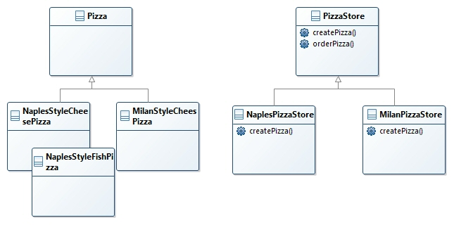
The representation
This is our abstract creator class. It defines an abstract factory method that the subclasses implement to produce products.
Factories produce products,
and in the PizzaStore, our
product is a Pizza.
Often the creator contains code
that depends on an abstract product,
which is produced by a subclass. The
creator never really knows which
concrete product was produced
The createPizza() method is our factory method. It produces products.
Classes that produce
products are called
concrete creators.

Slide 85
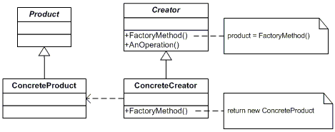
The Factory Method Pattern
The Factory Method Pattern defines an interface for creating an object, but lets subclasses decide which class to instantiate.
Factory Method lets a class defer instantiation to subclasses.
You say “decide” not because the pattern allows subclasses themselves to decide at runtime, but because the creator class is written without knowledge of the actual products that will be created, which is decided purely by the choice of the subclass that is used.

Slide 86
Object dependencies
If you don’t use a Factory, you instantiate an object, dependent on its concrete class.
Any changes to the concrete implementations of characters pizzas affects the CharacterStore,
The CharacterStore “depends on” the character implementations.
If the implementation of the concrete classes changes, then we may have to modify in CharacterStore.
Every new kind of character we add creates another dependency for CharacterStore.
Character character … if (crown) { character = new King() } else if (horse){ character = new Knight() } …

Slide 87
The Dependency Inversion Principle
Dependency Inversion Principle. Depend upon abstractions. Do not depend upon concrete classes
It suggests that our high-level components should not depend on our low-level components; rather, they should both depend on abstractions.
Now, this principle tells us we should instead write our code so that we are depending on abstractions, not concrete classes.
That goes for both our high-level modules and our low-level modules.

Slide 88
Applying the Principle
Character character … if (crown) { character = new King() } else if (horse){ character = new Knight() } …
The concrete characters classes depend on the abstraction too, because they implement the interface in the Character abstract class.
Game
This is an abstract class
Character
Character
Cleric
King
King
Queen
knight
Queen
knight
Wizard
Wizard
Cleric
Unicorn
Unicorn

Slide 89
The “inversion” in Dependency Inversion Principle
The low-level components now depend on a higher level abstraction.
Likewise, the high-level component is also tied to the same abstraction.
How to avoid OO designs that violate the Dependency Inversion Principle
No variable should hold a reference to a concrete class.
If you use new, you’ll be holding a reference to a concrete class. Use a factory to get around that!
No class should derive from a concrete class.
If you derive from a concrete class, you’re depending on a concrete class. Derive from an abstraction, like an interface or an abstract class.
No method should override an implemented method of any of its base classes.
If yes, then your base class wasn’t really an abstraction to start with. Those methods implemented in the base class are meant to be shared by all your subclasses.
This is a guideline you should strive for, rather than a rule you should follow all the time.
Clearly, every single Java program ever written violates these guidelines

Slide 90
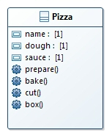
The PizzaStore Again
We should ensuring consistency in the ingredients
Each family (Store) consists of a type of dough, sauce, cheese
We could build a factory to create the ingredients

Slide 91
The ingredient factories
public interface PizzaIngredientFactory {
public Dough createDough();
public Sauce createSauce();
public Cheese createCheese();
public Veggies[] createVeggies();
public Pepperoni createPepperoni();
public Clams createClam();
}
Lots of new classes here, one per ingredient
Build a Factory for each region.
You’ll create a subclass of PizzaIngredientFactory that implements each create method.
Implement a set of ingredient classes to be used with the Factory, like ReggianoCheese. These classes can be shared among regions where appropriate.
Then we still need to hook all this up by working our new ingredient Factories into the old PizzaStore code.

Slide 92
Building the Naples ingredient factory
public class NaplesPizzaIngredientFactory implements PizzaIngredientFactory {
public Dough createDough() {
return new ThinCrustDough();
}
public Sauce createSauce() {
return new MarinaraSauce();
}
public Cheese createCheese() {
return new ReggianoCheese();
}
public Veggies[] createVeggies() {
Veggies veggies[] = { new Garlic(), new Onion(), new Mushroom(), new RedPepper() };
return veggies;
}
public Pepperoni createPepperoni() {
return new SlicedPepperoni();
}
public Clams createClam() {
return new FreshClams();
}
}

Slide 93
The new Pizza Abstract Class
public abstract class Pizza {
String name;
Dough dough;
Sauce sauce;
Veggies veggies[];
Cheese cheese;
Pepperoni pepperoni;
Clams clam;
abstract void prepare();
void bake() {System.out.println("Bake for 25 minutes at 350");
}
void cut() {
System.out.println("Cutting the pizza into diagonal slices");
}
void box() {
System.out.println("Place pizza in official PizzaStore box");
}
void setName(String name) {this.name = name;
}
String getName() {return name;
}
public String toString() {
// code to print pizza here
}
}
We’ve now made the prepare method abstract. This is where we are going to collect the ingredients needed for the pizza, which of course will come from the ingredient factory.

Slide 94
The concrete Pizzas
public class CheesePizza extends Pizza {
PizzaIngredientFactory ingredientFactory;
public CheesePizza(PizzaIngredientFactory ingredientFactory) {
this.ingredientFactory = ingredientFactory;
}
void prepare() {
System.out.println("Preparing " + name);
dough = ingredientFactory.createDough();
sauce = ingredientFactory.createSauce();
cheese = ingredientFactory.createCheese();
}
}
When we wrote the Factory Method code, we had a NaplesCheesePizza and a MilanCheesePizza class.
The only thing that differs is the use of regional ingredients.

Slide 95
Revisiting the pizza stores
public class NaplesPizzaStore extends PizzaStore {
protected Pizza createPizza(String item) {
Pizza pizza = null;
PizzaIngredientFactory ingredientFactory =
new NaplesPizzaIngredientFactory();
if (item.equals("cheese")) {
pizza = new CheesePizza(ingredientFactory);
pizza.setName(“Naples Style Cheese Pizza");
} else if (item.equals("clam")) {
pizza = new ClamPizza(ingredientFactory);
pizza.setName(" Naples Style Clam Pizza");
} else if (item.equals(“…")) {
…
}
return pizza;
}
}

Slide 96
What we have done
We provided a means of creating a family of ingredients for pizzas by introducing a new type of factory called an Abstract Factory.
An Abstract Factory gives us an interface for creating a family of products.
By writing code that uses this interface, we decouple our code from the actual factory that creates the products.
That allows us to implement a variety of factories that produce products meant for different contexts—such as different regions, different operating systems, or different look and feels.
Because the code is decoupled from the actual products, we can substitute different factories to get different behaviors (like getting marinara instead of plum tomatoes).

Slide 97
How to serve pizzas
First we need a Naples PizzaStore: PizzaStore naplesPizzaStore = new NaplesPizzaStore();
Now that we have a store, we can take an order: naplesPizzaStore.orderPizza("cheese");
The orderPizza() method first calls the createPizza() method: Pizza pizza = createPizza("cheese");
When the createPizza() method is called, that’s when our ingredient factory gets involved: Pizza pizza = new CheesePizza(naplesIngredientFactory);
The ingredient factory is chosen and instantiated in the PizzaStore and then passed into the constructor of each pizza

Slide 98
How to serve pizzas (2)
Next we need to prepare the pizza. Once the prepare() method is called, the factory is asked to prepare ingredients:
void prepare() { dough = factory.createDough(); sauce = factory.createSauce(); cheese = factory.createCheese(); }
Finally, we have the prepared pizza in hand and the orderPizza() method bakes, cuts, and boxes the pizza.

Slide 99
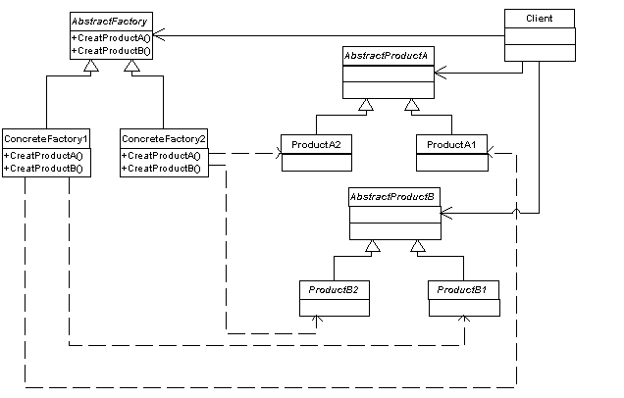
Abstract Factory Pattern defined
The Abstract Factory Pattern provides an interface for creating families of related or dependent objects without specifying their concrete classes.
The Client is written against the abstract factory and then composed at runtime with an actual factory.
The concrete factories implement the different product families. To create a product, the client uses one of these factories, so it never has to instantiate a product object.
This is the product family. Each concrete factory can produce an entire set of products.

Slide 100
Key Points
All factories encapsulate object creation.
Simple Factory is a simple way to decouple your clients from concrete classes.
Factory Method relies on inheritance: object creation is delegated to subclasses, which implement the factory method to create objects.
Abstract Factory relies on object composition: object creation is implemented in methods exposed in the factory interface.
All factory patterns promote loose coupling by reducing the dependency of your application on concrete classes.
The intent of Factory Method is to allow a class to defer instantiation to its subclasses.
The intent of Abstract Factory is to create families of related objects without having to depend on their concrete classes.
The Dependency Inversion Principle guides us to avoid dependencies on concrete types and to strive for abstractions.
Factories are a powerful technique for coding to abstractions, not concrete classes.

Slide 101
Singleton Pattern
It creates one-of-a-kind objects for which there is only one instance.
The Singleton is the simplest path in terms of its class diagram;
Despite its simplicity from a class design perspective, its implementation can present critical issues.
Motivation
There are many objects we only need one of:
thread pools, caches, dialog boxes,
objects that handle preferences and registry settings, objects used for logging
objects that act as device drivers to devices like printers and graphics cards.

Slide 102
Instantiate an object
So as long as we have a public class, I can always instantiate an object one or more times?
new MyObject();
If it’s not a public class, only classes in the same package can instantiate it. But they can still instantiate it more than once.
public MyClass {
private MyClass() {}
}
This class that can’t be instantiated.
Is there ANY object that could use the private constructor?

Slide 103
Instantiate an object
Can I use a static variable to instantiate a class?
public MyClass {
private MyClass() {}
public static MyClass getInstance() {
return new MyClass();
}
}
MyClass.getInstance();
How can I modify the code so that only a single object will be instantiated?

Slide 104
The classic Singleton Pattern implementation
public class Singleton {
private static Singleton uniqueInstance;
// other useful instance variables here
private Singleton() {}
public static Singleton getInstance() {
if (uniqueInstance == null) {
uniqueInstance = new Singleton();
}
return uniqueInstance;
}
// other useful methods here
}

Slide 105
Motivating example
We have to manage a controller for cauldron used in the production of Parmigiano Reggiano cheese
public void boil() {
if (!isEmpty() && !isBoiled()) {
// bring the contents to a boil
boiled = true;
}
}
public boolean isEmpty() {
return empty;
}
public boolean isBoiled() {
return boiled;
}
}
public class Cauldron{
private boolean empty;
private boolean boiled;
private Cauldron() {
empty = true;
boiled = false;
}
public void fill() {
if (isEmpty()) {
empty = false;
boiled = false;
// fill the cauldron with a milk mixture
}
}
public void removed() {
if (!isEmpty() && isBoiled()) {
// remove the boiled milk and chocolate
empty = true;
}
}

Slide 106
Using a Singleton
public class Cauldron{
private boolean empty;
private boolean boiled;
private static Cauldron uniqueInstance;
private Cauldron() {
empty = true;
boiled = false;
}
public static Cauldron getInstance() {
if (uniqueInstance == null) {
uniqueInstance = new Cauldron();
}
return uniqueInstance;
}
public void fill() {
if (isEmpty()) {
empty = false;
boiled = false;
}
}
// rest of Cauldron code...
}

Slide 107
Managing multiple threads
In case of multiple threads we can have two instantiations of the same class
Thread 1
public static Cauldron
getInstance() {
if (uniqueInstance == null) {
uniqueInstance =
new Cauldron();
return uniqueInstance
Thread 2
public static Cauldron
getInstance() {
if (uniqueInstance == null) {
uniqueInstance =
new Cauldron();
return uniqueInstance

Slide 108
Dealing with multithreading
public class Singleton {
private static Singleton uniqueInstance;
// other useful instance variables here
private Singleton() {}
public static synchronized Singleton getInstance() {
if (uniqueInstance == null) {
uniqueInstance = new Singleton();
}
return uniqueInstance;
}
// other useful methods here
}
By adding the synchronized keyword to getInstance(), we force every thread to wait its turn before it can enter the method.
Synchronizing a method can decrease performance by a factor of 100

Slide 109
How to improve multithreading
Do nothing if the performance of getInstance() isn’t critical to the application.
Move to an eagerly created instance rather than a lazily created one.
public class Singleton {
private static Singleton uniqueInstance = new Singleton();
private Singleton() {}
public static Singleton getInstance() {
return uniqueInstance;
}
}
We rely on the JVM to create the unique instance of the Singleton when the class is loaded.
The JVM guarantees that the instance will be created before any thread accesses the static uniqueInstance variable.

Slide 110
How to improve multithreading (2)
Use “double-checked locking” to reduce the use of synchronization in getInstance().
public class Singleton {
private volatile static Singleton uniqueInstance;
private Singleton() {}
public static Singleton getInstance() {
if (uniqueInstance == null) {
synchronized (Singleton.class) {
if (uniqueInstance == null) {
uniqueInstance = new Singleton();
}
}
}
return uniqueInstance;
}
}
The volatile keyword ensures that multiple threads handle the uniqueInstance variable correctly when it is being initialized to the Singleton instance.

Slide 111
Singleton Pattern defined
The Singleton Pattern ensures a class has only one instance, and provides a global point of access to it.
The Singleton Pattern ensures you have at most one instance of a class in your application.
The Singleton Pattern also provides a global access point to that instance. 
Java’s implementation of the Singleton Pattern makes use of a private constructor, a static method combined with a static variable.
Examine your performance and resource constraints and carefully choose an appropriate Singleton implementation for multithreaded applications.
Be careful if you are using multiple class loaders; this could defeat the Singleton implementation and result in multiple instances.

Slide 112
The Command Pattern
The Command Pattern allows us to encapsulate method invocation.
By encapsulating method invocation, we can crystallize pieces of computation so that the object invoking the computation doesn’t need to worry about how to do things.
We can also do some wickedly smart things with these encapsulated method invocations, like save them away for logging or reuse them to implement undo in our code.

Slide 113
The Command Pattern - motivation
Let us think to be in a restaurant
order
Waiter
Client
Cook
order
Order

Slide 114

The Command Pattern – overview
He take an order from the customer,,
He invoke the orderUp() method
Let us think to be in a restaurant
createOrder()
Client
Order
takeOrder()
Waiter
It can be passed around.
It has an interface that consists of only one method, orderUp(), that encapsulates the actions needed to prepare the meal.
It also has a reference to the object that needs to prepare it (in our case, the Cook).
orderUp()
Order
Cook
makeMeal()

Slide 115
In other words
createCommandObject()
The command object provides the method execute(), that
encapsulates the actions and
can be called to invoke the
actions on the Receiver
Create Command Object()
The client is responsible for
creating the command object.
The command object consists of a set of actions on a receiver.
execute()
Command
Set Command()
Client
setCommand()
At some point in the future
the Invoker calls the command
object’s execute() method...
The client calls setCommand() on an Invoker object and passes it the command object, where it gets stored until it is needed.
execute()
execute()
Invoker
action1() action2()
Command
Receiver

Slide 116
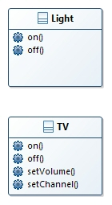
Example
You have to implement the code for handling a universal remote control for managing several devises in your home (e.g. light control, …)
on
off
1
2
3
4
5
6
7
undo

Slide 117
Implementing the device
public interface Command {
public void execute();
}
Implementing the Command interface
Implementing a command to turn a light on
public class LightOnCommand implements Command {
Light light;
public LightOnCommand(Light light) {
this.light = light;
}
public void execute() {
light.on();
}
}
A command has to be created for each device and for each function we can enable

Slide 118
Implementing a simple Remote Control
public class SimpleRemoteControl {
Command slot;
public SimpleRemoteControl() {}
public void setCommand(Command command) {
slot = command;
}
public void buttonWasPressed() {
slot.execute();
}
}
invoker
public class RemoteControlTest {
public static void main(String[] args) {
SimpleRemoteControl remote = new SimpleRemoteControl();
Light light = new Light();
LightOnCommand lightOn = new LightOnCommand(light);
remote.setCommand(lightOn);
remote.buttonWasPressed();
}
}

Slide 119
Implementing the “big” Remote Control
public class RemoteControl {
Command[] onCommands;
Command[] offCommands;
public RemoteControl() {
onCommands = new Command[7];
offCommands = new Command[7];
Command noCommand = new NoCommand();
for (int i = 0; i < 7; i++) {
onCommands[i] = noCommand;
offCommands[i] = noCommand;
}
}

Slide 120
Implementing the “big” Remote Control
public void setCommand(int slot, Command onCommand, Command offCommand) {
onCommands[slot] = onCommand;
offCommands[slot] = offCommand;
}
public void onButtonWasPushed(int slot) {
onCommands[slot].execute();
}
public void offButtonWasPushed(int slot) {
offCommands[slot].execute();
}
public String toString() {
StringBuffer stringBuff = new StringBuffer();
stringBuff.append("\n------ Remote Control -------\n");
for (int i = 0; i < onCommands.length; i++) {
stringBuff.append("[slot " + i + "] " + onCommands[i].getClass().getName()
+ " " + offCommands[i].getClass().getName() + "\n");
}
return stringBuff.toString();
}
}

Slide 121
Implementing the Commands
public class TVOn implements Command {
TV tv;
public TVOn (TV tv) {
this.tv = tv;
}
public void execute() {
tv.on();
tv.setChannel(1);
tv.setVolume(11);
}
}
public class LightOffCommand implements Command {
Light light;
public LightOffCommand(Light light) {
this.light = light;
}
public void execute() {
light.off();
}
}

Slide 122
Setting the Remote Control
public class RemoteLoader {
public static void main(String[] args) {
RemoteControl remoteControl = new RemoteControl();
Light livingRoomLight = new Light("Living Room");
Light kitchenLight = new Light("Kitchen");
TV tv = new TV("Living Room");
LightOnCommand livingRoomLightOn =
new LightOnCommand(livingRoomLight);
LightOffCommand livingRoomLightOff =
new LightOffCommand(livingRoomLight);
LightOnCommand kitchenLightOn =
new LightOnCommand(kitchenLight);
LightOffCommand kitchenLightOff =
new LightOffCommand(kitchenLight);
TVOn tvOn= new TVOn (tv );
TVOff tvOff = new TVOff(tv );
remoteControl.setCommand(0, livingRoomLightOn, livingRoomLightOff);
remoteControl.setCommand(1, kitchenLightOn, kitchenLightOff);
remoteControl.setCommand(2, tvOn, tvOff);
}
}

Slide 123
NoCommand
public class NoCommand implements Command {
public void execute() { }
}
The NoCommand object is an example of a null object.
A null object is useful when you don’t have a meaningful object to return, and yet you want to remove the responsibility for handling null from the client.
You’ll find uses for Null Objects in conjunction with many Design Patterns and
sometimes you’ll even see Null Object listed as a Design Pattern.

Slide 124
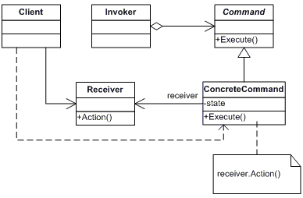
The UML Diagram
The Client (Remote Loader) creates a number of Command objects. These are loaded into the slots of the Remote Control.
The RemoteControl manages a set of Command objects, one per button. When a button is pressed, the corresponding ButtonWasPushed() method is called, which invokes the execute() method on the command.
All RemoteControl commands implement the Command interface, which consists of one
method: execute(). Commands encapsulate a set of actions on a
specific vendor class. The remote invokes these actions by calling the execute() method
The Vendor Classes are used to perform the actual home-automation work of controlling devices
Using the Command Interface, we implement each action that can be invoked by pressing a button on the remote with a simple Command object. The Command object holds a reference to an object that is an instance o a Vendor Class and implements an execute method that calls one or more methods on that object.

Slide 125
… and the UNDO Button?
When commands support undo, they have an undo() method that mirrors the execute() method.
public interface Command {
public void execute();
public void undo();
}
We have to modify the concrete command
public class LightOnCommand implements Command {
Light light;
public LightOnCommand(Light light) {
this.light = light;
}
public void execute() {
light.on();
}
public void undo() {
light.off();
}
}

Slide 126
… and the UNDO Button? (2)
We have also to modify the remote control
public class RemoteControlWithUndo {
Command[] onCommands;
Command[] offCommands;
Command undoCommand;
…
public void onButtonWasPushed(int slot) {
onCommands[slot].execute();
undoCommand = onCommands[slot];
}
public void offButtonWasPushed(int slot) {
offCommands[slot].execute();
undoCommand = offCommands[slot];
public void undoButtonWasPushed() {
undoCommand.undo();
}
}

Slide 127
Implementing Macro-Commands
A macro command is a command which executes one or more other commands
public class MacroCommand implements Command {
Command[] commands;
public MacroCommand(Command[] commands) {
this.commands = commands;
}
public void execute() {
for (int i = 0; i < commands.length; i++) {
commands[i].execute();
}
}
}
Command[] allOn = { lightOn, stereoOn, tvOn, hottubOn};
MacroCommand allOnMacro = new MacroCommand(allOn);

Slide 128
More uses of the Command Pattern: queuing requests
Commands give us a way to package a piece of computation (a receiver and a set of actions) and pass it around as a first-class object.
The computation may be invoked after some client application creates the command object.
Useful applications such as schedulers, thread pools, and job queues,…
Imagine a job queue:
you add commands to the queue on one end, and on the other end sits a group of threads.
Threads run the following script:
they remove a command from the queue,
call its execute() method,
wait or the call to finish,
then discard the command object,
retrieve a new one.
The job queue classes are decoupled from the objects doing the computation.
The job queue objects just retrieve commands and call execute().

Slide 129
More uses of the Command Pattern: logging requests
The semantics of some applications require that we log all actions and be able to recover after a crash by reinvoking those actions.
The Command Pattern can support these semantics with the addition of two methods: store() and load().
As we execute commands, we store a history of them on disk.
When a crash occurs, we reload the command objects and invoke their execute() methods in batch and in order.
By using logging, we can save all the operations since the last check point, and if there is a system failure, apply those operations to our checkpoint.

Slide 130
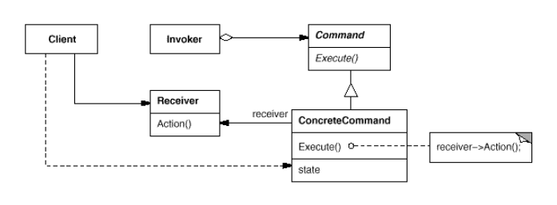
The Command Pattern defined
The Command Pattern encapsulates a request as an object, thereby letting you parameterize other objects with different requests, queue or log requests, and support undoable operations.

Slide 131
Key Points
The Command Pattern decouples an object making a request from the one that knows how to perform it.
A Command object is at the center of this decoupling and encapsulates a receiver with an action (or set of actions) .  An invoker makes a request of a Command object by calling its execute() method, which invokes those actions on the receiver.
Invokers can be parameterized with Commands, even dynamically at runtime.
Commands may support undo by implementing an undo method that restores the object to its previous state before the execute() method was last called. 
Macro Commands are a simple extension of Command that allow multiple commands to be invoked.
In practice, it is not uncommon for “smart” Command objects to implement the request themselves rather than delegating to a receiver.
Commands may also be used to implement logging and transactional systems.

Slide 132
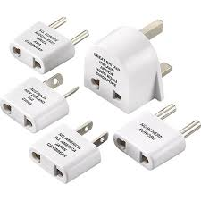
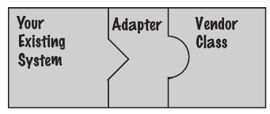
The Adapter Pattern
With this pattern we can adapt a design expecting one interface to a class that implements a different interface
Say you’ve got an existing software system that you need to work a new vendor class library into, but the new vendor designed their interfaces differently than the last vendor
The adapter acts as the middleman by receiving requests from the client and converting them into requests that make sense on the vendor classes.

Slide 133
Example
public interface EUWeatherStation{
public void getTemperature();
public void showTemperature();
}
public interface USAWeatherStation{
public void getTemperatureFar();
public void showTemperature();
}
public class EUDisplay implements EUWeatherStation{
public float getTemperature() {
System.out.println(“Temperature in Celsius");
}
public void showTemperature() {
System.out.println(“This is the temperature in Celsius");
}
}
public class USADisplay implements UsaWeatherStation{
public float getTemperatureFar() {
System.out.println(“Temperature in Fahrenheit");
}
public void showTemperature() {
System.out.println(“This is the temperature in Fahrenheit");
}
}

Slide 134
Example: the Adapter
public class USADisplayAdapter implements EUWeatherStation {
USADisplay newStation;
public USADisplayAdapter(USADisplay newStation) {
this.newStation = newStation;
}
public float getTemperature() {
return ((newStation.getTemperatureFar()-32)*5/9);
}
public void showTemperature() {
newStation.showTemperature(); }
}
public class TestDrive {
public static void main(String[] args) {
EUDisplay euDisplay= new EUDisplay();
USADisplay usaDisplay= new USADisplay();
EUWeatherStation wStation= new USADisplayAdapter(usaDisplay);
test(wStation);
}
static void test(EUWeatherStation euW) {
euW.getTemperature();
euW.showTemperature();
}
}

Slide 135
Roles
Client
Adapter
Adaptee
The Adapter implements the
target interface and holds an instance of the Adaptee
The Client is implemented
against the target interface
The client makes a request to the adapter by using the target interface.
The adapter translates the request into one or more calls on the adaptee using the adaptee interface.
The client receives the results of the call and never knows there is an adapter doing the translation.

Slide 136
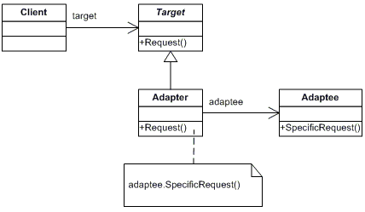
The Adapter Pattern defined
The Adapter Pattern converts the interface of a class into an other interface the clients expect. Adapter lets classes work together that couldn’t otherwise because of incompatible interfaces.
The Adapter implements
the Target interface.
The client sees only the Target interface
All requests get
delegated to the
Adaptee.

Slide 137
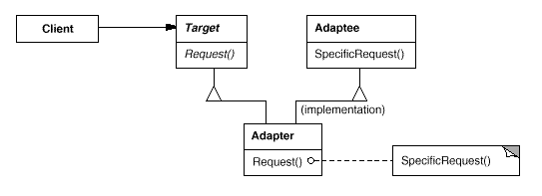
Object and class adapters
There are actually two kinds of adapters: object adapters and class adapters.
The class adapter
A class adapter uses multiple inheritance to adapt one interface to another … this is not possible in java!

Slide 138
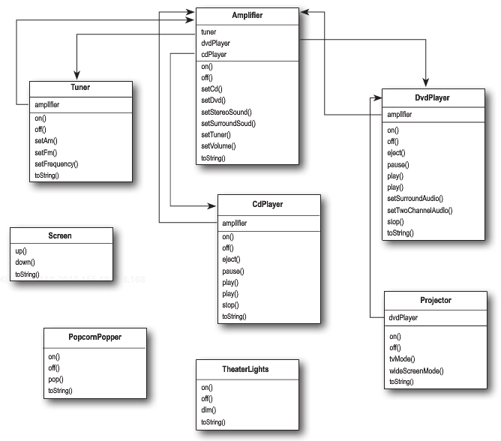
The Facade Pattern
A facade is an object that provides a simplified interface to a larger body of code, such as a class library.
Let us suppose to have to manage a home theater.
If we want to watch a movie we have to (e.g.)
Dim the lights
Put the screen down
Turn the projector on
Put the projector on wide-screen mode
Turn the sound amplifier on
Set the amplifier to DVD input
Set the amplifier to surround sound
Set the amplifier volume to medium (5)
Turn the DVD player on
Start the DVD player playing12111098
Set the projector input to DVD

Slide 139
In terms of classes and methods
lights.dim(10);
screen.down();
projector.on();
projector.setInput(dvd);
projector.wideScreenMode();
amp.on();
amp.setDvd(dvd);
amp.setSurroundSound();
amp.setVolume(5);
dvd.on();
dvd.play(movie);
This involves 5 classes!
A similar situation happens if we want to turn everything off r perform other operations!

Slide 140
Managing complexity
With the Facade Pattern you can take a complex subsystem and make it easier to use by implementing a Facade class that provides a more reasonable interface.
We can create a new class HomeTheaterFacade, which exposes a few simple methods
For example watchMovie().
The Facade class treats the home theater components as a subsystem,
E.g., it calls on the subsystem to implement its watchMovie() method.
The client code now calls methods on the home theater Facade, not on the subsystem.
To watch a movie we just call one method, watchMovie(), and it communicates with the rest of the classes
The Facade still leaves the subsystem accessible to be used directly.
The functionality of the subsystem classes are still available

Slide 141
Implementing the simplified interface
public class HomeTheaterFacade {
Amplifier amp;
Tuner tuner;
DvdPlayer dvd;
CdPlayer cd;
Projector projector;
TheaterLights lights;
Screen screen;
public HomeTheaterFacade(Amplifier amp,
Tuner tuner,
DvdPlayer dvd,
CdPlayer cd,
Projector projector,
Screen screen,
TheaterLights lights) {
this.amp = amp;
this.tuner = tuner;
this.dvd = dvd;
this.cd = cd;
this.projector = projector;
this.screen = screen;
this.lights = lights;
}
// other methods here}

Slide 142
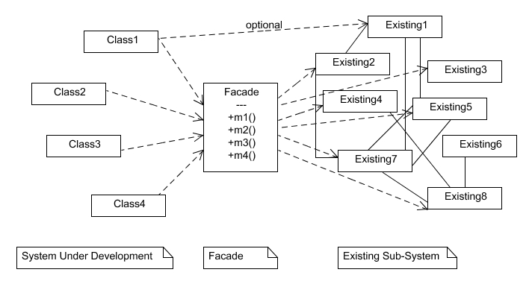
Facade Pattern defined
The Facade Pattern provides a unified interface to a set of interfaces in a subsystem. Facade defines a higher-level interface that makes the subsystem easier to use.

Slide 143
The Principle of Least Knowledge (aka Principle of Demeter)
Principle of Least Knowledge: talk only to your immediate friends.
For any object, be careful of the number of classes it interacts with and also how it comes to interact with those classes.
This principle prevents us from creating designs that have a large number of classes coupled together so that changes in one part of the system cascade to other parts.
From any method in that object, the principle tells us that we should only invoke methods that belong to:
The object itself
Objects passed in as a parameter to the method
Any object the method creates or instantiates
Any components of the object

Slide 144
The Principle of Least Knowledge example
public float getTemp() {
Thermometer thermometer = station.getThermometer();
return thermometer.getTemperature();
}
While the principle reduces
the dependencies between objects and studies have shown this reduces software
maintenance, applying
this principle results in more “wrapper” classes being written to handle method
calls to other components.
This can result in increased complexity and development time as well as decreased runtime performance.
Without the Principle
we get the thermometer object from the station and then call the getTemperature() method ourselves.
public float getTemp() {
return station.getTemperature();
}
With the Principle
We add a method to the Station class that makes the request to the thermometer for us.
This reduces the number of classes we’re dependent on.

Slide 145
Key Points
When you need to use an existing class and its interface is not the one you need, use an adapter.
An adapter changes an interface into one a client expects.
The effort for implementing an adapter depends on the target interface.
There are two forms of the Adapter Pattern: object and class adapters. Class adapters require multiple inheritance.
When you need to simplify and unify a large interface or complex set of interfaces, use a facade.
A facade decouples a client from a complex subsystem.
Implementing a façade requires that we compose the facade with its subsystem and use delegation to perform the work of the facade.
You can implement more than one facade for a subsystem. 
An adapter wraps an object to change its interface, a decorator wraps an object to add new behaviors and responsibilities, and a facade “wraps” a set of objects to simplify.

Slide 146
The Template Method Pattern
Let us consider two classes for supporting the preparation of tea and (USA) coffee
public class Tea {
void prepareRecipe() {
boilWater();
steepTeaBag();
pourInCup();
addLemon();
}
public void boilWater() {
System.out.println("Boiling ");
}
public void steepTeaBag() {
System.out.println("Steeping the tea");
}
public void addLemon() {
System.out.println("Adding Lemon");
}
public void pourInCup() {
System.out.println("Pouring into cup");
}
}
public class Coffee {
void prepareRecipe() {
boilWater();
brewCoffeeGrinds();
pourInCup();
addSugarAndMilk();
}
public void boilWater() {
System.out.println("Boiling");
}
public void brewCoffeeGrinds() {
System.out.println("Dripping Coffee through filter");
}
public void pourInCup() {
System.out.println("Pouring into cup");
}
public void addSugarAndMilk() {
System.out.println("Adding Sugar and Milk");
}
}

Slide 147
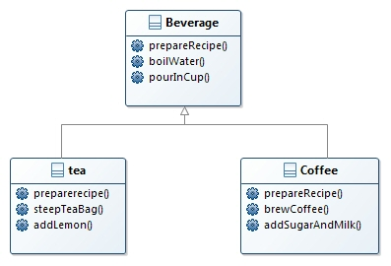
Abstracting the process
The prepareRecipe() method differs in each subclass, so it is defined as abstract.
Each subclass overrides the prepareRecipe() method and implements its own recipe.
The boilWater() and pourInCup() methods are shared by both subclasses, so they are defined in the superclass.

Slide 148
Restructuring the model
The methods which differ in the subclasses have to be unified
addLemon(), addMilkAndSugar(), -- > addCondiments()
and defined as abstract in the superclass
They will be implemented in the specific subclasses Tea and Coffee classes
The prepareRecipe() method has to be the same and then made final in the superclass

Slide 149
Meet the Template Method
public abstract class CaffeineBeverage {
void final prepareRecipe() {
brew();
pourInCup();
addCondiments();
boilWater();
}
abstract void brew();
abstract void addCondiments();
void boilWater() {
// implementation
}
void pourInCup() {
// implementation
}
}
The Template Method defines the steps of an algorithm and allows subclasses to provide the implementation for one or more steps.

Slide 150
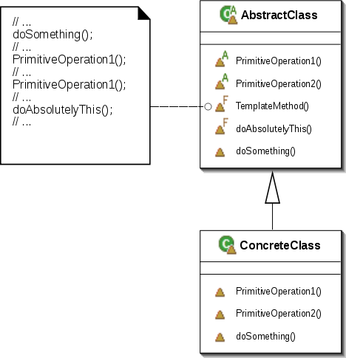
Template Method Pattern defined
The Template Method Pattern defines the skeleton of an algorithm in a method, deferring some steps to subclasses. Template Method lets subclasses redefine certain steps of an algorithm without changing the algorithm’s structure.
The AbstractClass contains the template method ...and abstract versions of the operations used in the template method.

Slide 151
Another possible implementation including a hook()
abstract class AbstractClass {
final void templateMethod() {
primitiveOperation1();
primitiveOperation2();
concreteOperation();
hook();
}
abstract void primitiveOperation1();
abstract void primitiveOperation2();
final void concreteOperation() {
// implementation here
}
void hook() {}
}
We can also have concrete methods that do nothing by default; we call these “hooks.”
Subclasses are free to override these but don’t have to.

Slide 152
hook()
A hook is a method that is declared in the abstract class, but only given an empty or default implementation.
This gives subclasses the ability to “hook into” the algorithm at various points, if they wish;
a subclass is also free to ignore the hook.
public abstract class BeverageWithHook {
final void prepareRecipe() {
boilWater();
brew();
pourInCup();
if (wantsCondiments()) {
addCondiments();
}
}
abstract void brew();
abstract void addCondiments();
void boilWater() {
System.out.println("Boiling water");
}
void pourInCup() {
System.out.println("Pouring into cup");
}
boolean wantsCondiments() {
return true;
}
}
This is a hook!

Slide 153
Using the hook
public class CoffeeWithHook extends BeverageWithHook {
…
public boolean customerWantsCondiments() {
String answer = getUserInput();
if (answer.toLowerCase().startsWith("y")) {
return true;
} else {
return false;
}
}
private String getUserInput() {
String answer = null;
System.out.print("Would you like milk with your coffee (y/n)? ");
BufferedReader in = new BufferedReader(new InputStreamReader(System.in));
try {
answer = in.readLine();
} catch (IOException ioe) {
System.err.println("IO error trying to read your answer");
}
if (answer == null) {
return "no";
}
return answer;
}
}

Slide 154
The Hollywood Principle
The Hollywood Principle: Don’t call us, we’ll call you.
The Hollywood Principle gives us a way to prevent “dependency rot.”
You have high-level components depending on low-level components depending on high-level components depending on sideways …
When rot sets in, no one can easily understand the way a system is designed.
With the Hollywood Principle, we allow low-level components to hook themselves into a system, but the high-level components determine when they are needed, and how.
The high-level components give the low-level components a “don’t call us, we’ll call you” treatment.

Slide 155
Sorting with Template Method
The designers of the Java Arrays class have provided us with a handy template method for sorting.
public static void sort(Object[] a) {
Object aux[] = (Object[])a.clone();
mergeSort(aux, a, 0, a.length, 0);
}
private static void mergeSort(Object src[], Object dest[],
int low, int high, int off)
{
// a lot of other code here
for (int i=low; i<high; i++){
for (int j=i; j>low &&
((Comparable)dest[j-1]).compareTo((Comparable)dest[j])>0; j--)
{
swap(dest, j, j-1);
}
}
// and a lot of other code here
}
The mergeSort() method contains the sort algorithm, and relies on an implementation of the compareTo() method to complete the algorithm.

Slide 156
What is compareTo()?
The compareTo() method compares two objects and returns whether one is less than, greater than, or equal to the other.
sort() uses this as the basis of its comparison of objects in the array.
The problem here is that java.Arrays is not subclass of anything
It is not possible to apply the template method as introduced
Java designers made use of the Comparable interface.
All you have to do is implement this interface, which has one method: compareTo().

Slide 157
Comparing people
public class People implements Comparable {
String name;
int weight;
public Duck(String name, int weight) {
this.name = name;
this.weight = weight;
}
public int compareTo(Object object) {
People person = (People)object;
if (this.weight < person.weight) {
return -1;
} else if (this.weight == person.weight) {
return 0;
} else { // this.weight > person.weight
return 1;
}
}
}

Slide 158
Applets
Concrete applets make extensive use of hooks to supply their own behaviors.
public class MyApplet extends Applet {
String message;
public void init() {
message = "Hello World, I'm alive!";
repaint();
}
public void start() {
message = "Now I'm starting up...";
repaint();
}
public void stop() {
message = "Oh, now I'm being stopped...";
repaint();
}
public void paint(Graphics g) {
g.drawString(message, 5, 15);
}
}
All methods are hooks that allow the customization of the Applet

Slide 159
The template method key points
A “template method” defines the steps of an algorithm, deferring to subclasses for the implementation of those steps.
The Template Method Pattern gives us an important technique for code reuse.
The template method’s abstract class may define concrete methods, abstract methods, and hooks.
To prevent subclasses from changing the algorithm in the template method, declare the template method as final.
The Hollywood Principle guides us to put decision making in high-level modules that can decide how and when to call low-level modules.
The Strategy and Template Method Patterns both encapsulate algorithms, one by inheritance and one by composition.

Slide 160
The Iterator
Let us consider Array, a Stack, a List, a Hashmap ...
Each has its own advantages and tradeoffs.
If your client is going to want to iterate over those objects, it is better not to show him your implementation.
The iterator allows you to hide the internal implementation of the data structure.

Slide 161
Motivating example
public class MenuItem {
String name;
String description;
boolean vegetarian;
double price;
public MenuItem(String name,
String description,
boolean vegetarian,
double price)
{
this.name = name;
this.description = description;
this.vegetarian = vegetarian;
this.price = price;
}
public String getName() {
return name;
}
public String getDescription() {
return description;
}
Let us consider a Restaurant menu.
It has lots of items, each one has a name,
a description, and a price.
public double getPrice() {
return price;
}
public boolean isVegetarian() {
return vegetarian;
}
}

Slide 162
Restaurant1 ArrayList
public class Menu1 {
ArrayList<MenuItem> menuItems;
public Menu1() {
menuItems = new ArrayList<MenuItem>();
addItem("K&B's Pancake Breakfast",
"Pancakes with scrambled eggs, and toast",
true,
2.99);
… other items
}
public void addItem(String name, String description,
boolean vegetarian, double price)
{
MenuItem menuItem = new MenuItem(name, description, vegetarian, price);
menuItems.add(menuItem);
}
public ArrayList<MenuItem> getMenuItems() {
return menuItems;
}
// other menu methods here
}

Slide 163
Restaurant 2 Array
public class Menu2 {
static final int MAX_ITEMS = 6;
int numberOfItems = 0;
MenuItem[] menuItems;
public Menu2() {
menuItems = new MenuItem[MAX_ITEMS];
addItem("Vegetarian BLT",
"(Fakin') Bacon with lettuce & tomato on whole wheat", true, 2.99);
// a couple of other Diner Menu items added here
}
public void addItem(String name, String description,
boolean vegetarian, double price)
{
MenuItem menuItem = new MenuItem(name, description, vegetarian, price);
if (numberOfItems >= MAX_ITEMS) {
System.err.println("Sorry, menu is full! Can’t add item to menu");
} else {
menuItems[numberOfItems] = menuItem;
numberOfItems = numberOfItems + 1;
}
}
public MenuItem[] getMenuItems() {
return menuItems;
}
// other menu methods here

Slide 164
Merging the menus
What’s the problem with having two different menu representations?
Let’s try implementing a client that uses the two menus.
You have to create a software waiter working according to these specifications
printMenu() -prints every item on the menu
printMenu1()- prints just menu1 items
printMenu2() -prints just menu2 items
printVegetarianMenu() - prints all vegetarian menu items
isItemVegetarian(name) - given the name of an item, returns true if the items is vegetarian

Slide 165
printMenu()
Menu1 menu1= new menu1();
ArrayList<MenuItem> menu1 = menu1.getMenuItems();
Menu2 menu2 = new Menu2();
MenuItem[] menu2 = menu2.getMenuItems();
The getMenuItems() method looks the same, but the calls are returning different types.
for (int i = 0; i < menu1.size(); i++) {
MenuItem menuItem = menu1.get(i);
System.out.print(menuItem.getName() + " ");
System.out.println(menuItem.getPrice() + " ");
System.out.println(menuItem.getDescription());
}
for (int i = 0; i < menu2.length; i++) {
MenuItem menuItem = menu2[i];
System.out.print(menuItem.getName() + " ");
System.out.println(menuItem.getPrice() + " ");
System.out.println(menuItem.getDescription());
}
Implementing every other method is going to be a variation of this theme

Slide 166
Using for … each to loop
It would really be nice if we could implement the same interface for the menus
We minimize the concrete references in the code and also get rid of the multiple loops required to iterate over both menus.
Using for each would allow us to hide the complexity of the different kinds of iteration.
But that doesn’t solve the real problem here: ttwo different implementations of the menus

Slide 167
Using for … each to loop (2)
Menu1 menu1 = new Menu1();
ArrayList<MenuItem> menu1= menu1.getMenuItems();
Menu2 menu2 = new menu2();
MenuItem[] menu2= menu2.getMenuItems();
for (MenuItem menuItem : menu1 ) {
System.out.print(menuItem.getName());
System.out.println("\t\t" + menuItem.getPrice());
System.out.println("\t" + menuItem.getDescription());
}
for (MenuItem menuItem : menu2 ) {
System.out.print(menuItem.getName());
System.out.println("\t\t" + menuItem.getPrice());
System.out.println("\t" + menuItem.getDescription());
}
Our goal is to decouple the software from the concrete implementations of the menus completely.

Slide 168
Encapsulating the iteration
To iterate through the menu1 items we use the size() and get() methods on the ArrayList:
for (int i = 0; i < breakfastItems.size(); i++) {
MenuItem menuItem = breakfastItems.get(i);
}
To iterate through the menu2 items we use we use the Array length field and the array subscript notation on the MenuItem Array:
for (int i = 0; i < lunchItems.length; i++) {
MenuItem menuItem = lunchItems[i];
}
What if we create an object, let’s call it an Iterator, that encapsulates the way we iterate through a collection of objects?
Iterator iterator = menu1.createIterator();
while (iterator.hasNext()) {
MenuItem menuItem = iterator.next();
}
Both menus implement the same code!

Slide 169
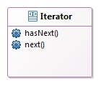
The Iterator Pattern
The Iterator Pattern relies on an interface called Iterator.
The hasNext() method tells us if there are more elements to iterate.
The next() method returns the next object in the aggregate.
we can implement Iterators for any kind of collection of objects: arrays, lists, hashmaps, ...

Slide 170
Adding an Iterator to Menu
public interface Iterator {
boolean hasNext();
Object next();
}
public class Menu2Iterator implements Iterator {
MenuItem[] items;
int position = 0;
public Menu2Iterator(MenuItem[] items) {
this.items = items;
}
public MenuItem next() {
MenuItem menuItem = items[position];
position = position + 1;
return menuItem;
}
public boolean hasNext() {
if (position >= items.length || items[position] == null) {
return false;
} else {
return true;
}
}
}

Slide 171
Refactoring Menu2 with Iterator
public class Menu2 {
static final int MAX_ITEMS = 6;
int numberOfItems = 0;
MenuItem[] menuItems;
// constructor here
// addItem here
public MenuItem[] getMenuItems() {
return menuItems;
}
public Iterator createIterator() {
return new Menu2Iterator(menuItems);
}
// other menu methods here
}
We’re returning the Iterator interface.
The client doesn’t need to know how the menuItems are maintained in the Menu, nor does it need to know how the DinerMenuIterator is implemented.
It just needs to use the iterators to step through the items in the menu.

Slide 172
Printing the Menus
public void printMenu() {
Iterator menu1Iterator = menu1.createIterator();
Iterator menu2Iterator = menu2.createIterator();
printMenu(menu1Iterator);
printMenu(menu2Iterator);
}
private void printMenu(Iterator iterator) {
while (iterator.hasNext()) {
MenuItem menuItem = iterator.next();
System.out.print(menuItem.getName() + ", ");
System.out.print(menuItem.getPrice() + " -- ");
System.out.println(menuItem.getDescription());
}
}

Slide 173
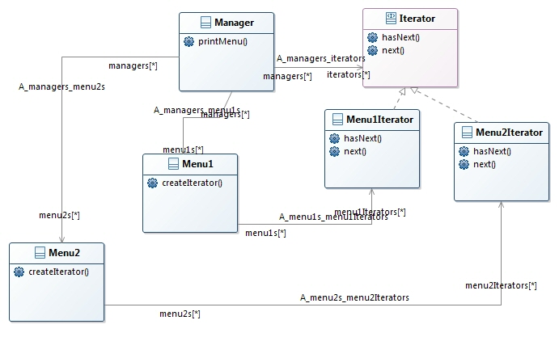
The class representation
The Manager doesn’t need to know if a Menu is implemented with an Array, an ArrayList,
These two menus implement the same exact set of methods, but they aren’t implementing the same interface.
The iterators implement the new createIterator() method; they are responsible for creating the iterator for their respective menu items’ implementations.

Slide 174
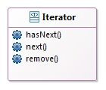
Making improvements using the Java Iterator Interface
The Java Iterator interface looks just similar to the previous definition.
There is an additional method that allows us to remove the last item returned by the next() method from the aggregate.
The remove() method is considered optional.
You don’t have to provide remove functionality.
But, you should provide the method because it’s part of the Iterator interface.
If you’re not going to allow remove() in your iterator you’ll want to throw the runtime exception java.lang.UnsupportedOperationException.
This exception may be thrown from remove() and any client that is a good citizen will check for this exception when calling the remove() method.

Slide 175
Using java.util.Iterator
public interface Menu {
public Iterator<MenuItem> createIterator();
}
import java.util.Iterator;
public class Manager {
Menu Menu1;
Menu Menu2;
public Manager(Menu menu1, Menu menu2) {
this. menu1 = menu1;
this. menu2 = menu2;
}
public void printMenu() {
Iterator<MenuItem> menu1Iterator = menu1.createIterator();
Iterator<MenuItem> menu2Iterator = menu2.createIterator();
printMenu(menu1Iterator);
printMenu(menu2Iterator);
}
private void printMenu(Iterator iterator) {
while (iterator.hasNext()) {
MenuItem menuItem = (MenuItem)iterator.next();
System.out.print(menuItem.getName() + ", ");
System.out.print(menuItem.getPrice() + " -- ");
System.out.println(menuItem.getDescription());
}
}
}

Slide 176
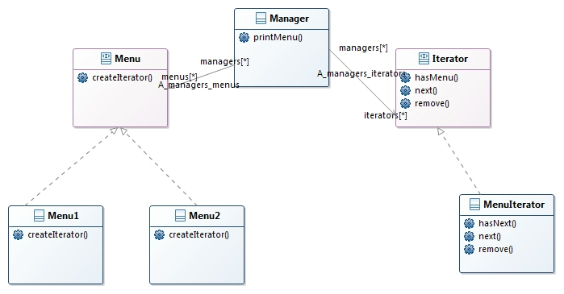
What is changed?
Manager is decoupled from the implementation of the menus: we can use an Iterator without having to know about how the list of items is implemented
Menu1 (and 2) return a MenuIterator from its createIterator() method because that’s the kind of iterator required to iterate over its Array of menu items.
Both the menus now implement the Menu interface, which means they need to implement the new createIterator() method.

Slide 177
Iterator Pattern defined
The Iterator Pattern provides a way to access the elements of an aggregate object sequentially without exposing its underlying representation.
The Iterator Pattern allows traversal of the elements of an aggregate without exposing the underlying implementation.
It also places the task of traversal on the iterator object, not on the aggregate, which simplifies the aggregate interface and implementation, and places the responsibility where it should be.

Slide 178
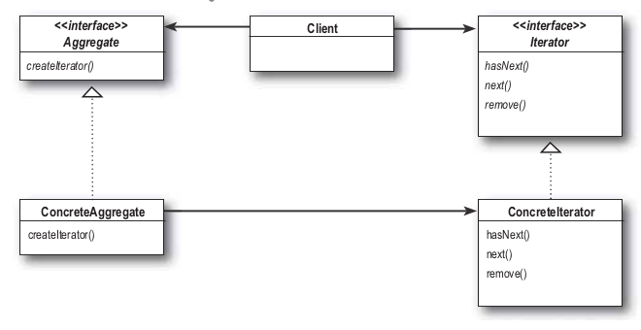
Iterator Pattern defined (2)
It decouples the client from the implementation of the collection of objects.
The Iterator interface provides a set of methods for traversing over elements of a collection.
The ConcreteAggregate has a collection of objects and implements the method that returns an Iterator for its collection.
Each ConcreteAggregate is responsible for instantiating a ConcreteIterator that can iterate over its collection of objects.

Slide 179
Single Responsibility
Design Principle: A class should have only one reason to change.
Every responsibility of a class is an area of potential change.
More than one responsibility means more than one area of change.
What if we allowed our aggregates to implement their internal collections and related operations AND the iteration methods?
The can change if the collection changes in some way, and if the way we iterate changes.
Cohesion is the term used as a measure of how closely a class or a module supports a single purpose or responsibility.
Cohesion is a more general concept than the Single Responsibility Principle
Classes that adhere to the principle tend to have high cohesion and are more maintainable than classes that take on multiple responsibilities and have low cohesion.

Slide 180
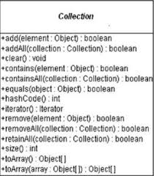
Java Iterators and Collections
Java gives you a lot of “collection” classes that allow you to store and retrieve groups of objects.
For example, Vector and LinkedList.
The nice thing about Collections and Iterator is that each Collection object knows how to create its own Iterator.

Slide 181
Adding another menu
public class Menu3 {
HashMap<String, MenuItem> menuItems = new HashMap<String, MenuItem>();
public CafeMenu3() {
addItem("Veggie Burger and Air Fries","Veggie burger on a whole wheat bun, lettuce, tomato, and fries",true, 3.99);
addItem("Soup of the day","A cup of the soup of the day, with a side salad",false, 3.69);
addItem("Burrito","A large burrito, with whole pinto beans, salsa, guacamole",true, 4.29);
}
public void addItem(String name, String description,
boolean vegetarian, double price)
{
MenuItem menuItem = new MenuItem(name, description, vegetarian, price);
menuItems.put(menuItem.getName(), menuItem);
}
public Map<String, MenuItem> getItems() {
return menuItems;
}
}

Slide 182
Adapting the menu
public class CafeMenu implements Menu {
HashMap<String, MenuItem> menuItems = new HashMap<String, MenuItem>();
public CafeMenu() {
// constructor code here
}
public void addItem(String name, String description,
boolean vegetarian, double price)
{
MenuItem menuItem = new MenuItem(name, description, vegetarian,price);
menuItems.put(menuItem.getName(), menuItem);
}
public Map<String, MenuItem> getItems() {
return menuItems;
}
public Iterator<MenuItem> createIterator() {
return menuItems.values().iterator();
}
}
x

Slide 183
Adding Menu3 to the Manager
public class Waitress {
Menu menu1;
Menu menu2;
Menu menu3;
public Waitress(Menu menu1, Menu menu2, Menu menu3) {
this. menu1 = menu1;
this. menu2 = menu2;
this. menu3 = menu3;
}
public void printMenu() {
Iterator<MenuItem> menu1 = menu1.createIterator();
Iterator<MenuItem> menu2= menu2.createIterator();
Iterator<MenuItem> menu3 = menu3 createIterator();
printMenu(menu1);
printMenu(menu2);
printMenu(menu3);
}
}

Slide 184
Violating the “Open Closed Principle”?
Every time we add a new menu we are going to have to open up the Manager implementation and add more code.
The previous implementation
decoupled the menu implementation
extracted the iteration into an iterator.
The menus are handled with separate, independent objects
Solution
package the menus up into an ArrayList and then
get its iterator to iterate through each Menu.

Slide 185
Solution
public class Manager{
ArrayList<Menu> menus;
public Manager(ArrayList<Menu> menus) {
this.menus = menus;
}
public void printMenu() {
Iterator<Menu> menuIterator = menus.iterator();
while(menuIterator.hasNext()) {
Menu menu = menuIterator.next();
printMenu(menu.createIterator());
}
}
void printMenu(Iterator<Menu> iterator) {
while (iterator.hasNext()) {
MenuItem menuItem = iterator.next();
System.out.print(menuItem.getName() + ", ");
System.out.print(menuItem.getPrice() + " -- ");
System.out.println(menuItem.getDescription());
}
}
}

Slide 186
And … if we want to manage sub-menus?
We have rework the implementation into something that is general enough to work over all the menus (and now submenus).
We have reached a level of complexity such that if we don’t rework the design now, we’re never going to have a design that can accommodate further acquisitions or submenus.
We need some kind of a tree-shaped structure that will accommodate menus, submenus, and menu items.
We need to make sure we maintain a way to traverse the items in each menu that is at least as convenient as what we are doing now with iterators.
We may need to traverse the items in a more flexible manner.
For instance, we might need to iterate over only one menu,
or we might need to iterate over an entire menu, including the submenus.
Because we need to represent menus, nested submenus and menu items, we can naturally fit them in a tree-like structure.

Slide 187
The Composite Pattern defined
The Composite Pattern allows you to compose objects into tree structures to represent part-whole hierarchies. Composite lets clients treat individual objects and compositions o objects uniformly
The Composite Pattern allows us to build structures of objects in the form of trees that contain both compositions of objects and individual objects as nodes.
Using a composite structure, we can apply the same operations over both composites and individual objects.
In other words, in most cases we can ignore the differences between compositions of objects and individual objects.

Slide 188
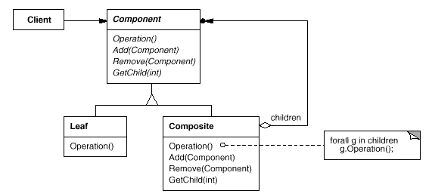
UML Diagram
The Client uses the
Component interface to manipulate the objects in the composition.
The Component defines an interface for all objects in the composition: both the composite and the leaf nodes.
The Component may implement a default behavior for add(), remove(), getChild() and its operations.
Note that the leaf also inherits methods like add(), remove() and getChild(), which don’t necessarily make a lot of sense for a leaf node.
The Composite also
implements the Leaf-related operations. Note that some of these may not make sense on a Composite, so in that case an exception might be generated
A leaf defines the behavior for the elements in the composition. It does this by implementing the operations the Composite supports.

Slide 189
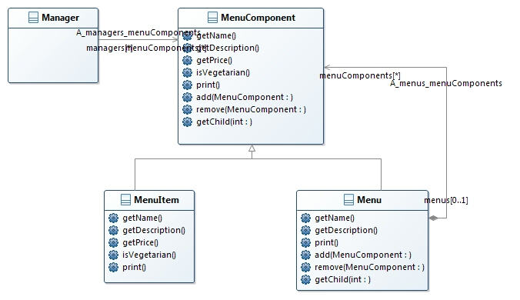
Designing Menus with Composite
MenuComponent represents the interface for both MenuItem and Menu. It is an abstract class because we want to provide default implementations for these methods.
The Manager uses the MenuComponent interface to access both Menus and MenuItems.
MenuItem and Menuoverrides some methods, and uses the default implementations in other ones
Both MenuItem and Menus override print().

Slide 190
Implementing the Menu Component
All components must implement the MenuComponent interface
Leaves and nodes have different roles and it is not possible to define a default implementation for each method that makes sense.
Typically the default implementation is UnsupportedOperationException.
if MenuItem or Menu doesn’t support an operation, they don’t have to do anything; they can just inherit the default implementation.

Slide 191
Implementing the Menu Component (2)
public abstract class MenuComponent {
public void add(MenuComponent menuComponent) {
throw new UnsupportedOperationException();
}
public void remove(MenuComponent menuComponent) {
throw new UnsupportedOperationException();
}
public MenuComponent getChild(int i) {
throw new UnsupportedOperationException();
}
public String getName() {
throw new UnsupportedOperationException();
}
public String getDescription() {
throw new UnsupportedOperationException();
}
public double getPrice() {
throw new UnsupportedOperationException();
}
public boolean isVegetarian() {
throw new UnsupportedOperationException();
}
public void print() {
throw new UnsupportedOperationException();
}
}

Slide 192
Implementing the Menu Item
public class MenuItem extends MenuComponent {
String name;
String description;
boolean vegetarian;
double price;
public MenuItem(String name,
String description,
boolean vegetarian,
double price)
{
this.name = name;
this.description = description;
this.vegetarian = vegetarian;
this.price = price;
}
public String getName() {
return name;
}
public String getDescription() {
return description;
}
public double getPrice() {
return price;
}
public boolean isVegetarian() {
return vegetarian;
}
public void print() {
System.out.print(" " + getName());
if (isVegetarian()) {
System.out.print("(v)");
}
System.out.println(", " + getPrice());
System.out.println(" -- " + getDescription());
}
}

Slide 193
Implementing the Composite Menu
public class Menu extends MenuComponent {
ArrayList<MenuComponent> menuComponents = new ArrayList<MenuComponent>();
String name;
String description;
public Menu(String name, String description) {
this.name = name;
this.description = description; }
public void add(MenuComponent menuComponent) {
menuComponents.add(menuComponent); }
public void remove(MenuComponent menuComponent) {
menuComponents.remove(menuComponent);
}
public MenuComponent getChild(int i) {
returnmenuComponents.get(i); }
public String getName() {
return name; }
public String getDescription() {
return description;
}
}

Slide 194
The print Method
public void print() {
System.out.print("\n" + getName());
System.out.println(", " + getDescription());
System.out.println("---------------------");
Iterator<MenuComponent> iterator = menuComponents.iterator();
while (iterator.hasNext()) {
MenuComponent menuComponent =
iterator.next();
menuComponent.print();
}
}
It should print not only the information about this Menu, but all of this Menu’s components: other Menus and MenuItems.
We use an Iterator to iterate through all the Menu’s components... those could be other Menus, or they could be MenuItems.
Since both Menus and MenuItems implement print(), we just call print() and the rest is up to them.

Slide 195
One Class, one Responsibility?
The Composite Pattern does not follow the rule:
It manages a hierarchy
it performs operations related to Menus.
The Composite Pattern takes the Single Responsibility design principle and trades it for transparency.
by allowing the Component interface to contain the child management operations and the leaf operations, a client can treat both composites and leaf nodes uniformly; so whether an element is a composite or leaf node becomes transparent to the client.
We lose a bit of safety because a client might try to do something inappropriate or meaningless on an element (like try to add a menu to a menu item).
We could take the design in the other direction and separate out the responsibilities into interfaces.
This would make our design safe, but we’d lose transparency and our code would have to use conditionals and the instanceof operator.
So, to return to your question, this is a classic case of tradeoff.

Slide 196
Using Iterator with a Composite
public class Menu extends MenuComponent {
Iterator<MenuComponent> iterator = null;
// other code here doesn't change
public Iterator<MenuComponent> createIterator() {
if (iterator == null) {
iterator = new CompositeIterator(menuComponents.iterator());
}
return iterator;
}
}
public class MenuItem extends MenuComponent {
// other code here doesn’t change
public Iterator<MenuComponent> createIterator() {
return new NullIterator();
}
}
CompositeIterator knows how to iterate over any composite.
let’s add a createIterator() method in the abstract MenuComponent
calling createIterator() on a composite should apply to all children of the composite

Slide 197
The Composite Iterator
import java.util.*;
public class CompositeIterator implements Iterator {
Stack<Iterator<MenuComponent>> stack = new Stack<Iterator<MenuComponent>>();
public CompositeIterator(Iterator iterator) {
stack.push(iterator);
}
public Object next() {
if (hasNext()) {
Iterator<MenuComponent> iterator = stack.peek();
MenuComponent component = iterator.next();
stack.push(component.createIterator());
return component;
} else {
return null;
}
}
If there is a next element, we get the current iterator off the stack and get its next element.
public boolean hasNext() {
if (stack.empty()) {
return false;
} else {
Iterator<MenuComponent> iterator = stack.peek();
if (!iterator.hasNext()) {
stack.pop();
return hasNext();
} else {
return true;
}
}
We then throw that component's iterator on the stack. If the component is a Menu, it will iterate over all its items. If the component is a MenuItem, we get the NullIterator, and no iteration happens. Then we return the component.

Slide 198
The Null Iterator
Choice 1: Return null
We could return null from createIterator(), but then we’d need conditional code in the client to see if null was returned or not.
Choice 2:Return an iterator that always returns false when hasNext() is called
We can still return an iterator, but the client doesn’t have to worry about whether or not null is ever returned. This is an iterator that is a “no op.”
import java.util.Iterator;
public class NullIterator implements <MenuComponent> {
public Object next() {
return null;
}
public boolean hasNext() {
return false;
}
public void remove() {
throw new UnsupportedOperationException();
}
}

Slide 199
Print Vegetarian Menu
public class Waitress {
MenuComponent allMenus;
public Waitress(MenuComponent allMenus) {
this.allMenus = allMenus;
}
public void printMenu() {
allMenus.print();
}
public void printVegetarianMenu() {
Iterator<MenuComponent> iterator = allMenus.createIterator();
System.out.println("\nVEGETARIAN MENU\n----");
while (iterator.hasNext()) {
MenuComponent menuComponent = iterator.next();
try {
if (menuComponent.isVegetarian()) {
menuComponent.print();
}
} catch (UnsupportedOperationException e) {}
}
}
}
Iterate through every element of the composite.
If an exception.happens we catch the exception, but continue with our iteration.

Slide 200
Be carefull!
try {
if (menuComponent.isVegetarian()) {
menuComponent.print();
}
} catch (UnsupportedOperationException) {}
In general try/catch is meant for error handling, not program logic.
What are our other options?
We could have checked the runtime type of the menu component with instanceof to make sure it’s a MenuItem before making the call to isVegetarian().
But in the process we’d lose transparency because we wouldn’t be treating Menus and MenuItems uniformly.
We could also change isVegetarian() in the Menus so that it returns false. This provides a simple solution and we keep our transparency.
In our solution we are going for clarity: we really want to communicate that this is an unsupported operation on the Menu.

Slide 201
Key Points
An Iterator allows access to an aggregate’s elements without exposing its internal structure.
It takes the job of iterating over an aggregate and encapsulates it in another object.
When using an Iterator, we relieve the aggregate of the responsibility of supporting operations for traversing its data.
An Iterator provides a common interface for traversing the items of an aggregate, allowing you to use polymorphism when writing code that makes use of the items of the aggregate.
We should strive to assign only one responsibility to each class.
The Composite Pattern provides a structure to hold both individual objects and composites.
It allows clients to treat composites and individual objects uniformly.
A Component is any object in a Composite structure. Components may be other composites or leaf nodes.
There are many design tradeoffs in implementing Composite. You need to balance transparency and safety with your needs.

Slide 202

The State Pattern
State helps objects to control their behavior by changing their internal state.
Has token
Turns crank
Insert token
Out of gumballs
Eject token
No token
Gumball > 0
Gumball Sold
Dispense gumball
Gumball = 0

Slide 203
Creating the state machine
Considering 4 states and an instance variable to hold the current state
final static int SOLD_OUT = 0;
final static int NO_QUARTER = 1;
final static int HAS_QUARTER = 2;
final static int SOLD = 3;
int state = SOLD_OUT;
We create a class that acts as the state machine.
For each action (insert token, eject token …), there is method that uses conditional statements to determine what behavior is appropriate.
public void insertQuarter() {
if (state == HAS_QUARTER) {
System.out.println("You can't insert another quarter");
} else if (state == NO_QUARTER) {
state = HAS_QUARTER;
System.out.println("You inserted a quarter");
} else if (state == SOLD_OUT) {
System.out.println("You can't insert a quarter, machine sold out");
} else if (state == SOLD) {
System.out.println("Please wait, we're giving you a gumball");
}
}

Slide 204
Creating the state machine (2)
We are
modeling state within an object by creating an instance variable to hold the state values
writing conditional code within our methods to handle the various states.

Slide 205
The (partial) code
public class GumballMachine {
final static int SOLD_OUT = 0;
final static int NO_QUARTER = 1;
final static int HAS_QUARTER = 2;
final static int SOLD = 3;
int state = SOLD_OUT;
int count = 0;
public GumballMachine(int count) {
this.count = count;
if (count > 0) {
state = NO_QUARTER;
}
}
public void insertQuarter() {
if (state == HAS_QUARTER) {
System.out.println("You can't insert another quarter");
} else if (state == NO_QUARTER) {
state = HAS_QUARTER;
System.out.println("You inserted a quarter");
} else if (state == SOLD_OUT) {
System.out.println(“The machine is sold out");
} else if (state == SOLD) {
System.out.println(“We're already giving you a gumball");
}
}
… and so on for all the possible actions

Slide 206
Improvement
10% of the time, when the crank is turned, the customer gets two gumballs instead of one.
Has token
Turns crank & winner
Winner
Turns crank
Insert token
Eject token
Dispense 2 gumballs
Gumball = 0
Out of gumballs
No token
Gumball > 0
Gumball Sold
Gumball > 0
Dispense gumball
Gumball = 0

Slide 207
Implementation
The code previously implemented is not simple to extend
You’d have to add a new WINNER state
You’d have to add a new conditional in every single method to handle the WINNER state
that’s a lot of code to modify
turnCrank() will get especially messy, because you’d have to add code to check to see whether you’ve got a WINNER and then switch to either the WINNER state or the SOLD state.

Slide 208
The new design
A solution could be to rework the existing code and
encapsulate state objects in their own classes
Delegate to the current state when an action occurs.
Steps
define a State interface that contains a method for every action in the Gumball Machine.
implement a State class for every state of the machine.
These classes will be responsible for the behavior of the machine when it is in the corresponding state.
delegate to the State class to do the work for us.

Slide 209
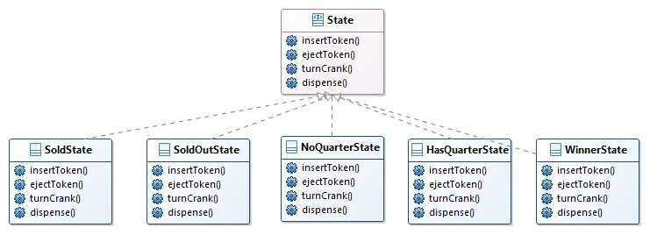
The UML representation

Slide 210
Implementing the State Classes
public class NoQuarterState implements State {
GumballMachine gumballMachine;
public NoQuarterState(GumballMachine gumballMachine) {
this.gumballMachine = gumballMachine;
}
public void insertQuarter() {
System.out.println("You inserted a quarter");
gumballMachine.setState(gumballMachine.getHasQuarterState());
}
public void ejectQuarter() {
System.out.println("You haven't inserted a quarter");
}
public void turnCrank() {
System.out.println("You turned, but there's no quarter");
}
public void dispense() {
System.out.println("You need to pay first");
}
}

Slide 211
The machine
public class GumballMachine {
State soldOutState;
State noQuarterState;
State hasQuarterState;
State soldState;
State state;
int count = 0;
public GumballMachine(int numberGumballs) {
soldOutState = new SoldOutState(this);
noQuarterState = new NoQuarterState(this);
hasQuarterState = new HasQuarterState(this);
soldState = new SoldState(this);
this.count = numberGumballs;
if (numberGumballs > 0) {
state = noQuarterState;
} else {
state = soldOutState;
}
}
public void insertQuarter() {
state.insertQuarter();
}
public void ejectQuarter() {
state.ejectQuarter();
}
public void turnCrank() {
state.turnCrank();
state.dispense();
}
void setState(State state) {
this.state = state;
}
void releaseBall() {
System.out.println("A gumball comes rolling out the slot...");
if (count != 0) {
count = count - 1;
}
}
// More methods here including getters for each State...
}

Slide 212
The new design
The Gumball Machine implementation is structurally different from the first version, and yet functionally it is exactly the same.
There is
the behavior of each state localized into its own class.
All the troublesome if statements that would have been difficult to maintain have been removed.
Closed each state for modification, and yet left the Gumball Machine open to extension .
Created a code base and class structure that maps much more closely to the diagram and is easier to read and understand.

Slide 213
The State Pattern defined
The State Pattern allows an object to alter its behavior when its internal state changes. The object will appear to change its class.
Because the pattern encapsulates state into separate classes and delegates to the object representing the current state, we know that behavior changes along with the internal state.
What does it mean for an object to “appear to change its class”?
Think about it from the perspective of a client:
if an object you’re using can completely change its behavior, then it appears to you that the object is actually instantiated from another class.
In reality, however, you know that we are using composition to give the appearance of a class change by simply referencing different state objects.

Slide 214
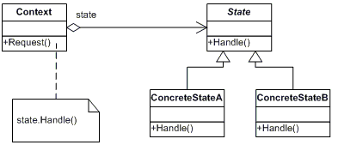
State Pattern class diagram
The Context is the class that can have a number of internal states. In our example, the
GumballMachine is the Context.
The State interface defines a common interface for all concrete states; the states all implement the same interface, so they are interchangeable.
ConcreteStates handle requests from the
Context. Each ConcreteState provides its
own implementation for a request. In this
way, when the Context changes state, its
behavior will change as well.
Many concrete states are possible
Whenever the request() is made on the Context it is delegated to the state to handle.

Slide 215
State vs Strategy Pattern
The class diagrams are essentially the same, but the two patterns differ in their intent.
With the State Pattern,
we have a set of behaviors encapsulated in state objects;
at any time the context is delegating to one o those states.
Over time, the current state changes across the set of state objects to reflect the internal state of the context, so the context’s behavior changes over time as well.
The client usually knows very little, id anything, about the state objects.
With Strategy,
the client usually specidies the strategy object that the context is composed with.
Often there is a strategy object that is most appropriate for a context object.
Think of the Strategy Pattern as a flexible alternative to subclassing.
Think of the State Pattern as an alternative to putting lots of conditionals in your context.

Slide 216
Key points
The State Pattern allows an object to have many different behaviors based on its internal state.
The Context gets its behavior by delegating to the current state object it is composed with.
By encapsulating each state into a class, we localize any changes that will need to be made.
The State and Strategy Patterns have the same class diagram, but they differ in intent.
Strategy Pattern typically configures Context classes with a behavior or algorithm. 
State Pattern allows a Context to change its behavior as the state of the Context changes.
State transitions can be controlled by the State classes or by the Context classes.
Using the State Pattern will typically result in a greater number of classes in your design.
State classes may be shared among Context instances.

Slide 217
The Proxy Pattern
The Proxy pattern controls and manages access.
Let us to implement a code for monitoring the gumball machine before.
public class GumballMonitor {
GumballMachine machine;
public GumballMonitor(GumballMachine machine) { this.machine = machine;}
public void report() {
System.out.println("Gumball Machine: " + machine.getLocation());
System.out.println("Current inventory: " + machine.getCount() + " gumballs");
System.out.println("Current state: " + machine.getState());
}
}
public class GumballMachine {
// other instance variables
String location;
public GumballMachine(String location, int count) {
// other constructor code here
this.location = location;
}
public String getLocation() {
return location;
}
// other methods here
}

Slide 218
Testing the Monitor
public class GumballMachineTestDrive {
public static void main(String[] args) {
int count = 0;
if (args.length < 2) {
System.out.println("GumballMachine <name> <inventory>");
System.exit(1);
}
count = Integer.parseInt(args[1]);
GumballMachine gumballMachine = new GumballMachine(args[0], count);
GumballMonitor monitor = new GumballMonitor(gumballMachine);
// rest of test code here
monitor.report();
}
}
The monitor looks good, but typically we have to monitor devices remotely.

Slide 219
A remote proxy
In the current implementation we give the GumballMonitor a reference to a machine and it gives us a report.
The problem is that the monitor runs in the same JVM as the gumball machine
So what if we left our GumballMonitor class as is, but handed it a proxy to a remote object?
A proxy is a stand in for a real object.
In this case, the proxy acts just like it is a Gumball Machine object, but behind the scenes it is communicating over the network to talk to the real, remote GumballMachine.

Slide 220

The role of the ‘remote proxy’
A remote proxy acts as a local representative to a remote object.
What’s a “remote object”?
It’s an object that lives in the heap of a different Java Virtual Machine
What’s a “local representative”?
It’s an object that you can call local methods on and have them forwarded on to the remote object.
Local Heap
Remote Heap
Proxy
Machine
Monitor

Slide 221
What we need?
We need to write some code that
takes a method invocation,
somehow transfers it over the network,
invokes the same method on a remote object.
Then I presume when the call is complete, the result gets sent back over the network to our client.
it’s pretty much built into Java’s remote invocation functionality.
All we have to do is retrofit our code so that it takes advantage of RMI

Slide 222
Remote methods
Let’s design a system that allows us to call a local object that forwards each request to a remote object.
We’d need helper objects that actually do the communicating for us. They make it possible for the client to act as though it’s calling a method on a local object.
The client calls a method on the client helper, as if the client helper were the actual service.
The client helper then takes care of forwarding that request.
The client helper isn’t really the remote service: it contacts the server, transfers information about the method waits for a return from the server.
On the server side, the service helper receives the request (through a Socket connection), unpacks the information about the call, and then invokes the real method on the real service object.
So, to the service object, the call is local. It’s coming from the service helper, not a remote client.
The service helper gets the return value from the service, packs it up, and ships it back (over a Socket’s output stream) to the client helper. The client helper unpacks the information and returns the value to the client object.

Slide 223
Java RMI
Client Heap
Server Heap
Client Helper
Service Helper
Service Object
Client Object
RMI STUB
RMI SKELETON
Newer versions of Java don’t require an explicit skeleton object
What RMI does for you is build the client and service helper objects, right down to creating a client helper object with the same methods as the remote service.
You don’t have to write any of the networking or I/O code yourself.
There is one difference between RMI calls and local (normal) method calls.
RMI provides all the runtime infrastructure to make it all work, including a lookup service that the client can use to find and access the remote objects.

Slide 224
Making the Remote service
Step one: Make the remote interface
The remote interface defines the methods that a client can call remotely. It’s what the client will use as the class type for your service.
Step two: Make e remote implementation
This is the class that does the Real Work. It has the real implementation of the remote methods defined in the remote interface. It’s the object that the client wants to call methods on.
Step three: Start the RMI registry
The rmiregistry is like the white pages of a phone book. It’s where the client goes to get the proxy (the client stub/helper object)
Step Four: Start the remote service
You have to get the service object up and running. Your service implementation class instantiates an instance of the service and registers it with the RMI registry. Registering it makes the service available for clients.

Slide 225
Step one: make a Remote interface
import java.rmi.*;
public interface MyRemote extends Remote {
public String sayHello() throws RemoteException;
}
Remote is a ‘marker’ interface: it has no methods.
Notice that we say ‘extends’ here. One interface is allowed to extend another interface.
Declare that all methods throw a RemoteException
The remote interface is the one the client uses as the type for the service. In other words, the client invokes methods on something that implements the remote interface.
Be sure arguments and return values are primitives or Serializable
Arguments and return values of a remote method must be either primitive or Serializable.

Slide 226
Step two: make a Remote implementation
import java.rmi.*;
import java.rmi.server.*;
public class MyRemoteImpl extends UnicastRemoteObject implements MyRemote {
private static final long serialVersionUID = 1L;
public String sayHello() {
return "Server says, 'Hey'";
}
public MyRemoteImpl() throws RemoteException { }
public static void main (String[] args) {
try {
MyRemote service = new MyRemoteImpl();
Naming.rebind("RemoteHello", service);
} catch(Exception ex) {
ex.printStackTrace();
}
}
}
The service has to implement the remote interface with the methods your client is going to call
You have to make the service available to remote clients, by instantiating it and putting it into the RMI registry . When you register the implementation object, the RMI system actually puts the stub in the registry, since that’s what the client really needs. Register your service using the static rebind() method of the java.rmi.Naming class.
Extend UnicastRemoteObject
To work as a remote service object, your object needs some functionality. The simplest way is to extend UnicastRemoteObject (from the java.rmi.server package) and let that class (your superclass) do the work for you
Write a no-arg constructor that declares a RemoteException
UnicastRemoteObject constructor throws a RemoteException. The only way to deal with this is to declare a constructor for your remote implementation, just so that you have a place to declare the RemoteException. When a class is instantiated, its superclass constructor is always called. If your superclass constructor throws an exception, you have no choice but to declare that your constructor also throws an exception.
Register the service with the RMI registry

Slide 227
make a Remote implementation (2)
%rmiregistry
%java MyRemoteImpl
Step three: run rmiregistry
Bring up a terminal and start the rmiregistry.
Be sure you start it from a directory that has access to your classes. The simplest way is to start it from your classes directory.
Step four: start the service
Bring up another terminal and start your serviceThis might be from a main() method in your remote implementation class, or from a separate launcher class.

Slide 228
How does the client get the stub object?
The client has to get the stub object (our proxy), since that’s the thing the client will call methods on.
That’s where the RMI registry comes in.
The client does a ‘lookup’, like going to the white pages of a phone book, and essentially says, “Here’s a name, and I’d like the stub that goes with that name.”
lookup() is a static method of the Naming class.
MyRemote service = (MyRemote) naming.lookup("rmi://127.0.0.1/RemoteHello");
The client always uses the remote interface as the type of the service. In fact, the client never needs to know the actual class name of your remote service.

Slide 229
The Client Code
import java.rmi.*;
public class MyRemoteClient {
public static void main (String[] args) {
new MyRemoteClient().go();
}
public void go() {
try {
MyRemote service = (MyRemote) Naming.lookup("rmi://127.0.0.1/RemoteHello");
String s = service.sayHello();
System.out.println(s);
} catch(Exception ex) {
ex.printStackTrace();
}
}
}
Client does a lookup on the RMI registry
RMI registry returns the stub object (as the return value of the lookup method) and RMI deserializes the stub automatically.
Client invokes a method on the stub, as if the stub IS the real service

Slide 230
The GumballMachine remote proxy
Server Heap
Client Heap
Service Skeleton
Client Stub
Service Object
Client Object
The stub is a proxy to the remote
GumballMachine.
The skeleton accepts the remote calls and makes everything work on the service side.
The GumballMachine is
our remote service;
it’s going to expose
a remote interface
for the client to
use.
This is our
Monitor code. It
uses a proxy to
talk to remote
gumball machines.

Slide 231
Getting the GumballMachine ready to be a remote service
In other words, we’re going to make the GumballMachine into a service.
1. Create a remote interface for the GumballMachine. This will provide a set of methods that can be called remotely.
2. Make sure all the return types in the interface are serializable.
3. Implement the interface in a concrete class.
import java.rmi.*;
public interface GumballMachineRemote extends Remote {
public int getCount() throws RemoteException;
public String getLocation() throws RemoteException;
public State getState() throws RemoteException;
}
import java.io.*;
public interface State extends Serializable {
public void insertQuarter();
public void ejectQuarter();
public void turnCrank();
public void dispense();
}

Slide 232
GumballMachine RMI
import java.rmi.*;
import java.rmi.server.*;
public class GumballMachine
extends UnicastRemoteObject implements GumballMachineRemote
{
private static final long serialVersionUID = 2L;
// other instance variables here
public GumballMachine(String location, int numberGumballs) throws RemoteException {
// code here
}
public int getCount() {
return count;
}
public State getState() {
return state;
}
public String getLocation() {
return location;
}
// other methods here
}

Slide 233
Registering with the RMI registry...
public class GumballMachineTestDrive {
public static void main(String[] args) {
GumballMachineRemote gumballMachine = null;
int count;
if (args.length < 2) {
System.out.println("GumballMachine <name> <inventory>");
System.exit(1);
}
try {
count = Integer.parseInt(args[1]);
gumballMachine = new GumballMachine(args[0], count);
Naming.rebind("//" + args[0] + "/gumballmachine", gumballMachine);
} catch (Exception e) {
e.printStackTrace();
}
}
}

Slide 234
GumballMonitor client
import java.rmi.*;
public class GumballMonitor {
GumballMachineRemote machine;
public GumballMonitor(GumballMachineRemote machine) {
this.machine = machine;
}
public void report() {
try {
System.out.println("Gumball Machine: " + machine.getLocation());
System.out.println("Current inventory: " + machine.getCount() + " gumballs");
System.out.println("Current state: " + machine.getState());
} catch (RemoteException e) {
e.printStackTrace();
}
}
}
We need to catch any remote exceptions that might happen as we try to invoke methods that are ultimately happening over the network.

Slide 235
Monitoring test
import java.rmi.*;
public class GumballMonitorTestDrive {
public static void main(String[] args) {
String[] location = {"rmi://santafe.mightygumball.com/gumballmachine",
"rmi://boulder.mightygumball.com/gumballmachine",
"rmi://seattle.mightygumball.com/gumballmachine"};
GumballMonitor[] monitor = new GumballMonitor[location.length];
for (int i=0; i < location.length; i++) {
try {
GumballMachineRemote machine =
(GumballMachineRemote) Naming.lookup(location[i]);
monitor[i] = new GumballMonitor(machine);
System.out.println(monitor[i]);
} catch (Exception e) {
e.printStackTrace();
}
}
for (int i=0; i < monitor.length; i++) {
monitor[i].report();
}
}
}
This returns a proxy to the remote Gumball Machine (or throws an exception if one can’t be located).
Once we get a proxy to the remote
machine, we create a new GumballMonitor
and pass it the machine to the monitor

Slide 236
The Proxy Pattern defined
The Proxy Pattern provides a surrogate or placeholder for another object to control access to it.
But what about a proxy controlling access?
The proxy needed to control access because our client, the monitor, didn’t know how to talk to a remote object.
So in some sense the remote proxy controlled access so that it could handle the network details for us.
There are many variations of the Proxy Pattern, and the variations typically revolve around the way the proxy “controls access.”
A remote proxy controls access to a remote object.
A virtual proxy controls access to a resource that is expensive to create.
A protection proxy controls access to a resource based on access rights.

Slide 237
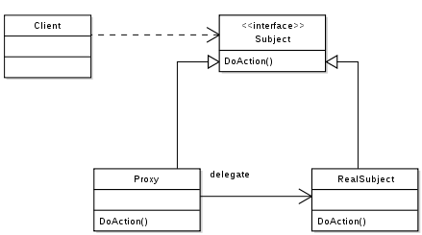
The UML Diagram
Both the Proxy and the
RealSubject implement the
Subject interface. This
allows any client to treat
the proxy just like the
RealSubject
The Proxy often instantiates or handles the creation of the RealSubject.
The Proxy keeps a reference to the
Subject, so it can forward requests
to the Subject when necessary.
The RealSubject is usually the object that does most of the real work; the Proxy controls access to it.

Slide 238
Virtual Proxy
Remote Proxy
With Remote Proxy, the proxy acts as a local representative for an object that lives in a different JVM. A method call on the proxy results in the call being transferred over the wire, invoked remotely, and the result being returned back to the proxy and then to the Client.
Virtual Proxy
Virtual Proxy acts as a representative for an object that may be expensive to create. The Virtual Proxy often defers the creation of the object until it is needed; the Virtual Proxy also acts as a surrogate for the object before and while it is being created. After that, the proxy delegates requests directly to the RealSubject.

Slide 239
Virtual proxy - example
Displaying CD covers
We want to write an application that displays compact disc covers.
We might create a menu of the CD titles and then retrieve the images from an online service like Amazon.com.
If you’re using Swing, we might create an Icon and ask it to load the image from the network.
The only problem is retrieving a CD cover might take a little time, so the application should display something while you are waiting for the image to load.
Once the image is loaded, the message should go away and you should see the image.
The virtual proxy can stand in place of the icon, manage the background loading, and before the image is fully retrieved from the network, display “Loading CD cover, please wait...”.
Once the image is loaded, the proxy delegates the display to the Icon.

Slide 240
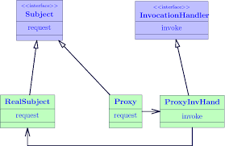
Using the Java API’s Proxy to create a protection proxy
Java’s got its own proxy support right in the java.lang.reflect package.
With this package, Java lets you create a proxy class on the fly that implements one or more interfaces and forwards method invocations to a class that you specify.
Because the actual proxy class is created at runtime, we refer to this Java technology as a dynamic proxy.
The Proxy is generated by Java and implements the entire Subject interface.
The Proxy now consists
of two classes
You supply the InvocationHandler, which gets passed all method calls that are invoked on the Proxy. The InvocationHandler controls access to the methods of the RealSubject.

Slide 241
Using the Java API’s Proxy to create a protection proxy (2)
Java creates the Proxy class for you, you need a way to tell the Proxy class what to do.
You can’t put that code into the Proxy class like we did before, because you’re not implementing one directly.
The job of the InvocationHandler is to respond to any method calls on the proxy.
Think of the InvocationHandler as the object the Proxy asks to do all the real work after it’s received the method calls.

Slide 242
Example
We want to create an application for rating the professors
public class ProfessorBeanImpl implements ProfessorBean {
String name;
String gender;
String topic;
int rating;
int ratingCount = 0;
public String getName() {
return name;
}
public int rating() {
if (ratingCount == 0) return 0;
return (rating/ratingCount);
}
public void setName(String name) {
this.name = name;
}
public void setRating(int rating) {
this.rating += rating;
ratingCount++;
}
}
public interface ProfessorBean {
String getName();
String getGender();
String getTopic();
int getRating();
void setName(String name);
void setGender(String gender);
void setTopic(String interests);
void setRating(int rating);
}
Some setters and getters are not reported

Slide 243
Keeping the software protected
You shouldn’t be able to vote for yoursel or to change another customer’s data.
The way our PersonBean is defined, any client can call any of the methods.
This is a perfect example of where we might be able to use a Protection Proxy.
What’s a Protection Proxy? It’s a proxy that controls access to an object based on access rights.
For instance, if we had an employee object, a Protection Proxy might allow the employee to call certain methods on the object, a manager to call additional methods (like setSalary()), and a human resources employee to call any method on the object.
In our service
we want to make sure that a customer can set his own information while preventing others from altering it.
we want to allow just the opposite with the ratings: we want the other customers to be able to set the rating, but not that particular customer.

Slide 244
Creating a Dynamic Proxy
To fix these problems we’re going to create two proxies:
one for accessing your own ProfessorBean object
One for accessing another customer’s ProfessorBean object.
That way, the proxies can control what requests can be made in each circumstance.
Java will create two proxies for us; all we need to do is supply the handlers that know what to do when a method is invoked on the proxy.
Create two InvocationHandlers.
InvocationHandlers implement the behavior of the proxy. As you’ll see, Java will take care of creating the actual proxy class and object; we just need to supply a handler that knows what to do when a method is called on it.
Write the code that creates the dynamic proxies.
We need to write a little bit of code to generate the proxy class and instantiate it. We’ll step through this code in just a bit.
Wrap any ProfessorBean object withthe appropriate proxy.
When we need to use a ProfessorBean object, either it’s the object of the customer himself, or it’s another user.

Slide 245
Creating Invocation Handlers
We know we need to write two invocation handlers, one for the owner and one for the non-owner.
What are invocation handlers?
When a method call is made on the proxy, the proxy forwards that call to your invocation handler
There’s only one method, invoke(), and no matter what methods get called on the proxy, the invoke() method is what gets called on the handler.
Let’s say the setRating() method is called on the proxy
proxy.setRating(9);
The proxy then turns around and calls invoke() on the InvocationHandler.
invoke(Object proxy, Method method, Object[] args)
The handler decides what it should do with the request and possibly
forwards it on to the RealSubject.
return method.invoke(person, args);

Slide 246
Creating Invocation Handlers (2)
import java.lang.reflect.*;
public class OwnerInvocationHandler implements InvocationHandler {
ProfessornBean person;
public OwnerInvocationHandler(ProfessorBean person) {
this.person = person;
}
public Object invoke(Object proxy, Method method, Object[] args)
throws IllegalAccessException {
try {
if (method.getName().startsWith("get")) {
return method.invoke(person, args);
} else if (method.getName().equals("setRating")) {
throw new IllegalAccessException();
} else if (method.getName().startsWith("set")) {
return method.invoke(person, args);
}
} catch (InvocationTargetException e) {
e.printStackTrace();
}
return null;
}
}
We're passed the Real Subject in the constructor and we keep a reference to it.
If the method is a getter, we go ahead and invoke it on the real subject.
If it is the setHotOrNotRating() method we disallow it by throwing a IllegalAccessException.

Slide 247
Creating Invocation Handlers (3)
import java.lang.reflect.*;
public class NonOwnerInvocationHandler implements InvocationHandler {
ProfessorBean person;
public NonOwnerInvocationHandler(ProfessorBean person) {
this.person = person;
}
public Object invoke(Object proxy, Method method, Object[] args)
throws IllegalAccessException {
try {
if (method.getName().startsWith("get")) {
return method.invoke(person, args);
} else if (method.getName().equals("setHotOrNotRating")) {
return method.invoke(person, args);
} else if (method.getName().startsWith("set")) {
throw new IllegalAccessException();
}
} catch (InvocationTargetException e) {
e.printStackTrace();
}
return null;
}
}

Slide 248
Creating the Proxy class and instantiating the Proxy object
This method takes a person object (the real subject) and returns a proxy for it. Because the proxy has the same interface as the subject, we return a ProfessorBean.
ProfessorBean getOwnerProxy(ProfessorBean person) {
return (ProfessorBean) Proxy.newProxyInstance(
person.getClass().getClassLoader(),
person.getClass().getInterfaces(),
new OwnerInvocationHandler(person));
}
This code creates the
proxy. Now this is some
mighty ugly code, so let’s
step through it carefully.

Slide 249
Key points
The Proxy Pattern provides a representative for another object in order to control the client’s access to it. There are a number of ways it can manage that access.
A Remote Proxy manages interaction between a client and a remote object.
A Virtual Proxy controls access to an object that is expensive to instantiate.
A Protection Proxy controls access to the methods of an object based on the caller. 
Many other variants of the Proxy Pattern exist including caching proxies, synchronization proxies, firewall proxies, copy-on-write proxies, and so on.
Proxy is structurally similar to Decorator, but the two differ in their purpose.
The Decorator Pattern adds behavior to an object, while a Proxy controls access.
Java’s built-in support for Proxy can build a dynamic proxy class on demand and dispatch all calls on it to a handler of your choosing.
Like any wrapper, proxies will increase the number of classes and objects in your designs.

Slide 250
Other patterns
Bridge
Builder
Chain of responsibility
Flyweight
Interpreter
Mediator
Memento
Prototype
Visitor

Slide 251
Bridge
Use the Bridge Pattern to vary not only your implementations, but also your abstractions.
Scenario
Imagine you’re going to revolutionize “extreme lounging.” You’re writing the code for a new ergonomic and user-friendly remote control for TVs. You already know that you’ve got to use good OO techniques because while the remote is based on the same abstraction, there will be lots of implementations—one for each model of TV.
Your dilemma
You know that the remote’s user interface won’t be right the first time. You expect that the product will be refined many times as usability data is collected on the remote control.
So your dilemma is that the remotes are going to change and the TVs are going to change. You’ve already abstracted the user interface so that you can vary the implementation over the many TVs your customers will own. But you are also going to need to vary the abstraction because it is going to change over time as the remote is improved based on the user feedback.So how are you going to create an OO design that allows you to vary the implementation and the abstraction

Slide 252

Bridge (2)
The Bridge Pattern allows you to vary the implementation and the abstraction by placing the two in separate class hierarchies.

Slide 253

The UML Model
All methods in the abstraction are implemented in terms of the implementation
Concrete subclasses are implemented in terms of the abstraction, not the implementation.

Slide 254
Pros and Cons
Decouples an implementation so that it is not bound permanently to an interface.
Abstraction and implementation can be extended independently.
Changes to the concrete abstraction classes don’t affect the client.
Useful in graphics and windowing systems that need to run over multiple platforms.
Useful any time you need to vary an interface and an implementation in different ways.
Increases complexity

Slide 255
The Builder pattern
Use the Builder Pattern to encapsulate the construction of a product and allow it to be constructed in steps.
A scenario
You’ve just been asked to build a vacation planner for a new theme park just. Park guests can choose a hotel and various types of admission tickets, make restaurant reservations, and even book special events.
Each vacation is planned over some number of days.
Each day can have any combination of hotel reservations, tickets, meals and special events.
For instance, a local resident might not need a hotel, but wants to make dinner and special event reservations.
Another guest might be flying and needs a hotel, dinner reservations, and admission tickets.
So, you need
a flexible data structure that can represent guest planners and all their variations;
you also need to follow a sequence of potentially complex steps to create the planner.

Slide 256

The Builder pattern (2)
The Client directs
the builder to
construct the
planner.
The client uses an abstract interface to build the planner.
The concrete builder
creates real products
and stores them in
the vacation composite
structure
builder.buildDay(date);
builder.addHotel(date, "Grand Facadian");
builder.addTickets("Patterns on Ice");
// plan rest of vacation
Planner yourPlanner =
builder.getVacationPlanner();
In the iterator, we encapsulated the iteration into a separate object and hid the internal representation of the collection from the client. It’s the same idea here: we encapsulate the creation of the trip planner in an object (let’s call it a builder), and have our client ask the builder to construct the trip planner structure for it.

Slide 257
Pros and Cons
Encapsulates the way a complex object is constructed.
Allows objects to be constructed in a multistep and varying process (as opposed to one-step factories).
Hides the internal representation of the product from the client.
Product implementations can be swapped in and out because the client only sees an abstract interface.
Often used for building composite structures.
Constructing objects requires more domain knowledge of the client than when using a Factory.

Slide 258
Chain of Responsibility
Use the Chain of Responsibility Pattern when you want to give more than one object a chance to handle a request.
Scenario
A company has been getting more email than they can handle. From their own analysis they get four kinds of email:
fan mails -- > go straight to the CEO
complaints -- > go to the legal department
requests -- >go to business development
Spam -- > deleted
The task
The company has already written some AI detectors that can tell the kind of the e-mail, but they need you to create a design that can use the detectors to handle incoming email.

Slide 259

Chain of Responsibility (2)
Each object in the chain
acts as a handler and has
a successor object. If it
can handle the request,
it does; otherwise, it
forwards the request to
its successor.
As email is received, it is passed to the first handler: the SpamHandler. If the SpamHandler can’t handle the request, it is passed on to the FanHandler. And so on..

Slide 260

Pros and Cons
Decouples the sender of the request and its receivers.
Simplifi es your object because it doesn’t have to know the chain’s structure and keep direct references to its members.
Allows you to add or remove responsibilities dynamically by changing the members or order of the chain.
Commonly used in windows systems to handle events like mouse clicks and keyboard events.
Execution of the request isn’t guaranteed; it may fall off the end of the chain if no object handles it (this can be an advantage or a disadvantage).
Can be hard to observe and debug at runtime.

Slide 261
Flyweight
Use the Flyweight Pattern when one instance of a class can be used to provide many “virtual instances.”
A scenario
You want to add trees as objects in your hot new landscape design application. In your application, trees don’t really do very much; they have an X-Y location, and they can draw themselves dynamically, depending on how old they are. The thing is, a user might want to have lots and lots of trees in one of their home landscape designs.
Your big client’s dilemma
You’ve just landed your “reference account.” That key client you’ve been pitching for months. They’re going to buy 1,000 seats of your application, and they’re using your software to do the landscape design for huge planned communities. After using your software for a week, your client is complaining that when they create large groves of trees, the app starts getting sluggish...

Slide 262

Flyweight (2)
What if, instead of having thousands of Tree objects, you could redesign your system so that you’ve got only one instance of Tree, and a client object that maintains the state of ALL your trees.
All the state, for ALL
of your virtual Tree
objects, is stored in this
2D-array.

Slide 263

Flyweight (3)
Actually the GoF Model is a little bit more complex.

Slide 264
Pros and Cons
Reduces the number of object instances at runtime, saving memory.
Centralizes state for many “virtual” objects into a single location.
The Flyweight is used when a class has many instances, and they can all be controlled identically.
A drawback of the Flyweight pattern is that once you’ve implemented it, single, logical instances of the class will not be able to behave independently from the other instances.

Slide 265
Interpreter
Use the Interpreter Pattern to build an interpreter for a language.
The Interpreter Pattern requires some knowledge of formal grammars.
Representing each grammar rule in a class makes the language easy to implement.
Because the grammar is represented by classes, you can easily change or extend the language.
By adding methods to the class structure, you can add new behaviors beyond interpretation, like pretty printing and more sophisticated program validation.

Slide 266
Mediator
Use the Mediator Pattern to centralize complex communications and control between related objects.
A scenario
Bob has a Java-enabled auto-house. All of his appliances are designed to make his life easier. When Bob stops hitting the snooze button, his alarm clock tells the coffee maker to start brewing. Even though life is good for Bob, he and other clients are always asking for lots of new features: No coffee on the weekends... Turn off the sprinkler 15 minutes before a shower is scheduled... Set the alarm early on trash days...
It’s getting really hard to keep track of which rules reside in which objects, and how the various objects should relate to each other.

Slide 267
Mediator (2)
With a Mediator added to the system, all o the appliance objects can be greatly simplified:
They tell the Mediator when their state changes.
They respond to requests rom the Mediator.
Before we added the Mediator, all of the appliance objects needed to know about each other... they were all tightly coupled. With the Mediator in place, the appliance objects are all completely decoupled from each other.
The Mediator contains all o the control logic for the entire system. When an existing appliance needs a new rule, or a new appliance is added to the system, you’ll know that all of the necessary logic will be added to the Mediator.

Slide 268

Pros and Cons
Increases the reusability of the objects supported by the Mediator by decoupling them from the system.
Simplifies maintenance of the system by centralizing control logic.
Simplifies and reduces the variety of messages sent between objects in the system.
The Mediator is commonly used to coordinate related GUI components.
A drawback of the Mediator Pattern is that without proper design, the Mediator object itself can become overly complex.

Slide 269
Memento
Use the Memento Pattern when you need to be able to return an object to one of its previous states; for instance, if your user requests an “undo.”
A scenario
Your interactive role playing game is hugely successful, and has created a legion of addicts, all trying to get to the fabled “level 13.” As users progress to more challenging game levels, the odds of encountering a game-ending situation increase. Fans who have spent days progressing to an advanced level are understandably miffed when their character gets snuffed, and they have to start all over. The cry goes out for a “save progress” command, so that players can store their game progress and at least recover most of their efforts when their character is unfairly extinguished. The “save progress” function needs to be designed to return a resurrected player to the last level she completed successfully.

Slide 270

Memento (2)
The Memento has two goals:
Saving the important state of a system’s key object.
Maintaining the key object’s encapsulation.
Keeping the single responsibility principle in mind, it’s also a good idea to keep the state that you’re saving separate from the key object. This separate object that holds the state is known as the Memento object.

Slide 271
Pros and Cons
Keeping the saved state external from the key object helps to maintain cohesion.
Keeps the key object’s data encapsulated.
Provides easy-to-implement recovery capability.
The Memento is used to save state.
A drawback to using Memento is that saving and restoring state can be time consuming.
In Java systems, consider using Serialization to save a system’s state.

Slide 272
Patterns in the real world
A Pattern is a solution to a problem in a context.
The context is the situation in which the pattern applies. This should be a recurring situation.
The problem refers to the goal you are trying to achieve in this context, but it also refers to any constraints that occur in the context.
The solution is what you’re after: a general design that anyone can apply which resolves the goal and set of constraints.

Slide 273
Prototype
Use the Prototype Pattern when creating an instance of a given class is either expensive or complicated.
A scenario
Your interactive role playing game has an insatiable appetite for monsters. As your heroes make their journey through a dynamically created landscape, they encounter an endless chain of foes that must be subdued. You’d like the monster’s characteristics to evolve with the changing landscape. It doesn’t make a lot of sense for bird-like monsters to follow your characters into underseas realms. Finally, you’d like to allow advanced players to create their own custom monsters.
The Prototype Pattern allows you to make new instances by copying existing instances.
In Java this typically means using the clone() method, or de-serialization when you need deep copies.
A key aspect of this pattern is that the client code can make new instances without knowing which specific class is being instantiated.

Slide 274

Pros and Cons
Hides the complexities of making new instances from the client.
Provides the option for the client to generate objects whose type is not known.
In some circumstances, copying an object can be more efficient than creating a new object.
Prototype should be considered when a system must create new objects of many types in a complex class hierarchy.
A drawback to using the Prototype is that making a copy of an object can sometimes be complicated.

Slide 275
Visitors
Use the Visitor Pattern when you want to add capabilities to a composite of objects and encapsulation is not important.
A scenario
Customers who frequent a restaurant have recently become more health conscious. They are asking for nutritional information before ordering their meals. Some customers are even asking for nutritional information on a per ingredient basis.
The Visitor works hand in hand with a Traverser.
The Traverser knows how to navigate to all of the objects in a Composite.
The Traverser guides the Visitor through the Composite so that the Visitor can collect state as it goes.
Once state has been gathered, the Client can have the Visitor perform various operations on the state.
When new functionality is required, only the Visitor must be enhanced.

Slide 276
Pros and Cons
Allows you to add operations to a Composite structure without changing the structure itself.
Adding new operations is relatively easy.
The code for operations performed by the Visitor is centralized.
The Composite classes’ encapsulation is broken when the Visitor is used.
Because the traversal function is involved, changes to the Composite structure are more difficult.

Slide 277
Patterns in the real world
Is it possible to create your own Design Patterns? Or is that something you have to be a “patterns guru” to do?
Patterns are discovered, not created.
Anyone can discover a Design Pattern and then author its description; however, it’s not easy and doesn’t happen quickly, nor often. Being a “patterns writer” takes commitment.
You might work in a specialized domain for which you think new patterns would be helpful, or you might have come across a solution to what you think is a recurring problem, or you may just want to get involved in the patterns community and contribute to the growing body of work.
You don’t have a pattern until others have used it and found it to work.
You don’t have a pattern until it passes the “Rule of Three.”
This rule states that a pattern can be called a pattern only if it has been applied in a real-world solution at least three times.

Slide 278
So you want to be a Design Patterns writer
Do your homework.
You need to be well versed in the existing patterns before you can create a new one. Most patterns that appear to be new, are, in fact, just variants of existing patterns
Take time to reflect, evaluate.
Your experience—the problems you’ve encountered, and the solutions you’ve used —are where ideas for patterns are born.
Get your ideas down on paper in a way others can understand.
Locating new patterns isn’t of much use if others can’t make use of your find; you need to document your pattern candidates so that others can read, understand, and apply them to their own solution and then supply you with feedback. Use the GoF template.
Have others try your patterns; then refine and refine some more.
Have other developers review your candidate pattern, try it out, and give you feedback.
Incorporate that feedback into your description and try again.
Don’t forget the Rule of Three.

Slide 279
References
Eric Freeman, Elisabeth Robson, Bert Bates, Kathy Sierra: Head First Design Patterns, O'Reilly Media 2004
Erich Gamma, Ralph Johnson, Richard Helm, John Vlissides: Design Patterns: Elements of Reusable Object-Oriented Software, Addison-Wesley, 1994

