Slide 1

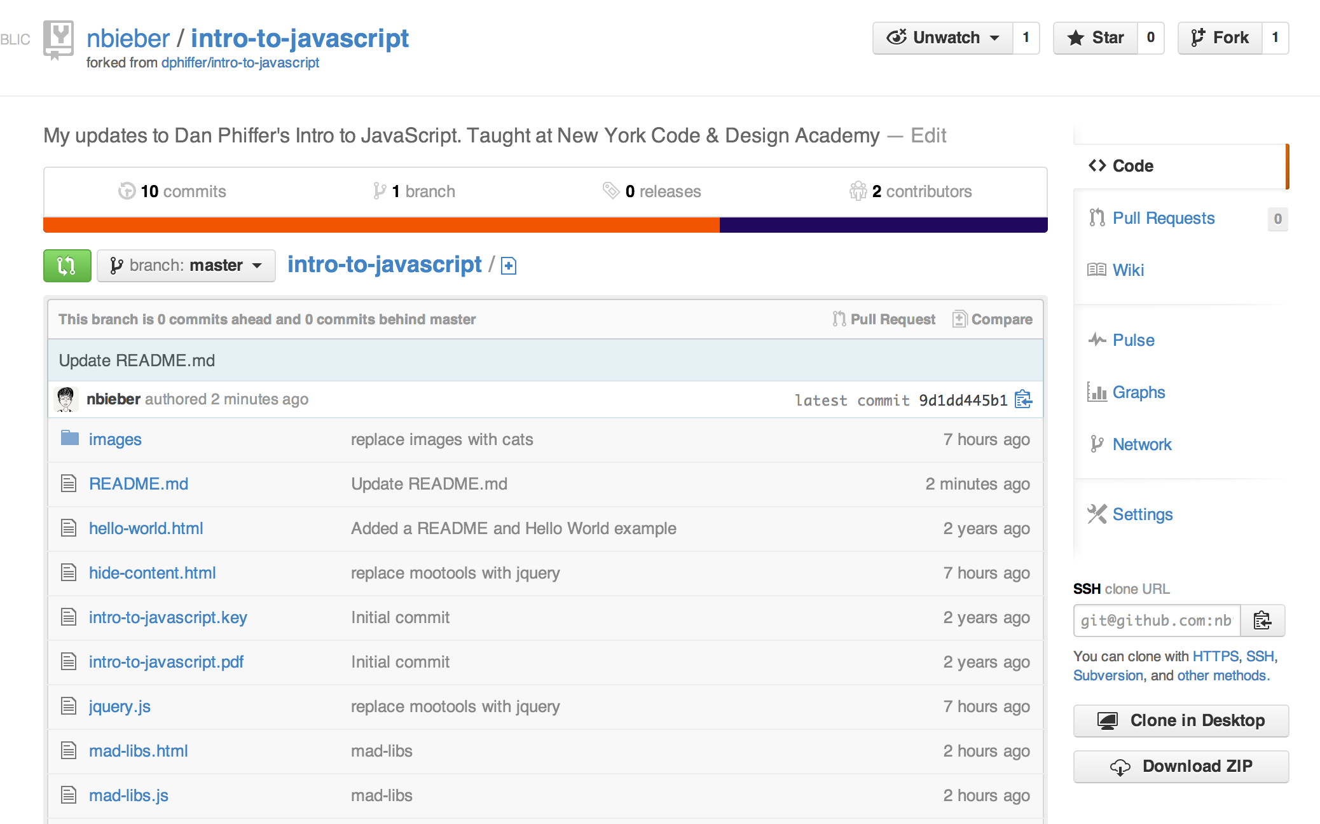
Welcome! Please download today’s lesson files:
https://github.com/nbieber/intro-to-javascript
Click here!

Slide 2
Introduction to JavaScript
Nicole Bieber
(Slides adapted from Dan Phiffer’s Intro to JavaScript)

Slide 3

Introduction to Me
Software Developer at Amplify
Studied computer science at MIT
Newest member of the NYCDA team

Slide 4
0
Why program computers?

Slide 5

“Everything is deeply intertwingled. In an
important sense there are no “subjects” at all; there is only all knowledge, since the cross- connections among the myriad topics of this world simply cannot be divided up neatly.”
—Ted Nelson, Computer Lib/Dream Machines

Slide 6

“When human beings acquired language, we
learned not just how to listen but how to speak. When we gained literacy, we learned not just how to read but how to write. And as we move into an increasingly digital reality, we must learn not just how to use programs but how to make them.”
—Douglas Rushkoff, Program or Be Programmed

Slide 7

“The single most significant change in the politics of cyberspace is the coming of age of this simple idea: The code is law. The architectures of cyberspace are as important as the law in defining and defeating the liberties of the Net.”
—Lawrence Lessig, The Code Is the Law

Slide 8
1
Learning a new language

Slide 9
Code is text

Slide 10
Programming is
typing

Slide 11
Programming is very careful typing

Slide 12
Programming is fast typing

Slide 13
Programming is
figuring out why it broke

Slide 14
Programming in general
• A series of text files that get compiled and executed
• Code is “digested,” going from human- readable to a hardware-ready form
• Ultimately programs run as assembly, low-level instructions for your CPU

Slide 15
JavaScript
• Increasingly the web page scripting language
• Most likely the widest deployed runtime
• JavaScript has nothing to do with
Java, except some syntax similarities

Slide 16
How is this different from Rails?
• Rails is server-side – it runs on the machine that is hosting your webpage
• JavaScript is client-side – it runs on the browser that is viewing your webpage
• JavaScript lets you mess with how things look/behave on the page
Notes:
Show client/server slides here?

Slide 17
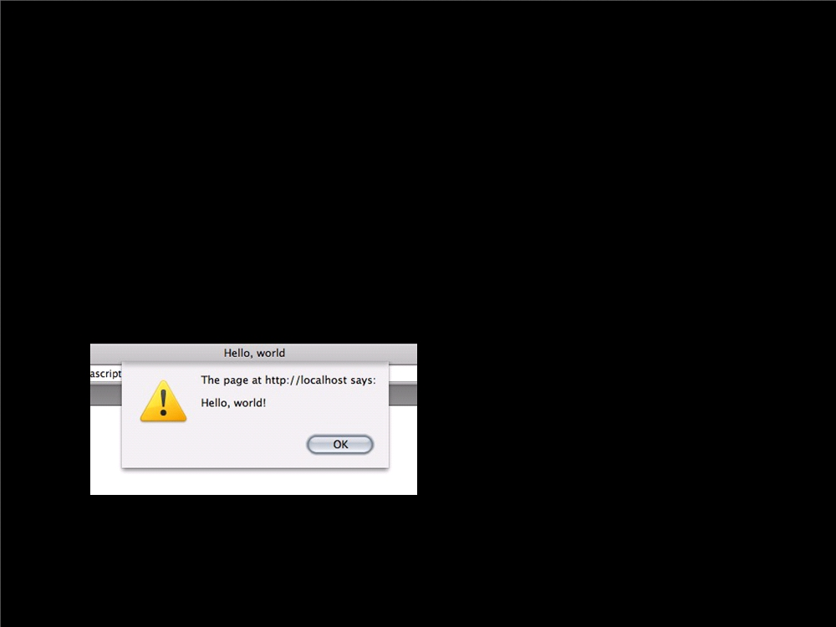
A simple line of code
alert("Hello, world!");

Slide 18
Let’s try this using
Chrome Developer
Tools
Notes:
Have students open Chrome dev tools
Type in alert(“Hello world!”);

Slide 19
2
Writing code

Slide 20
Compilers are unforgiving
• The computer cuts you no slack
• All code is subject to bugs
• The error console is your friend
• Debugging is about identifying, characterizing, and resolving
problems
Notes:
Dev tools will become your best friend!

Slide 21
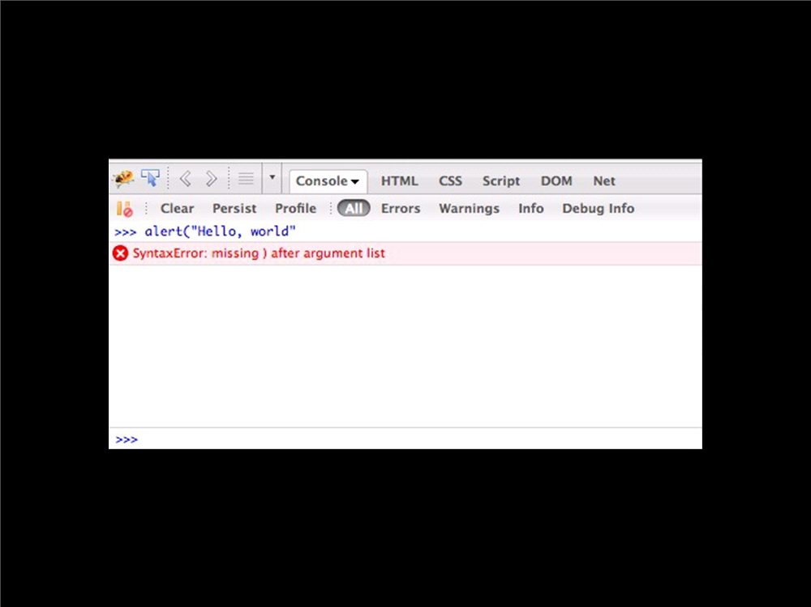
Notes:
Let’s try

Slide 22
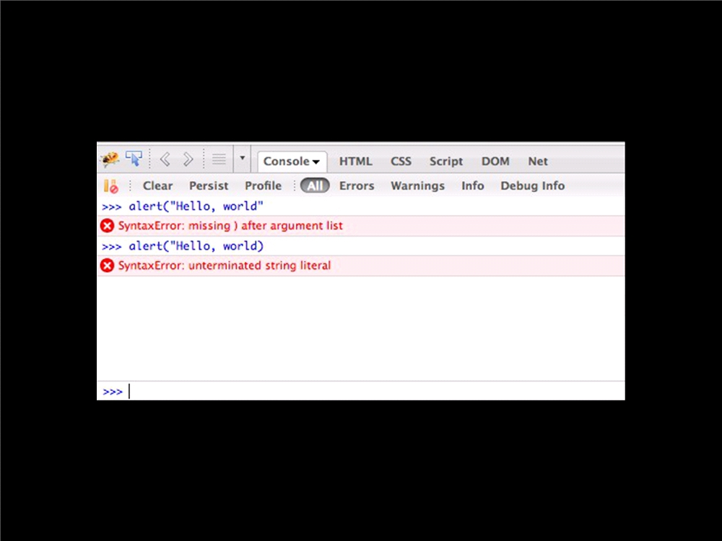

Slide 23
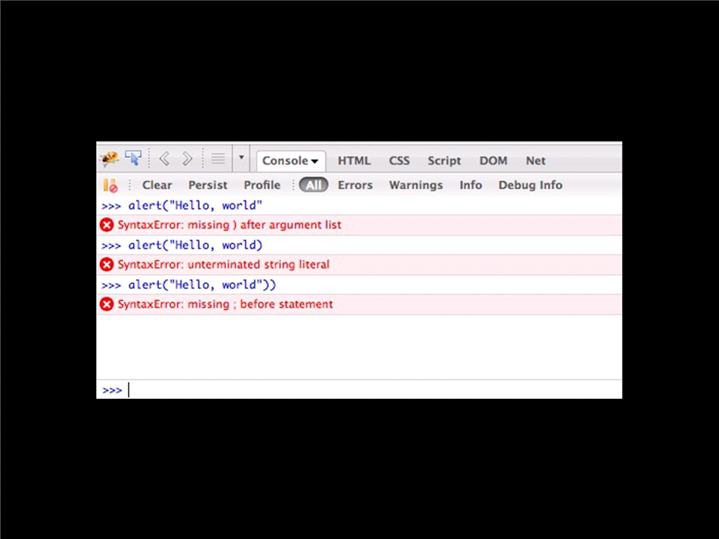

Slide 24

A simple line of code
alert("Hello, world!");
Function name

Slide 25

A simple line of code
alert("Hello, world!");
Function name Parentheses call the function

Slide 26
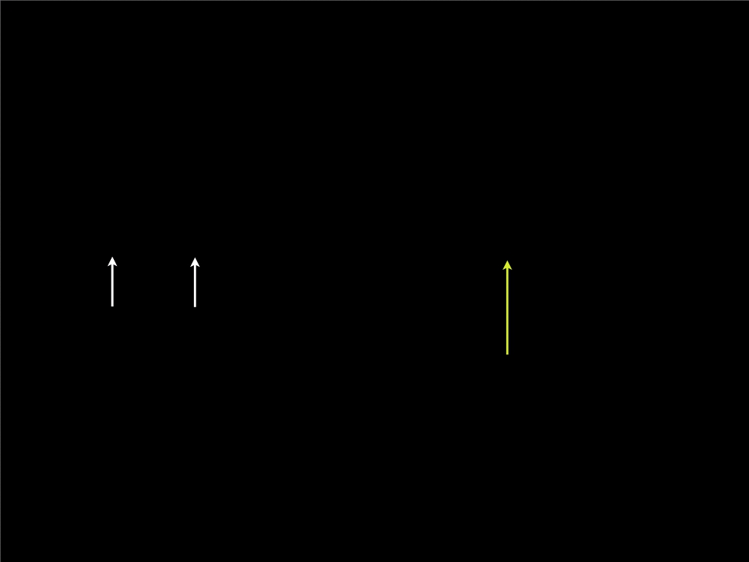
A simple line of code
alert("Hello, world!");
Function name Parentheses call the function
Function argument (a string)

Slide 27
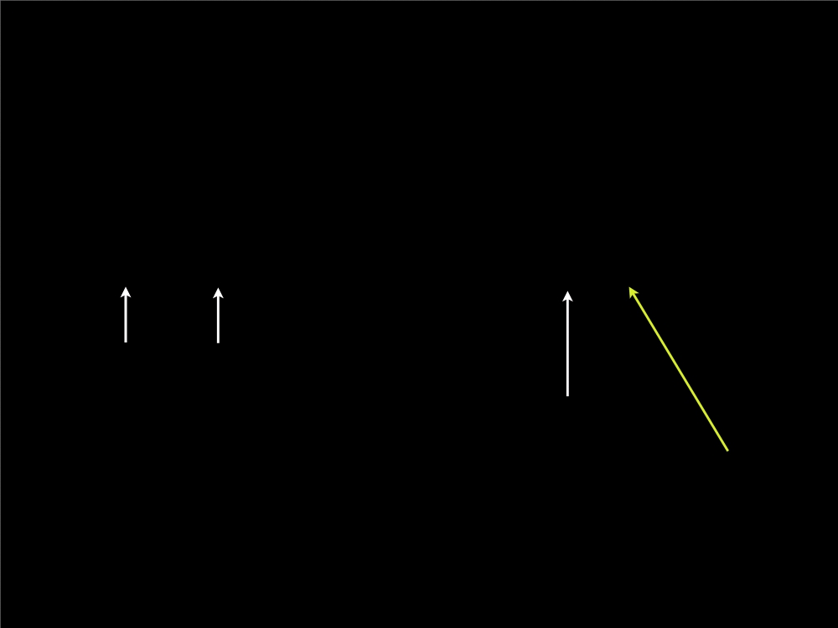
A simple line of code
alert("Hello, world!");
Function name Parentheses call the function
Function argument (a string)
Designates the end of the line

Slide 28
More simple functions
prompt(string);
confirm(string);

Slide 29
3
Variables

Slide 30
The variable metaphor
“Variables are like a box
you can put data into.”

Slide 31
The variable metaphor

Slide 32
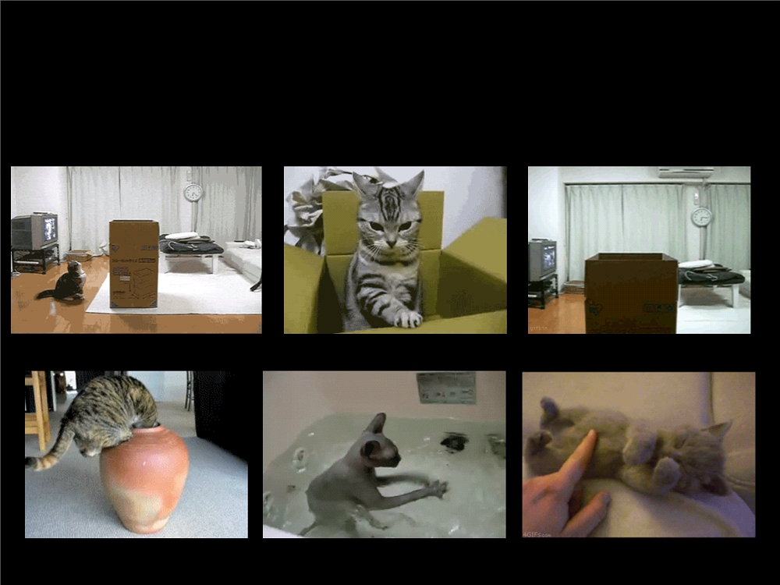
The variable metaphor

Slide 33
Variables
• Variables store data for future use
• var x = y; is how you assign a new variable in JavaScript
• We can now refer to x in future lines of code, and know it means y

Slide 34
Variables (boolean type)
• Variables store data for future use
• var x = true; is how you assign a new variable in JavaScript
• We can now refer to x in future lines of code, and know it means true

Slide 35
Variables (boolean type)
• Variables store data for future use
• var x = false; is how you assign a new variable in JavaScript
• We can now refer to x in future lines of code, and know it means false

Slide 36
Variables (numeric type)
• Variables store data for future use
• var x = 47; is how you assign a new variable in JavaScript
• We can now refer to x in future lines of code, and know it means 47

Slide 37
Variables (string type)
• Variables store data for future use
• var x = "pony"; is how you assign a new variable in JavaScript
• We can now refer to x in future lines of code, and know it means pony.
Notes:
Let’s try this out. Create some variables

Slide 38
Variable logic
// What is the value of z?
var x = 3;
var y = x + 1; var z = y;

Slide 39
Try it out…
Create some variables in the console.
A variable a with a String in it
A variable b with a Number in it
A variable c with a Boolean in it
Notes:
http://stackoverflow.com/questions/1470488/difference-between-using-var-and-not-using-var-in-javascript

Slide 40
Now let’s try something crazy…
Notes:
Set c = a
Print a
Print c

Slide 41
Dynamic Typing
Variables in JavaScript can be any type (just like in Ruby on Rails!)
Types of variables:
undefined
Null
String
Number
Boolean
Array
Object
Function
Whoa! They’re different!
Notes:
You don’t need to decide when you initialize – this is called static typing
Undefined and Null are two different things!

Slide 42
4
Functions

Slide 43
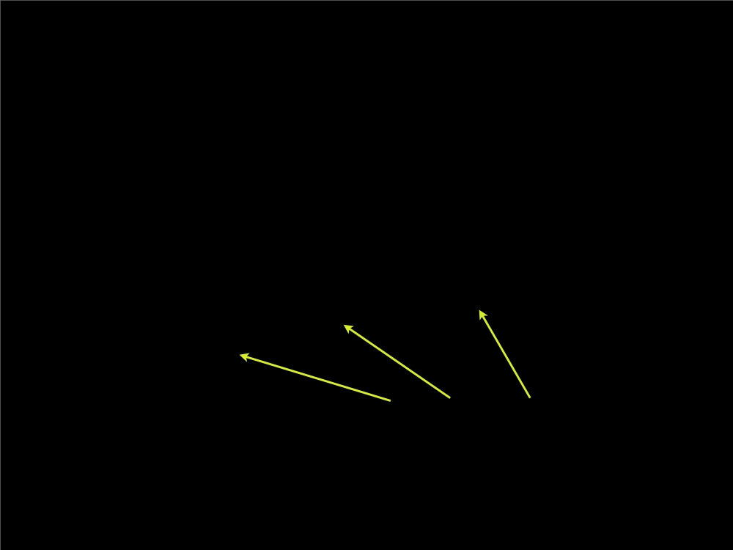
Multiple lines of code
var msg = "Hello, world!"; var func = alert;
func(msg);
Designate the ends of the lines

Slide 44
Multiple lines of code
var msg = "Hello, world!";
var func = alert;
func(msg);
The first line stores a string

Slide 45
Multiple lines of code
var msg = "Hello, world!";
var func = alert;
func(msg);
The second line stores a function

Slide 46
Multiple lines of code
var msg = "Hello, world!"; var func = alert;
func(msg);
The third line executes the
stored function with the string

Slide 47
Commenting code
// First we store the message
var msg = "Hello, world!";
// Next, we choose a function to call
var func = alert;
// Finally, we combine the two
func(msg);

Slide 48
Commenting code
/*
This code demonstrates the standard
Hello World program, over three lines instead of just one.
*/
var msg = "Hello, world!"; var func = alert;
func(msg);

Slide 49
Creating a new function
// Outputs a simple message
function output_message() {
var msg = "Hello, world!"; var func = alert;
func(msg);
}

Slide 50
Calling our function
// Outputs a simple message function output_message() { var msg = "Hello, world!"; var func = alert;
func(msg);
}
output_message();

Slide 51
Arguments
// Outputs a simple message
function output_message(msg) { var func = alert;
func(msg);
}
output_message("Hello, world!"); output_message("¡Hola, mundo!");

Slide 52
6
Objects

Slide 53
Creating Objects
var person=new Object();
person.firstname="John";
person.lastname="Doe";
person.age=50;
person.eyecolor="blue";
or
var person={firstname:"John",
lastname:"Doe",
age:50,
eyecolor:"blue"};
Notes:
Try ma

Slide 54
JavaScript on the web
<script>
// JavaScript code is typically embedded in HTML // <script> tags
</script>

Slide 55
HTML + JavaScript
<html>
<head>
<title>HTML + JavaScript</title> </head>
<body>
<p>Stuff *on* the page goes up here.</p> <script>
// JavaScript code that modifies the page should // go below everything else in the <body>.
</script>
</body> </html>

Slide 56
HTML + CSS + JavaScript
<html>
<head>
<title>HTML + CSS + JavaScript</title> <style>
#content {
background: #000;
}
</style> </head> <body>
<p id="content">Hello, world!</p> <script>
var content = document.getElementById('content'); content.style.color = '#fff';
</script>
</body> </html>

Slide 57
HTML + CSS + JavaScript
<html>
<head>
<title>HTML + CSS + JavaScript</title>
<link rel="stylesheet" href="styles.css" /> </head>
<body> <p>
Separating code into .js and .css files is a good way to keep things tidy.
</p>
<script src="scripts.js"></script> </body>
</html>

Slide 58
6
The DOM

Slide 59
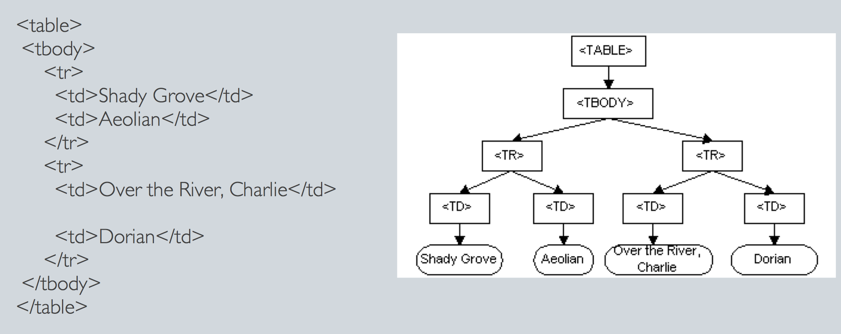
Introducing the DOM…
DOM = Document Object Model
Notes:
A hierarchy/tree for describing elements on the page

Slide 60
Objects in the DOM
Objects exist for the document, the window, and everything in them
Notes:
See http://www.w3schools.com/jsref/dom_obj_document.asp

Slide 61
Some useful functions…
document.getElementById()
element.innerHTML
(Find the full list at http://www.w3schools.com/jsref/dom_obj_document.asp)
Notes:
See http://www.w3schools.com/jsref/dom_obj_document.asp
Write a changeText function as a class
function changeText() {
document.getElementById(‘boldStuff’).innerHTML = ‘Fred Flinstone’;
}
<p>Hello, <b id=“boldStuff”>dude</b></p>
<input type =‘button’ onclick=‘changeText()’ value=‘Change Text’/>

Slide 62
7
Libraries

Slide 63
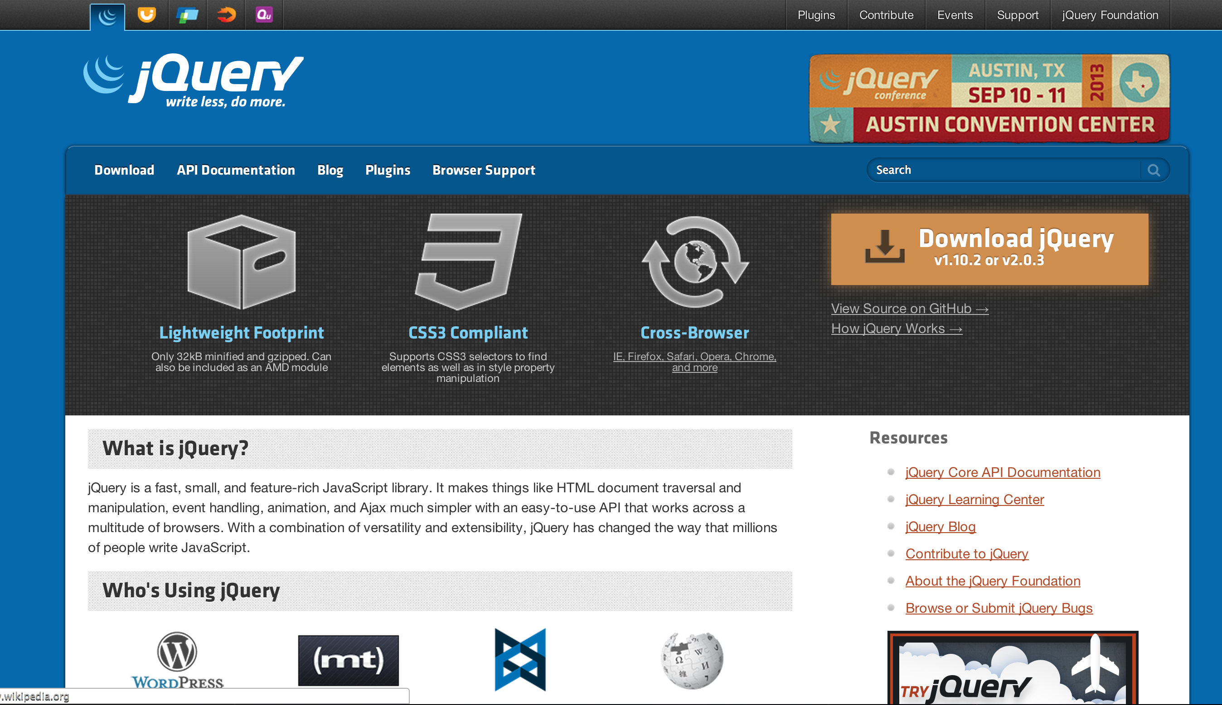

Slide 64
Hide content
<html>
<head>
<title>Hide content</title> </head>
<body>
<p id="hide">Click to hide me!</p> <script src=”jquery.js"></script> <script>
$('#hide').click(function () {
$('#hide').fadeOut("slow");
});
</script> </body> </html>

Slide 65
7
Slide show

Slide 66
Slide show HTML
<html>
<head>
<title>Slide show</title>
<link rel="stylesheet" href="styles.css" /> </head>
<body>
<div id="slides"> <div id="inner">
<img src="images/1.jpg" /> <img src="images/2.jpg" /> <img src="images/3.jpg" /> <img src="images/4.jpg" />
</div>
</div>
<script src=”jquery.js"></script> <script src="script.js"></script> </body>
</html>
Notes:
Point out that scripts are loaded at the bottom, so we give the page time to render first
CSS goes at the top, because you need it to render the page

Slide 67
Slide show CSS
#slides {
width: 991px; height: 671px; margin: 0 auto;
overflow: hidden;
position: relative; }
#inner {
position: absolute; left: 0;
top: 0;
}
#slides img { float: left; }

Slide 68
Slide show JavaScript
Notes:
Open file, have students open too.
Missing code:
hide(n);
n = (n + 1) % count;
show(n);

Slide 69
8
What next?

Slide 70
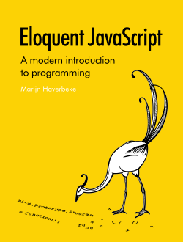

Notes:
The best way to learn is by doing – practice a little more, then pick a project and stick w/ it!

Slide 71
Resources
• Eloquent JavaScript
• Visual Quickstart Guide
• w3schools.com
• Lynda tutorials
• Mozilla devmo
• JavaScript: The Good Parts
• WebMonkey
• Codecademy
• The Rhino Book

