Slide 1
Deed Index
Content, Structure and Design

Slide 2
Sources of deed text
Sasine Deeds
RAC Abridgements
LR Deeds
Land Register C Section for Standard Securities
Common Deeds Index for burden deeds (may overlap with Sasines)

Slide 3
RAC Abridgements – Standard Structure
1850
CHARLES MCBEATH, Shipowner, Fraserburgh, Seised,— in a half Tenement of Feu land with the Houses, Yards and others thereon betwixt the town and Harbour of ROSEHEARTY, (under exception), par. Pitsligo;—on Disp. by Christian Mackie, and John Tarves, Farmer or Crofter, Cadgertown or Broomhill, New Deer, her husband, Margaret Mackie residing in Fraserburgh, relict of James Urquhart, Shoemaker, Memsie, and James Mitchell, Mariner, Aberdeen, to George Ewen, Mariner, Rosehearty, and Ann Anderson, his spouse, Jun. 26. Jul. 18. 1848; Disp. and Assig. by them, Dec. 21. 1849. - P. R. 233. 165.
ALEXANDER DINGWALL FORDYCE of Culsh and Brucklay, Seised,—in the Towns and lands of SLACKS of CAIRNBANNO, the Backtown, Overtown, Earnhillock, and Mill and Mill town of Cairnbanno, par. Auchreddie ;—towns and lands of Asleid; town and lands of Gravehill commonly called Grainhill, and the town and lands of Boghead, par. Monquhitter ;—town and lands of Auchmunziel, comp. the towns and lands of Rottencairns, Todshole, Stripeside, and Peeldegg; parts of the Barony of Altrie, viz., the lands of Little Auchreddie or New Deer and Kirktown thereof, Turfhill, Corshill or Crossbill, Brucehill, Falliedyke or Faddliedyke, and St. Magdalen's Mercat and Customs thereof, with the Pendicle (about 55 Acres) of the lands of Auchenleck or Affleck adjoining to Falliedyke, par. New Deer;—and Teinds;—On Disp. and Deed of Entail by James Gordon of Manar, with consent of the Trustees of John Dingwall of Croydon, Co. Surry, and of Brucklay, Co. Aberdeen, Dec. 24.1849. Jan. 3. 1850. P. R. 233. 189. 1850.

Slide 4
RAC Abridgements – Standard Structure
1910
Bond for £1100, and Disp. in security, by ALEXANDER REDDELL, Spirit Merchant, Union Bar, Fraserburgh—To The Fraser burgh Economic Building Society,—of subjects on the north side of HIGH STREET, FRASERBURGH, consisting of the Dwelling Houses, including Shop, and of the Fishcuring Yard, and Buildings thereon, described in Disp. referred to as a half Tenement of Feu land, with Houses and Yards thereon, having the High Street at the south, and small Piece of ground or Yard, bounded on the south by said half Tenement at the back of the Yards of Fraserburgh. Dated Dec. 20, 1909; with Warrant of Registration thereon, on behalf of said Society. Presented by Don. Stewart, Register of Sasines. Lib. 1630. 84.
Disp. by ROLAND TARRAS WILL, sometime Ship Broker and Fishcurer, residing in Charlotte Street, Fraserburgh, now or lately residing in Crown Street, Aberdeen—To James Milne of Auchtercrag, Ellon, Solicitor, Fraserburgh,—of the subjects in the immediately preceding Minute. Dated May 3,1909 ; with Warrant of Registration thereon, on behalf of said Grantee. Presented by Don. Stewart, Register of Sasines. Lib. 1632. 184.

Slide 5
RAC Abridgements – Standard Structure
1940
BOND for £550, and ASSIG. in security, by ALEXANDER HACDONALD STUART and MURDO DONALD CAMPBELL MACKENZIE, both Malvern, Nethy Bridge - TO the Standard Property Investment Company Limited,Edinburgh, - of Lease ('recorded 22nd Apr. 1889) of 3 Roods of ground, with House to be known as BLAIRMCRE, &c. thereon, bounded on the east by the Road from Nethy Bridge to Dell of Abernethy, and on the north partly by another Road, forming part of the lands and Estate of ABERNETHY, in Parish of Abernethy. Dated Jan. 20, 1940; with Warrant of Registration thereon, on behalf of said Grantee. Transmitted by Post, and presented by H.C. Duff, Register of Sasines. 652. 163.
DISP. by CATHERINE GOLLAN or GORDON, widow, Y/oodbourne, 18 Glenurquhart Road, Inverness and JAMES FRASER, General Merchant, Glalckbea, Kiltarllty, (proprietor of subjects 52 Harrowden Road,Inverness, described in Disp. to Simon Hutcheson, recorded 18th Dec. 1924 for his Interest) - TO Archibald Thomas MacLennan, C.A., 60 Harrowden Road, Inverness,- of the following subjects last vested in John Gordon, Draper, Inverness, from whom said Catherine Gollan or Gordon acquired right by his Last Will and Testament, dated 4th May 1937, and, with Testamentary Writing, registered in Sheriff Court Books of Inverness-shire 22nd Nov.1937,viz., subjects 50 HARROVTDEN ROAD, INVERNESS, being the lower Flat of Flatted Villas 50 and 52 Harrowden Road, bounded on the east by an access way or lane and on the west partly by and extending 28 Feet along said Road, with Strip of Garden ground 19 Feet 2 laches wide between said subjects and said Road, forming parts of Piece of ground between said Read and ROSS AVENUE, described in Feu Ch. to James Grant, recorded 30th May 1893, with Telnds, and common rightto back Green, Wash-house, Ac. Dated Dec. 26, 1939 and Jan.10, 1940; with Warrant of Registration thereon, on behalf of said Grantee. Transmitted by Post, and presented by H.C. Duff, Regist.P of SWIM. 65g> go9_

Slide 6
RAC Abridgements – Standard Structure
1980
STANDARD SECURITY by ADAM BROTHERS, Farmers, Auchenhove, Ythanwells, Huntly and DEREK STUART ADAM, STEWART ALEXANDER ADAM and ROBERT ADAM, all Farmers, Auchenhove, and Bruntlands, Rivefolds, Slackend and Lower Millburns, Ythanwells, Huntly — TO ROYAL BANK OF SCOTLAND LIMITED, — over Farm and lands of AUCHENHOVE, extending to 58 673/1000 Acres, in Parish of Auchterless. Dated 8 Nov. 1979.
DISP. by Executors of ANNIE SIMPSON CRUICKSHANK or LEMON, 20 Balgownie Crescent, Bridge of Don, Aberdeen — TO IAN JOHN JAMIESON and MARGARET SHAND JAMIESON, spouses, 35 Caledonian Place, Aberdeen, equally and survivor, — of 18 Poles 1 square yard of ground, with House 20 BALGOWNIE CRESCENT thereon, measuring along north side of said Crescent and west side of MOUNT PLEASANT, BRIDGE OF DON, ABERDEEN, described in Feu Disp. to Halifax Building Society, recorded 15 Jun. 1937; which subjects were last vested in ANGUS LEMON (otherwise ANGUS McINTOSH LEMON), 20 Balgownie Crescent, Bridge of Don, Aberdeen, from whom said Annie Simpson Cruickshank or Lemon acquired right by Confirmation with Docket thereon and from whom said Granters acquired right by Confirmation. Dated 20 Feb. 1980.

Slide 7
RAC Abridgements - Number of entries by year
LR introduced
Unstructured
D,G,G,S
Upper case
Control chars

Slide 8
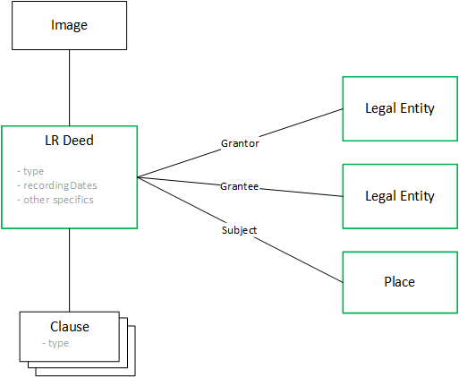
Deed Model

Slide 9
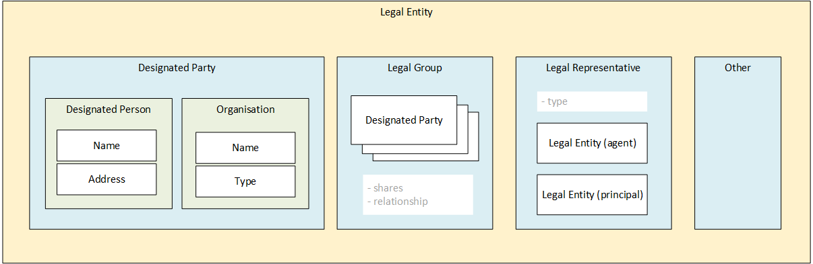
Deed Model

Slide 10
Abridgement Text Parsing
Uses a technology called lexical analysis and a tool called Antlr4
Steps
Correct spelling errors in the text
Parse the text into high level blocks
Parse each block using a pre-defined grammar to produce structured data
If it fails to parse fall back to a less strict grammar or an alternate grammar
Output the structure as JSON

Slide 11
Abridgement Text Parsing – Example 1
Input
STANDARD SECURITY by Dr. ANTHONY DOUGLAS COCKAYNE, formerly 22 Stanley Street, Spital, Chesterfield, now Newburgh House, Newburgh, with a consent -TO T S B SCOTLAND P L C, - over house 5A SALTOUN PLACE?, FRASERBURGH, described in Disp. to Maggie Ann Sinclair or Scott, recorded 17 Sep. 1943 (under exception of subjects in Disp. to Fergus Pirie, recorded 27 May 1985). Dated 9 Feb. 1989.
Output
{ _type:"standardSecurity",
grantor:{ _type:"designatedPerson", person:
{ name: { salutation:"Dr.", firstNames:"ANTHONY DOUGLAS", surname:"COCKAYNE"}},
address: { lines:["Newburgh House","Newburgh"]},
formerAddress:{ lines:["22 Stanley Street","Spital","Chesterfield"]}},
grantee: { _type:"designatedOrganisation", organisation:
{ name:"T S B SCOTLAND P L C", type:"PLC"}},
recordingDates:["09-02-1989"]}

Slide 12
Abridgement Text Parsing – Example 2
Input
DISP. by CLYDESDALE BANK LIMITED, with consent of CHARLES HORN REID, Farmer, Milton of Auchindoir, Lumsden,and his wife CATHERINE MARY REID, Farmer — TO FREDA BEECHAM, Horticulturist, 28 Grove Park Gardens, Chiswick, London, — of Area of ground pink on Plan, part of Farm of CLACK, Rhynie, in Parish of Rhynie, described in Disp. to Jane Stewart or Campbell, recorded 26 Sept. 1923, with and under burden of rights of access. Dated 24 and 28 Dec. 1979.
Output
{_type:"disposition",
grantor:{ _type:"legalRep",
agent:{ _type:"designatedOrganisation", organisation:{name:"CLYDESDALE BANK LIMITED", type:"Bank"}},
principal:{_type:"legalGroup", designatedParties:[
{_type:"designatedPerson", person:{name:{firstNames:"CHARLES HORN",surname:"REID"}}, address:{lines:["Milton of Auchindoir","Lumsden"]}, profession:"Farmer"},
{"_type":"designatedPerson","person":{"name":{"firstNames":"CATHERINE MARY", surname:"REID"}}, address:{ lines:["Milton of Auchindoir","Lumsden"]}, profession:"Farmer"}], relationship:"spouses"}, type:"AgentOrganisation"},
grantee:{_type:"designatedPerson", person:{ name:{ firstNames:"FREDA", surname:" BEECHAM"}}, address: { lines:["28 Grove Park Gardens","Chiswick","London"]}, profession:"Horticulturist"},
recordingDates:["24-12-1979","28-12-1979"]}

Slide 13
Logical View
LR Deed Index
Front End App
REST Api / URL
REST Api
- Transform image
- Get Image (via url)
- Find deed
- Update deed (add details)
- Validate deed (correct details)
LR Deed Image Service
LR Deed Index Service
REST Api
CDI DB
(?)
- Get image details
LR Deed Index ETL App
Deed Index DB
(Mongo)
Periodic loads
RAC DB
(SQL Server)
Deed Image Store (FS)
Parser

Slide 14
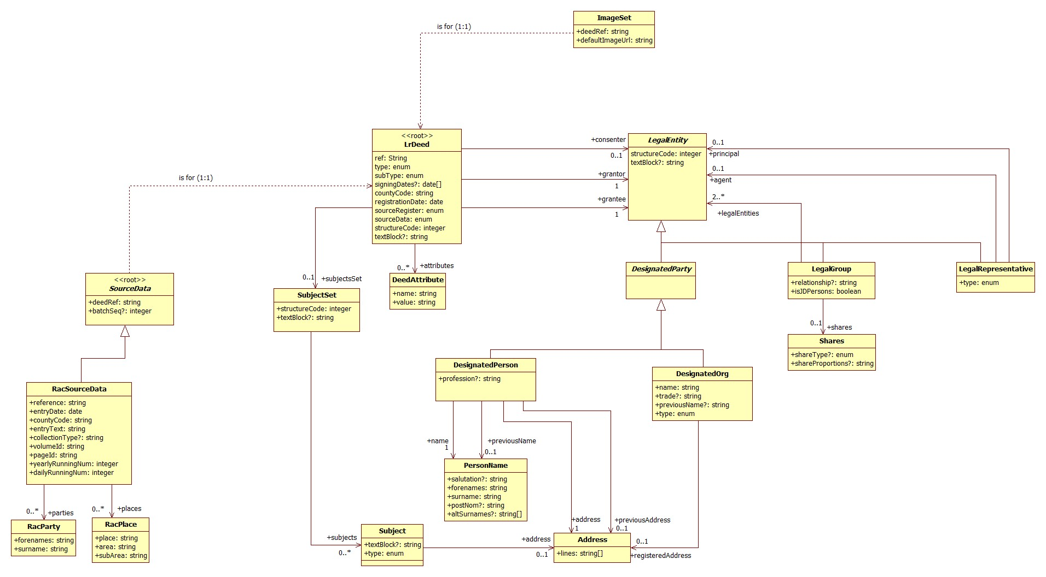
Domain Model

Slide 15
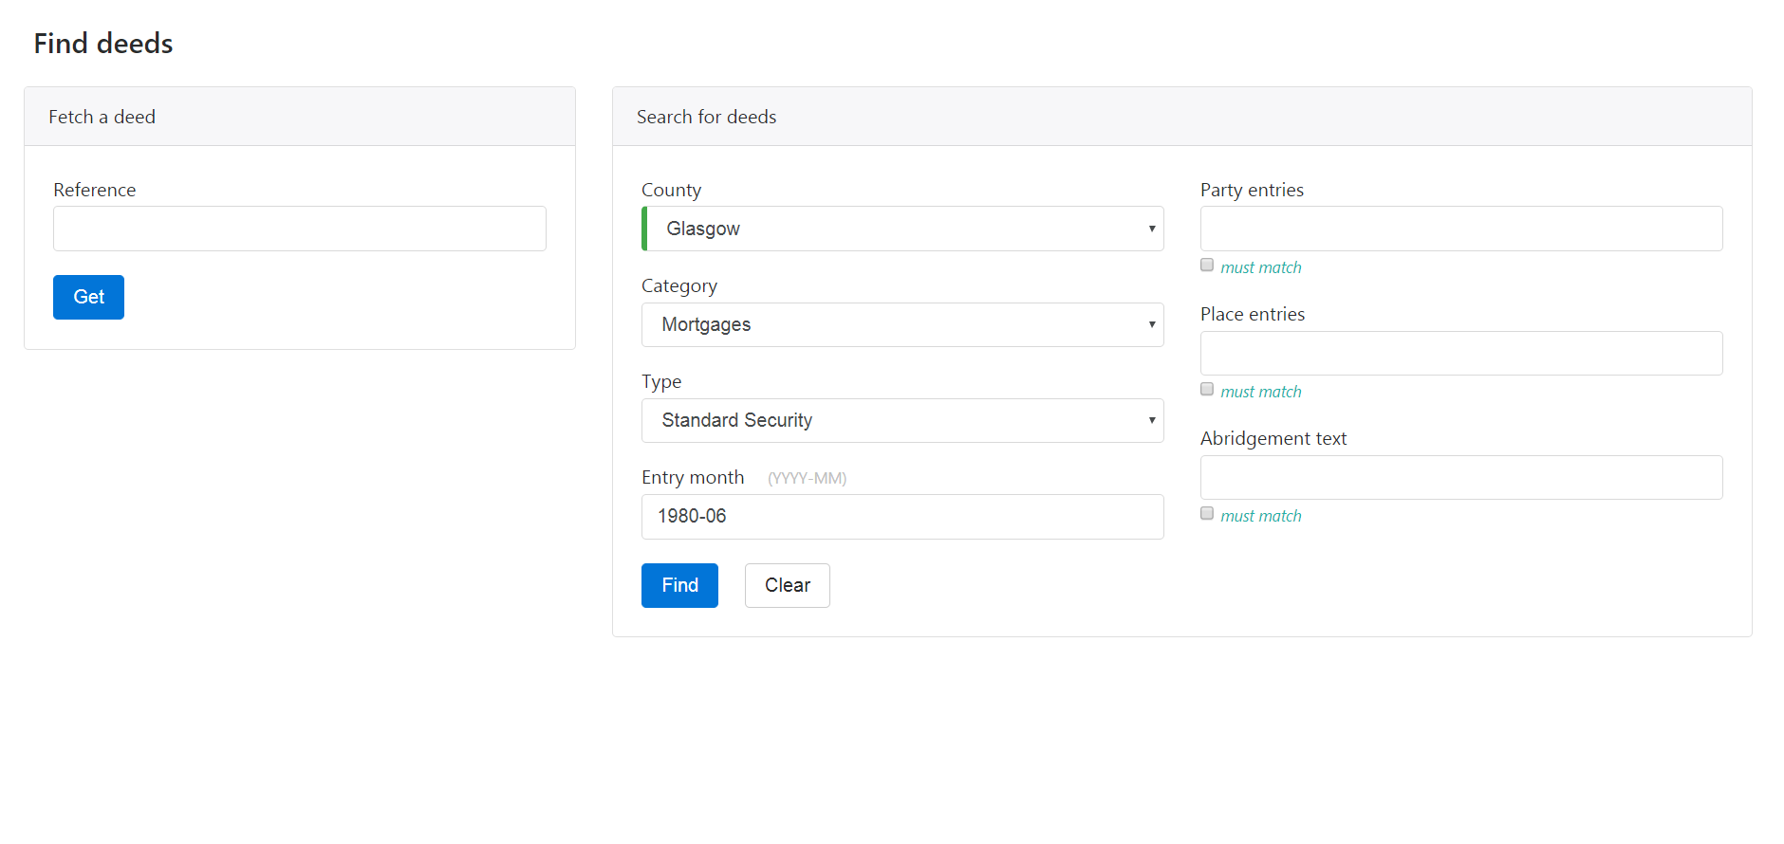

Slide 16
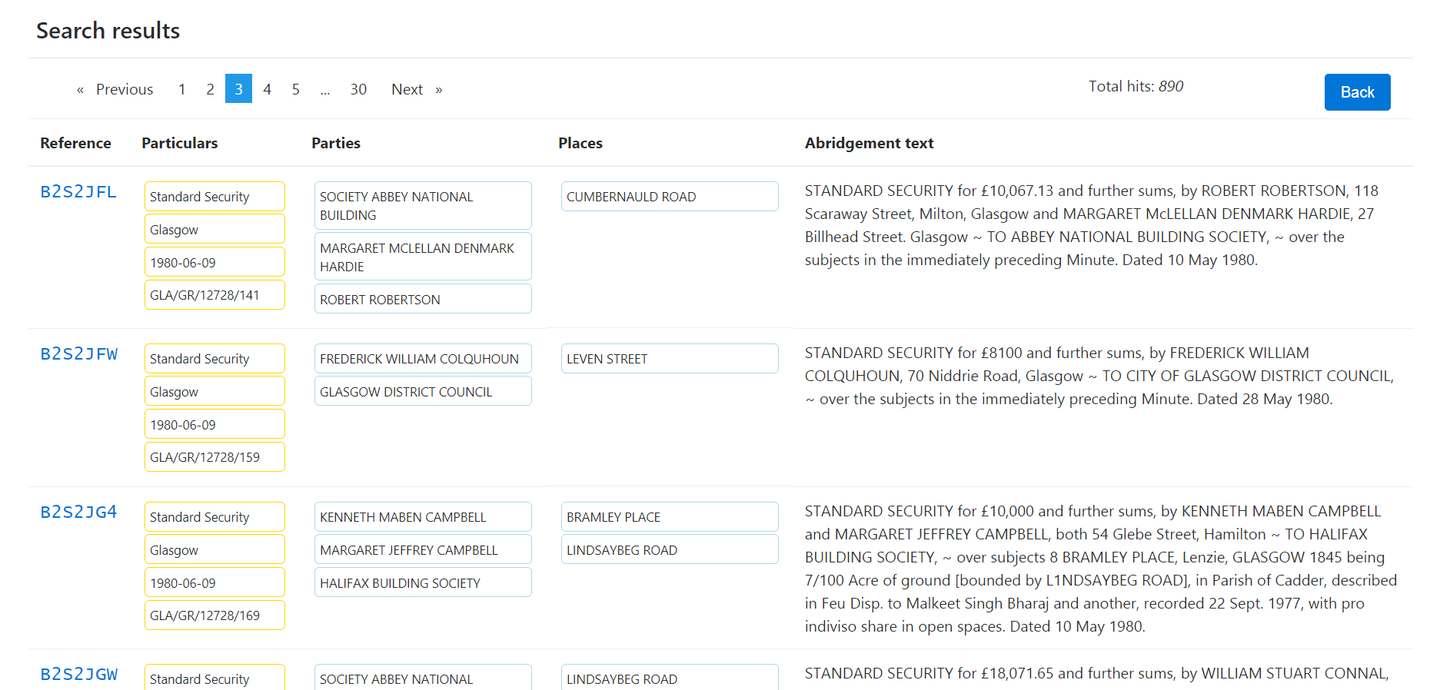

Slide 17
