Slide 1

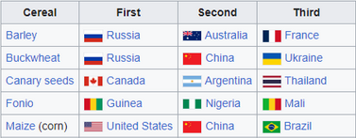

Picture #1
How does Picture 1 differ from Picture 2?
Picture #2

