Slide 1
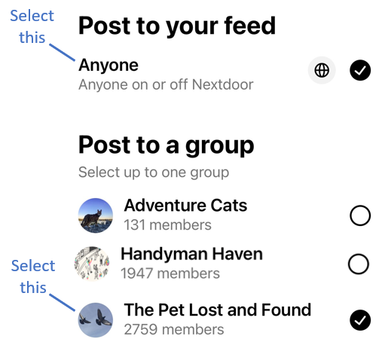
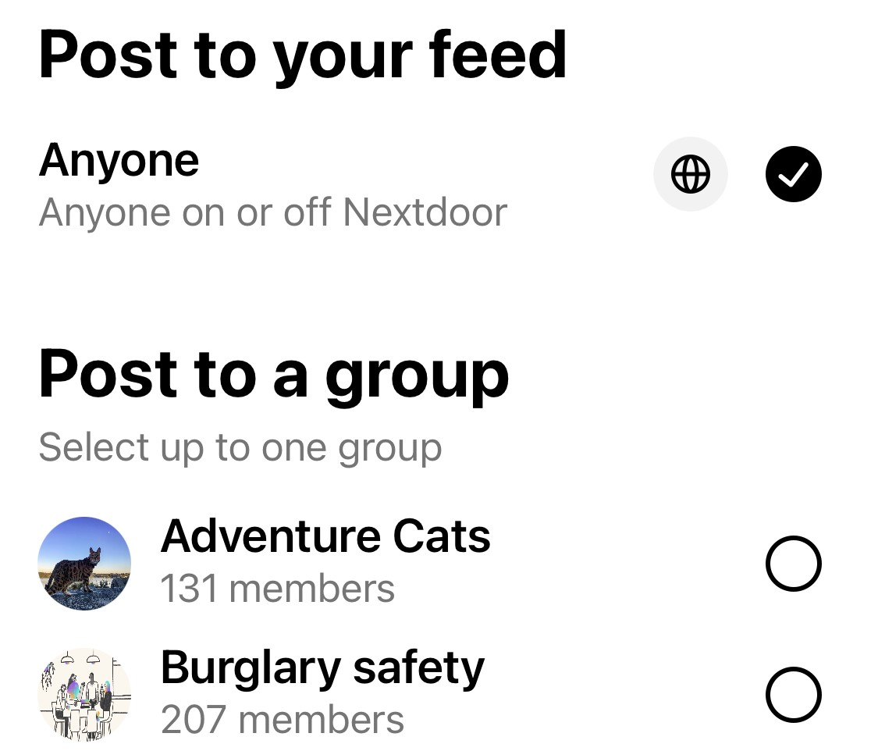

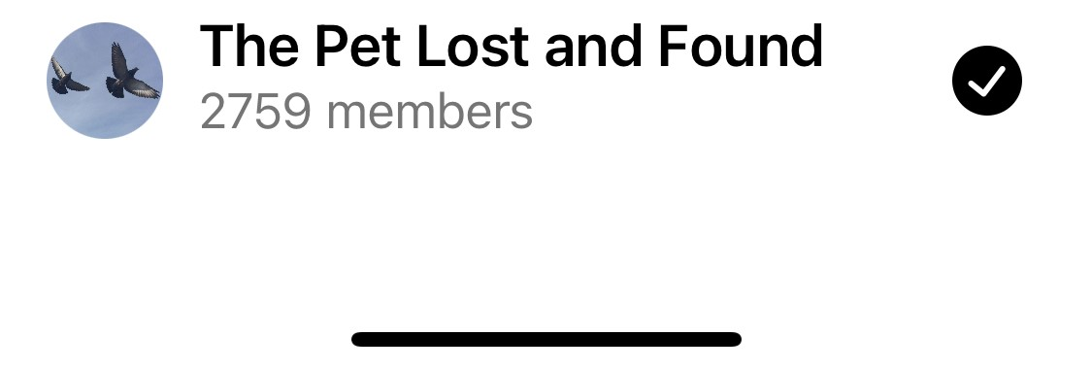
Select this
#1 Select this
Select this
#2 Select this
82%

Slide 2
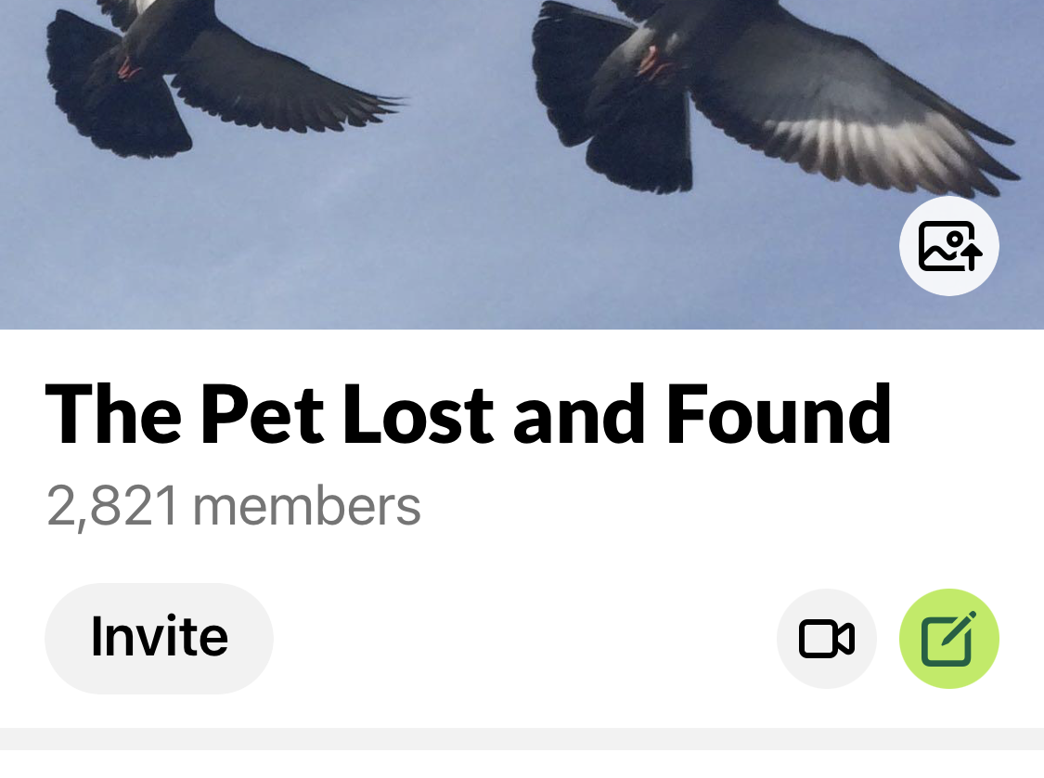

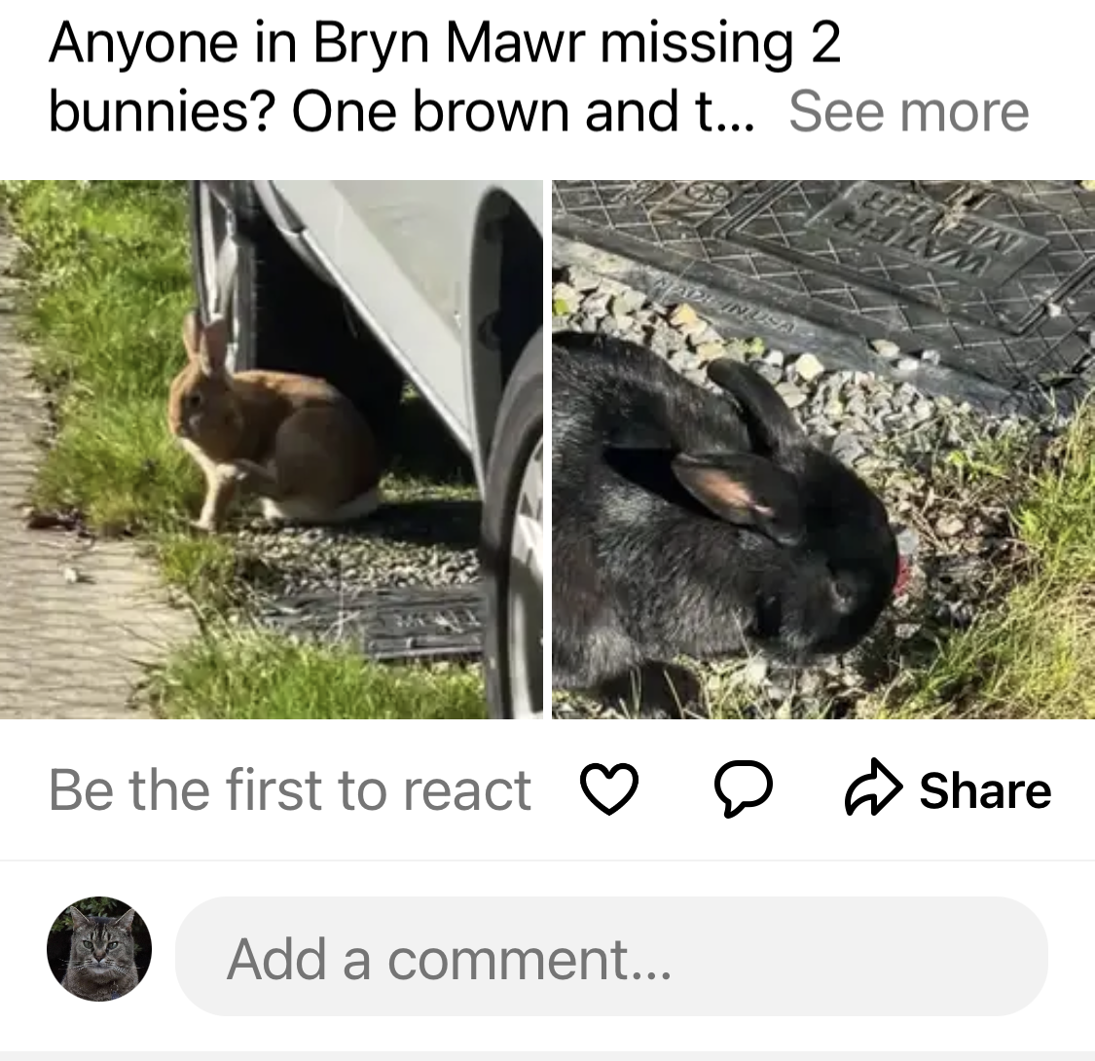

Btn 2
Click here to post a message only to the ‘Pet Lost and Found’
Loki Goodcat
Seattle, WA . 6h
Click here to post a message to all of NextDoor and to the ‘Pet Lost and Found’
Btn 1
82%

