Slide 1
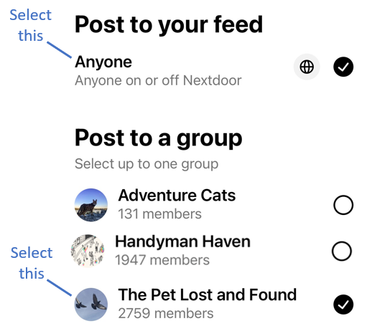
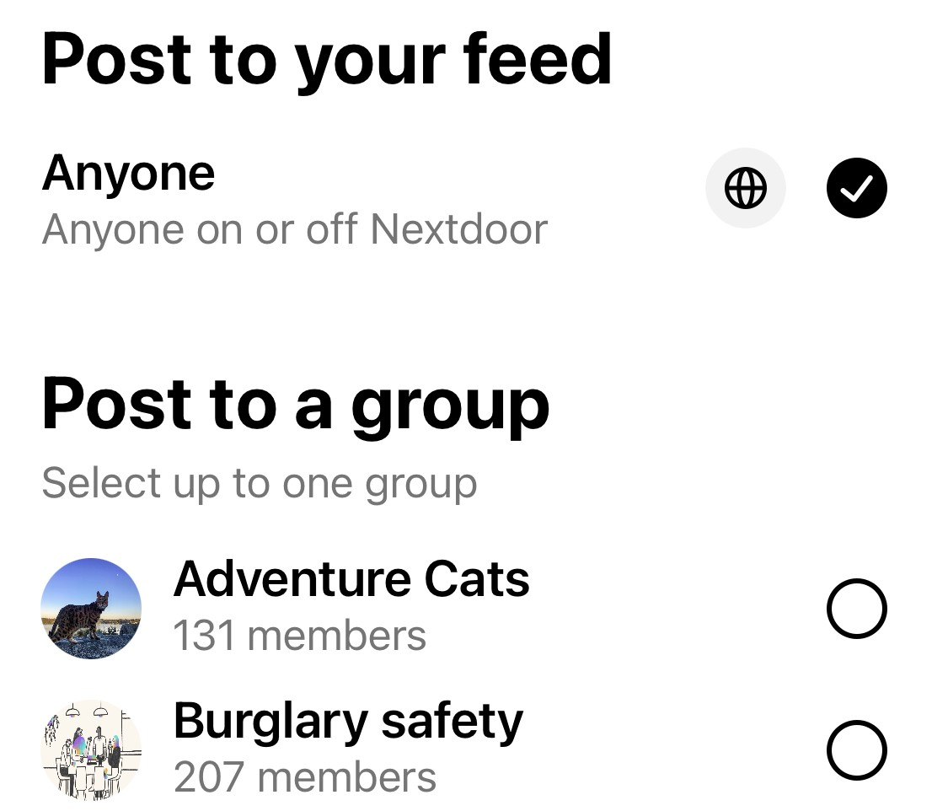

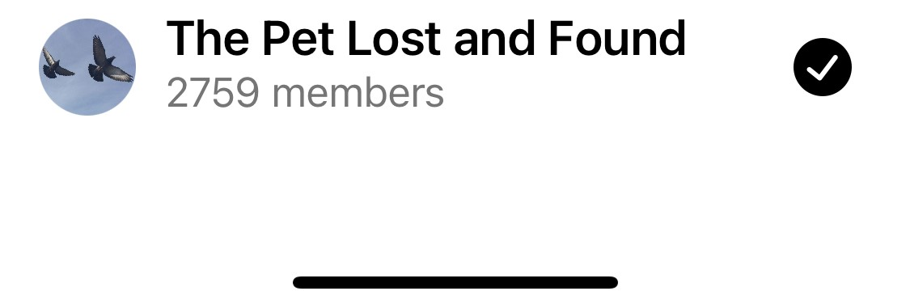
Select this
#1 Select this
Select this
#2 Select this
82%

Slide 2
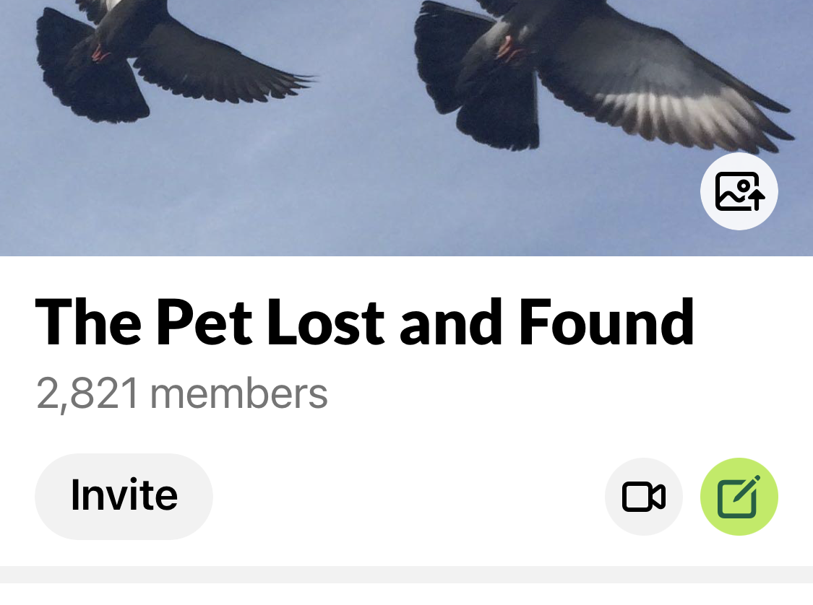

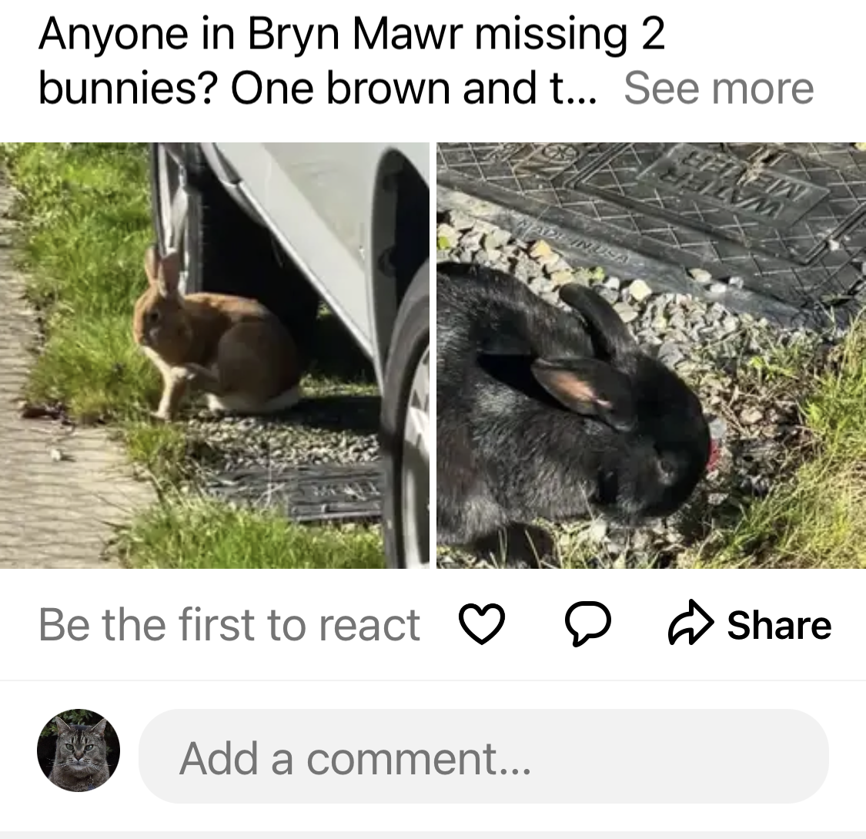

Btn 2
Click here to post a message only to the ‘Pet Lost and Found’
Loki Goodcat
Seattle, WA . 6h
Click here to post a message to all of NextDoor and to the ‘Pet Lost and Found’
Btn 1
82%

Slide 3
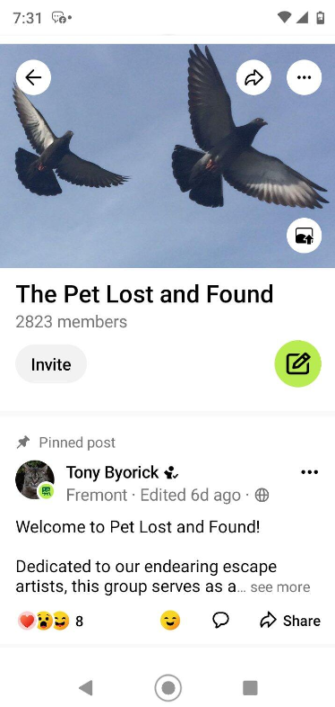
Screen Snap of Brett’s Phone

Slide 4
The Pet Lost and Found
Only Pet Lost and Found
Anyone on NextDoor
The Pet Lost and Found
Anyone on NextDoor
Anyone on NextDoor
The Pet Lost and Found
Both Pet Lost and Found and Anyone on NextDoor
Anyone on NextDoor
82%

