Slide 1
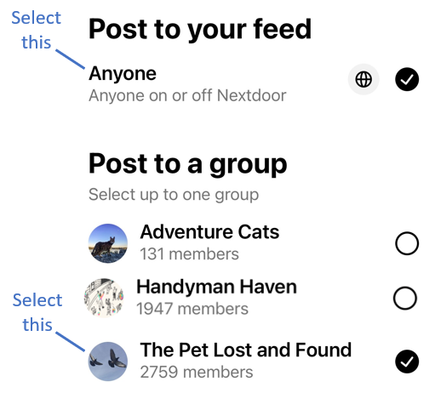
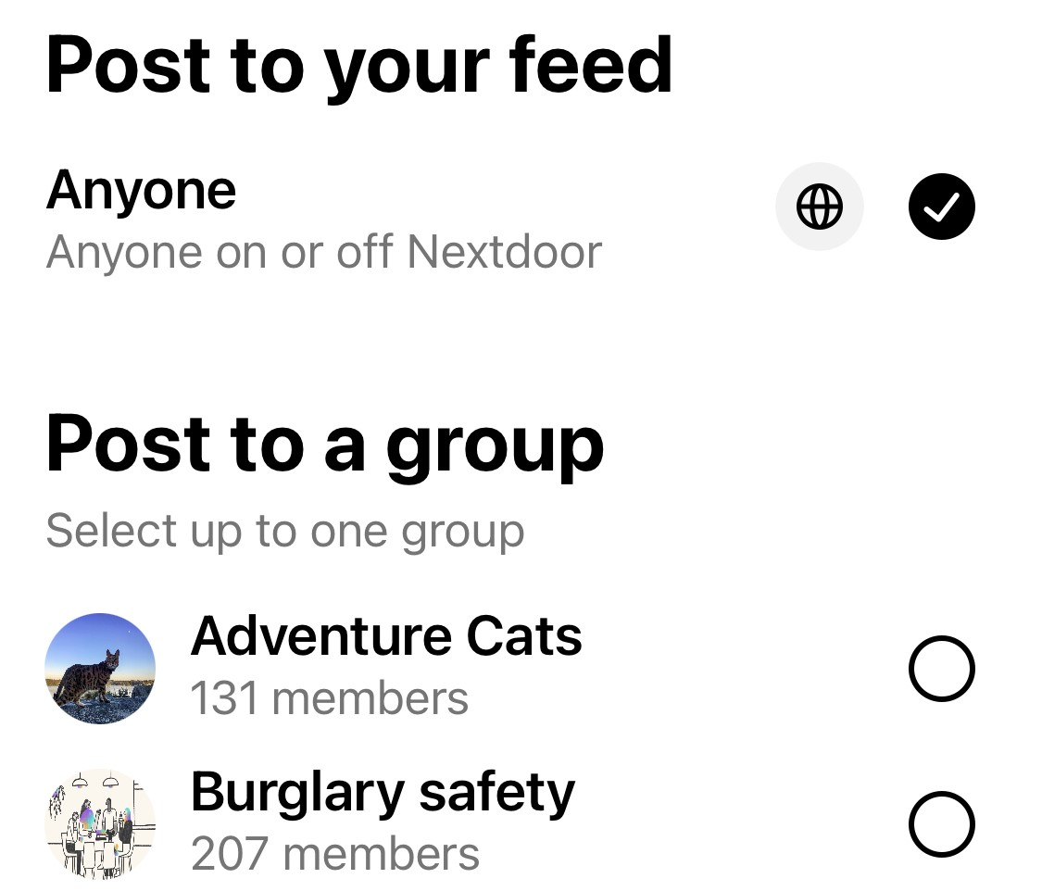

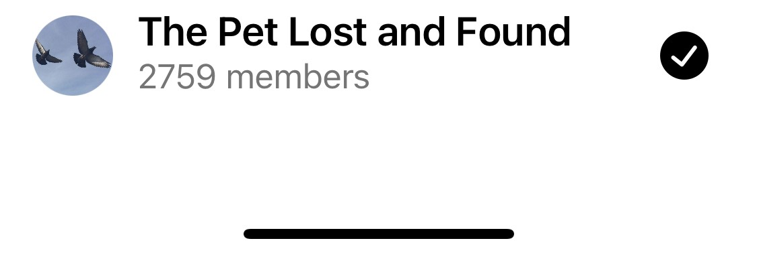
Select this
#1 Select this
Select this
#2 Select this
82%

Slide 2
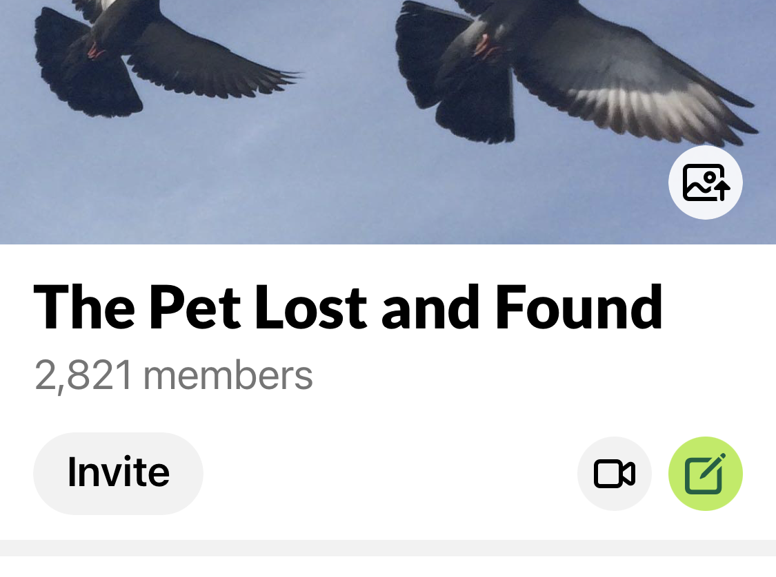

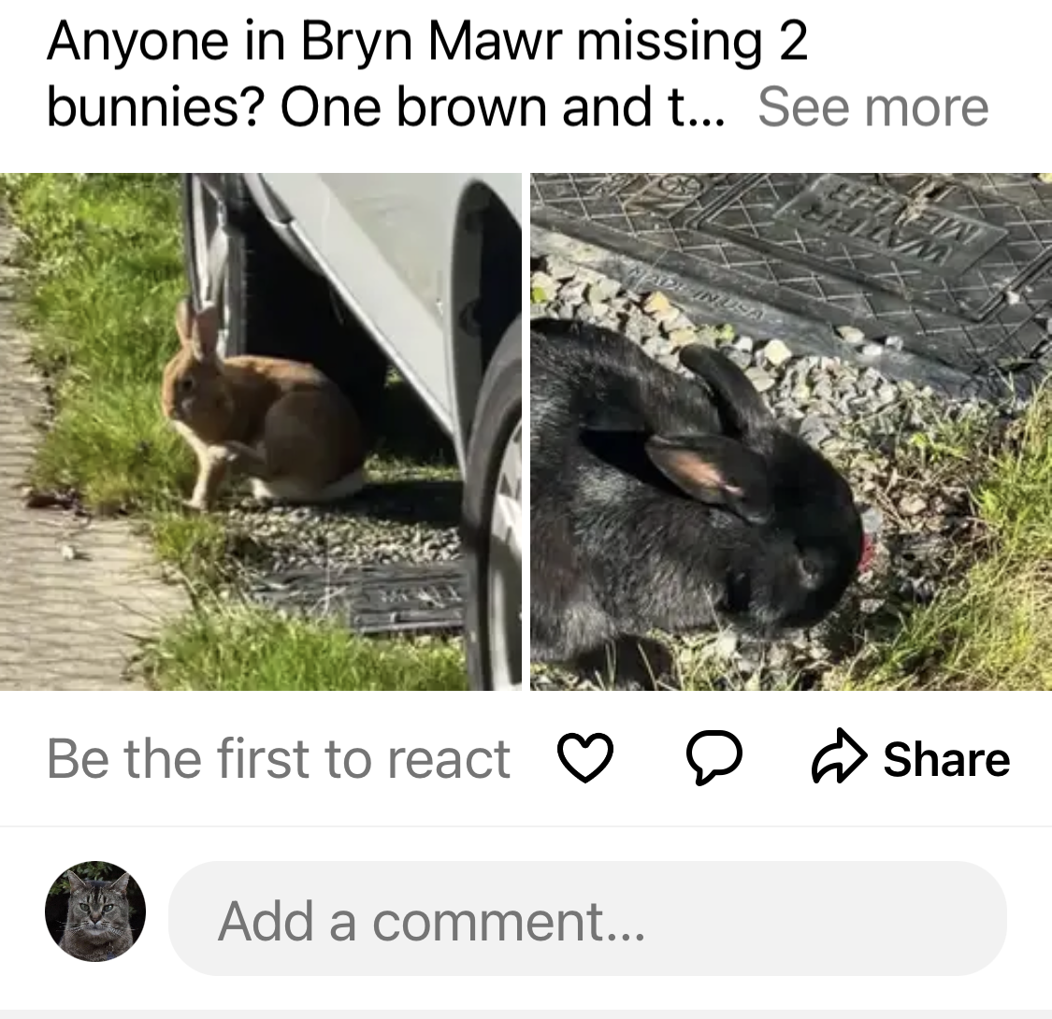

Btn 2
Click here to post a message only to the ‘Pet Lost and Found’
Loki Goodcat
Seattle, WA . 6h
Click here to post a message to all of NextDoor and to the ‘Pet Lost and Found’
Btn 1
82%

Slide 3
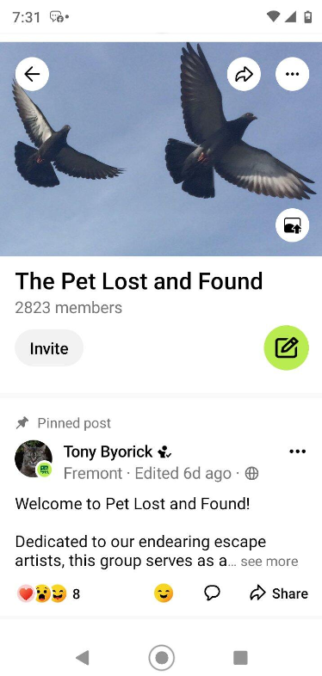
Screen Snap #1 of Brett’s Phone

Slide 4
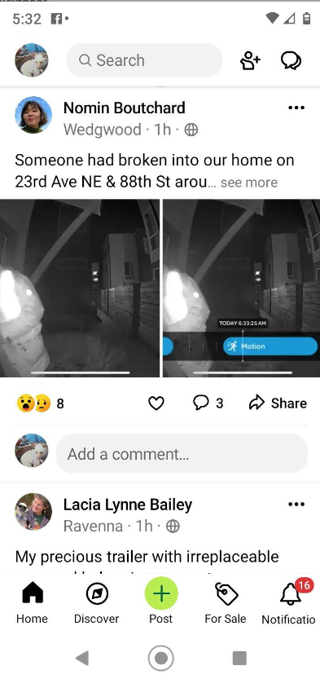
Screen Snap #2 of Brett’s Phone

Slide 5
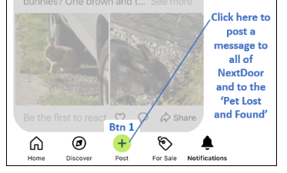
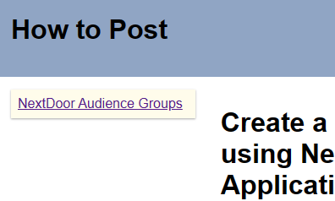
This button not always visible
Added this

Slide 6




NextDoor Clients
NextDoor allows members to choose between at least 5 different methods to access the platform. These different clients offer slightly different user experiences
App
Web Browser
1
2
NextDoor “App” on Android Phone
Web Browser on Android
Chrome
3
4
NextDoor “App” on iPhone
Web Browser on Windows PC
Edge
Chrome
Firefox
Opera
2. Btn 1 is located on NextDoor Home page.
3. Provides Btn 1 located within PLF for posting to specified groups including “anyone on NextDoor”
5
Web Browser on Apple PC
Safari
You could say if there isa green button on the bottom of the screen use it if not go to the main page and use the button at the bottom of the screen

Slide 7
The Pet Lost and Found
Only Pet Lost and Found
Anyone on NextDoor
The Pet Lost and Found
Anyone on NextDoor
Anyone on NextDoor
The Pet Lost and Found
Both Pet Lost and Found and Anyone on NextDoor
Anyone on NextDoor
82%

