Slide 1
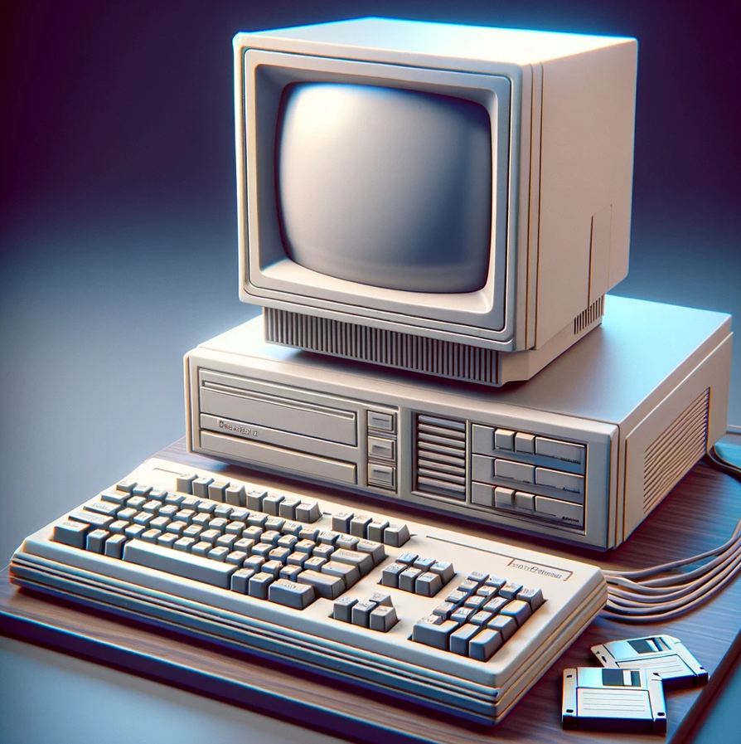
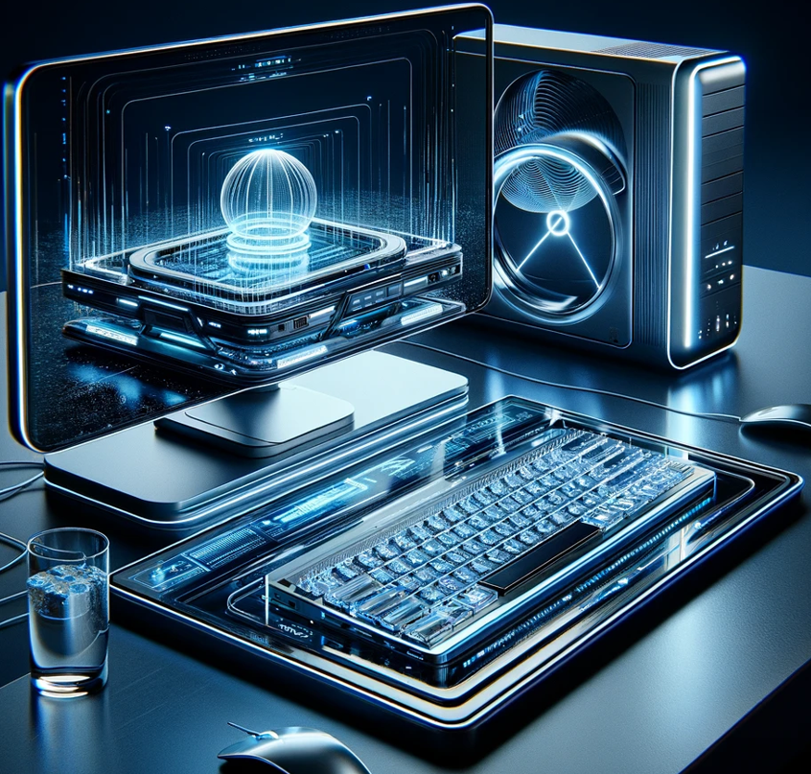
How fast is todays AI compared with tomorrow’s Quantum AI computing?
Today
Tomorrow
Q-Star
ChatGPT
ChatGPT
+
+
Digital Computer
Quantum Computer
Slow
Fast
Tomorrow’s
AI Speed
Quantum AI computing could be 1,000 to 1 million times faster

