Slide 1
Continuous Development SOURCE CODE MANAGEMENT GIT
VIKAS

Slide 2
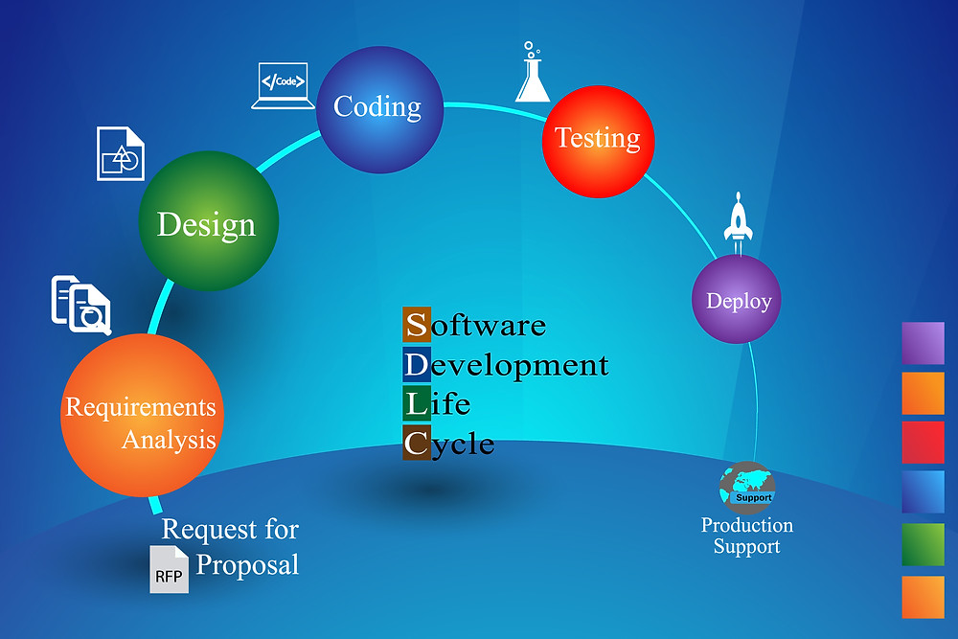

Slide 3


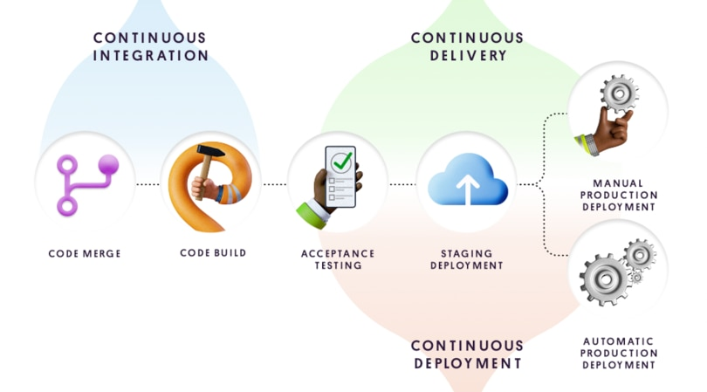
Notes:
Continuous Development : git, GitHub, GitLab, bitbucket

Slide 4
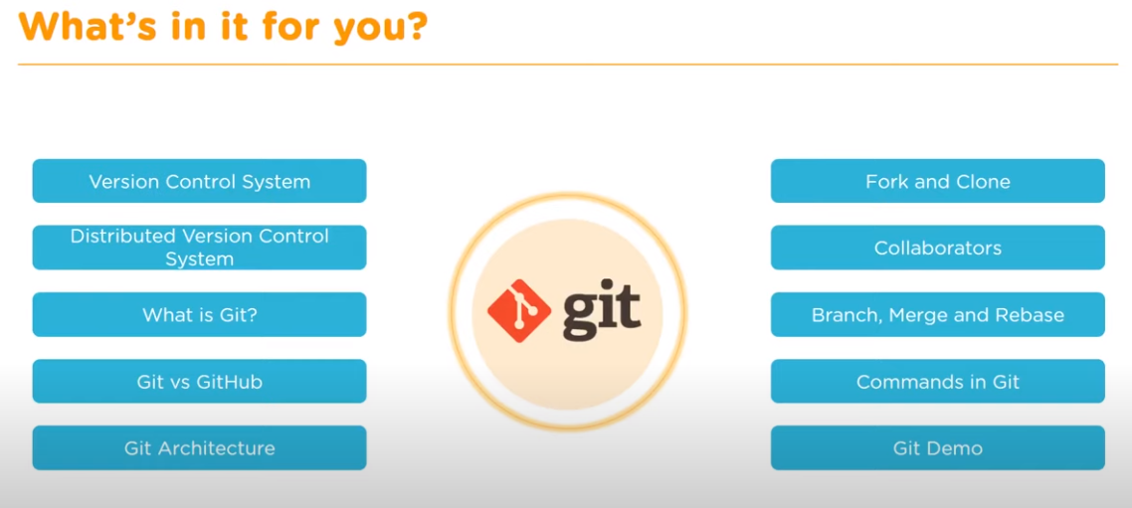
Notes:
Introduction to Version control
Basic concepts
Setup git repo
Working with git (add, commit, status, checkout)
Avoid Merge conflict (rebase)
Going back to history (log)
Save wip changes( git stash)
Revert mistakes (revert , reset)
Resolve merge conflict
Branches

Slide 5
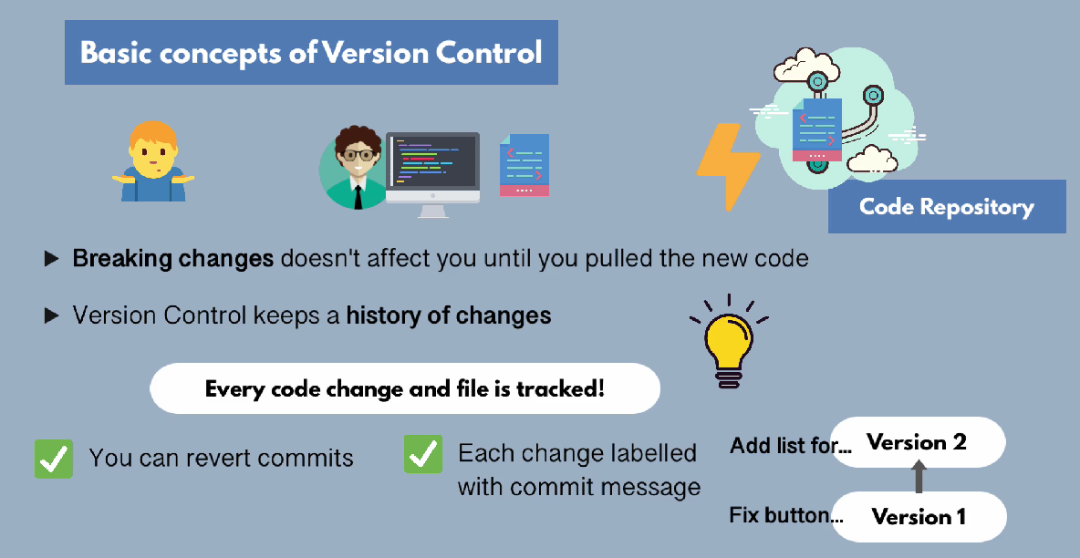

Slide 6
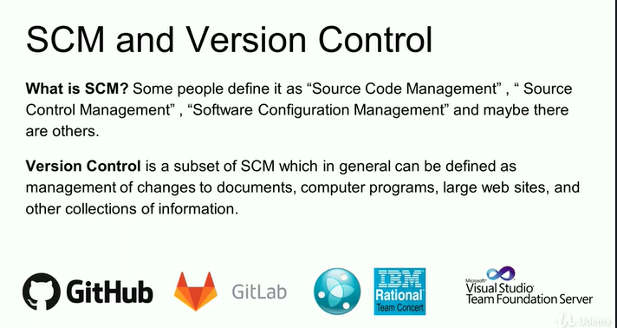
Notes:
Benefits of Git :
Free and open source
Fast and light weight
Encryption using SHA (Secured Hashing Aldo)
Branching

Slide 7
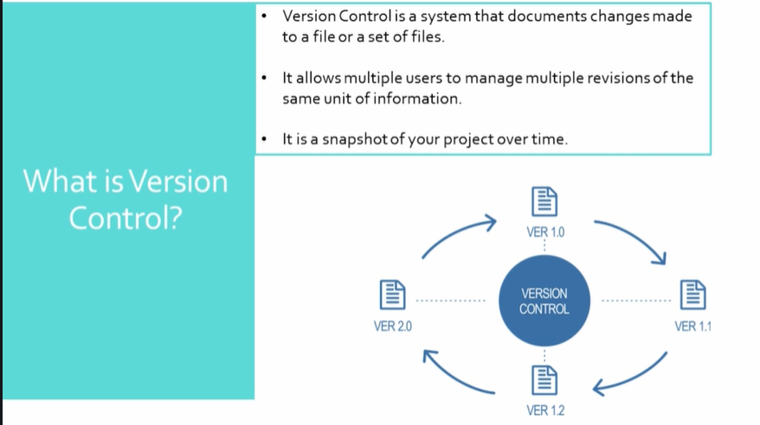
Notes:
1. What is git?
2. What is difference between git and GitHub and GitLab (for CI tool also we can use)?
3. Any other version control tools other than git?
4. What is difference between svn and git?
5. What is merge conflicts have you faced ever in you experience? if you face how you resolve?
6. What is git stash?
7. What is git HEAD?
8. What is staging area in git?
9. What is difference between git fetch and pull and clone?
10. What is difference between git merge and rebase?
11. What is .gitignore file? What is the purpose of the file?
12. What is git branch? Have you worked on branches?
13. How to merge branches?
14. What is cherry-pick in git?
15. How to create a git project?
16. How to check difference in between two files?
17. How edit the committed message?
18. How to check the last few commits?
19. How to delete remote branch and local branch?
20. How to create local branch?
21. What is tag? How many types in tag? How we will create tags?
22. How to roll back committed code.

Slide 8
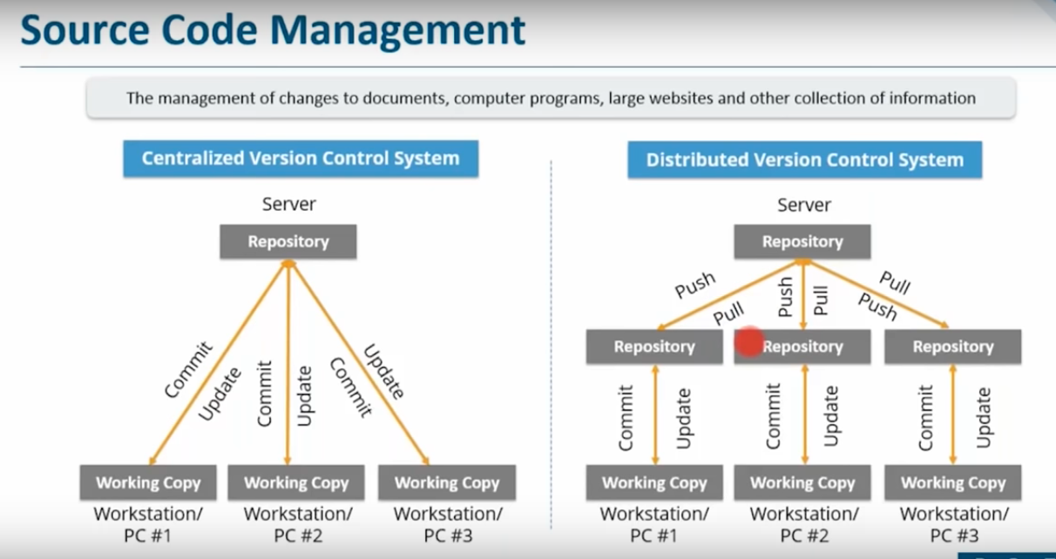
Notes:
Types of Version Control:
================
Local version control
Centralized version control – Highly dependent on central server and needs the connectivity to be up always .Eg: SVN, TFS, Perforce .
Distributed version Control – Every user has a copy of remote repository which is backed in his local repository .No need to be connected always .Eg : Git ,Mercurial
https://www.perforce.com/blog/vcs/best-branching-strategies-high-velocity-development

Slide 9
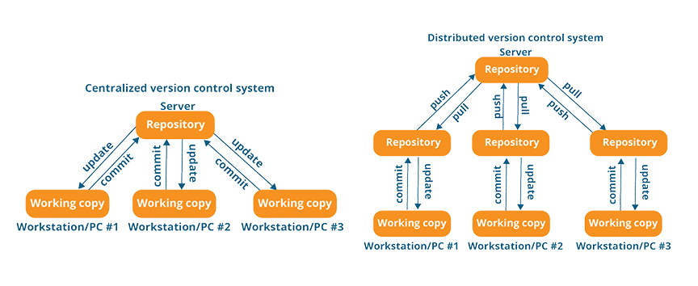

Slide 10
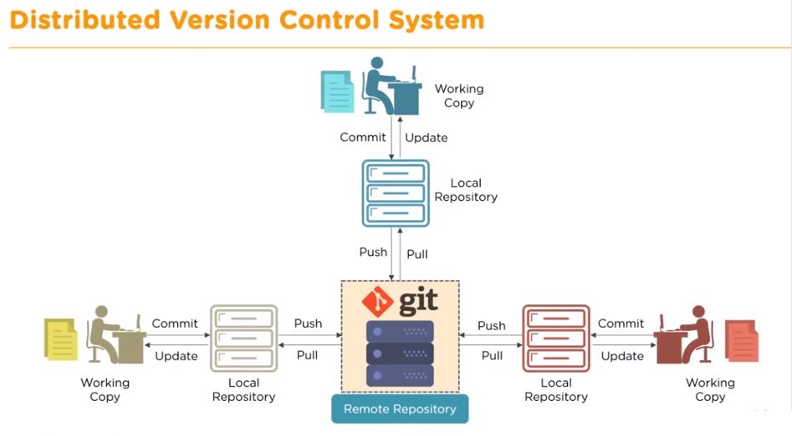

Slide 11
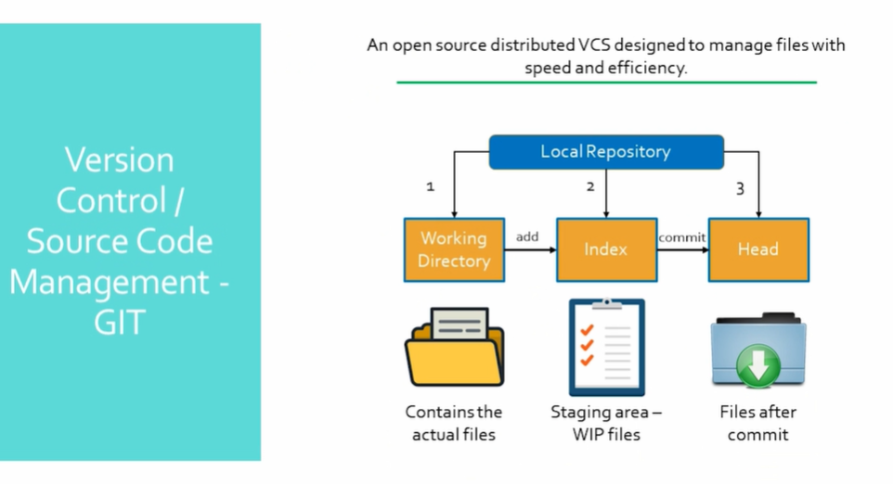
Notes:
Git is a version-control system for tracking changes in computer(code) and coordinate work on those files among multiple people(developers).
Benefits of git :
================
Simultaneous update by multiple users .
Logs can be maintained .
History
Backup

Slide 12
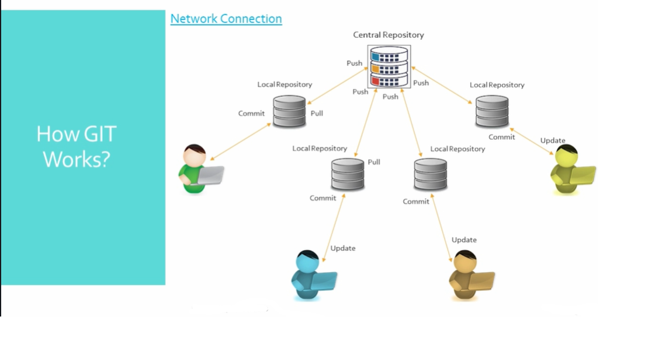

Slide 13
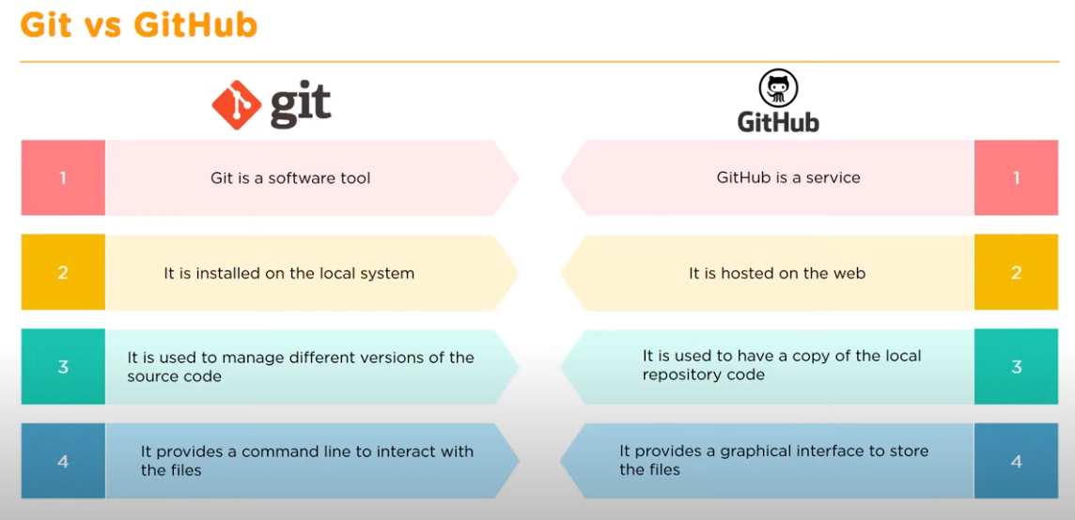
Notes:
GIT – Open source version control tools for developers to manage source code .
Git Hub – Cloud based platform for GIT users to connect ,upload and download resources .

Slide 14
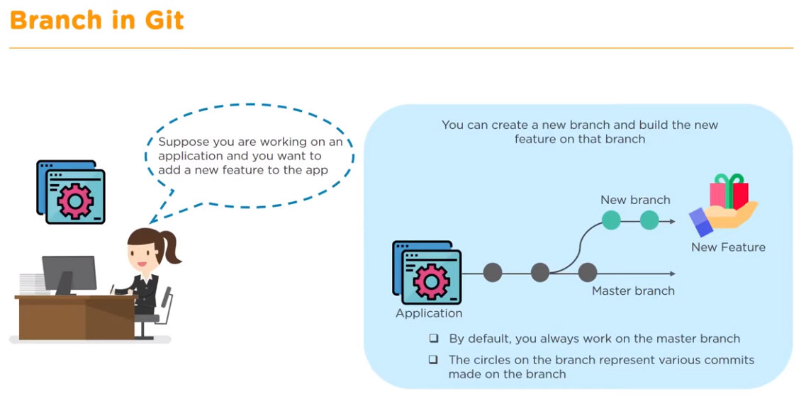

Slide 15
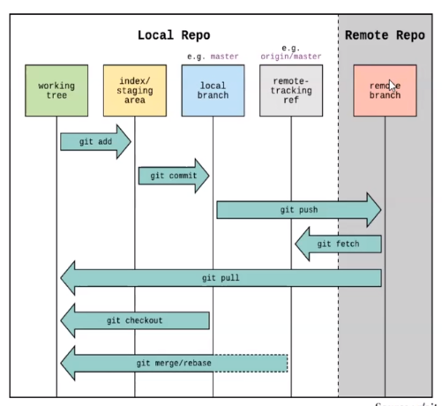
Notes:
Git Installation :
==================
To install git -- > yum install git -y
To check Version -- > git --version
git config :
============
git config --global user.name “vikas99341”
git config --global user.email “vikasisinlove@gmail.com”
git config --list
git config --global push.default simple
Create a git repo and push it :
==============================
To Create a Local Repository on Git :
mkdir gitprojects/project1 -- > cd gitprojects/project1 -- > git init (initialize empty git repository) --> vi file1
ls -- > you see the file in working directory but
git ls-files will not show anything as the file has not moved to local repo.
git log and diff :
=================
git log -- > this will give you SHA details .
git log --oneline -- > for brief commit detail
git log --pretty=oneline
git log <particular 7 digit commit id > -- > to see details for one particular file1
git show <comit id> or git show <shaid > -- > detailed description
git show HEAD -- > See the latest commit ID .
git reset--HARD <sha-code> -- > to uncommit some commit and move the head down
git fsck --lost-found -- > which commit was not done or dangaling
git diff <fikle3.txt> -- > differnce before commiting the change
git diff <commit id 1> <commit id 2>-- > will let you know changes between two commits
git diff --staged <fikle3.txt> -- > differnce after commiting the change
Adding & Revert in different stages :
=====================================
touch a.txt
git status -- > see what has changed since last commit
git add . - - > add all file to staging area which can be checked by git status .
git add --all > add all files
git add –A -- > to add multiple changed files in one shot
git commit –m “<message >” ➔ commit the code
git commit –a –m “direct add “ -- > If you want to skip staging area and add
git rm <file name > -- > remove file from WD as well as local repo
git rm --cached <file name > -- > remove file from Local repo
git ls -- > view files on working directory
git ls-files -- > view files on local repo
Branch :
=======
git branch to see all the available branches
git branch <name the branch> or git checkout -b branch1 master -- > to create a new branch branch1 from master and checkout @ same time
git checkout <branch name> -- > to go to <branch name > -- > changes done here will not be visible unless and until merged with master .
git cherry-pick <sha-id > if you want to selective commit in feature branch .
To delete a branch :
git branch –d <branch-name>
Merge conflict :
===============
git merge go to that(master) branch and say git merge <other branch >
merge the content -- > come to master and use “ git merge master1 “ -- > if there is a conflict on merge -- > edit the file and commit again .
git log --oneline --graph --decorate --all
Pushing and pulling from repo :
==============================
git remote add origin “git hub clone link “ -- > copy to git
git remote –v (to check where is origin)
git pull original master -- > pull command to get the code (run it from the repo)
git fetch origin – same as git pull but will only show the change
git push origin master -- > push command to put the code in git hub
git pull = git fetch + git merge (git fetch will check the remote repo and git pull will pull the changes)
Ignore files on commit:
=======================
vim .gitignore -- > if you don’t want to upload to remote directory put those extensions here .
.gitignore file
Revert changes from staging area :
==================================
you made changes in local repo no git add and no commit
git checkout <file name >
you made changes in local repo and done git add and no commit
git reset HEAD <file name >
git checkout <file name >
Removing files :
===============
git rm file3.txt -- > will remove from working directory and local repo and the you have commit to see in remote repo
git rm --cached file3.txt -- > will remove the content only from Local repo and not working directory (remove prior you commit).
Modify the comment at top :
==========================
git commit --amend -m “New comment”
Adding tag :
============
git tag --a <tag name> <7 digit commit id> -m “adding tag ”
git tag
now these two are equivalent : git show <7 digit commit id > and git show <tag name>
git push origin --tags
Reverting git commit :
=====================
git revert <7 digit commit id > or git revert <commit id >
Remove entry from log :
======================
git reset –hard <commit id> -- > all the commits before this we be deleted
git reset –hard <commit id > then git push –f -- > remove the commit permanently
git revert head -- > git push -- > remove comit with revert
Git Rebase and Stash:
=====================
git rebase master
git stash -- > park it temporarily
git stash list
git show <stash>
git stash pop -- > bring it back
git stash pop <stash number > and same git stash apply <stash number> -- > get your work back

Slide 16
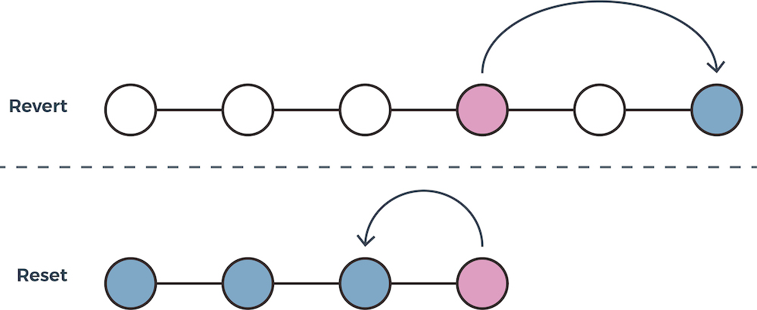
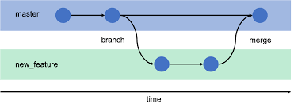

Slide 18
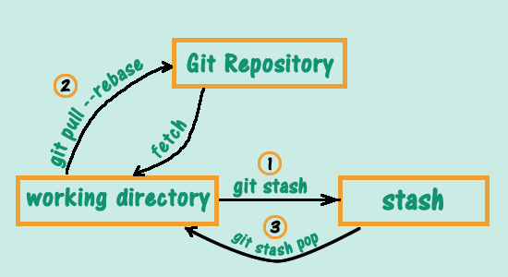

Slide 19
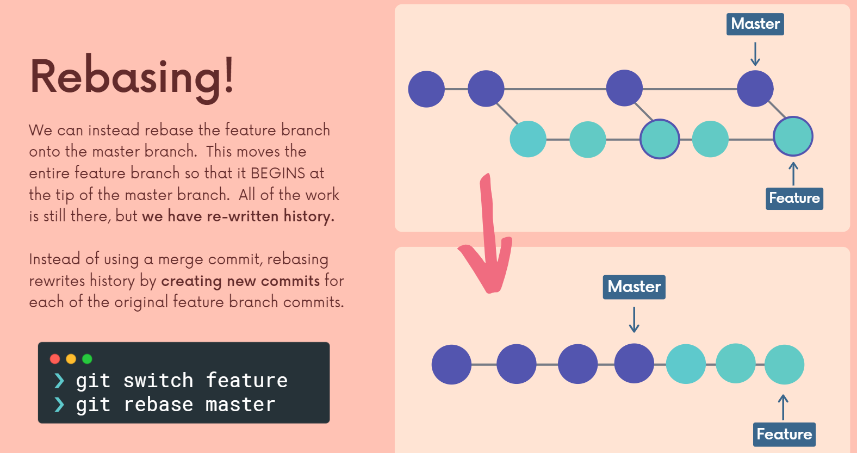
Notes:
Rebasing
There are two main ways to use the git rebase command:
- as an alternative to merging
as a cleanup tool
We get a much cleaner project history. No unnecessary merge commits! We end up with a linear project history.
https://medium.com/@fredrikmorken/why-you-should-stop-using-git-rebase-5552bee4fed1

