Slide 1
Investigation of Quality and Reliability benefits of AEC-Q200 for Class-II X7R Multilayer Ceramic Capacitors (MLCCs)
Nikhil Bharadwaj Kulkarni and Dr. Michael H. Azarian at CALCE, UMD.

Slide 2
Objectives
Determine whether there are measurable differences in quality and reliability between components that are AEC qualified parts and comparable (with same temperature, capacitance and case size) non-automotive grade parts (commercial/standard).
Quality through the use of process capability (equation) of as received parts (on board) and individual parts analysis.
Reliability through the highly accelerated life test (HALT for MLCCs: temp + DC bias) testing for 5000 hrs.

Slide 3
Background
AEC-Q200 is a standard that defines the minimum stress-test driven qualification requirements that must be met by automotive grade passive parts.
Based on the size of component and type of qualification either an individual component or family.
In case of family qualification for Class II MLCCs the sample size to be tested is 77 parts and 3 lots.
Purpose: Exploring whether we can use combined pool of these parts based on this comparison.
The 2 possible failure mechanisms for insulation resistance degradation in MLCCs are cracks and oxygen vacancy migration.

Slide 4
Dielectrics used in MLCCs [1]
Class I dielectrics (examples: C0G,U2J) are primarily made of calcium zirconate with Temperature Coefficient of Capacitance (TCC) 30-ppm across temperature -55℃ to 125℃ but has relative permittivity (K) up to 100.
Class II dielectrics (examples: X7R,X5R) are primarily made of barium titanate and these have much higher relative permittivity (K) up to 16,000 with TCC of +/-15% across temperature -55℃ to 125℃ for X7R and TCC +/-15% across temperature -55℃ to 85℃ for X5R.
Class III dielectrics (examples: Z5U,Y5V) are known for two things, their very high capacitance and temperature instability. Although still made with barium titanate, different manufacturers add certain dopants to flatten out the curve of relative permittivity vs temperature such that it becomes more with TCC +22, -56% across temperature -30℃ to 85℃ for Z5U and 10℃ to 85℃ for Y5V but has relative permittivity (K) up to 18,000.
[1] Hiroshi Kishi et al 2003, Base-Metal Electrode-Multilayer Ceramic Capacitors: Past, Present and Future Perspectives, Japanese Journal of Applied Physics. Vol. 42 Part 1, No. 1 pages 1-15

Slide 5
Literature Review Automotive and Non-Automotive Commercial-Off-the-Shelf (COTS) Testing by NASA Engineering and Safety Center
Automotive and non-automotive COTS EEE part types tested exhibited a high Destructive Physical Analysis (DPA) defect rate (i.e., 21% for automotive, and 22% for non-automotive parts) with statistically indistinguishable patterns of non-conformances to NASA GSFC S-311-M-70 (Specification for Destructive Physical Analyses).
During environmental testing, one of six automotive, and one of one non-automotive COTS EEE part types did not pass the subset of the Automotive Executive Council (AEC) Q101 qualification tests, due to electrical failures observed after highly accelerated stress testing (HAST) and thermal cycling.

Slide 6
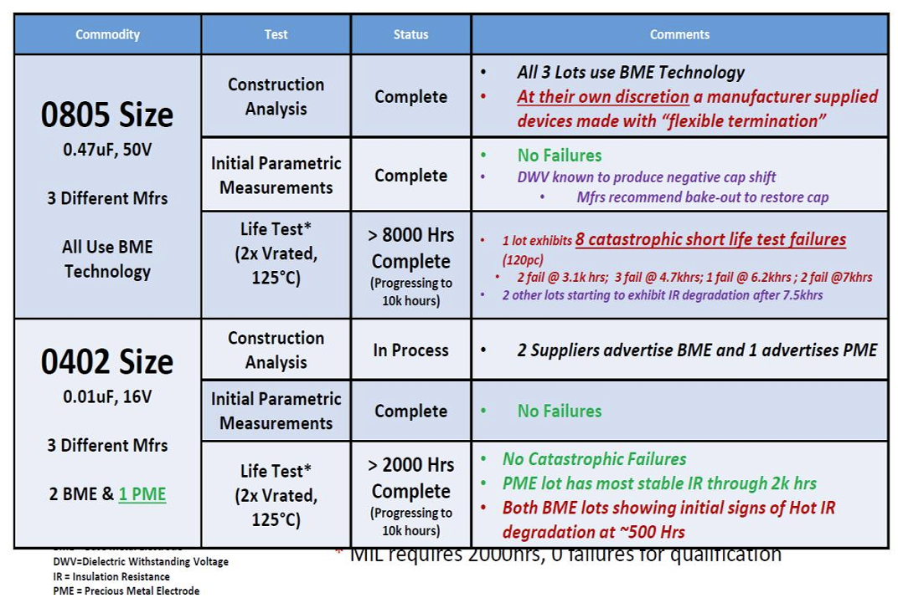
Literature Review of AEC-Q200 MLCCs
Michael J. Sampson, An Overview Of NASA Automotive Component Reliability Studies

Slide 7
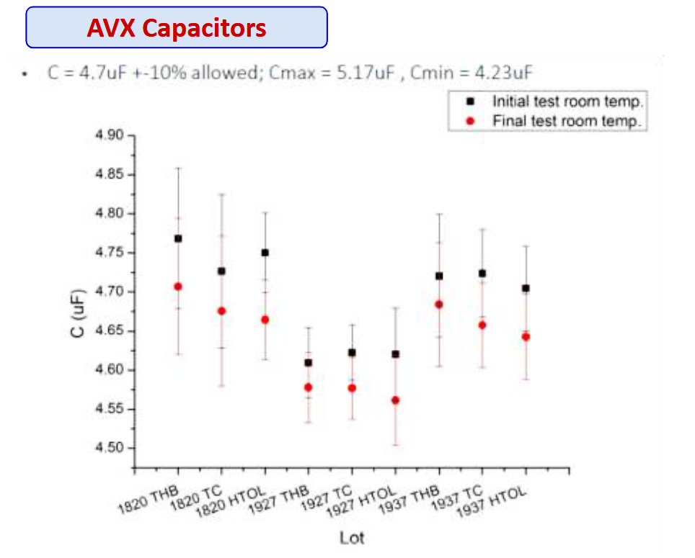
Literature Review of AECQ Components for Space Application
Investigated both active and passive AECQ components: for variability lot-to-lot, part-to-part, construction analysis
Reliability with Thermal Cycling (500 Cycles from -55 ° C to +125 ° C) THB (1000hours at 85°C / 85% RH, biased) & HTOL Tests (1,000 hours at +125 ° C with bias), Inspection & Electrical Test (Before/After Stress)
No failures reported in reliability tests and observed electrical parameter drift but was within the specification limits.
Results indicated a potential for use of AEC parts limited to the tested parts
Finbarr Waldron, Luis de Pablo, Stephan Hernandez, Assessment of Automotive EEE Components Suitability For Space Applications, 22nd Sept 2021

Slide 8
MLCCs under Test
Description | Lot Identifier | AEC-Q200
Cap ceramic 220 nF 16 V X7R Case size: 0805, -55 ℃ to 125 ℃ Dissipation Factor 12.5% Insulation Resistance: 110 MOhms M1 | 1A, 1B, 1C | No
 | 2A, 2B, 2C | Yes
Cap ceramic 220 nF 16 V X7R Case size: 0805, -55 ℃ to 125 ℃ Dissipation Factor 3.5% Insulation Resistance: 110 MOhms M2 | 3A | Yes
 | 4A | No
Total | 8

Slide 9
Test Plan
Pre-test analysis :
Performed optical microscopy of as received parts.
Took measurements of capacitance (C), dissipation factor (DF), and leakage current on parts as received.
Completed de-aging at 150 ºC for 30 minutes and took measurements of C, DF, leakage current of parts again.
Testing :
HALT (highly accelerated life testing) at 2xV_{Rated} DC (32V), 125 ºC as per NASA environmental testing conditions, for 5200 hours with test measurement times (at room temperature) as 24, 48, 250, 500, 750, 1000, 1500, 2000, 2500, 3000, 3500, 4000, 4500, 5200 hours.

Slide 10
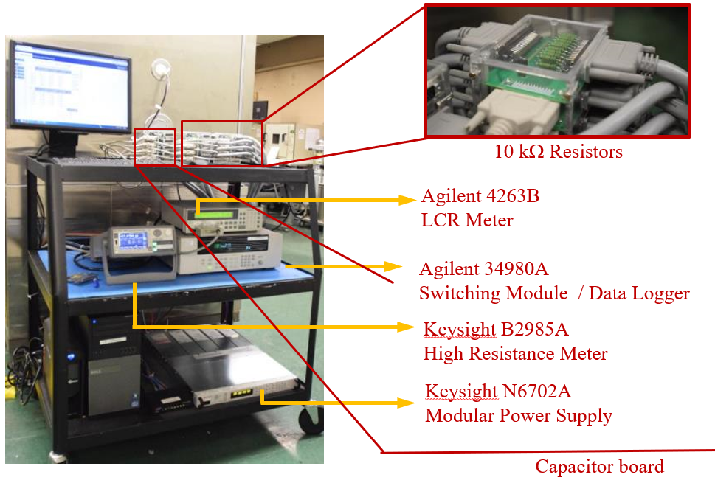
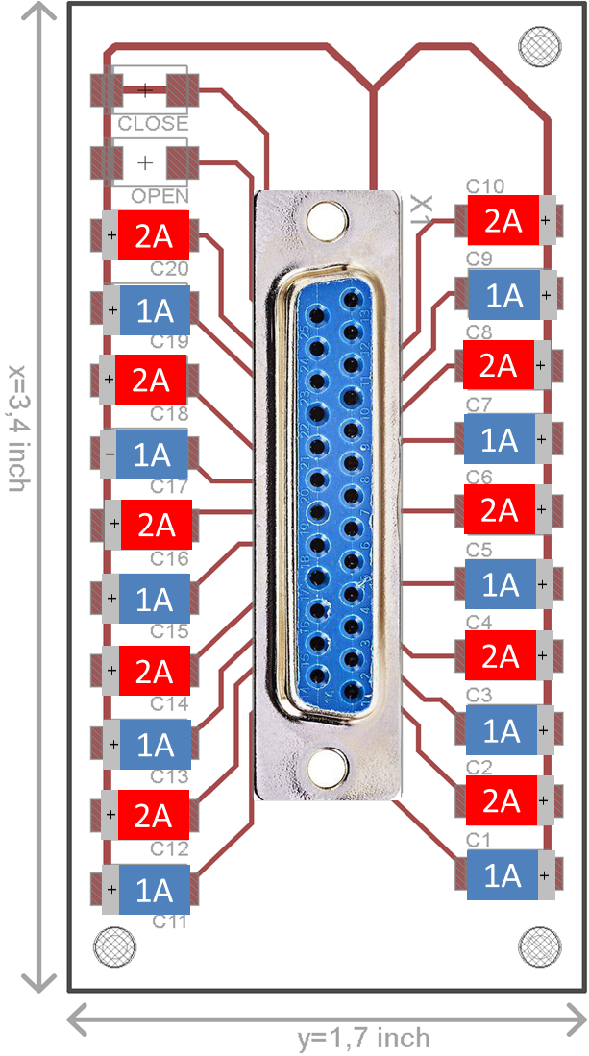
Test Setup
Oven

Slide 11
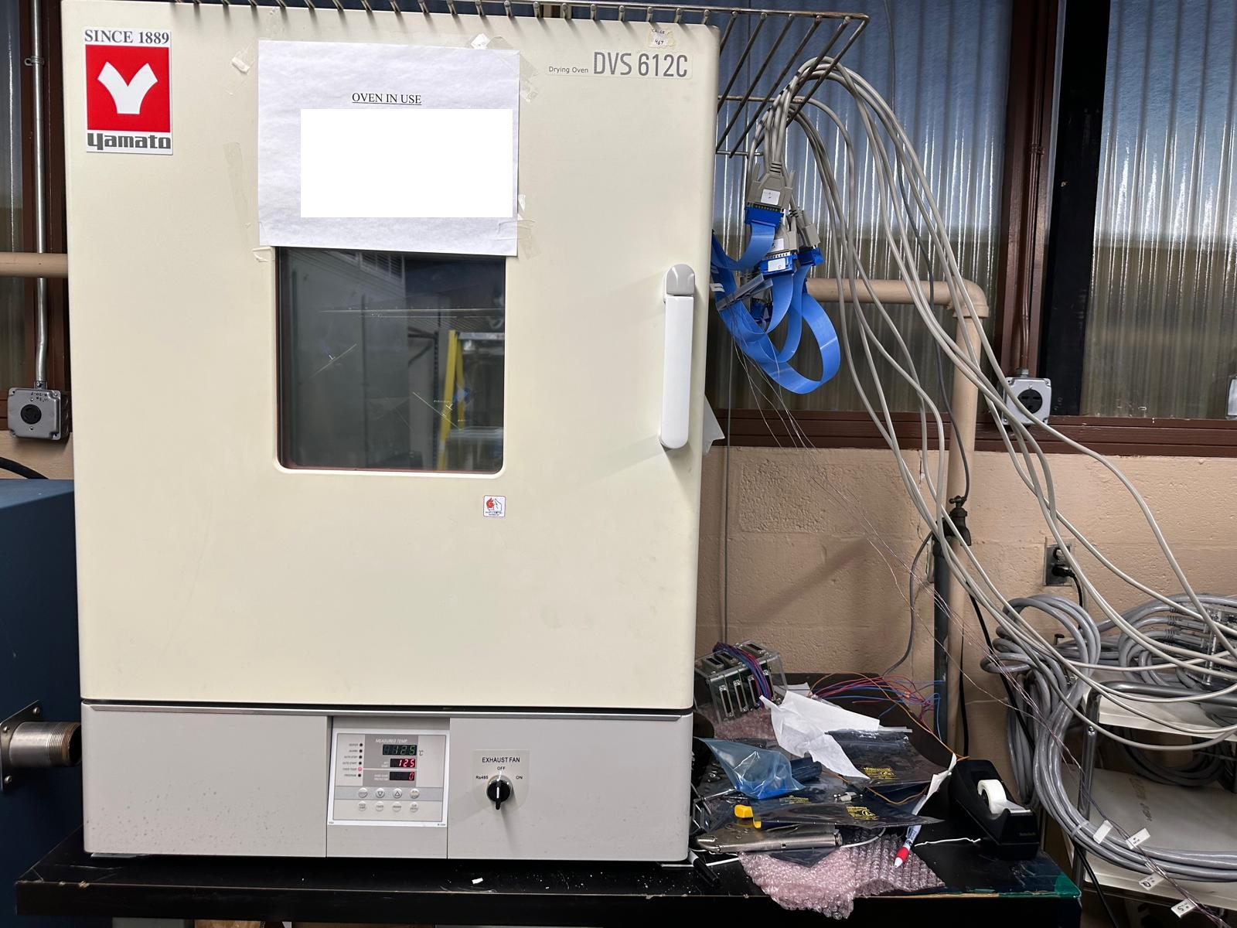
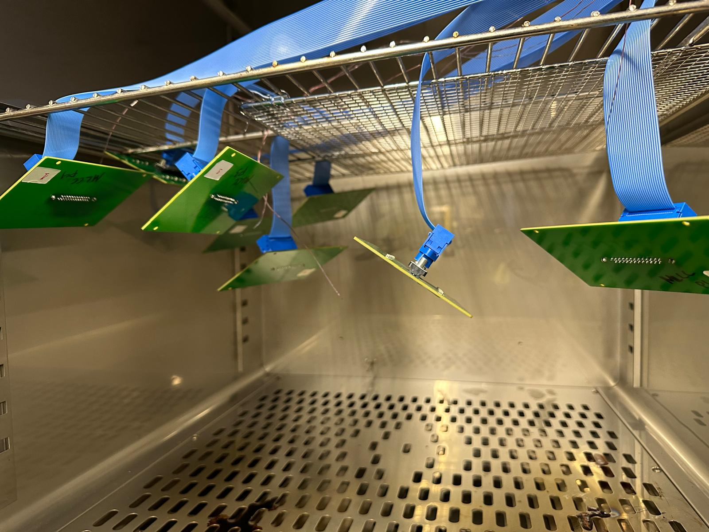
Connections to Boards
Ribbon cables connecting to Boards
Oven and connection of ribbon cables rated for 200 Celsius

Slide 12
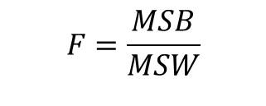
One-Way ANOVA
Testing the Null Hypothesis:
There is no difference in the population means of the different levels of factor A
Explanations:
Mean of Squares Between groups (MSB)
Mean of Squares Within groups (MSW)
A
A
B
C
B
Population
C
Population
$$F=\frac{MSB}{MSW}$$
Using the F-factor, we can determine the confidence p-value to either accept or reject the null hypothesis.

Slide 13

ANOVA Analysis Tasks Overview
Data Source
ANOVA Analysis
AECQ vs. Non AECQ
M1 AECQ vs. M1 Non AECQ
M2 AECQ vs. M2 Non AECQ
Combined AECQ vs. Combined Non AECQ
Data Changes / Degradation
M1 vs. M2
$$5200 hours data – 0 hour data$$
M1 AECQ vs. M2 AECQ
M1 Non AECQ vs. M2 Non AECQ
5200 hours Data
Repeat the Same Analysis

Slide 14
Electrical Parameter Results at 5200 hrs
Capacitance was well within the range specified in datasheets.
Dissipation factor, M2 had less variability and was close to its limit.
Insulation resistance dropped from 6 Giga Ohms to 0.2 Giga Ohms for all parts, while the failure threshold was at 0.11 Giga Ohms. Observed manufacturer dependent trends.

Slide 15
ANOVA Results
At 0 hrs, no differences were found between manufacturers and AECQ to non-AECQ
At 5200 hrs we found differences in DF and Insulation resistance.
Conclusion
The results show manufacturer dependent differences between AECQ to non-AECQ in MLCCs, so validating the manufacturers before use is necessary.

