Slide 1
Investigation of Quality and Reliability benefits of AEC-Q200 for Class-II X7R Multilayer Ceramic Capacitors (MLCCs)
Nikhil Bharadwaj Kulkarni and Dr. Michael H. Azarian at CALCE, UMD.

Slide 2
Objectives
Determine whether there are measurable differences in quality and reliability between components that are AEC qualified parts and comparable (with same temperature, capacitance and case size) non-automotive grade parts (commercial/standard).
Quality through the use of process capability (equation) of as received parts (on board) and individual parts analysis.
Reliability through the highly accelerated life test (HALT for MLCCs: temp + DC bias) testing for 5000 hrs.

Slide 3
Background
AEC-Q200 is a standard that defines the minimum stress-test driven qualification requirements that must be met by automotive grade passive parts.
Based on the size of component and type of qualification either an individual component or family.
In case of family qualification for Class II MLCCs the sample size to be tested is 77 parts and 3 lots.
Exploring whether we can use combined pool of these parts based on this comparison.
The 2 possible failure mechanisms for insulation resistance degradation in MLCCs are cracks and oxygen vacancy migration.

Slide 4
Literature Review Automotive and Non-Automotive Commercial-Off-the-Shelf (COTS) Testing by NASA Engineering and Safety Center
Automotive and non-automotive COTS EEE part types tested exhibited a high Destructive Physical Analysis (DPA) defect rate (i.e., 21% for automotive, and 22% for non-automotive parts) with statistically indistinguishable patterns of non-conformances to NASA GSFC S-311-M-70 (Specification for Destructive Physical Analyses).
During environmental testing, one of six automotive, and one of one non-automotive COTS EEE part types did not pass the subset of the Automotive Executive Council (AEC) Q101 qualification tests, due to electrical failures observed after highly accelerated stress testing (HAST) and thermal cycling.

Slide 5
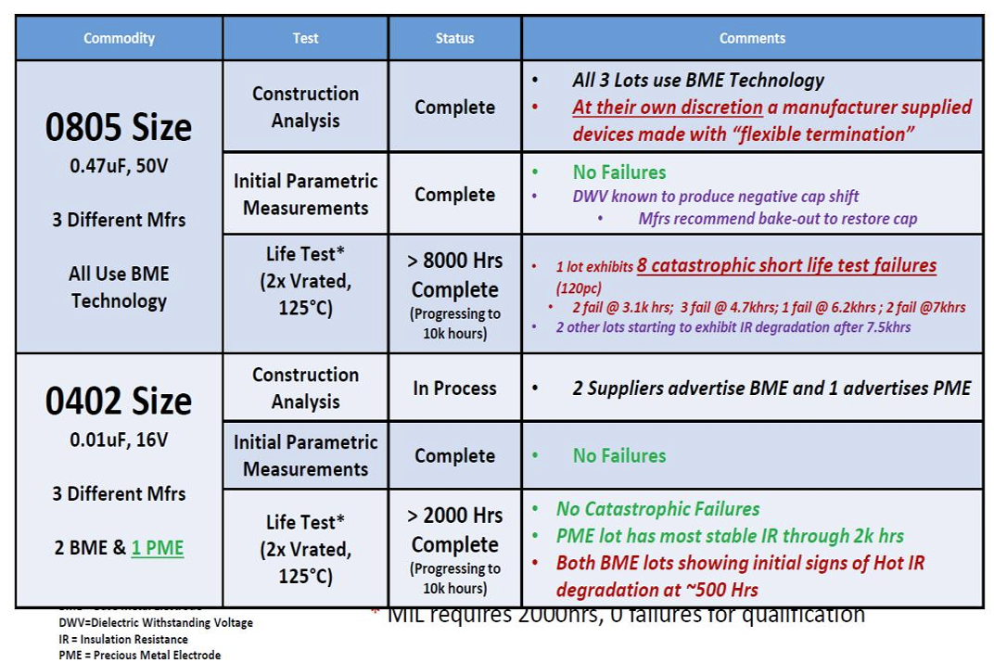
Literature Review of AEC-Q200 MLCCs
Michael J. Sampson, An Overview Of NASA Automotive Component Reliability Studies

Slide 6
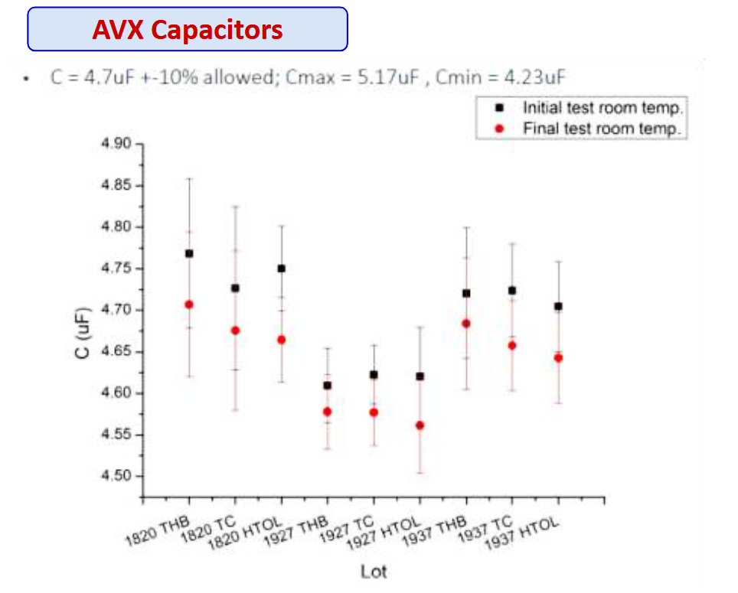
Literature Review of AECQ Components for Space Application
Investigated both active and passive AECQ components: for variability lot-to-lot, part-to-part, construction analysis
Reliability with Thermal Cycling (500 Cycles from -55 ° C to +125 ° C) THB (1000hours at 85°C / 85% RH, biased) & HTOL Tests (1,000 hours at +125 ° C with bias), Inspection & Electrical Test (Before/After Stress)
No failures reported in reliability tests and observed electrical parameter drift but was within the specification limits.
Results indicated a potential for use of AEC parts limited to the tested parts
Finbarr Waldron, Luis de Pablo, Stephan Hernandez, Assessment of Automotive EEE Components Suitability For Space Applications, 22nd Sept 2021

Slide 7
MLCCs under Test
Description | Lot Identifier | AEC-Q200
Cap ceramic 220 nF 16 V X7R Case size: 0805, -55 ℃ to 125 ℃ M1 | 1A, 1B, 1C | No
 | 2A, 2B, 2C | Yes
Cap ceramic 220 nF 16 V X7R Case size: 0805, -55 ℃ to 125 ℃ M2 | 3A | Yes
 | 4A | No
Total | 8

Slide 8
Test Plan
Pre-test analysis :
Performed optical microscopy of as received parts.
Took measurements of capacitance (C), dissipation factor (DF), and leakage current on parts as received.
Completed de-aging at 150 ºC for 30 minutes and took measurements of C, DF, leakage current of parts again.
Testing :
HALT (highly accelerated life testing) at 2xV_{Rated} DC (32V), 125 ºC as per NASA environmental testing conditions, for 5200 hours with test measurement times (at room temperature) as 24, 48, 250, 500, 750, 1000, 1500, 2000, 2500, 3000, 3500, 4000, 4500, 5200 hours.

Slide 9
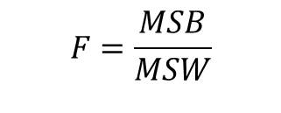
One-Way ANOVA
Testing the Null Hypothesis:
There is no difference in the population means of the different levels of factor A
Explanations:
Mean of Squares Within groups (MSW)
Mean of Squares Between groups (MSB)
A
A
B
C
B
Population
C
Population
$$F=\frac{MSB}{MSW}$$
Using the F-factor, we can determine the confidence p-value to either accept or reject the null hypothesis.

Slide 10
Electrical Parameter Results at 5200 hrs
Capacitance was well within the range specified in datasheets.
Dissipation factor, M2 had less variability and was close to its limit.
Insulation resistance dropped from 6 Giga Ohms to 0.2 Giga Ohms for all parts, while the failure threshold was at 0.11 Giga Ohms. Observed manufacturer dependent trends.

Slide 11
ANOVA Results
At 0 hrs, no differences were found between manufacturers and AECQ to non-AECQ
At 5200 hrs we found differences in DF and Insulation resistance.
Both of these differences we observed between manufacturers.

