Slide 1

“Design with Data” Applied
Nicholas Blair
Application Development & Integration – Internal Apps
Creating responsive and SOA-ready web applications.

Slide 2

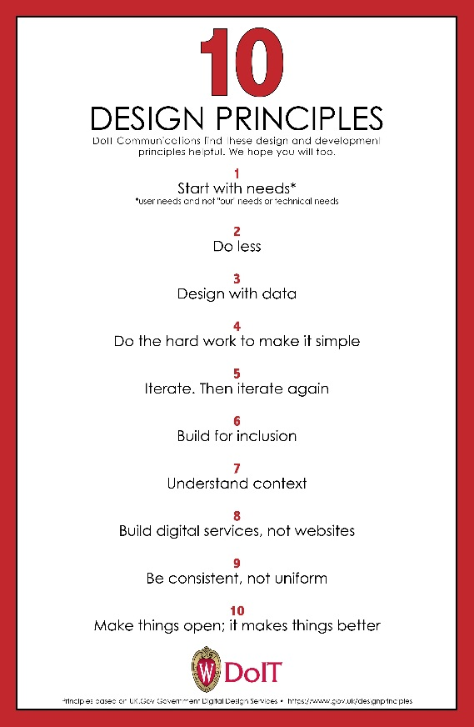

Slide 3
Agenda
How does “Design with Data” apply to application development in ADI?
Current State
A Pattern
Benefits
Questions

Slide 4
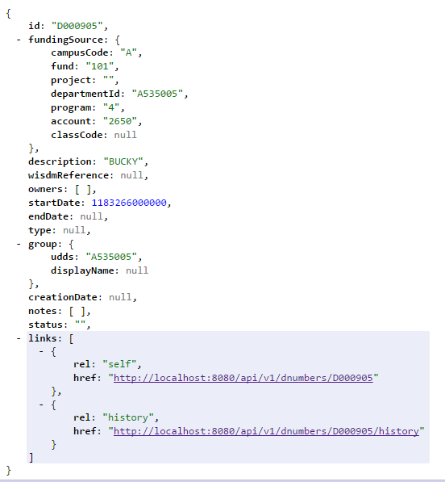
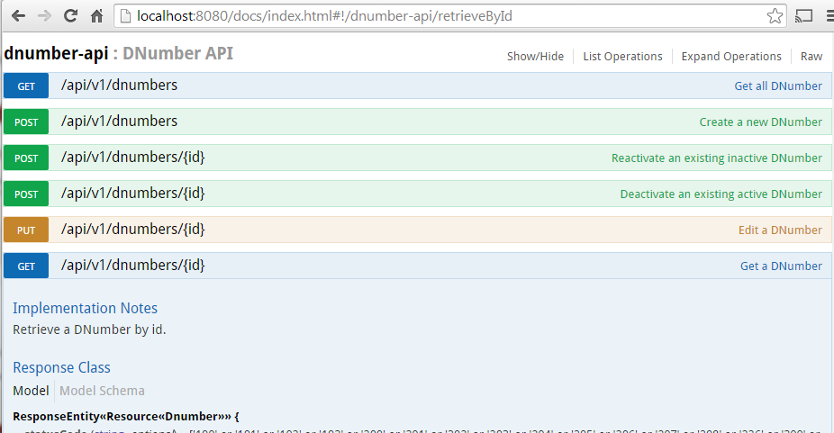
Data is Beautiful

Slide 5
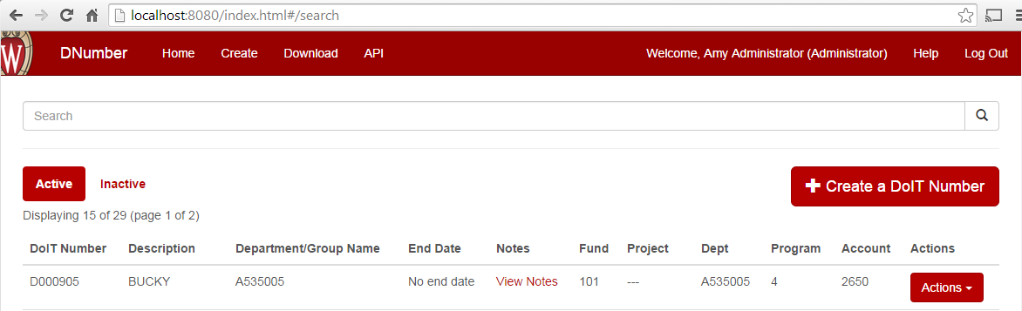
User Experience is Beautiful

Slide 6
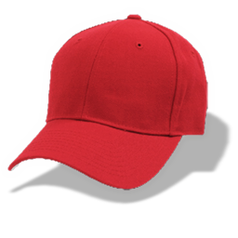
Application Development
Satisfy both concerns
Useful data presented in a user friendly way

Slide 7
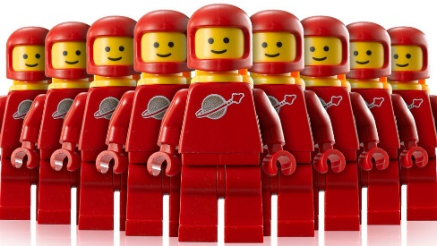



Problem

Slide 8
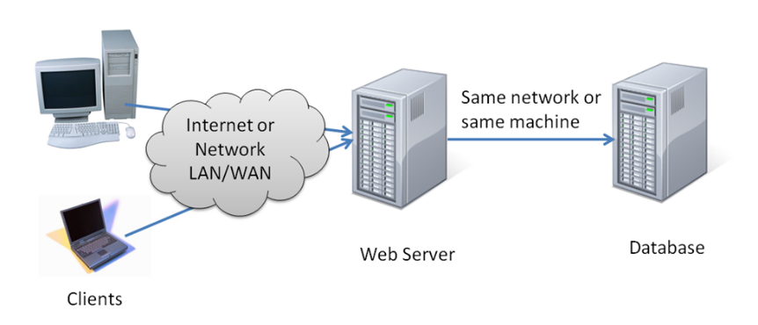
Answer
Such Web Server
So Cloud
Wow
Very HTTP
OMG Bootstrap

Slide 9







Application Engine Options

Slide 10
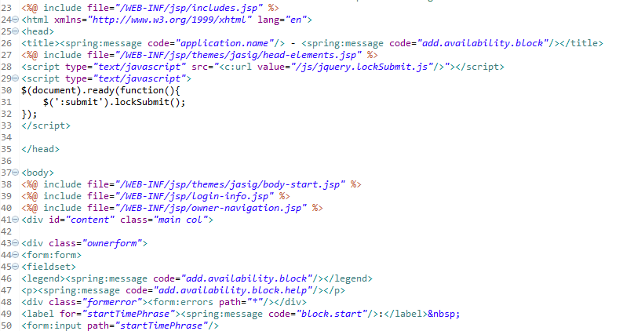
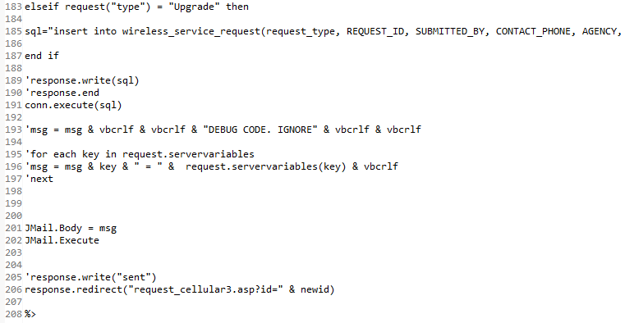
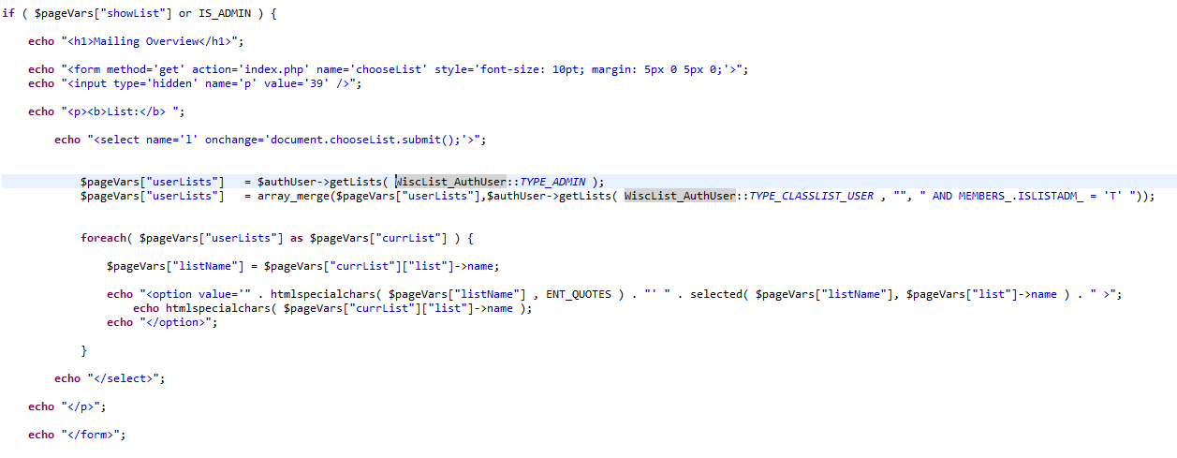
What’s inside the box?

Slide 11
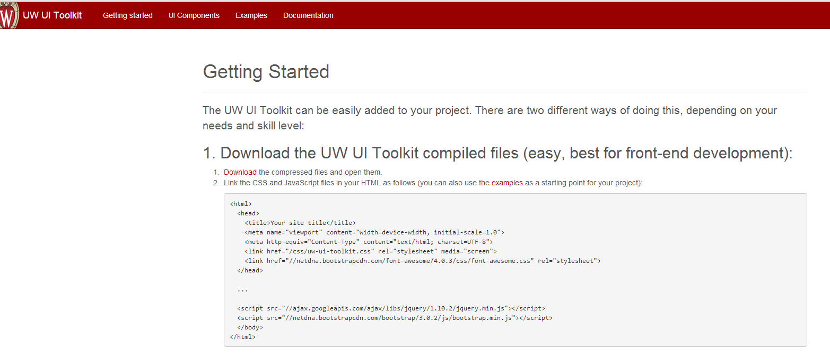

Incorporating UW Brand/Theme
header-include-p1.jsp
header-include-p2.jsp

Slide 12
Problem!
Application Developer === Surgeon
Application Developer === Archeologist
UI/UX specialist isolated from actual source

Slide 13
Web Services
Successful application deployment fosters ideas for new integration
“Can I connect to your database?”
NO!
“Write a side door service layer that adds…”
NO!

Slide 14
Problem

Slide 15
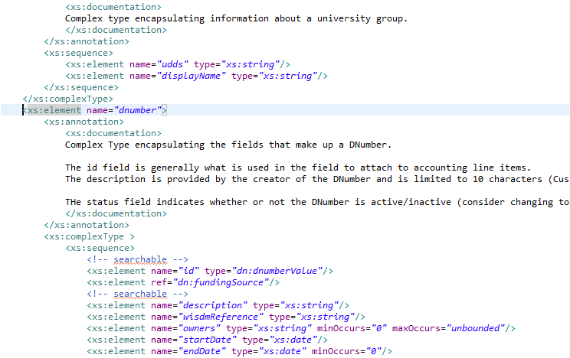
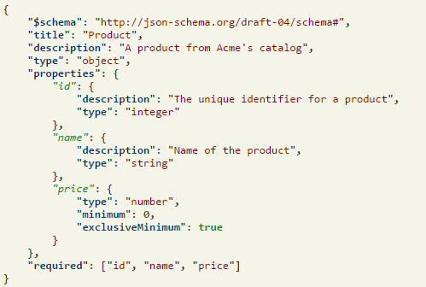
Design with Data
Start with data modeling
Serialized form to relay across the network

Slide 16



JSON – Application data
JavaScript Object Notation
Technology already deployed on the client
Deliver with REST

Slide 17



View Technologies – UX
JavaScript on the client side can be seen just like a Web Service client

Slide 18



Answer
Other Services
HTTP
JSON
HTML5
JS
CSS
Angular JS
REST
SERVICE
Data Access
HTTP
JSON

Slide 19
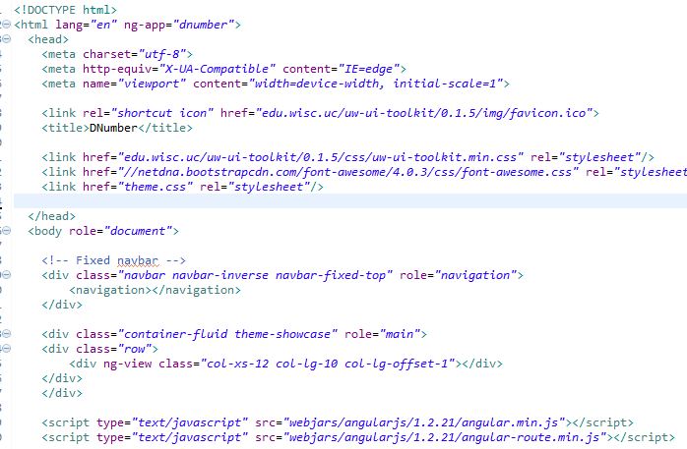
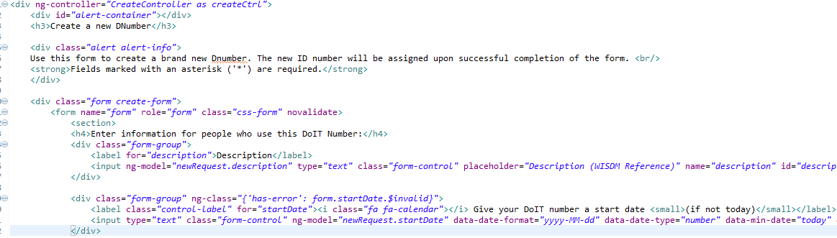
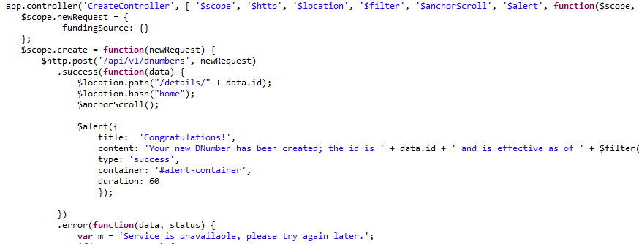
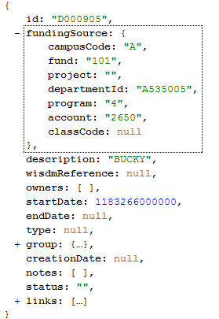
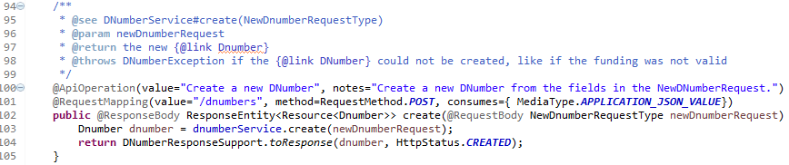
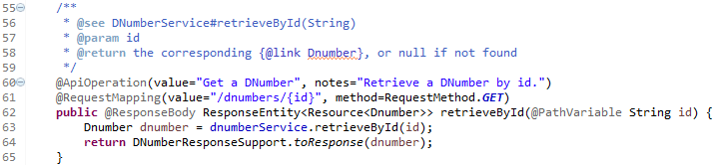
What’s inside the box?

Slide 20
Answer summary
Know your data model
Create (and Document!) a REST API for all of the data in scope for the application
Plain HTML5 and JavaScript for the user interface

Slide 21
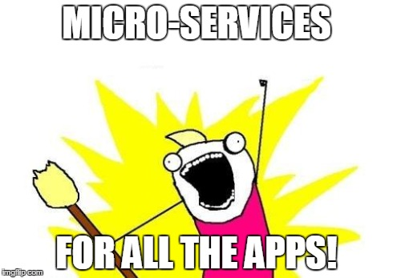
Benefits
Parallel development between service and UI
Edit UI without disrupting application code
Swap out app engine without disrupting UI

Slide 22

Requires

Slide 23

Questions Thank you!!

Slide 24
Contact
Nicholas Blair
nicholas.blair@wisc.edu (email or IM)
adi-tech-leads@lists.wisc.edu

Slide 25
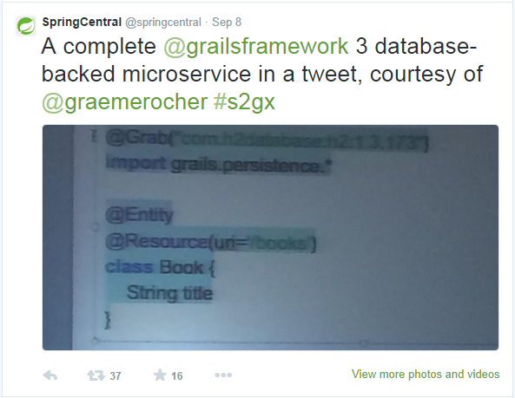
Micro-service in a tweet

