Slide 1
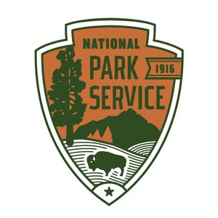

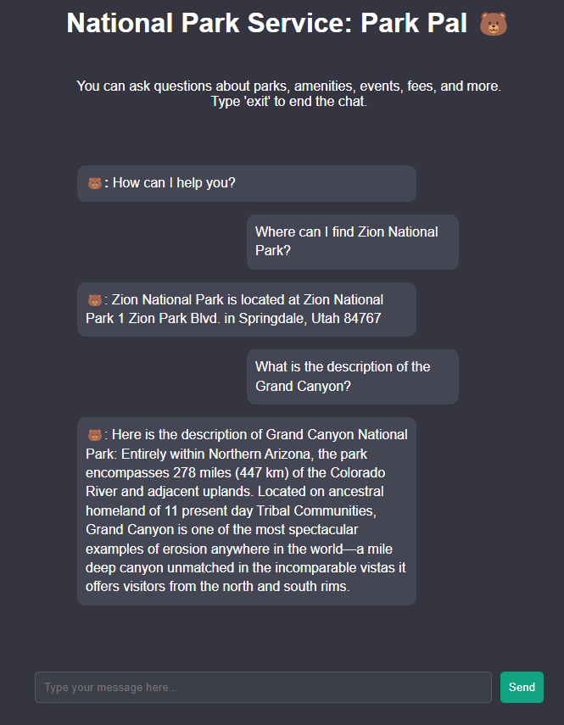

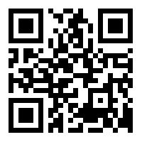



Infographic Resume
Park Pal
National Parks Service
Chatbot Creation
Nicole Blakkan-Esser
Lauralyn Curry-Leech Courtney Gibson
[Filler text]Our group has begun the process of creating ParkPal, a chatbot based on the National Park Service’s (NPS) API data. The data provided by NPS is publicly available and includes information on a variety of park related topics such as addresses, fees, park alerts, amenities and activities. Our team will be utilizing five separate endpoints as the basis for our chatbot and we have trained the chatbot to recognize all 500 national park entities. We have created three models to service the chatbot API calls. We will compare the performance of the NLTK, SpaCy, and GPT models before deciding which model to host using AWS.
7
Years
Use this to enter information about your experience.
Want to change the image? Right click, choose Fill, then choose Picture.
Recreational Visits 2023
Live in New York Since 2015
PERSONAL
Education
Top 5 National Parks 2023
On weekends I like spending time with my family.
When I have some time for myself, I enjoy my Xbox and reading science fiction. If I had a hero it would be Shakespeare.
To change icons, follow steps under Education.
2010
School ABC Do a right mouse click on icon.
2012
Studying at ABC Choose Change Graphic from the options.
2012
Studying at ABC
Choose icon from the options and then select icon.

