Slide 1
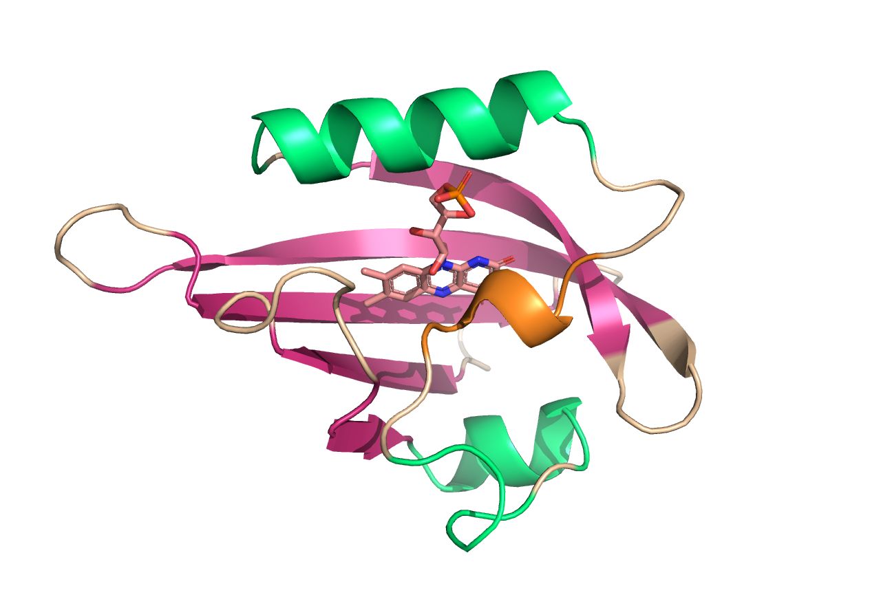
Reinforcement Learning with Experimental Feedback for Versatile Directed Generative Protein Design
Nathaniel Blalock, Dr. Philip Romero

Slide 2
Training Reward Model
with DMS dataset

Slide 3
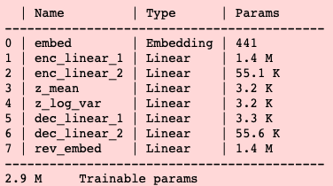
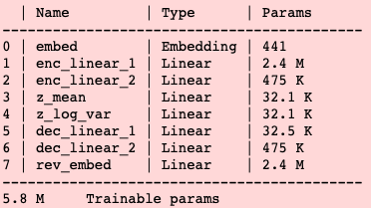
FCNN Dimension Sweep
Dimensions: 2499 → x → y → latent → y → x → 2499
Grid search
  x Dimensions of 1st Layer: [550,650,750,850,950]
  y Dimensions of 2nd Layer : [100,200,300,400,500]
  Dimensions of Latent Space: [32,48,64]
  Number of simulated annealing cycles = [1,4]
150 unique hyperparameter combinations tested
Smallest # of Parameters
Greatest # of Parameters

