Slide 1
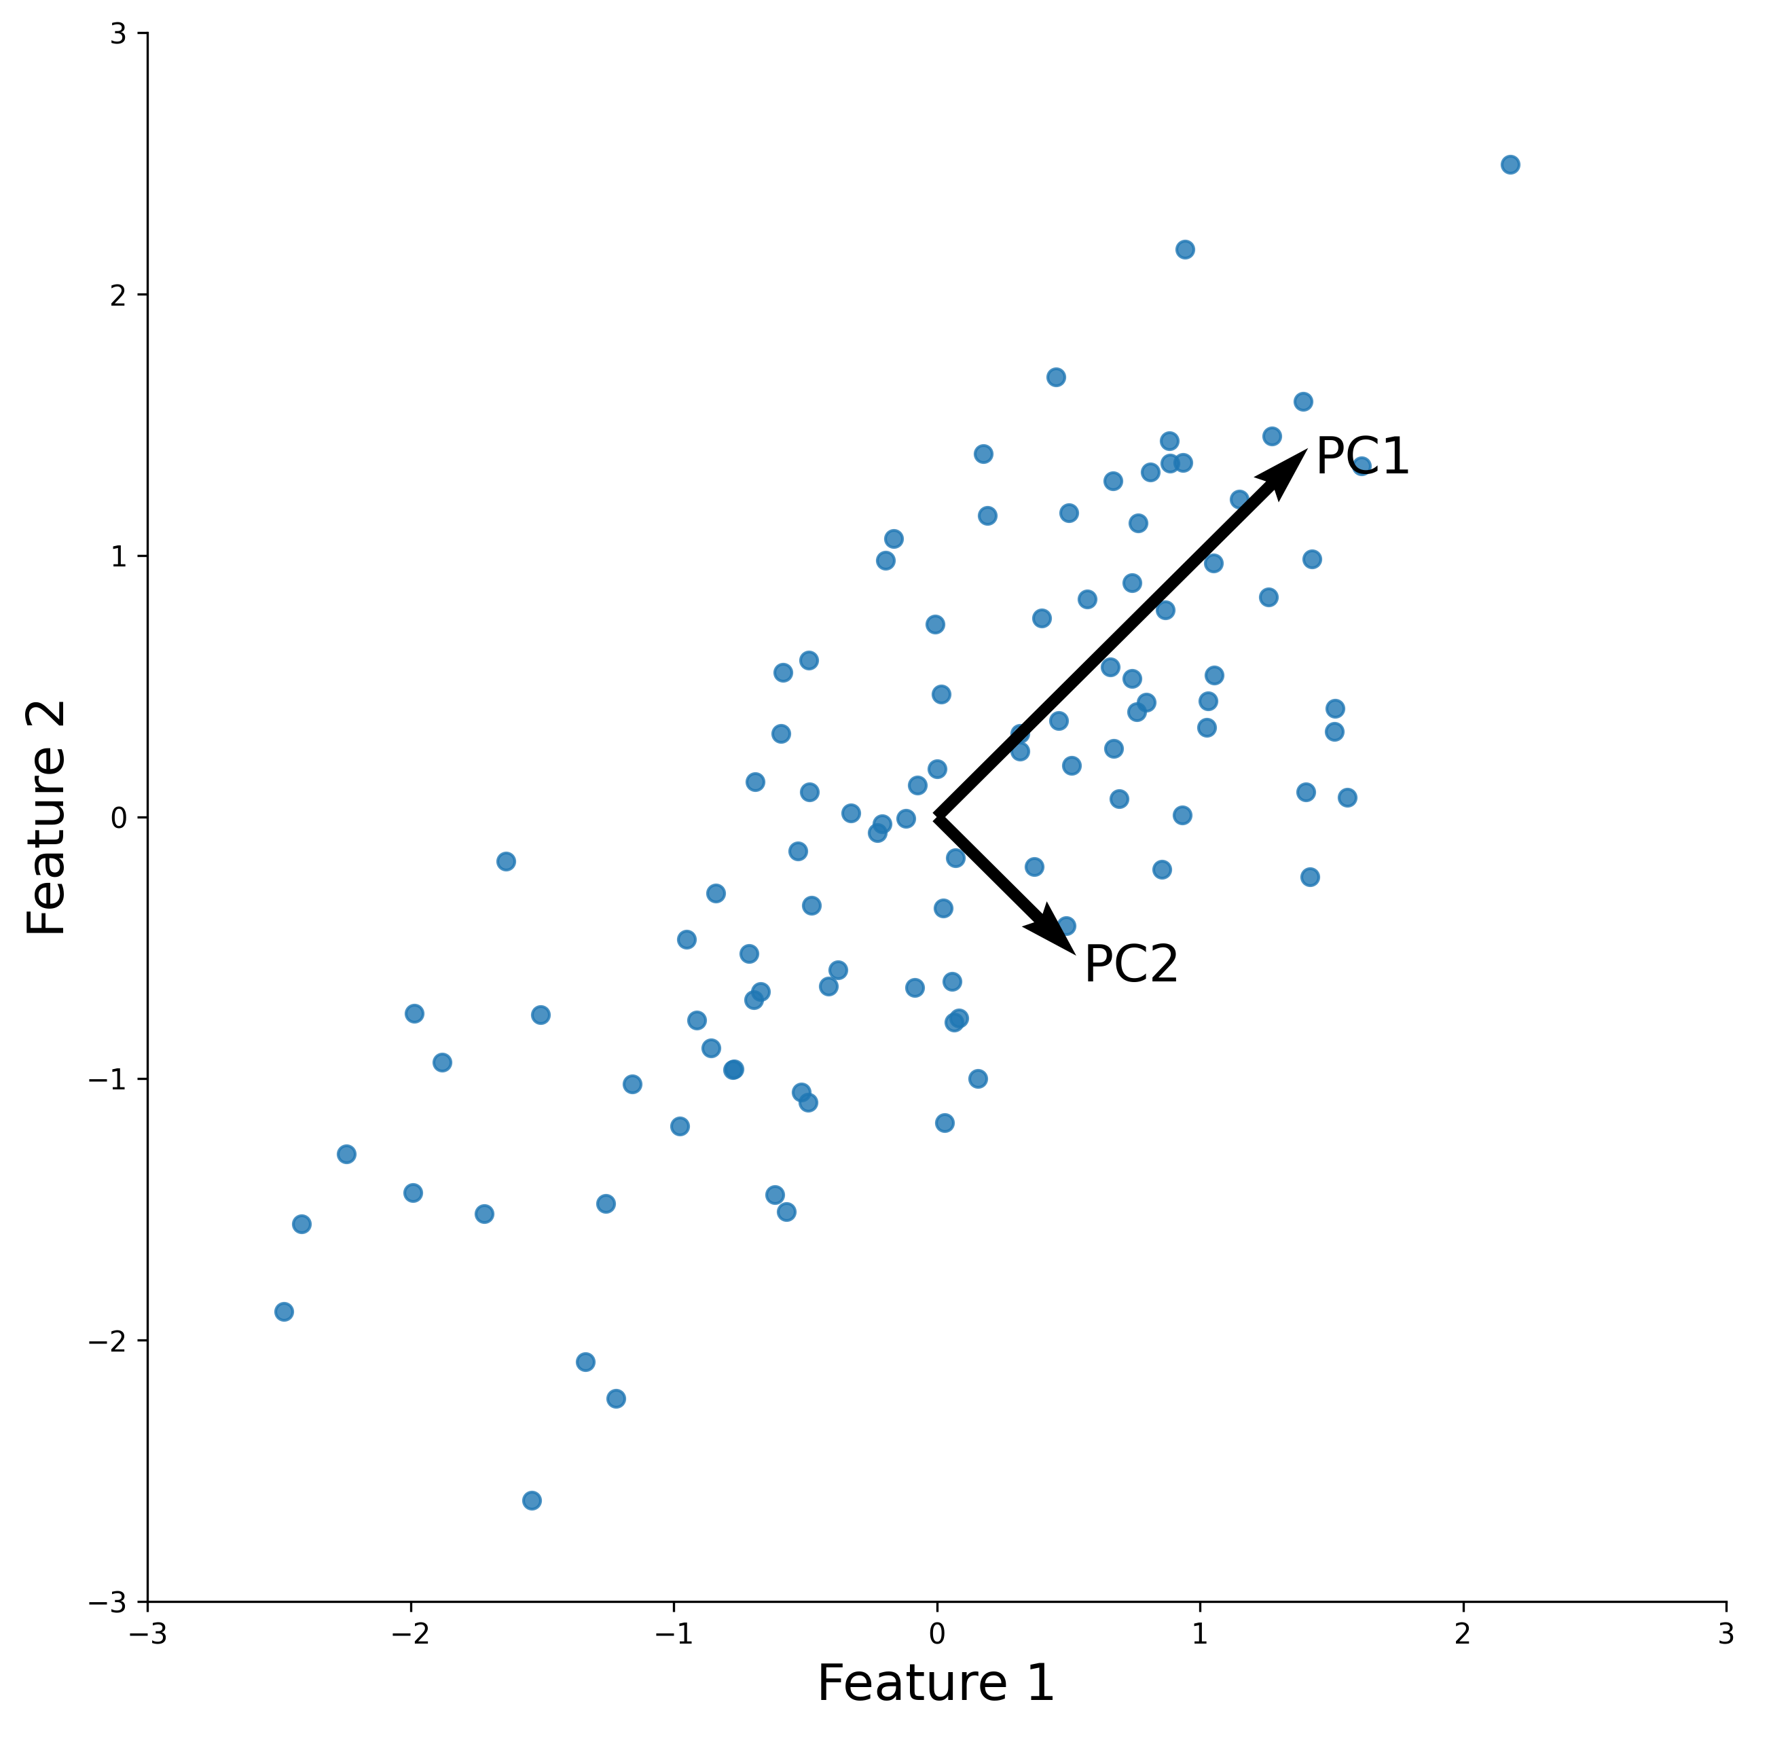
Brief Assessment of Principal Component Analysis for Protein Design
Nathaniel Blalock

Slide 2
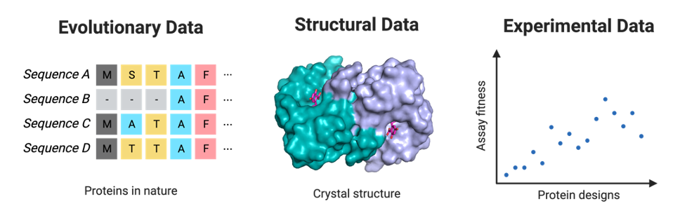
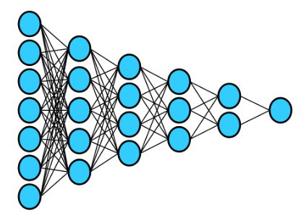
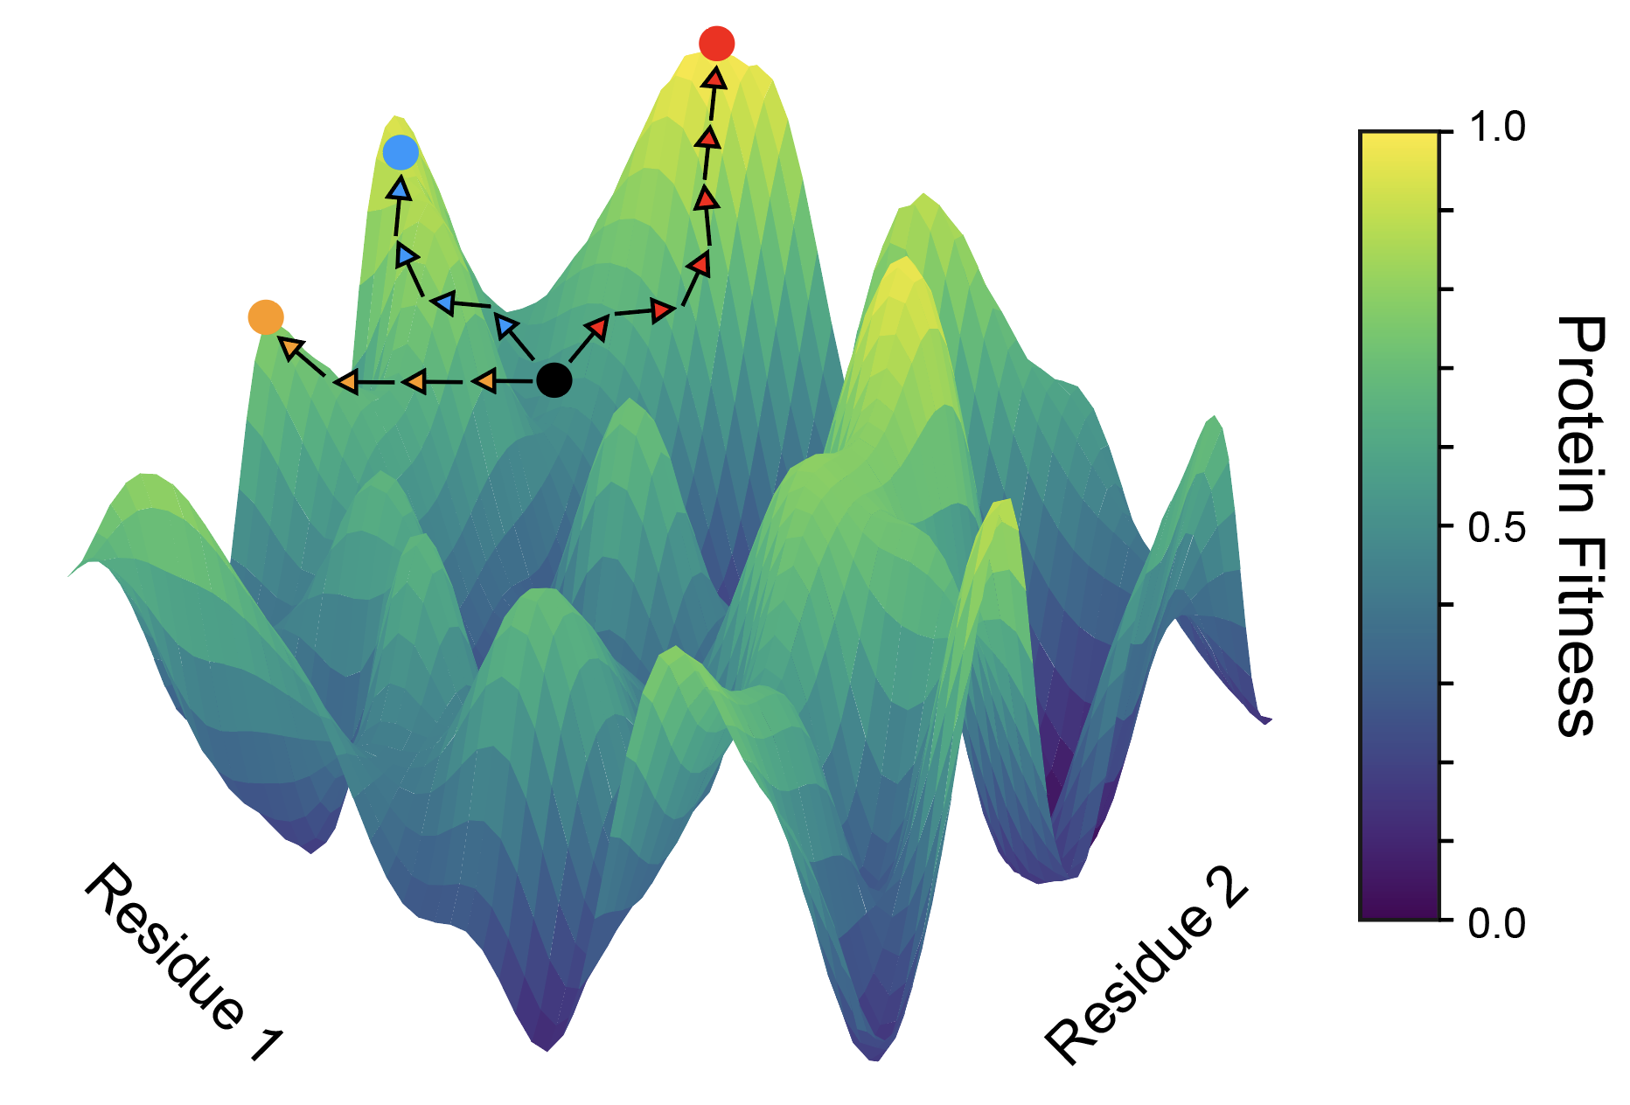
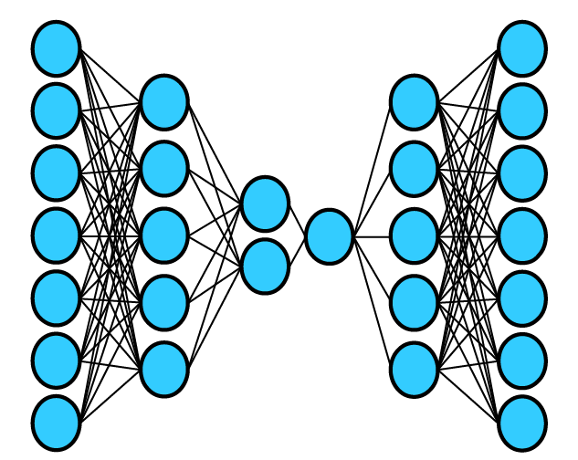
Unsupervised deep learning models can leverage evolutionary data for data-driven protein design
Supervised Neural Network
experimental data regime
VAE
[1] Freschlin, C.R., Fahlberg, S.A. and Romero, P.A., 2022. Current Opinion in Biotechnology. [2] Wu et al., 2021. Current Opinion in Chemical Biology.

Slide 3
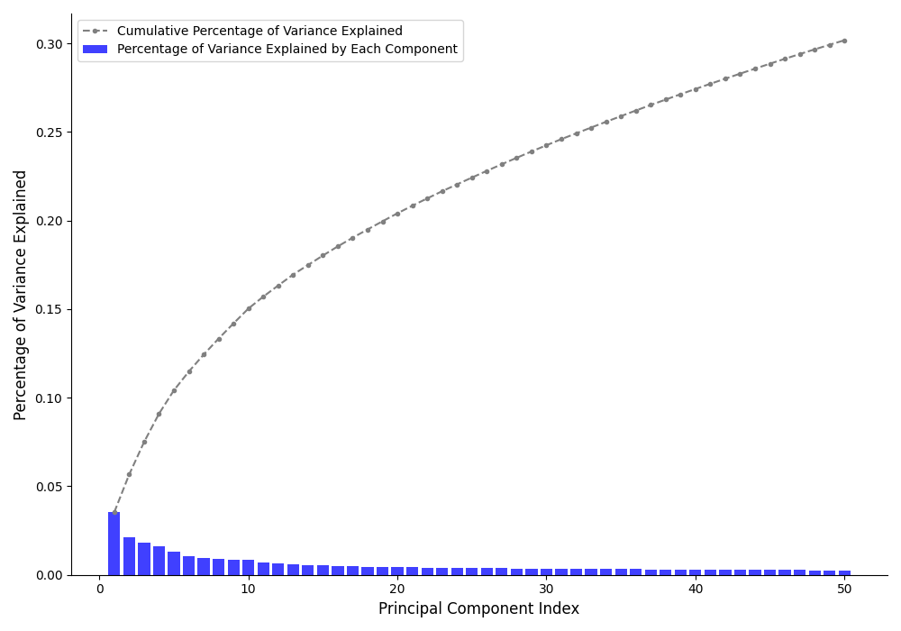
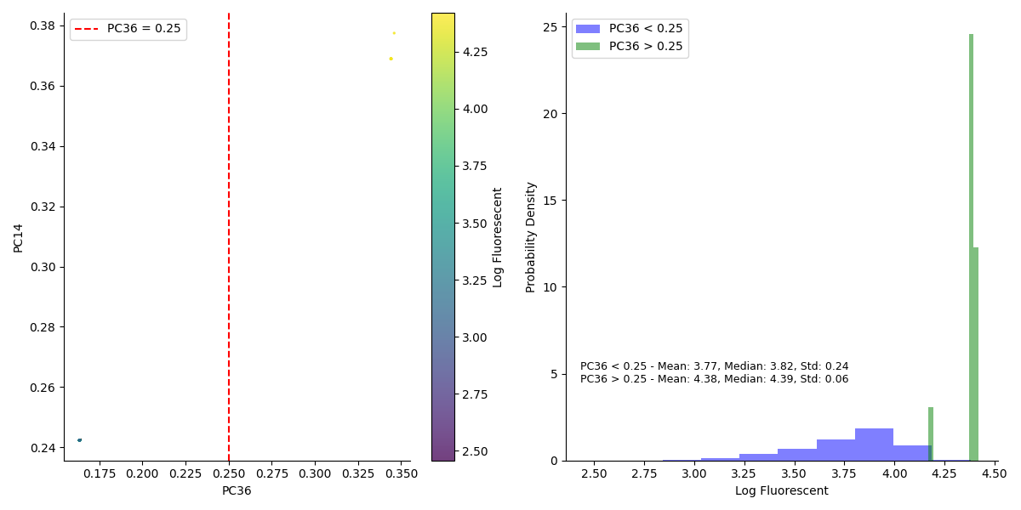
Principal Components from PCA of Multiple Sequence Alignment Discretely Separate Most Fluorescent Proteins

Slide 4
Principal Components from PCA of Multiple Sequence Alignment Discretely Separate Most Fluorescent Proteins
PC36 and PC14 had the greatest spearman correlation with fluorescent measurements

Slide 5
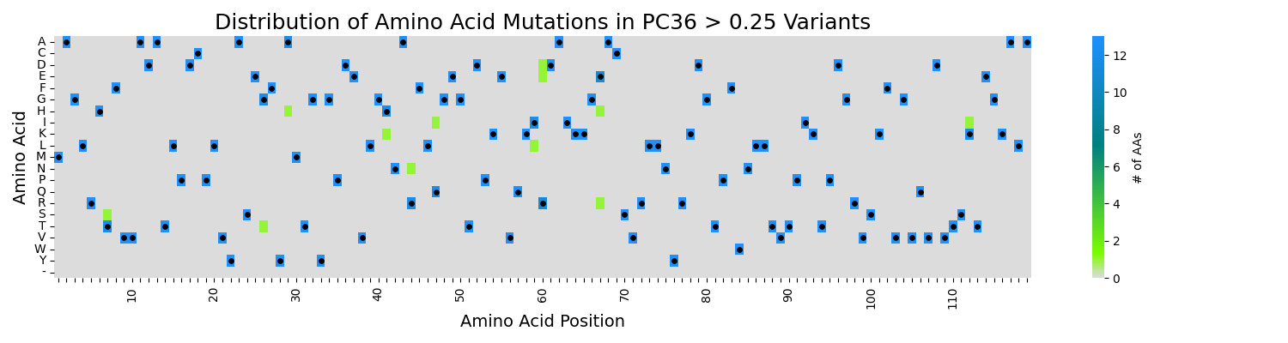
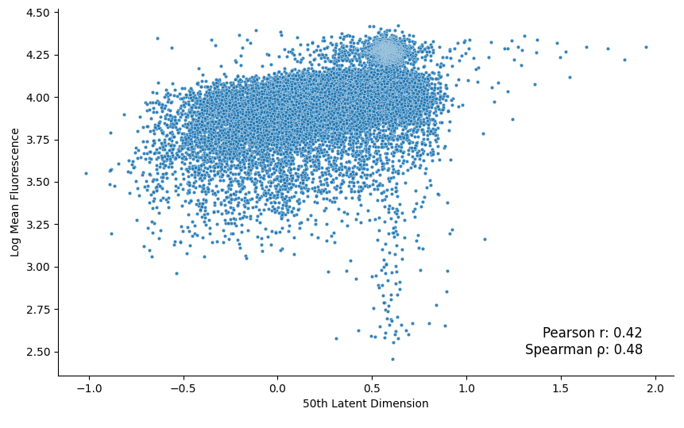
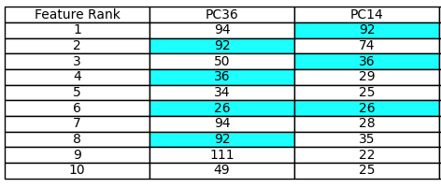
PCA interpretability may provide meaningful insight for protein design

