Slide 1
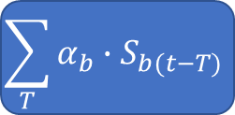
Training
Circuit Models for Blocks
Measured Side-Channel Signals
I_{b}(t), V_{b} (t)
Transform for Specific Side-Channel
Decomposition into Per-Block Signal Shapes
S_{b}(t)
S_{b}(t)
Estimator of Per-Block Weights
Validation
S_{b}(t), α_{b}
Per-Block
Event Timestamps
Cycle-Accurate Simulation
$$\sum_{T}{{α_{b}∙S}_{b(t−T)}}$$
Simulated Side Channel Signal

