Slide 1
Starcraft Data Mining Project
Noah Blumenfeld
Thomas Eliassen
Bridger Fisher
Ian Sime

Slide 2
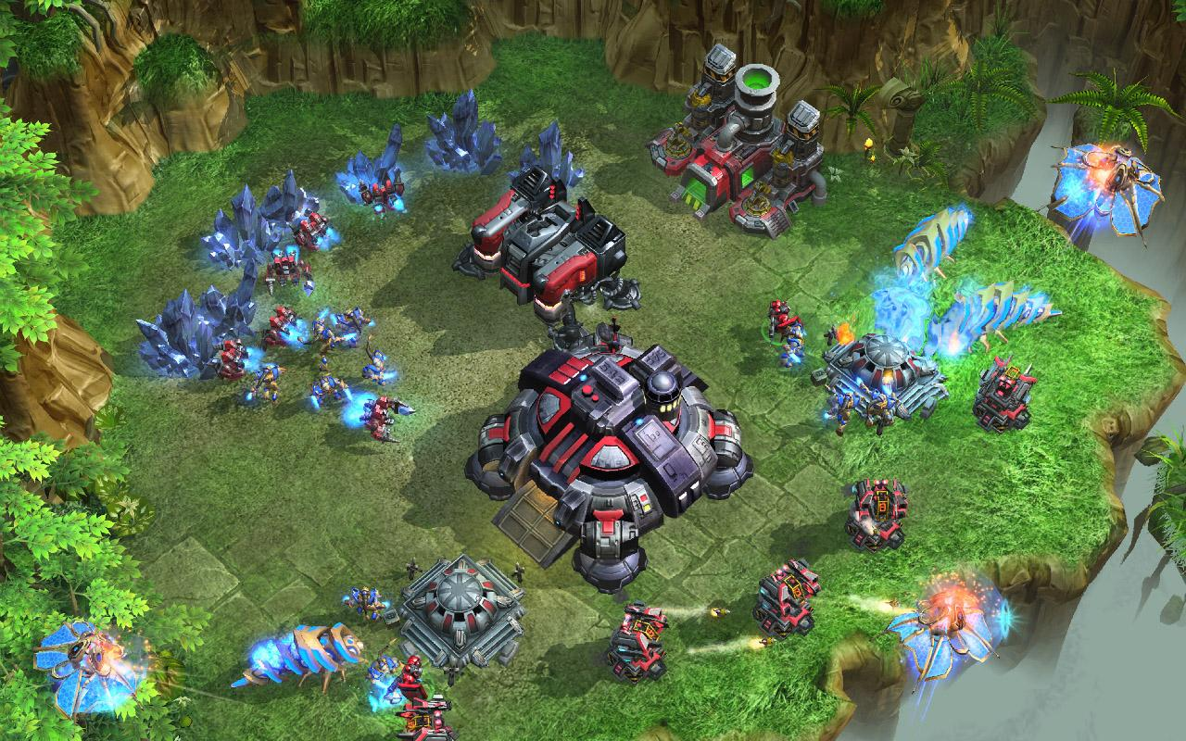
Overview of Starcraft
RTS: Real Time Strategy Game: “Like chess but being able to move all the pieces at the same time.”
Players battle each other by first gathering resources and then building up their army. Players must use strategy to build, create, and control their army.

Slide 3
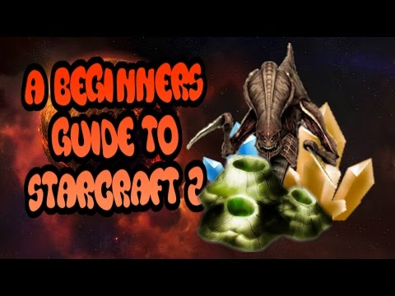

Slide 4
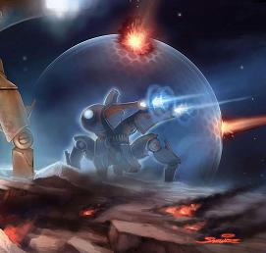

Dataset
Our data is solely focused on the build stage of the game that involves building bases, gathering resources, and building the army. Our model’s goal is to be able to predict the player’s final strategy based on what order the player chooses to build each different piece of their army.

Slide 5
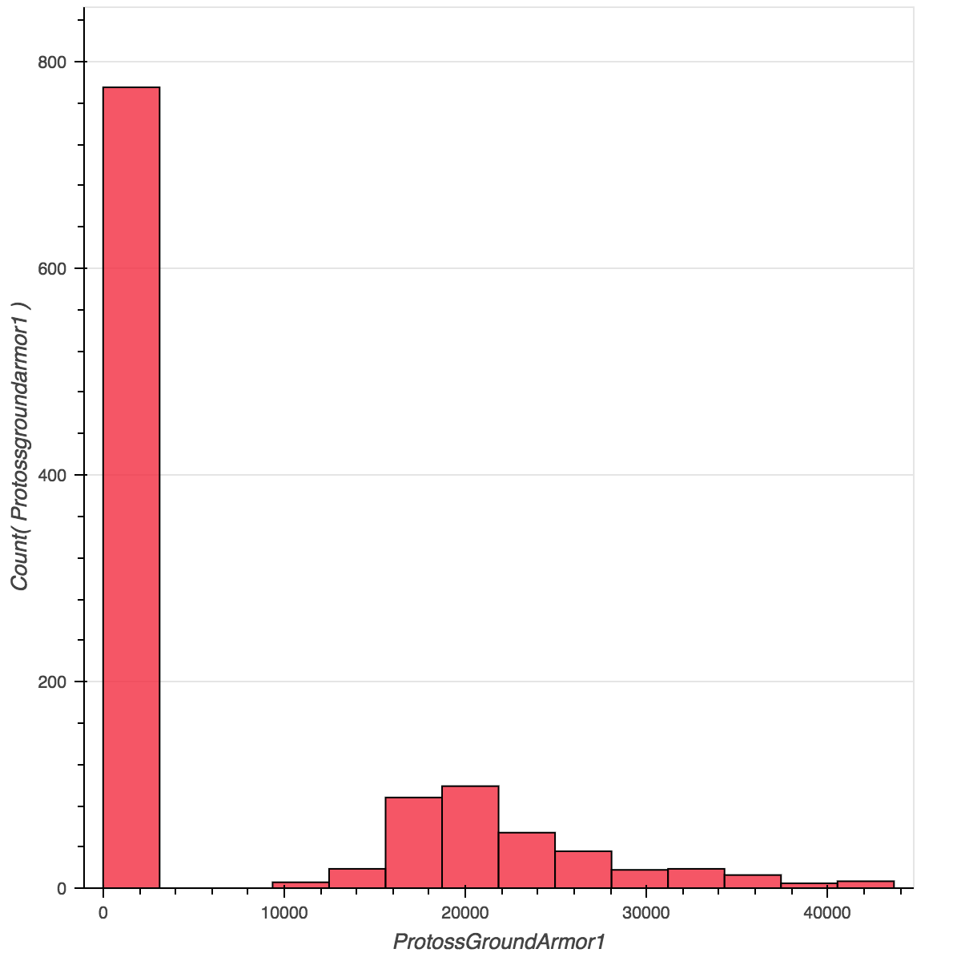
Distribution: Before preprocessing
The hard part about this dataset is that there are a lot of zero values that do play a vital part in reading the data. This makes the distribution of the dataset a little strange with lots of zero values and then fairly normally distributed data.
Outliers
Before Preprocessing

Slide 6
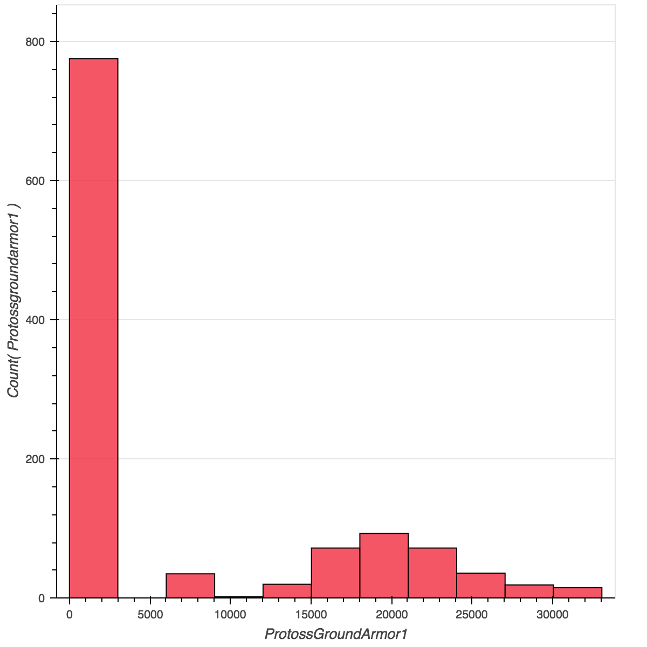
Distribution: After preprocessing
More Normal distribution
Mean Values
After Preprocessing

Slide 7
Preprocessing
Quantile of 97% to separate out the outliers
Replace outliers with the mean value of the data, instead of completely removing it.
Removed the non-essential upgrade attributes
We also decided to cut down on some of the attributes. Our rationale was that many of the attributes are simply upgrades of the same attribute and that focusing on choosing that attribute would simplify the data immensely. Therefore we removed the non-essential upgrade attributes and continued testing the models with 39 attributes, randomly dividing our data into 80% for training and 20% for testing.

Slide 8
Split the dataset
80% Training Data
20% Testing Data
Create our own data
Notes The features are always randomly permuted at each split. Therefore, the best found split may vary, even with the same training data and max_features=n_features, if the improvement of the criterion is identical for several splits enumerated during the search of the best split. To obtain a deterministic behaviour during fitting, random_state has to be fixed.
http://scikit-learn.org/stable/modules/generated/sklearn.ensemble.GradientBoostingClassifier.html

Slide 9
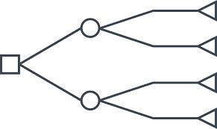
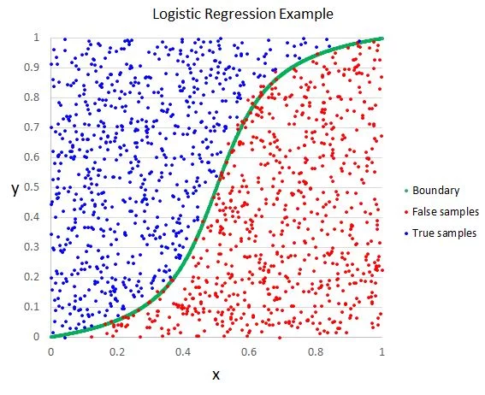
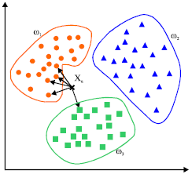
Algorithms
Decision Tree
Random Forest
K Nearest Neighbors
Gradient Boosting
Logistic Regression

Slide 10

Best Algorithm
Gradient Boosting

Slide 11
Model Results
Our model has an accuracy of 0.88

Slide 12
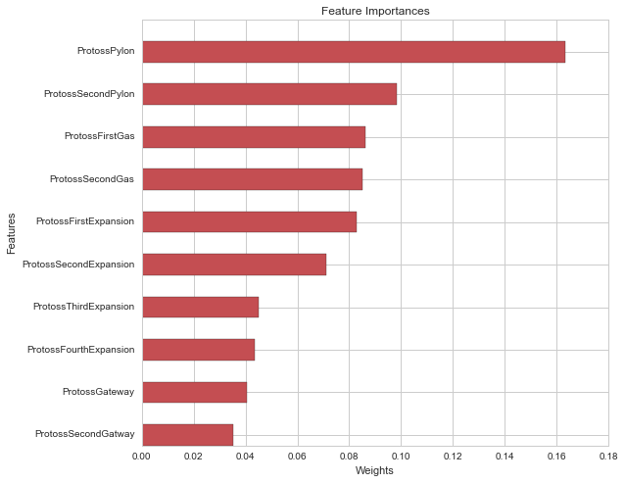
Best Feature: Bar Graph
This graph shows the importance of the features from the gradient boosting algorithm. The most important feature is ProtossGroundArmor1. ProtossGroundArmor1 describes starting the ground armor upgrade. Ground armor is used to protect ground units, essentially it makes it more difficult for them to be killed. The second most important feature is the ProtossDarkArchon feature. ProtossDarkAchron is a ground unit that supports other units. The purpose of the dark archon unit is to be a crowd control unit. It has the ability to take over the enemies’ units, keep all units from moving, and the ability to drain energy from enemy units.

Slide 13
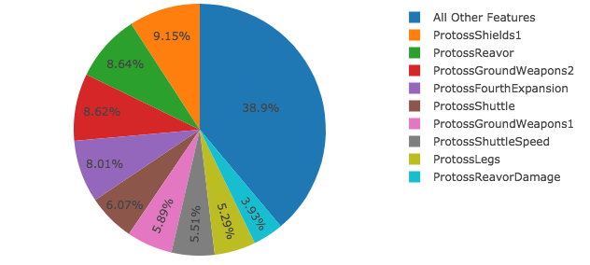
Best Feature: Pie Chart
This plotly pie chart shows the importance of features as well. In this chart the most import features is the ProtossThirdExpansion feature. ProtossThirdExpansion is referring to creating a third base and mineral field. This allows the player to increase the amount of minerals they are able to collect. Minerals are the currency in the game, you spend minerals to build and upgrade units. The second most important feature is the ProtossCannon feature. ProtossCannon is referring to the photon cannon structure. It is a defense structure that can target air and ground units. It is often used to defend “bases” that are on the map.

Slide 14
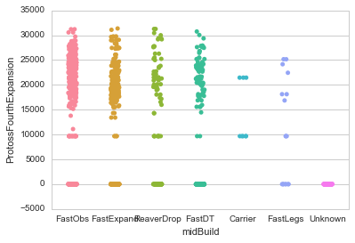
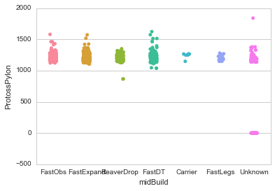
Categorical Scatterplot: Seaborn
The Seaborn Categorical Scatterplot shows the relationship of the occurrences of one attribute and its classifications at the midBuild, or halftime, of the game. The x-axis is the classification of strategy taken by the player at the midBuild, or halftime, of the game. The y-axis is the number of occurrences of that attribute. Then overall the scatter plot will show the relationship between the counts of each attribute and its classification. Therefore we can take each attribute and show the occurrences of each classification and look for patterns. The pattern we are looking for is if there are attributes that are most often categorized as a certain strategy or alternatively not very likely to be classified as a certain strategy.

Slide 15
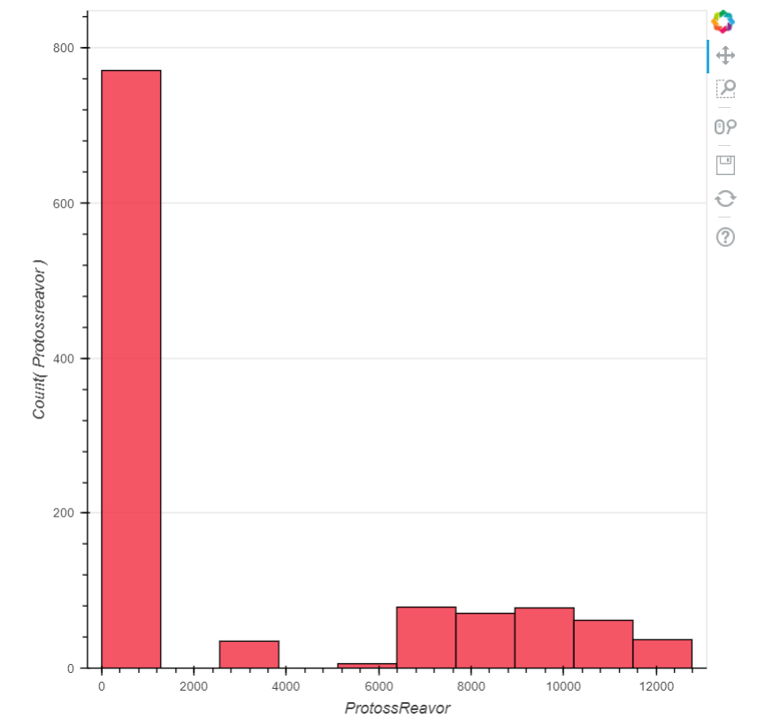
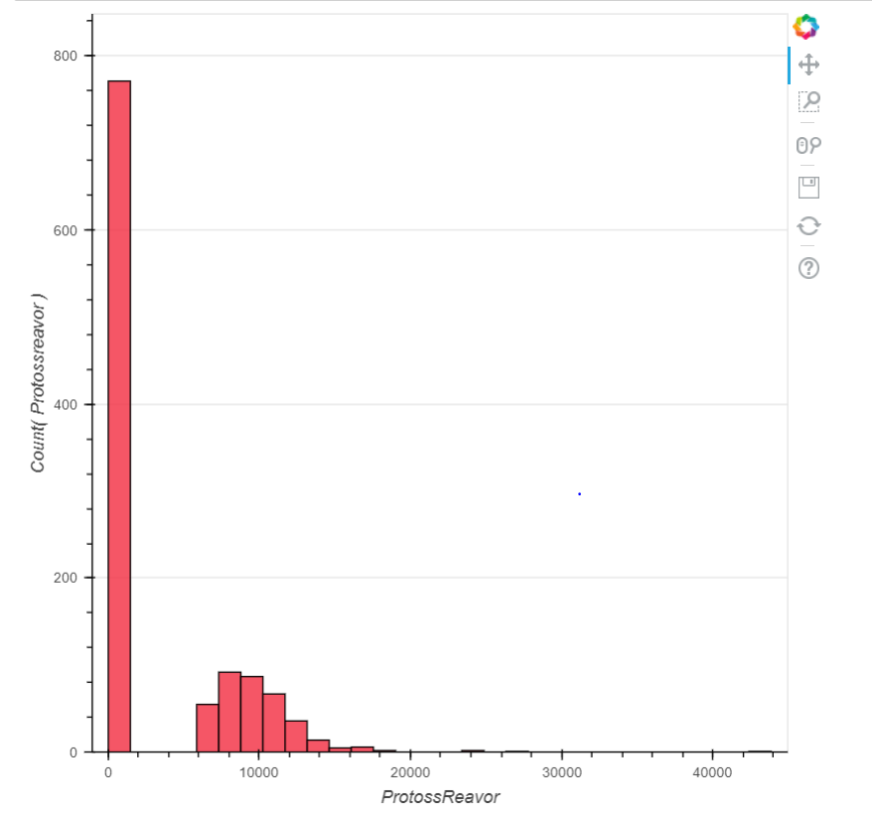
Dynamic Histogram: Bokeh
The dynamic histograms we plotted show the distribution of the data for a given feature. Every graph has a large column for the 0 value, and a good distribution other than that. The reason that the 0s are still there after preprocessing the data is because they are extremely meaningful 0s. The 0s represent decisions that are made in gameplay. Choosing a different upgrade or unit creates a 0 in certain features. For example if the player chooses to upgrade ProtossGroundArmor1 the ProtossArmor1 feature would recieve a 0. If we were to replace these 0s with the mean for the data valuable information would be lost.

Slide 16
Resources
https://github.com/bgweber/StarCraftMining/blob/master/data/scmPvT_Protoss_Mid.csv
https://www.starcraft2.com/en-us/media#screenshots-13
https://youtu.be/2mwgriM2PM8
https://seaborn.pydata.org/tutorial.html
https://bokeh.pydata.org/en/latest/
Github
https://github.com/nblumenfeld/Data-Mining-Project

