Slide 1
Exception Handiling

Slide 2
With out Exception handling
Requirement
Optimistic coding
Write code thinking that environment in which the code is running will always be stable and files and data the code is looking for will be available as well.
Pessimistic coding
Expect that there is a possibility of failure at every statement (which is possible) and handle exceptions for each and every line.

Slide 3
Java’s answer for this problem
try{
Write code here
}
catch(Exception){
Depending on the error, handle it
in the corresponding error block
}
This approach is a mix of Pessimistic coding and Optimistic coding

Slide 4
What is an Exception?
Any type of error which is encountered in the program is called exception
Example of exception
Divide by zero
ArrayIndexOutOfBounds
IllegalArgumentExceptions

Slide 5
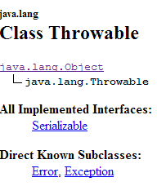
How did they organize Exception?
They observed the standard exceptions that can take place and created a class called Throwable, whose direct children are Error and Exception.

Slide 6
Hierarchy of Exceptions:
Throwable
Errors
Exceptions or CompileTime Exceptions (or checked)
Runtime (or unchecked)

Slide 7
Error
You call an event or occurrence as error when JVM says “GO TO HELL”. I will not execute the program.
Because something is so wrong that nothing can be done about it.
Examples:
Class path not set correctly
Configuration issue in the environment like ids setup in the LDAP and thus failing on authentication.
NOTE: This would not be something that you can fix programmatically.

Slide 8
Exceptions Basics
When an exception occurs java creates an object of that kind of exception class
Ex new NullPointerException();
This will be caught by the reference variable in the catch block
Ex Catch ( NullPointerException NP)
It is similar to (note but not same as)
NullPointerException NP = new NullPointerException()
There is no limit on number of Catch blocks that you can put after try.

Slide 9
Runtime Exception
Direct Known Subclasses:
ArithmeticException, ArrayStoreException, BufferOverflowException, BufferUnderflowException, CannotRedoException, CannotUndoException, ClassCastException, CMMException,ConcurrentModificationException, DOMException, EmptyStackException, IllegalArgumentException, IllegalMonitorStateException, IllegalPathStateException, IllegalStateException, ImagingOpException,IndexOutOfBoundsException, MissingResourceException, NegativeArraySizeException, NoSuchElementException, NullPointerException, ProfileDataException, ProviderException, RasterFormatException,SecurityException, SystemException, UndeclaredThrowableException, UnmodifiableSetException, UnsupportedOperationException

Slide 10
Most common Exceptions
ArithmeticException
ClassCastException
IndexOutOfBoundsException

Slide 11
Define Checked and Unchecked
The word Checked means that compiler caught exception and thus the program will not complie
The word Uchecked means that compiler this that these are fine and sends them to JVM to execute and JVM catches it.

Slide 12
Differences between Runtime Exception/ CompiletimeException
CompiletimeException (CheckedException)
Runtime Exception (Unchecked Excption)
These are Exceptions are derived Exceptions class but are not Part of RuntimeExceptions
The Compiler forces you to handle the exception and will not compile until the exception handling is take care off
These are derived from a class called RuntimeExceptions which inturn is a child of Exceptions
The Compiler does not force you to handle this kind of exception, but if unhandled will lead to abrupt exit from the application.

Slide 13
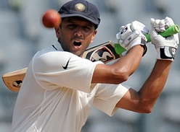
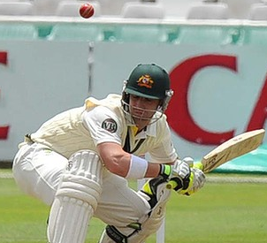
Ways to Handel exceptions
Handling Exceptions
Try Catch nest
(Handle in this class)
Throws
(Let some one else catch it)

Slide 14

Who is that some one
That someone is the class who is instantiating this throwing class and using the method which throws and exception

Slide 15
Exception Propagation
The process of propagating up the stack (inner method to outer method) to see which method in the stack provides the implementation for the occurred exception is called Exception Propagation
M5()
M4()
M3()
M2()
M1()
If there is any exception in any line JVM can not proceed further in any line

Slide 16
Finally
If try catch is called then finally will be called
Finally will be executed before the error propagates.

