Slide 1
Threads

Slide 2
Processes
Threads counter parts “Processes” in most operating systems demand complete resources and do not share resources. They are like Monarchs. So for a process to run it would reload the memory and registers every single time they run, which is very inefficient
Example of process is Application Server Like Tomcat

Slide 3
Threads
Share resources, while performing their tasks individually.
What does that mean?
Faster
Space efficiency due to shared code areas
Easier sharing of resources, with implicit shared memory
Allows program execution to overlap with I/O
Example of a thread is a user request to the server

Slide 4
Is that not Great?
Though it is great to be able to tell the OS what to do, you might get into highly complicated problems of contentions which will hang and blow out your application.

Slide 5
How often do we need to write threaded programs in Java
Not very often because of the complexity they bring in.
Most of the predefined classes are thread safe meaning even if you run multiple threads they will not get into complicated issues related to threads. This is because of the way they are defined.

Slide 6
Ways to Create threads in Java
Either extend the thread class or implement the Runnable interface
It is better to implement the Runnable interface, thus leaving the option open to derive from another class. For example:
Public class specialTask extends GeneralTask implements Runnable

Slide 7
Life Time of Thread
NEW
Sleep
Dead
Start()
Sleep()
Run() completes
Runnable
Scheduler
Running
Wait()
Lock Available
Synchronized()
Blocked in lock pool
Blocked in wait Pool
Notify()

Slide 8

This is when a thread is Created
NEW

Slide 9

Becomes Run able
NEW
Start()
Runnable

Slide 10

Scenario 1 - Running
Represents all the actions thread does while awake and alive
NEW
Start()
Runnable
Scheduler
Running

Slide 11
Scenario 1 – Go to Sleep
NEW
Sleep
Start()
Sleep()
Runnable
Scheduler
Running

Slide 12
Scenario 1 – Come out of sleep
NEW
Sleep
Start()
Sleeping()
completed
Sleep()
Runnable
Scheduler
Running

Slide 13
Scenario 2 - Running
NEW
Start()
Runnable
Scheduler
Running

Slide 14
Scenario 2 - Running
NEW
Dead
Start()
Run() completes
Runnable
Scheduler
Running

Slide 15
Scenario 3 – Youth Thread
NEW
Start()
Runnable
Scheduler
Running

Slide 16

Scenario 3 – Youth Threads
Threads
This is a Synchronized block
Lock pool

Slide 17
Scenario 3 – Youth Threads
NEW
Start()
Runnable
Scheduler
Running

Slide 18
Scenario 3
NEW
Start()
Runnable
Scheduler
Running
Synchronized()
Blocked in lock pool

Slide 19
Scenario 3
NEW
Start()
Runnable
Scheduler
Running
Lock Available
Synchronized()
Blocked in lock pool

Slide 20
Scenario 4
NEW
Start()
Runnable
Scheduler
Running

Slide 21

Scenario 4 – GrandMa Thread
I don’t care , I will wait until all of them are done
Notify me when your are done boarding

Slide 22
Scenario 4 – GrandMa Thread
NEW
Start()
Runnable
Scheduler
Running

Slide 23
Scenario 4 – GrandMa Thread
NEW
Start()
Runnable
Scheduler
Running
Wait()
Blocked in wait Pool

Slide 24
Scenario 4 – GrandMa Thread
NEW
Start()
Runnable
Scheduler
Running
Wait()
Blocked in lock pool
Blocked in wait Pool
Notify()

Slide 25
Scenario 4 – GrandMa Thread
NEW
Start()
Runnable
Scheduler
Running
Wait()
Lock Available
Blocked in lock pool
Blocked in wait Pool
Notify()

Slide 26
Life Time of Thread
NEW
Sleep
Dead
Start()
Sleep()
Run() completes
Runnable
Scheduler
Running
Wait()
Lock Available
Synchronized()
Blocked in lock pool
Blocked in wait Pool
Notify()

Slide 27
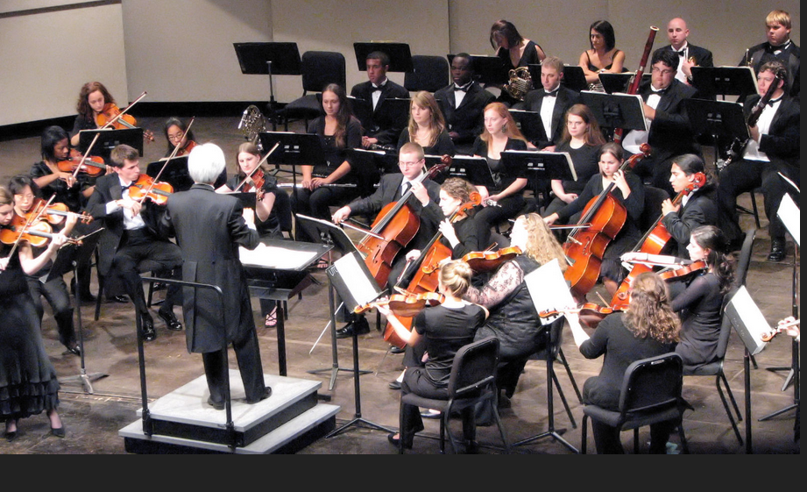
JVM Scheduler is preemptive approach

